Slide 1

HR ATTRITION ANALYSIS & STRATEGIC INSIGHTS
Executive Presentation for Teleperformance Leadership

Slide 2

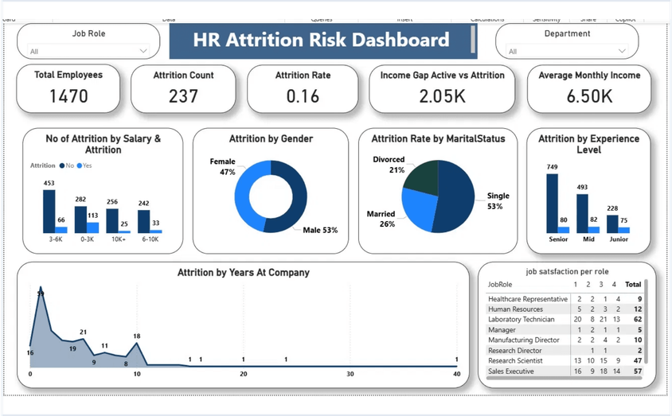
EXECUTIVE SUMMARY: ATTRITION LANDSCAPE
Total Employees
1,470
Attrition Rate
16% (237 Departures)
Income Gap (Active vs Attrition)
$2.05K
Avg. Monthly Income
$6.50K
OBJECTIVE: Identify high-risk segments and implement data-driven retention strategies.

Slide 3

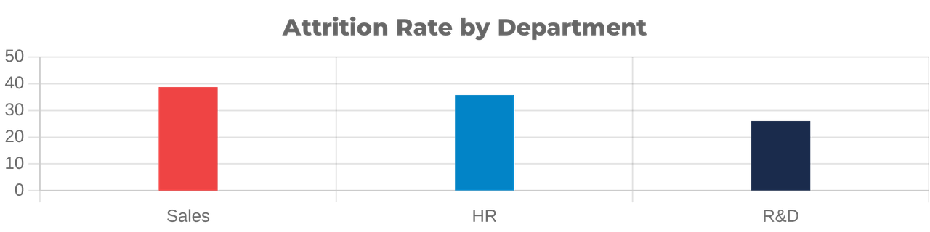
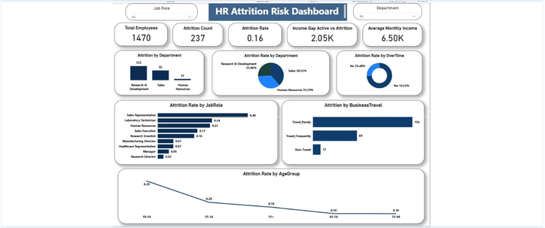
DEPARTMENTAL HOTSPOTS: SALES & HR RISKS
SALES: 38.55%
Critical risk level. Urgent intervention needed in sales culture and compensation structures.
HR: 35.59%
High attrition despite smaller headcount. Core stability is at stake.
R&D: 25.86%
Highest volume of departures (133). Talent drain in technical roles.

Slide 4

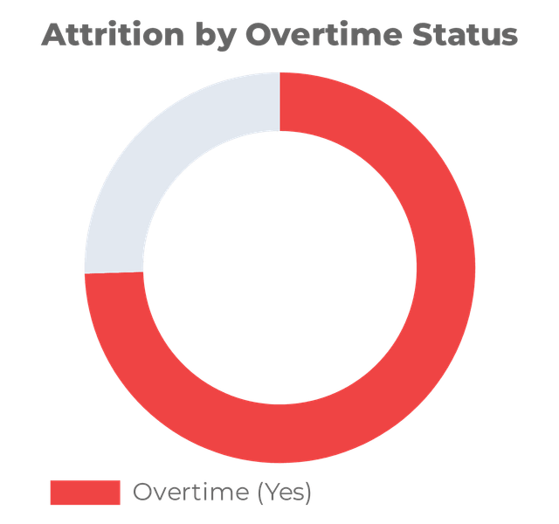
THE OVERTIME FACTOR: A CRITICAL DRIVER
74.52% ATTRITION LINK
An overwhelming majority of employees who left were working overtime, indicating a direct correlation with burnout.
STRATEGIC LEVER
Reviewing workload distribution is the most immediate and effective way to stabilize the workforce.
74.5% Worked Overtime

Slide 5

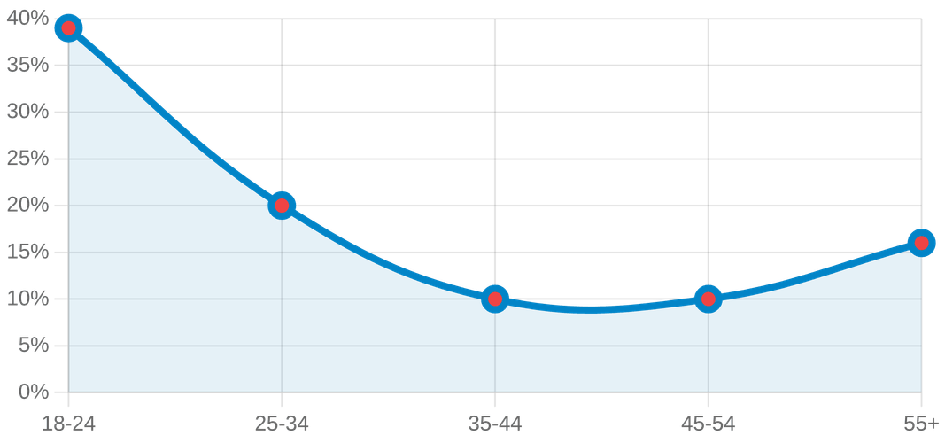
DEMOGRAPHIC VULNERABILITY: EARLY-CAREER TALENT
ATTRITION RATE BY AGE GROUP
MARITAL STATUS IMPACT
53%
Single Employees (Highest Risk)
26%
Married Employees
21%
Divorced Employees
The 18-24 age group shows a critical 39% attrition rate, nearly 4x higher than the 35-54 demographic.
STRATEGIC INSIGHT: We are losing our "future leaders" early. Mentorship for young, single professionals is vital.

Slide 6

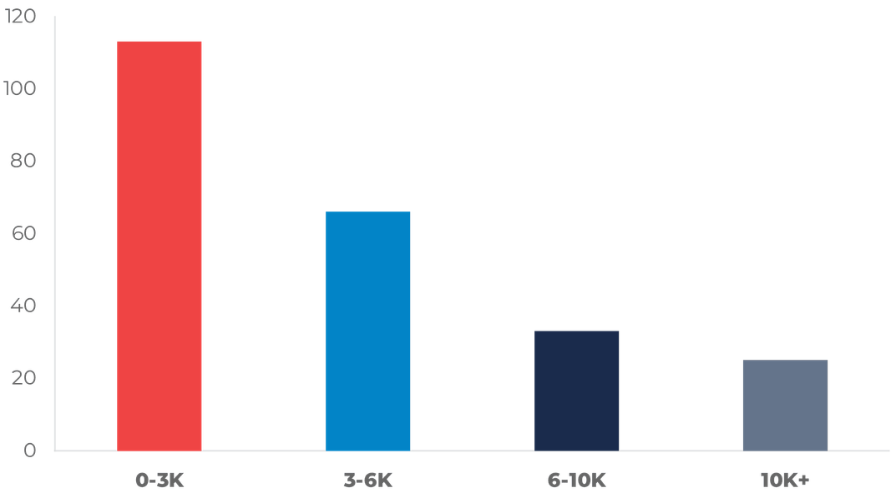
EXPERIENCE & INCOME: TURNOVER DRIVERS
Junior Vulnerability
Junior-level staff exhibit the highest attrition rates, while Senior staff remain the most stable anchor of the workforce.
Attrition Count by Salary Bracket
Income Threshold
The $0-3K income bracket is the primary churn zone with 113 departures, highlighting a critical compensation gap.
Retention ROI
Higher income brackets ($10K+) show significantly better retention, suggesting financial incentives are vital for stability.
STRATEGIC INSIGHT: FINANCIAL INCENTIVES ARE CRITICAL AT LOWER EXPERIENCE LEVELS TO PREVENT EARLY-STAGE TALENT DRAIN.

Slide 7

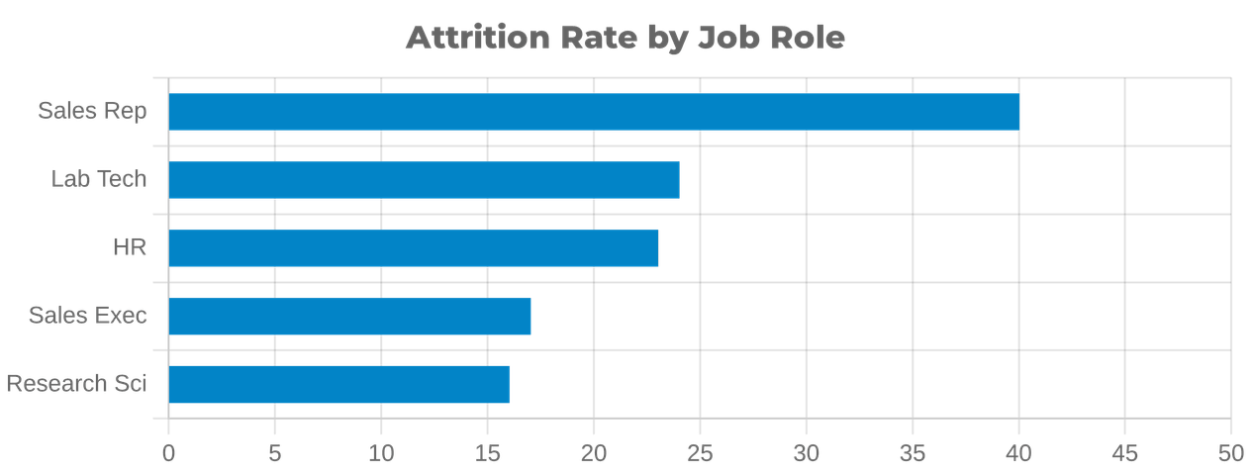
ROLE-SPECIFIC ANALYSIS: HIGH RISK ROLES
Sales Representatives (40%)
Top retention priority; high churn hurts revenue.
Laboratory Technicians (24%)
Technical talent loss—review lab workload.
Human Resources (23%)
HR turnover impacts company culture.
Sales Executives (17%)
Mid-level leadership needs engagement.
STABILITY LEADERS:
Research Directors (3%) & Managers (5%)

Slide 8

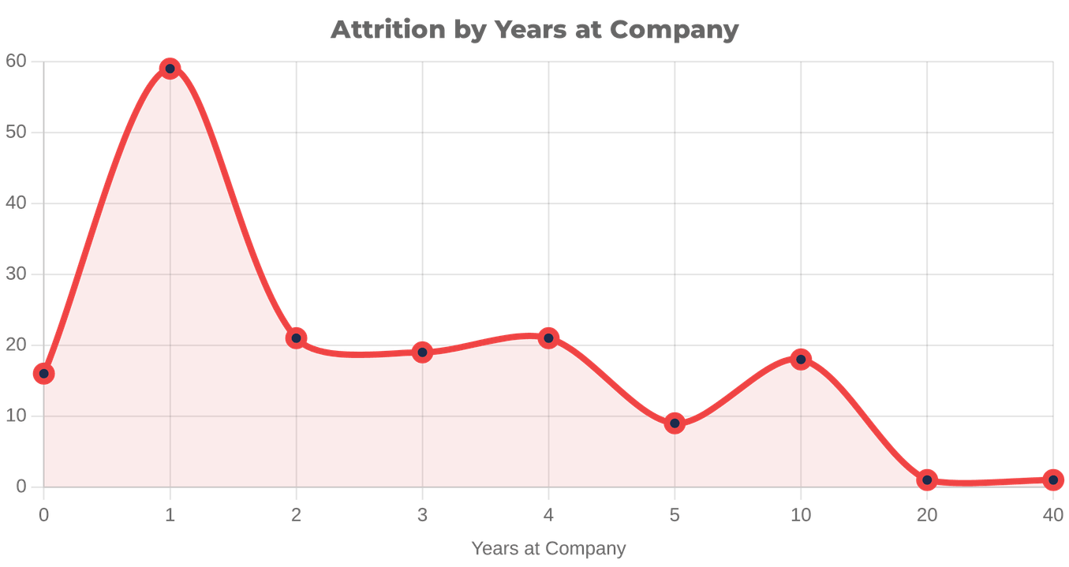
TENURE TRENDS: THE FIRST TWO YEARS
THE "DANGER ZONE"
Attrition peaks sharply within the first 24 months. 0-2 years represent the highest risk period for new talent.
STABILIZATION POINT
Departures drop significantly after 5 years and stabilize almost completely after the 10-year mark.
STRATEGIC FOCUS
Enhancing the "New Joiner Experience" is critical to securing long-term workforce stability.
RECOMMENDATION: Implement clear 2-year career roadmaps to mitigate early-stage turnover.

Slide 9

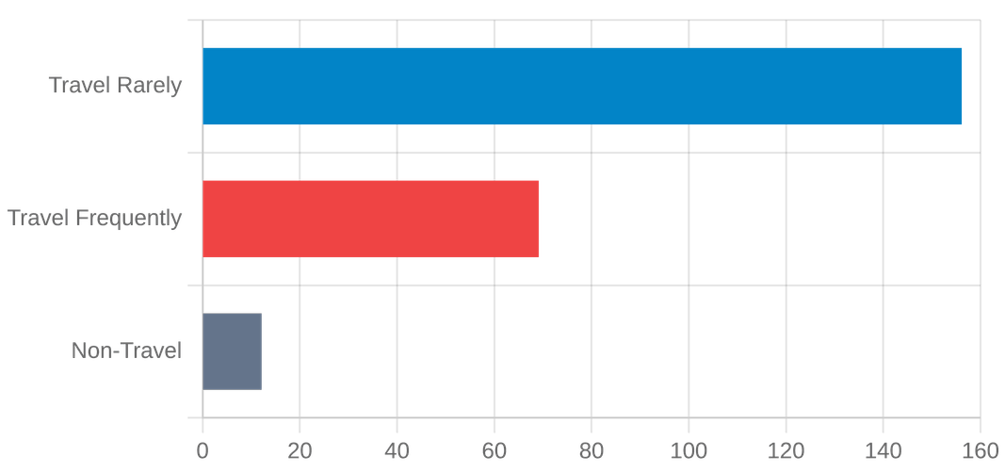
TRAVEL & SATISFACTION: WORK-LIFE BALANCE
SATISFACTION INSIGHTS
ATTRITION BY BUSINESS TRAVEL
Travel Impact
While "Travel Rarely" has the highest volume (156), frequent travel remains a significant stressor for the 18-24 demographic.
Role Satisfaction
Low satisfaction scores in Sales and Lab Tech roles correlate directly with high churn rates.
Strategic Goal
Balancing travel requirements and improving role-specific satisfaction is key to long-term retention.
INSIGHT: Reducing frequent travel for junior staff could stabilize the 18-24 age group.

Slide 10

STRATEGIC ROADMAP: RETENTION PLAN
IMMEDIATE (0-3M)
MID-TERM (3-9M)
LONG-TERM (1Y+)
Overtime Audit
Comp. Restructuring
Culture Initiative
Immediate review of workload distribution in Sales and R&D departments.
Revise salary bands for the $0-3K bracket to align with market rates.
Develop "Teleperformance Culture" focused on long-term tenure rewards.
Stay Interviews
Career Pathing
Work-Life Balance
Launch engagement sessions for the high-risk 18-24 age demographic.
Establish clear junior-to-mid level roadmaps to reduce early churn.
Implement flexible travel and remote options for frequent travelers.
GOAL: REDUCE OVERALL ATTRITION BY 20-30% WITHIN THE NEXT FISCAL YEAR.

Slide 11

CONCLUSION: SECURING OUR FUTURE TALENT
PROJECTED IMPACT
NEXT STEPS
20-30% Reduction
Immediate Approval
Targeted intervention in Overtime and Junior segments can significantly lower overall churn.
Authorization for the "Overtime Audit" and "Junior Retention Initiative" pilot programs.
Proactive Management
Stakeholder Alignment
Transitioning from reactive hiring to a data-driven, proactive talent retention strategy.
Briefing departmental heads in Sales and R&D on the upcoming retention roadmap.
DATA-DRIVEN DECISIONS FOR A STRONGER TELEPERFORMANCE

