Slide 1
Backend Development
PHP Basics

Slide 2
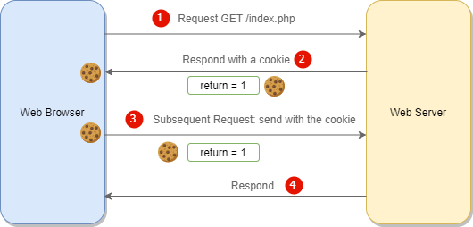
Create/Retrieve a Cookie
https://www.w3schools.com/php/php_cookies.asp

Slide 3
Create/Retrieve a Cookie
<?php $cookie_name = "user"; $cookie_value = "John Doe"; setcookie($cookie_name, $cookie_value, time() + (86400 * 30), "/"); // 86400 = 1 day ?> <html> <body> <?php if(!isset($_COOKIE[$cookie_name])) { echo "Cookie named '" . $cookie_name . "' is not set!"; } else { echo "Cookie '" . $cookie_name . "' is set!<br>"; echo "Value is: " . $_COOKIE[$cookie_name]; } ?> </body> </html>
https://www.w3schools.com/php/php_cookies.asp

Slide 4
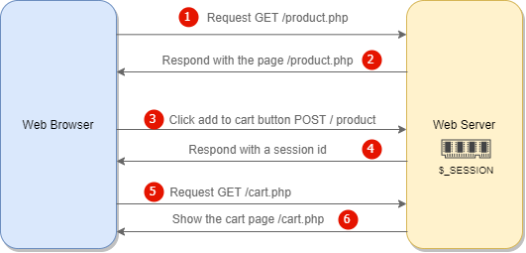
Sessions
<?php // Start the session session_start(); ?> <!DOCTYPE html> <html> <body> <?php // Set session variables $_SESSION["favcolor"] = "green"; $_SESSION["favanimal"] = "cat"; echo "Session variables are set."; ?> </body> </html>
https://www.w3schools.com/php/php_sessions.asp

Slide 5
What is SQL?
SQL is the standard language for dealing with Relational Databases.
SQL is used to insert, search, update, and delete database records.

Slide 6
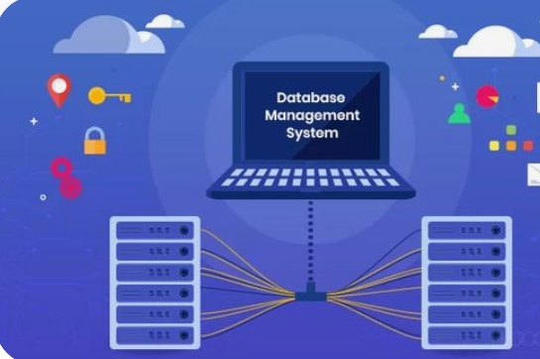
What is RDBMS?
RDBMS stands for Relational Database Management System.
RDBMS is a program used to maintain a relational database.
RDBMS is the basis for all modern database systems such as MySQL, Microsoft SQL Server, Oracle, and Microsoft Access.
RDBMS uses SQL queries to access the data in the database.

Slide 7
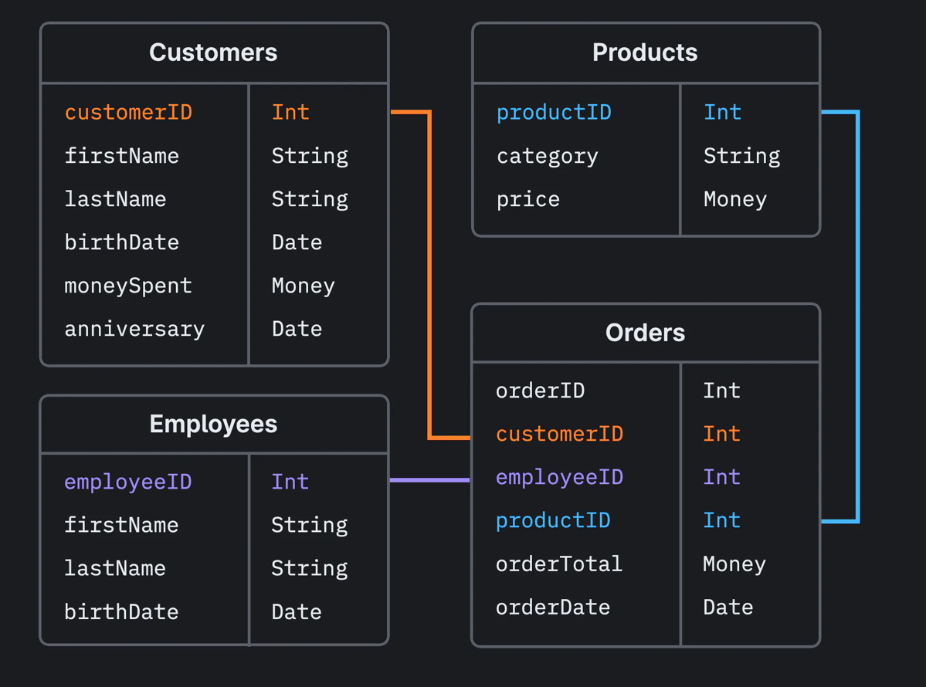
What is RDBMS?

Slide 8
What is mysql?
MySQL is a relational database management system
MySQL is open-source
MySQL is free
MySQL is ideal for both small and large applications
MySQL is very fast, reliable, scalable, and easy to use
MySQL is cross-platform
MySQL is compliant with the ANSI SQL standard
MySQL was first released in 1995
MySQL is developed, distributed, and supported by Oracle Corporation
MySQL is named after co-founder Monty Widenius's daughter: My

Slide 9
phpMyAdmin
phpMyAdmin is a free software tool written in PHP, intended to handle the administration of MySQL over the Web. phpMyAdmin supports a wide range of operations on MySQL and MariaDB. Frequently used operations (managing databases, tables, columns, relations, indexes, users, permissions, etc) can be performed via the user interface, while you still have the ability to directly execute any SQL statement.

Slide 10
CREATE DATABASE - sql
CREATE DATABASE databasename;

Slide 11
DROP DATABASE - sql
DROP DATABASE databasename;

Slide 12
CREATE TABLE - sql
CREATE TABLE table_name ( column1 datatype, column2 datatype, column3 datatype, .... );

Slide 13
Data Types - mysql
https://www.w3schools.com/MySQL/mysql_datatypes.asp

Slide 14
Constraints
NOT NULL - Ensures that a column cannot have a NULL value
UNIQUE - Ensures that all values in a column are different
PRIMARY KEY - A combination of a NOT NULL and UNIQUE. Uniquely identifies each row in a table
FOREIGN KEY - Prevents actions that would destroy links between tables
CHECK - Ensures that the values in a column satisfies a specific condition
DEFAULT - Sets a default value for a column if no value is specified
CREATE INDEX - Used to create and retrieve data from the database very quickly

Slide 15
Create Constraints - sql
CREATE TABLE table_name ( column1 datatype constraint, column2 datatype constraint, column3 datatype constraint, .... );

Slide 16
AUTO INCREMENT Field
Auto-increment allows a unique number to be generated automatically when a new record is inserted into a table.
Often this is the primary key field that we would like to be created automatically every time a new record is inserted.

Slide 17
Example - sql
CREATE TABLE Persons ( Personid int NOT NULL AUTO_INCREMENT, LastName varchar(255) NOT NULL, FirstName varchar(255), Age int, PRIMARY KEY (Personid) );

Slide 18
dates
DATE - format YYYY-MM-DD
DATETIME - format: YYYY-MM-DD HH:MI:SS
TIMESTAMP - format: YYYY-MM-DD HH:MI:SS
YEAR - format YYYY or YY

Slide 19
DROP TABLE - TRUNCATE TABLE - sql
DROP TABLE table_name;
TRUNCATE TABLE table_name;

Slide 20
ALTER TABLE - sql
// Add Column
ALTER TABLE table_name ADD column_name datatype;
// Delete Column
ALTER TABLE table_name DROP COLUMN column_name;

Slide 21
ALTER TABLE - sql
// Modify Column
ALTER TABLE table_name MODIFY COLUMN column_name datatype;

Slide 22
SELECT Statement - sql
SELECT column1, column2, ... FROM table_name;

Slide 23
WHERE Clause - sql
SELECT column1, column2, ... FROM table_name WHERE condition;

Slide 24
ORDER BY Keyword - sql
SELECT column1, column2, ... FROM table_name ORDER BY column1, column2, ... ASC|DESC;

Slide 25
Views
In SQL, a view is a virtual table based on the result-set of an SQL statement.
A view contains rows and columns, just like a real table. The fields in a view are fields from one or more real tables in the database.
You can add SQL statements and functions to a view and present the data as if the data were coming from one single table.
A view is created with the CREATE VIEW statement.

Slide 26
Syntax - sql
CREATE VIEW view_name AS SELECT column1, column2, ... FROM table_name WHERE condition;

Slide 27
Connect to MySQL
MySQLi extension (the "i" stands for improved)
PDO (PHP Data Objects)

Slide 28
Should I Use MySQLi or PDO?
If you need a short answer, it would be "Whatever you like".
Both MySQLi and PDO have their advantages:
PDO will work on 12 different database systems, whereas MySQLi will only work with MySQL databases.
So, if you have to switch your project to use another database, PDO makes the process easy. You only have to change the connection string and a few queries. With MySQLi, you will need to rewrite the entire code - queries included.
Both are object-oriented.
Both support Prepared Statements. Prepared Statements protect from SQL injection, and are very important for web application security.

Slide 29
Connect to db using pdo
<?php $servername = "localhost"; $username = "username"; $password = "password"; try { $conn = new PDO("mysql:host=$servername;dbname=myDB", $username, $password); // set the PDO error mode to exception $conn->setAttribute(PDO::ATTR_ERRMODE, PDO::ERRMODE_EXCEPTION); echo "Connected successfully"; } catch(PDOException $e) { echo "Connection failed: " . $e->getMessage(); } ?>

Slide 30
Select data
$servername = "localhost"; $username = "username"; $password = "password"; $dbname = "myDBPDO"; try { $conn = new PDO("mysql:host=$servername;dbname=$dbname", $username, $password); $conn->setAttribute(PDO::ATTR_ERRMODE, PDO::ERRMODE_EXCEPTION); $stmt = $conn->prepare("SELECT id, firstname, lastname FROM MyGuests"); $stmt->execute(); // set the resulting array to associative //$result = $stmt->setFetchMode(PDO::FETCH_ASSOC); foreach($stmt->fetchAll() as $k) { echo $k[“firstname”]; } } catch(PDOException $e) { echo "Error: " . $e->getMessage(); } $conn = null;

Slide 31
Another example
$stmt = $pdo->query("SELECT * FROM users");
while ($row = $stmt->fetch()) {
echo $row['name']."<br />\n";
}

Slide 32
3rd example
try {
$conn = new PDO("mysql:host=$servername;dbname=temp", $username, $password);
// set the PDO error mode to exception
$conn->setAttribute(PDO::ATTR_ERRMODE, PDO::ERRMODE_EXCEPTION);
$data = $conn->query("select * from users")->fetchAll();
foreach ($data as $row) {
echo $row['firstname'].'<br>';
}
} catch(PDOException $e) {
echo "Connection failed: " . $e->getMessage();
}

Slide 33
Query with parameter
try {
$conn = new PDO("mysql:host=$servername;dbname=temp", $username, $password);
// set the PDO error mode to exception
$conn->setAttribute(PDO::ATTR_ERRMODE, PDO::ERRMODE_EXCEPTION);
$data = $conn->prepare("select * from users where user_id=?");
$id = 1;
$data->execute([$id]);
$user = $data->fetch();
echo $user['firstname'];
} catch(PDOException $e) {
echo "Connection failed: " . $e->getMessage();
}

Slide 34
Pdo Insert data
try { $conn = new PDO("mysql:host=$servername;dbname=$dbname", $username, $password); // set the PDO error mode to exception $conn->setAttribute(PDO::ATTR_ERRMODE, PDO::ERRMODE_EXCEPTION); $sql = "INSERT INTO MyGuests (firstname, lastname, email) VALUES ('John', 'Doe', 'john@example.com')"; // use exec() because no results are returned $conn->exec($sql); echo "New record created successfully"; } catch(PDOException $e) { echo $sql . "<br>" . $e->getMessage(); } $conn = null;

Slide 35
HTML Forms
<form action="/action_page.php" method="get"> <label for="fname">First name:</label><br> <input type="text" id="fname" name="fname"><br> <label for="lname">Last name:</label><br> <input type="text" id="lname" name="lname"> <input type="submit" value="Submit"> </form>

Slide 36
Html Form elements
<input>
<label>
<select>
<textarea>
<button>
<fieldset>
<legend>
https://www.w3schools.com/html/html_form_elements.asp

Slide 37
Upload file by form
Using HTML form and PHP code

Slide 38
Php post
PHP $_POST is a PHP super global variable which is used to collect form data after submitting an HTML form with method="post". $_POST is also widely used to pass variables.
https://www.w3schools.com/php/php_superglobals_post.asp

Slide 39
Php get
PHP $_GET is a PHP super global variable which is used to collect form data after submitting an HTML form with method="get".
$_GET can also collect data sent in the URL.
https://www.w3schools.com/php/php_superglobals_get.asp

Slide 40
PHP_SELF
<form method="post" action="<?php echo $_SERVER['PHP_SELF'];?>"> Name: <input type="text" name="fname"> <input type="submit"> </form> <?php if ($_SERVER["REQUEST_METHOD"] === "POST") { // collect value of input field $name = $_POST['fname']; if (empty($name)) { echo "Name is empty"; } else { echo $name; } } ?>

Slide 41
Pdo insert with Form values
$sql = "INSERT INTO users (name, surname, sex) VALUES (?,?,?)";
$stmt= $pdo->prepare($sql);
$stmt->execute([$name, $surname, $sex]);

Slide 42
Mysql Collation and character set
A collation in MySQL is a set of rules used to compare the characters in a specific character set. It is a sequence of orders to any particular set. MySQL supports various character sets, and each character set always uses one or more collation, at least one default collation. MySQL does not allow us to have any two character sets use the same collation.
https://www.javatpoint.com/mysql-collation

Slide 43
Pdo delete row
try { $conn = new PDO("mysql:host=$servername;dbname=$dbname", $username, $password); // set the PDO error mode to exception $conn->setAttribute(PDO::ATTR_ERRMODE, PDO::ERRMODE_EXCEPTION); // sql to delete a record $sql = "DELETE FROM MyGuests WHERE id=3"; // use exec() because no results are returned $conn->exec($sql); echo "Record deleted successfully"; } catch(PDOException $e) { echo $sql . "<br>" . $e->getMessage(); }

Slide 44
Pdo update row
try { $conn = new PDO("mysql:host=$servername;dbname=$dbname", $username, $password); // set the PDO error mode to exception $conn->setAttribute(PDO::ATTR_ERRMODE, PDO::ERRMODE_EXCEPTION); $sql = "UPDATE MyGuests SET lastname='Doe' WHERE id=2"; // Prepare statement $stmt = $conn->prepare($sql); // execute the query $stmt->execute(); // echo a message to say the UPDATE succeeded echo $stmt->rowCount() . " records UPDATED successfully"; } catch(PDOException $e) { echo $sql . "<br>" . $e->getMessage(); }

Slide 45
Relations
One To One
One To Many
Many To Many

Slide 46
Handling relationships using MYSQL
Primary Keys: is a unique identifier for a row of data.
Making a column a PRIMARY KEY is essentially equivalent to adding NOT NULL and UNIQUE constraints to that column.
Example for creating primary key:
userId INT AUTO_INCREMENT PRIMARY KEY,

Slide 47
Handling relationships using MYSQL
A Foreign Key allows us to associate a row in one table to a row in another table. This is done by setting a column in one table as a Foreign Key and having that column reference another table's Primary Key column.
Example for creating foreign key in mysql:
userId INT, CONSTRAINT fk_user FOREIGN KEY (userId)
REFERENCES users(userId)
ON UPDATE CASCADE
ON DELETE CASCADE

Slide 48
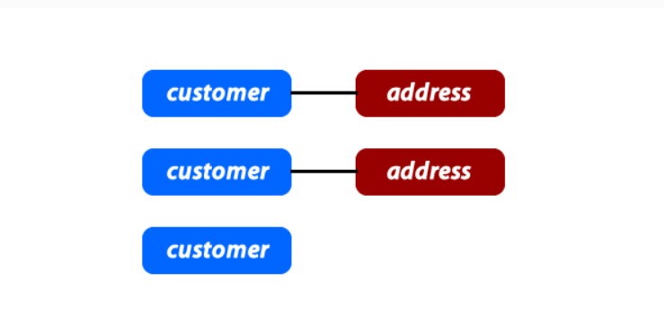
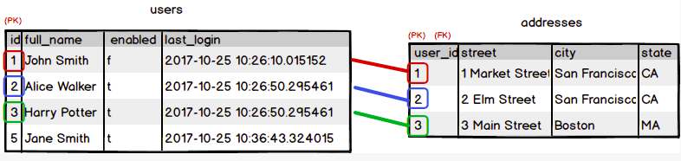
1:1 relationship
Representing 1:1 relationship

Slide 49
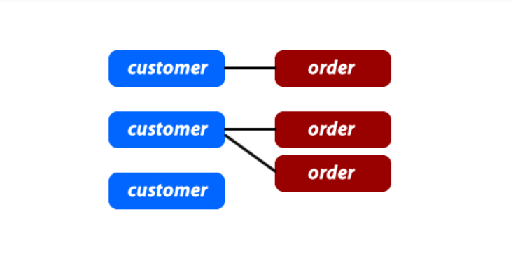
1:M relationship
A one-to-many relationship exists between two entities if an entity instance in one of the tables can be associated with multiple records (entity instances) in the other table. The opposite relationship does not exist; that is, each entity instance in the second table can only be associated with one entity instance in the first table.
Example: A review belongs to only one book. A book has many reviews.

Slide 50
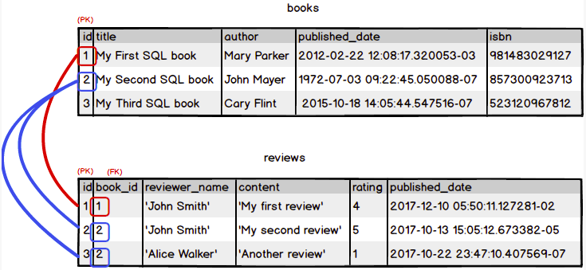
1:M relationship
Representing 1:M relationship:

Slide 51
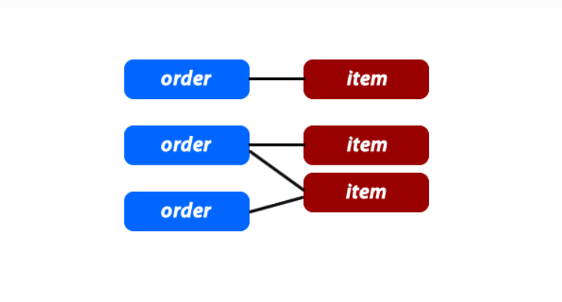
M:N relationship
Representing N:M relationship:

Slide 52
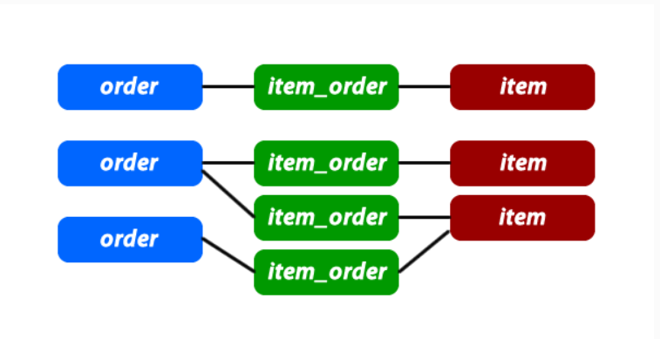
M:N relationship
Representing N:M relationship:

Slide 53
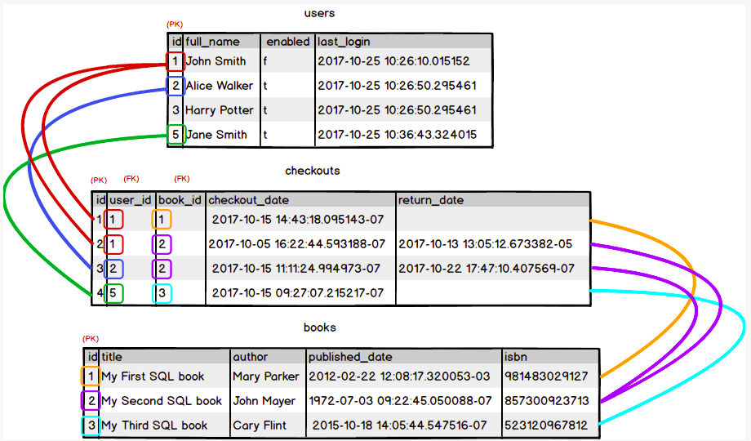
M:N relationship
Representing N:M relationship:

Slide 54
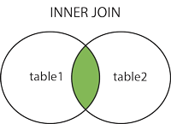
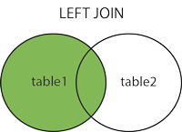
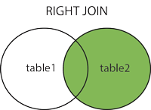
Join
https://www.w3schools.com/MySQL/mysql_join.asp

Slide 55
Mysql storage engines
InnoDB
MyISAM
https://hevodata.com/learn/myisam-vs-innodb/

Slide 56
Group by
SELECT column_name(s) FROM table_name WHERE condition GROUP BY column_name(s) ORDER BY column_name(s);

Slide 57
Having
SELECT column_name(s) FROM table_name WHERE condition GROUP BY column_name(s) HAVING condition ORDER BY column_name(s);

Slide 58
Difference between Where and Having
https://www.geeksforgeeks.org/difference-between-where-and-having-clause-in-sql/

Slide 59
More about sql
https://www.w3schools.com/sql/default.asp

Slide 60


