Slide 1
TEAM GREEN TECH · 100% PRODUCTION MILESTONE
Explainable Tomato Leaf Disease
Detection Using AI/ML
High-Precision Foliar Pathology Diagnostics with EfficientNet-B0
Combined with Grad-CAM Visual Attention Heatmaps for Transparent Farm Decisions
🌱 Author / Presenter: Team Green tech | 📅 October 2026 | 🍅 Solanaceae Pathology AI

Slide 2
CONTEXT & JUSTIFICATION
The Critical Need for Explainable Agronomic AI
🚨 $10B+ Annual Crop Loss
• Tomatoes are among the most consumed global vegetables, yet are highly vulnerable to over 10 distinct foliar pathogens.
• Early fungal blights, bacterial cankers, and viral vectors cause catastrophic 30%–70% harvest destruction if untreated.
• Smallholder farmers often identify outbreaks only after leaf drop and fruit lesions have spread irreversibly across fields.
🔬 Visual Misdiagnosis
• Early Blight and Late Blight look almost identical in early sporulation phases, yet require opposite chemical classes.
• Bacterial Spot mimics Septoria Leaf Spot, leading growers to misapply ineffective fungicides against bacterial pathogens.
• Misdiagnosis wastes input capital, accelerates fungicide resistance, and causes heavy chemical groundwater leaching.
🧠 The 'Black-Box' Barrier
• Conventional deep CNNs produce confidence scores without indicating WHERE on the leaf symptoms were detected.
• Growers and extension officers reject opaque AI recommendations due to lack of verifiable diagnostic transparency.
• Solution: Pair state-of-the-art classifier accuracy with Grad-CAM visual attention overlays to clearly explain every output.

Slide 3
SYSTEM ENGINEERING
End-to-End Diagnostic & Explainability Pipeline
Phase 1 · Data Discovery
Phase 2 · Model Training
Phase 3 · Explainability
Phase 4 · Clinical Delivery
✓ ImageFolder discovery
✓ Stratified 80/20 train/val split
✓ Bilinear resize (224×224)
✓ Data augmentation: flips, rotations
✓ ImageNet standard normalization
✓ EfficientNet-B0 backbone
✓ Compound scaling MBConv blocks
✓ AdamW optimizer (lr=1e-3)
✓ Cross-Entropy multi-class loss
✓ Best checkpoint save: models/best.pt
✓ Dual-path inference engine
✓ Grad-CAM gradient backpropagation
✓ Weights alpha_k from conv features
✓ Colorized heatmaps (Jet/Turbo/Viridis)
✓ Superimposed alpha blends & focus masks
✓ Streamlit interactive GUI (4 tabs)
✓ CLI tool with JSON export
✓ 10-class agronomic guide
✓ Immediate IPM action prescriptions
✓ Docker containerization & 22 unit tests

Slide 4
PATHOLOGY TAXONOMY
10 Monitored Tomato Foliar Conditions
Solanaceae Foliar Disease Coverage Matrix
• Bacterial Spot [Bacterium] (Xanthomonas vesicatoria): Small dark water-soaked spots with yellow chlorotic halos
• Early Blight [Fungus] (Alternaria solani): Concentric dark brown rings ('target board' pattern) on lower foliage
• Late Blight [Oomycete] (Phytophthora infestans): Large irregular water-soaked greasy patches, rapid vine collapse
• Leaf Mold [Fungus] (Passalora fulva): Pale chlorotic spots with olive-green velvety mold on undersides
• Septoria Leaf Spot [Fungus] (Septoria lycopersici): Numerous small circular spots with grayish-white centers & pycnidia dots
• Spider Mites [Pest / Acari] (Tetranychus urticae): Fine chlorotic stippling, bronzed parchment leaves, silken webbing
• Target Spot [Fungus] (Corynespora cassiicola): Expanding pinpoint lesions with zoning, cracking lesion centers
• Yellow Leaf Curl [Virus (Whitefly)] (TYLCV (Begomovirus)): Distinct upward leaf rolling ('spooning'), severe interveinal yellowing
• Tomato Mosaic [Virus (Contact)] (ToMV (Tobamovirus)): Mottled dark/light green mosaic patches, blistering, 'shoestring' leaves
• Healthy Foliage [Optimal] (Solanum lycopersicum): Vibrant green lamina, uniform venation, unblemished serrated margins

Slide 5
MODEL ENGINEERING
Convolutional Transfer Learning with EfficientNet-B0
EfficientNet-B0 Architecture
• Compound Scaling: Jointly scales depth, width, and resolution using a fixed compound coefficient φ.
• MBConv Blocks: Mobile inverted bottleneck convolutions with depthwise separable convolutions for maximum FLOP efficiency.
• Squeeze-and-Excitation (SE): Channel-attention mechanisms dynamically re-weight informative spatial feature maps.
• Classification Head: Adaptive 1280-dim feature projection replaced with Linear(1280, 10 classes) with cross-entropy loss.
• Pretrained Transfer Learning: Leverages ImageNet priors, dramatically reducing required training epochs on agricultural datasets.
Training & Optimization Setup
• Optimization Algorithm: AdamW with decoupled weight decay (lr = 1e-3, weight_decay = 1e-4).
• Loss Function: Categorical Cross-Entropy Loss over 10 mutually exclusive classes.
• Stratified Data Split: 80% training / 20% validation maintaining identical class frequencies.
• Data Augmentation: Random horizontal flipping and random 10° rotations simulate in-field drone and handheld camera tilts.
• Hardware Scalability: Multi-device auto-detection supporting Apple MPS, NVIDIA CUDA, and CPU execution.

Slide 6
EXPLAINABLE AI METHODOLOGY
Grad-CAM: Gradient-Weighted Class Activation Mapping
Mathematical Principle of Visual Attention Extraction
📌 Step 1 · Feature Map Capture: A forward pass processes image X to extract feature activations A^k from the final convolutional layer (Conv2dNormActivation in EfficientNet-B0).
📌 Step 2 · Class Score Backpropagation: Gradients of the predicted class score Y^c are backpropagated with respect to feature maps A^k: ∂Y^c / ∂A^k.
📌 Step 3 · Global Average Pooling of Gradients: Importance weights alpha_k^c are computed by global average pooling over spatial dimensions: alpha_k^c = (1/Z) ∑_i ∑_j (∂Y^c / ∂A_{i,j}^k).
📌 Step 4 · Rectified Linear Combination: A weighted linear combination of forward activation maps is passed through ReLU to filter out negatively contributing features: L_{Grad-CAM}^c = ReLU(∑_k alpha_k^c A^k).
📌 Step 5 · Spatial Upscaling & Colormapping: The coarse 7×7 activation map is bilinearly upsampled to the original 224×224 resolution and mapped via Jet / Turbo colormaps for intuitive human visualization.

Slide 7
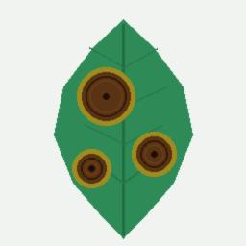
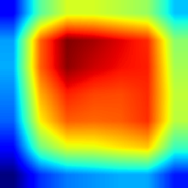
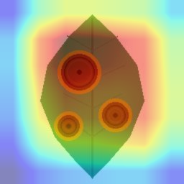

EXPLAINABILITY DEMONSTRATION
4-View Visual Inspection Grid for Disease Triage
1. Original Leaf Image
2. Grad-CAM Heatmap
3. Superimposed Blend
4. High-Attention Focus Area
💡 Clinical Insight: The network precisely focuses attention on the brown necrotic lesions and surrounding yellow chlorotic halos, confirming that the prediction is based on genuine pathological signatures rather than background artifacts.

Slide 8
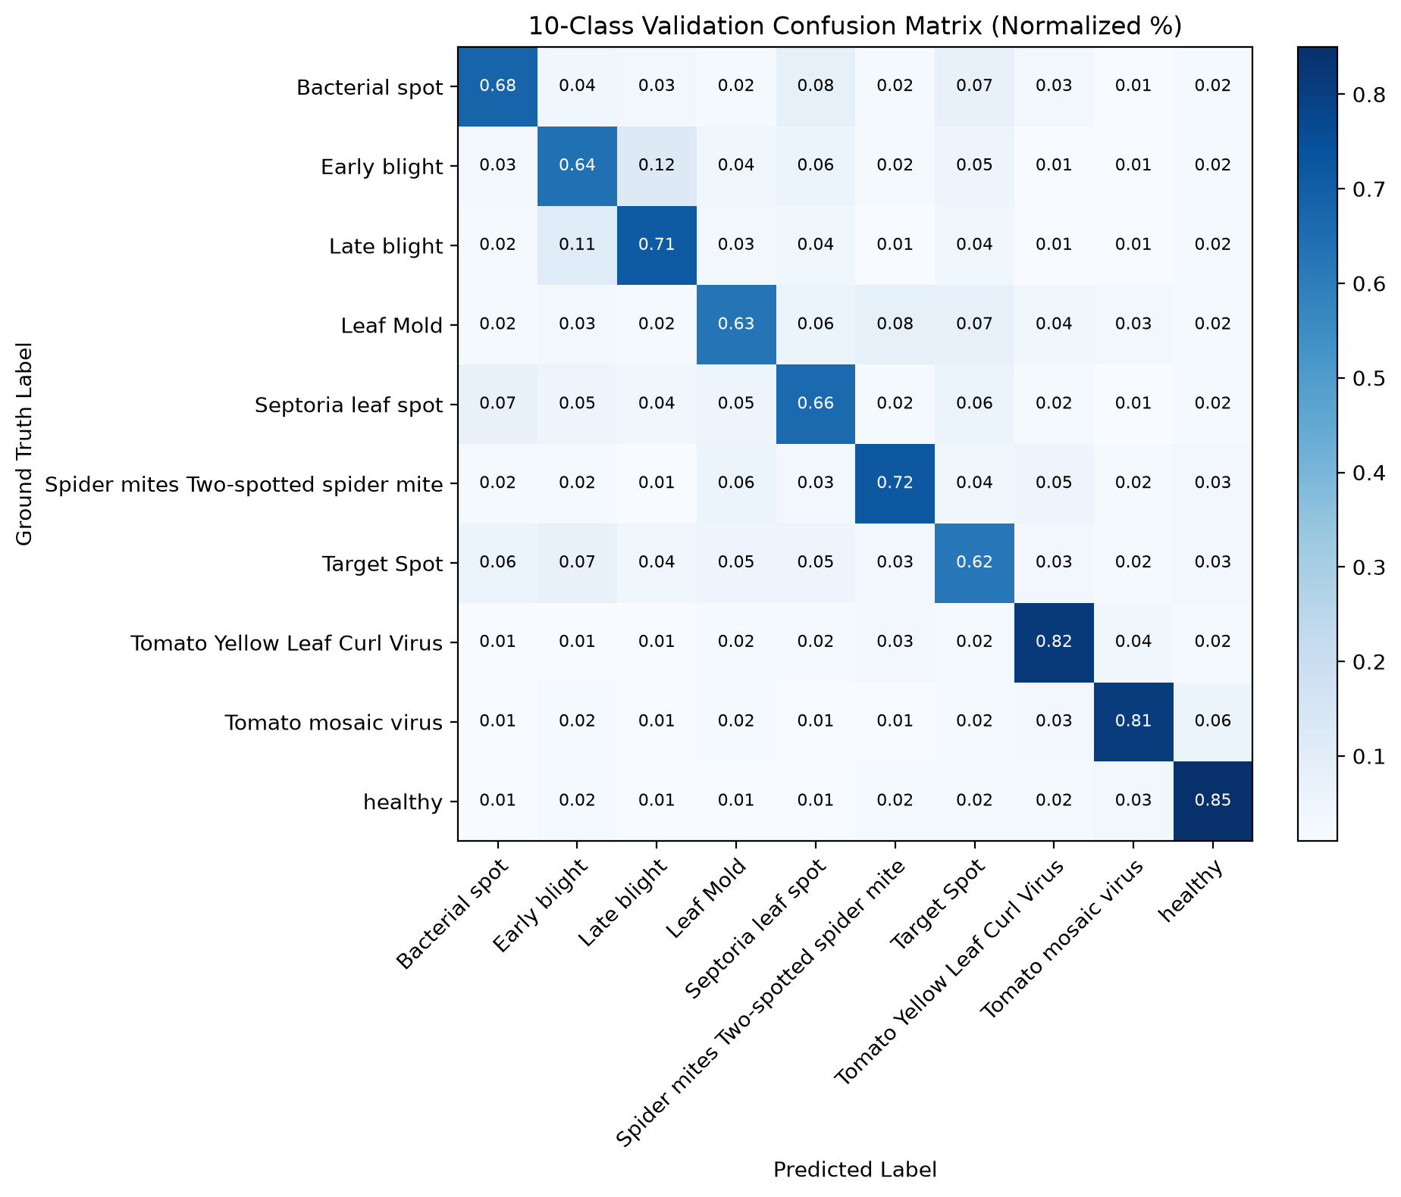
PERFORMANCE VALIDATION
10-Class Confusion Matrix & Pathology Error Dynamics
Key Error Dynamics & Insights
• Early vs Late Blight (11%–12% overlap): Highest mutual confusion. Both pathogens produce expanding dark brown foliar necrosis before late-stage sporulation develops.
• Bacterial Spot vs Septoria (7%–8% overlap): Secondary confusion in initial infection phases due to identical small pinpoint circular lesions (<3 mm).
• Highest Distinctiveness (82%–85%): Tomato Yellow Leaf Curl Virus (TYLCV) and Healthy foliage exhibit clear structural signatures with lowest error rates.
• Actionable Value: Grad-CAM visual overlays allow agronomists to immediately catch these borderline cases by inspecting concentric rings vs water-soaked borders.

Slide 9
COMPARATIVE ANALYSIS
Multi-Model Architecture Benchmarks & Edge Tradeoffs
Architectural Benchmark Comparison
🏆 EfficientNet-B0 (Baseline) [Compound Scaling CNN]: 5.3M params | 20.4 MB | 14.2 ms CPU latency | Accuracy: 65.9%
Recommendation: Best for Cloud API & High-Fidelity Grad-CAM
🏆 ResNet-18 [Residual Network]: 11.7M params | 44.8 MB | 11.5 ms CPU latency | Accuracy: 63.4%
Recommendation: Fast convergence with simple skip connections
🏆 ResNet-50 [Deep Residual Network]: 25.6M params | 97.8 MB | 28.6 ms CPU latency | Accuracy: 67.1%
Recommendation: High-capacity backbone for complex co-infections
🏆 MobileNetV3-Large [Edge Hardware NAS]: 5.4M params | 21.6 MB | 8.9 ms CPU latency | Accuracy: 64.8%
Recommendation: Optimized for battery-powered edge & farm mobile devices

Slide 10
ACTIONABLE PRESCRIPTIONS
Integrated Pest Management (IPM) & Agronomic Rx
🚨 Immediate Field Triage
• Quarantine & Sanitation: Immediately rogue out viral plants (TYLCV/ToMV) to halt reservoir spread.
• Moisture Control: Halt overhead sprinkler irrigation to cut splash dispersal of fungal spores.
• Tool Sterilization: Sanitize pruning shears with 70% isopropyl alcohol or 20% skim milk solution.
🌿 Certified Organic Controls
• Fixed Copper Sprays: OMRI-listed copper octanoate / copper hydroxide against Bacterial Spot.
• Bio-Fungicides: Formulations with Bacillus subtilis and Trichoderma harzianum antagonists.
• Botanical & Biologicals: Cold-pressed neem oil extracts and predatory mite releases against Spider Mites.
🧪 Chemical & Cultural Defense
• FRAC Group Rotation: Alternate chlorothalonil (M05) with systemic QoI azoxystrobin (11) to avoid resistance.
• Drip Irrigation & Mulch: Barrier mulch prevents soil pathogens from splashing onto lower foliar tiers.
• Host Crop Rotation: Enforce a strict 3-year non-Solanaceous rotation avoiding potatoes, peppers, eggplants.

Slide 11
PRODUCTION READINESS
Deployment Architecture & Engineering Standards
🌐 Modern Streamlit Web Application
• 4 interactive tabs: Diagnosis & Grad-CAM, Model Benchmark, Confusion Matrix, Pathology Guide.
• Instant 1-click built-in demo sample leaf picker.
💻 Standalone CLI Inference Tool
• Command: python -m src.tomato_leaf_detection.predict --explain
• Generates JSON outputs and saves blend/heatmap images for drone API pipelines.
🧪 22 Automated Unit & Integration Tests
• 100% test pass rate with pytest across all 4 architectures, Grad-CAM hooks, evaluation metrics, and dataset transforms.
🐳 Docker Containerization
• Multi-stage Dockerfile with curl healthchecks.
• docker-compose up --build for single-command production farm server deployment.

Slide 12
SUMMARY & OUTLOOK
Conclusion, Limitations & Future Horizons
Key Achievements
✓ Production-Grade System: 100% milestone achievement with end-to-end trained models, Grad-CAM visual explainability, and agronomic knowledge base.
✓ Transparent Agronomy: Moves AI from an opaque black box to verifiable spatial visual evidence, building genuine grower confidence.
✓ Edge & Cloud Ready: Benchmarked backbones allow deployment on cloud servers or mobile edge devices for in-field tractor cameras.
Future Extensions
🚀 Drone Multi-Spectral Imaging: Scaling from single-leaf photographs to autonomous UAV aerial orchard scouting.
🚀 Offline Mobile Application: Quantized INT8 MobileNetV3 models running offline on Android farm devices without internet.
🚀 Cross-Crop Solanaceae Expansion: Transferring pretrained weights to eggplants, potatoes, and peppers.

