Slide 1
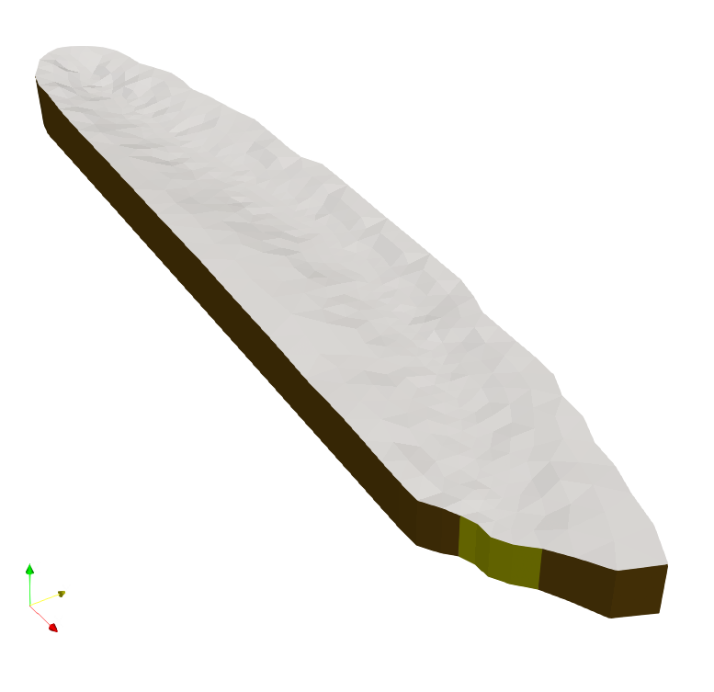
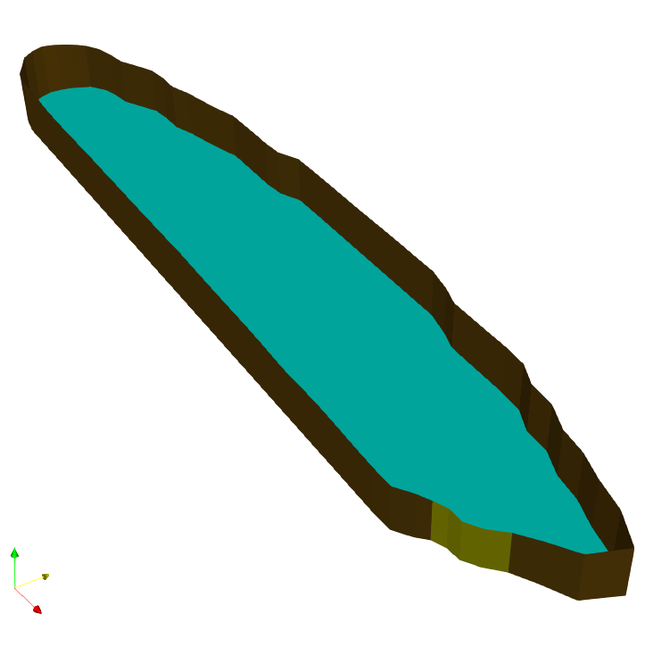
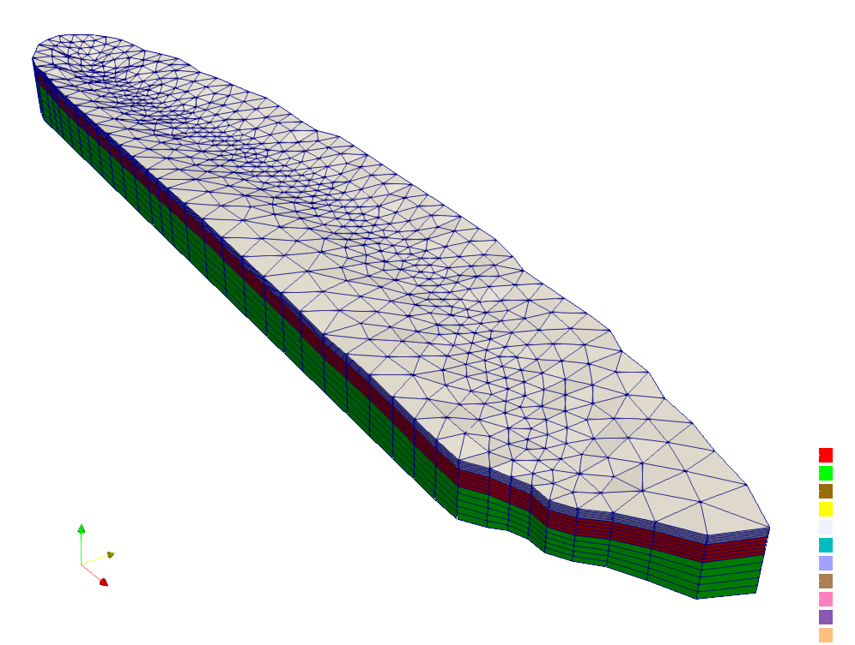
3 Soil Layers, each associated with a material ID. Vertical mesh resolution is finer near the surface.
The faceset covering the top surface is removed to show the facesets that cover the sides and bottom of the model.
Facesets define important regions for model, e.g., the stream outlet.

Slide 2
