Slide 1
Demo 1: Flow
Daniil Svyatsky & J. David Moulton
Los Alamos National Laboratory

Slide 2
Outline
Flow Modeling and Simulation with ATS
Flow is a critical driver in ecosystem dynamics
Variably saturated flow
Richards’ Equation
Infiltration in 1D column
Overland flow
Diffusive Wave Equation
Simple geometry, rainfall inducing flow, highlight different outflow boundary conditions
Integrated Hydrology
Coupling of Surface/Subsurface flow
Hillslope hydrology spinup simulation
Hillslope irrigation simulation

Slide 3
Motivation/Background

Slide 4
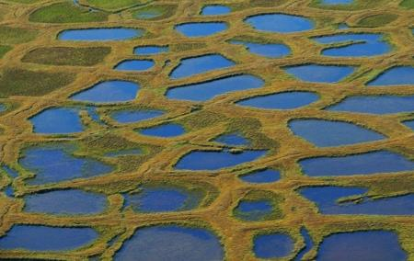
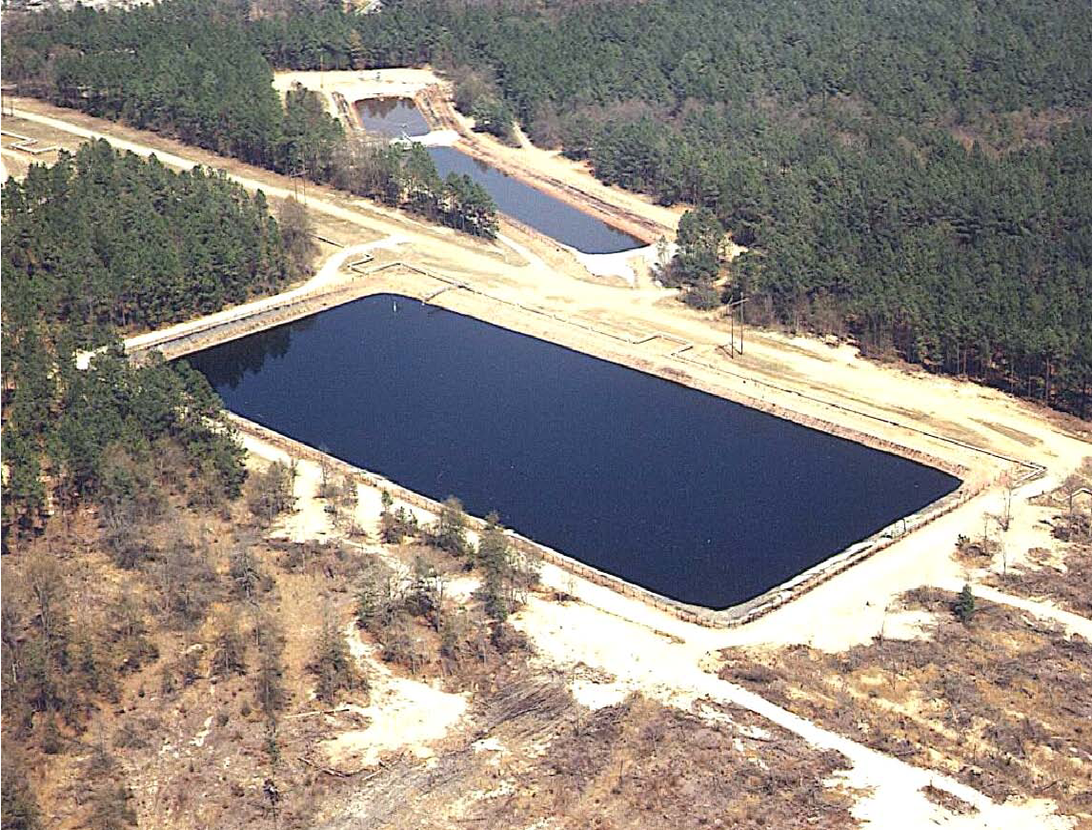
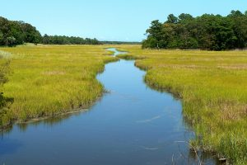
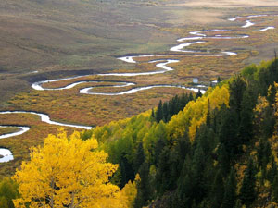
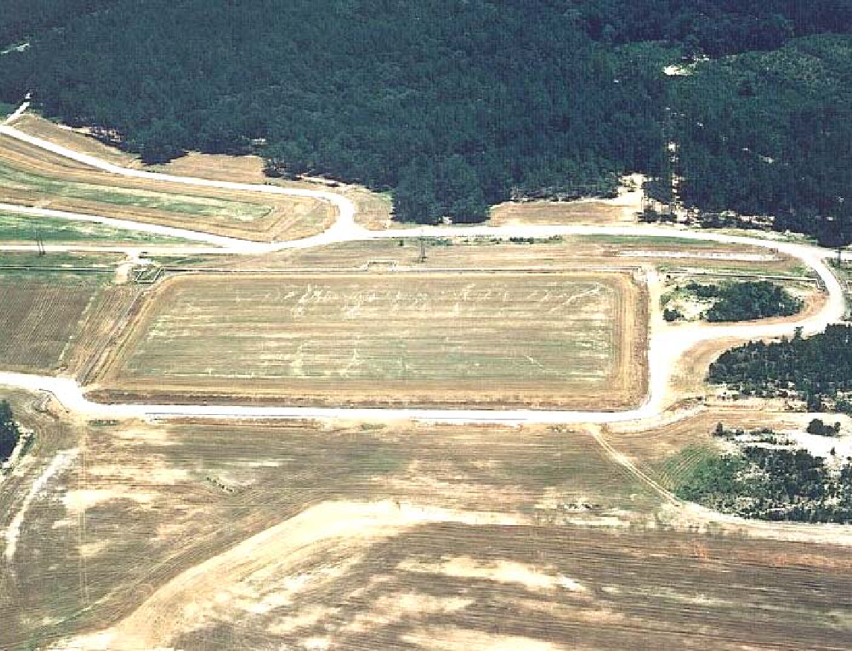
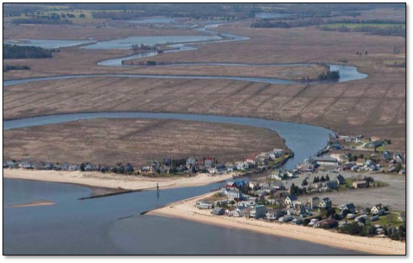
Flow plays a critical role in driving and coupling processes
Climate impacts and feedbacks (carbon and nitrogen cycling).
Contaminant transport and reactions.
Complex interaction of land surface and subsurface processes.

Slide 5
Subsurface Flow
Richards’ Equation

Slide 6
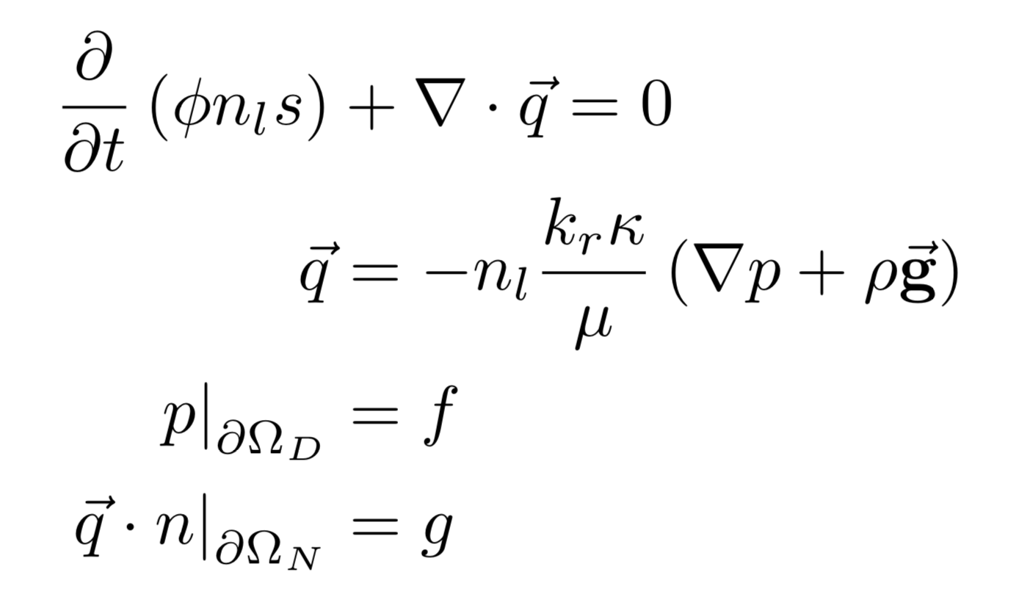
Variably Saturated Flow: Richards’ Equation
Richards (1931) model for variably saturated flow
Φ - soil porosity [-]
n_{l} - molar water density [mol m⁻³]
k_{r} - relative permeability [-]
k - absolute permeability [m²]
μ - dynamic viscosity [Pa s]
ρ - mass water density [kg m⁻³]
g - gravity [m s⁻²]
where the unknowns are the water pressure p [Pa] and the Darcy flux q [mol m⁻² s⁻¹]

Slide 7
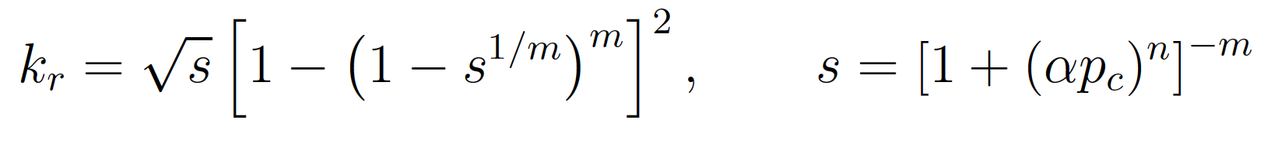
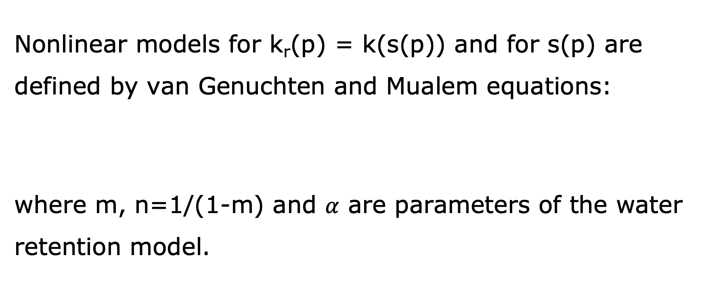
Water Retention Models
Nonlinear models for k_{r}(p) = k(s(p)) and for s(p) are defined by van Genuchten and Mualem equations:
where m, n=1/(1-m) and $α$ are parameters of the water retention model.

Slide 8
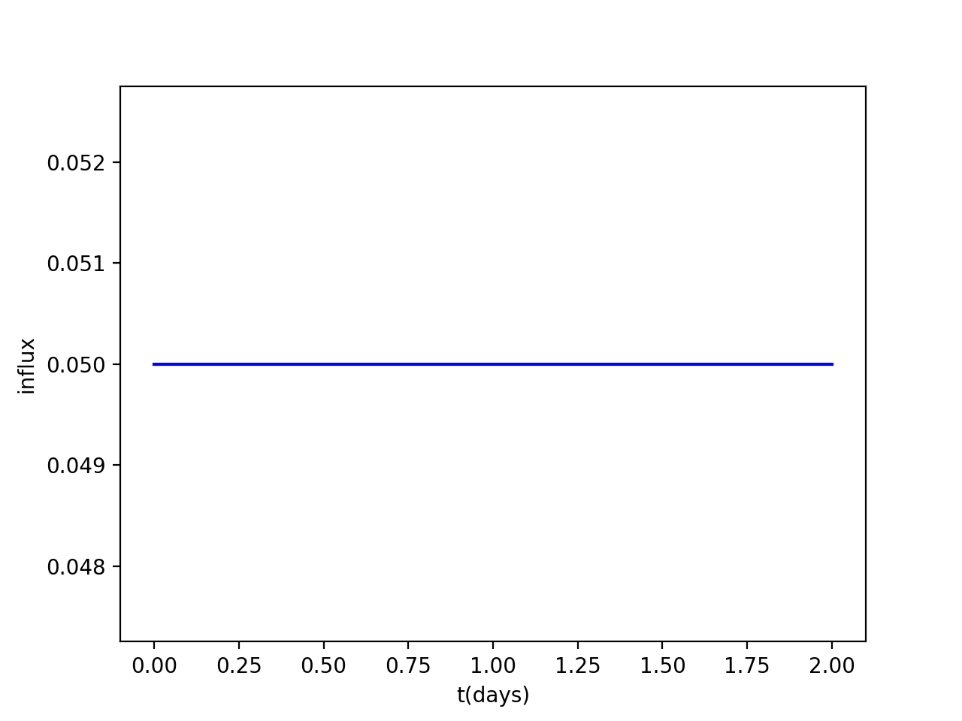
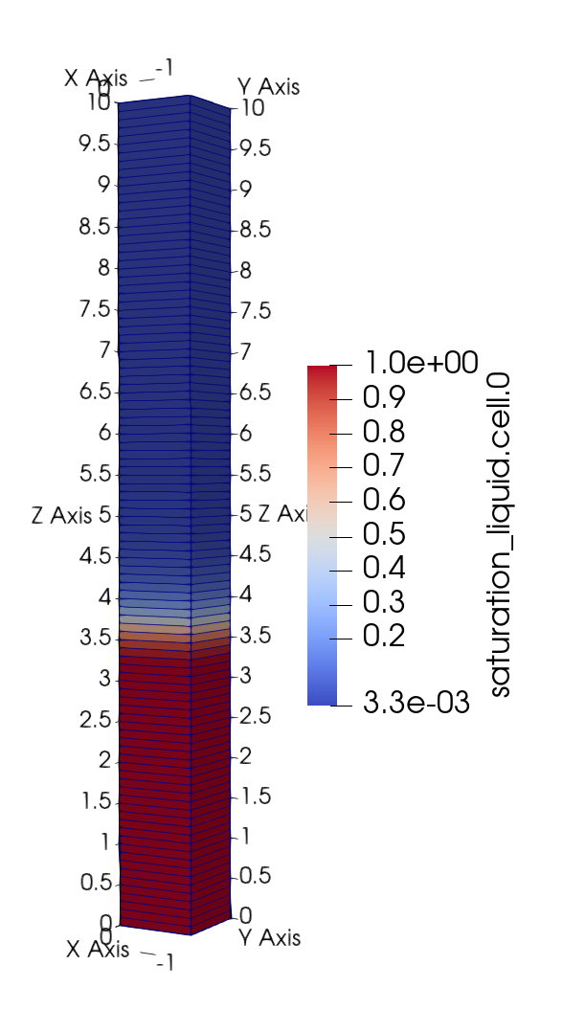
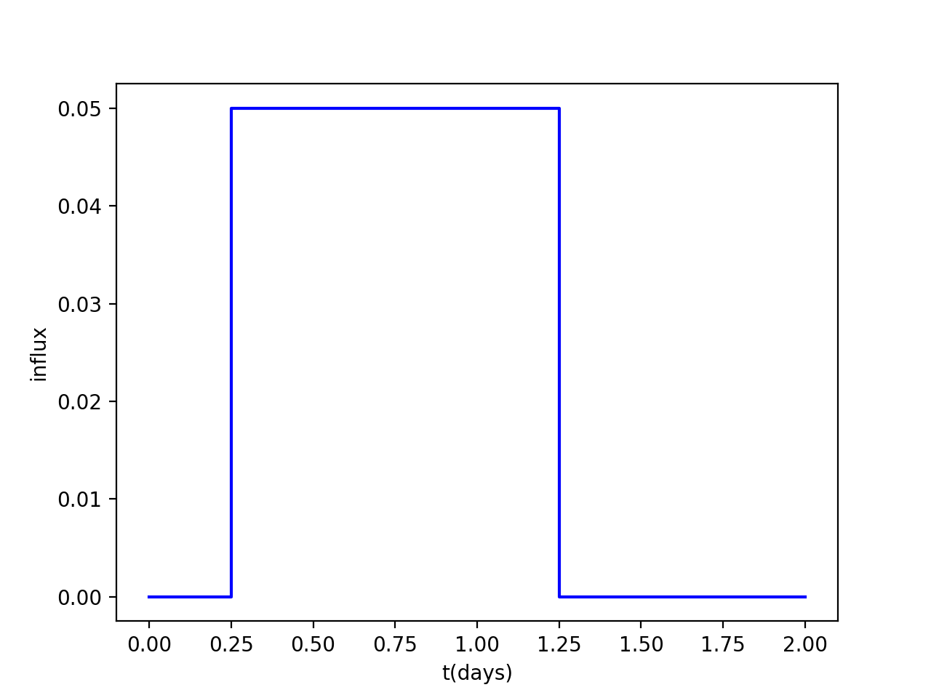
Infiltration into a 1D soil column (Transient)
A
Initial condition
Hydrostatic pressure with water table at 3m
Boundary conditions
Infiltration from the top at the rate 0.05 [mol m⁻² s⁻¹]
B

Slide 9
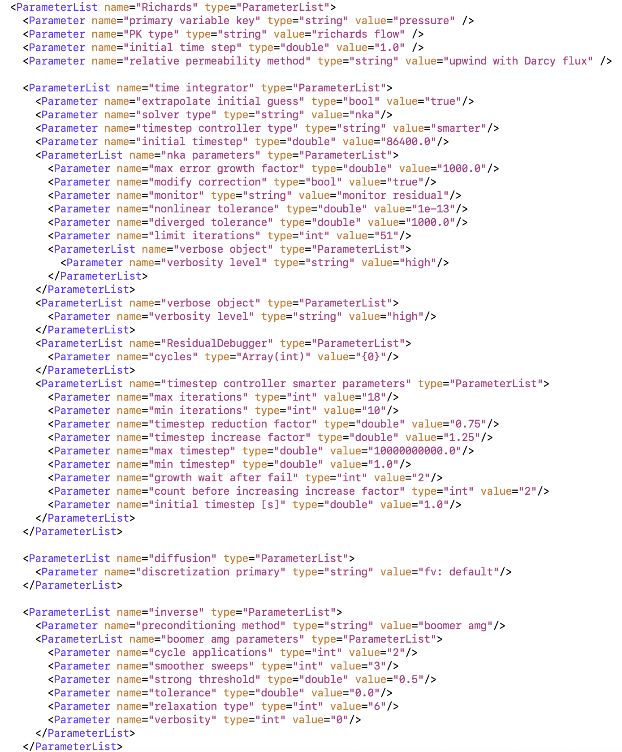
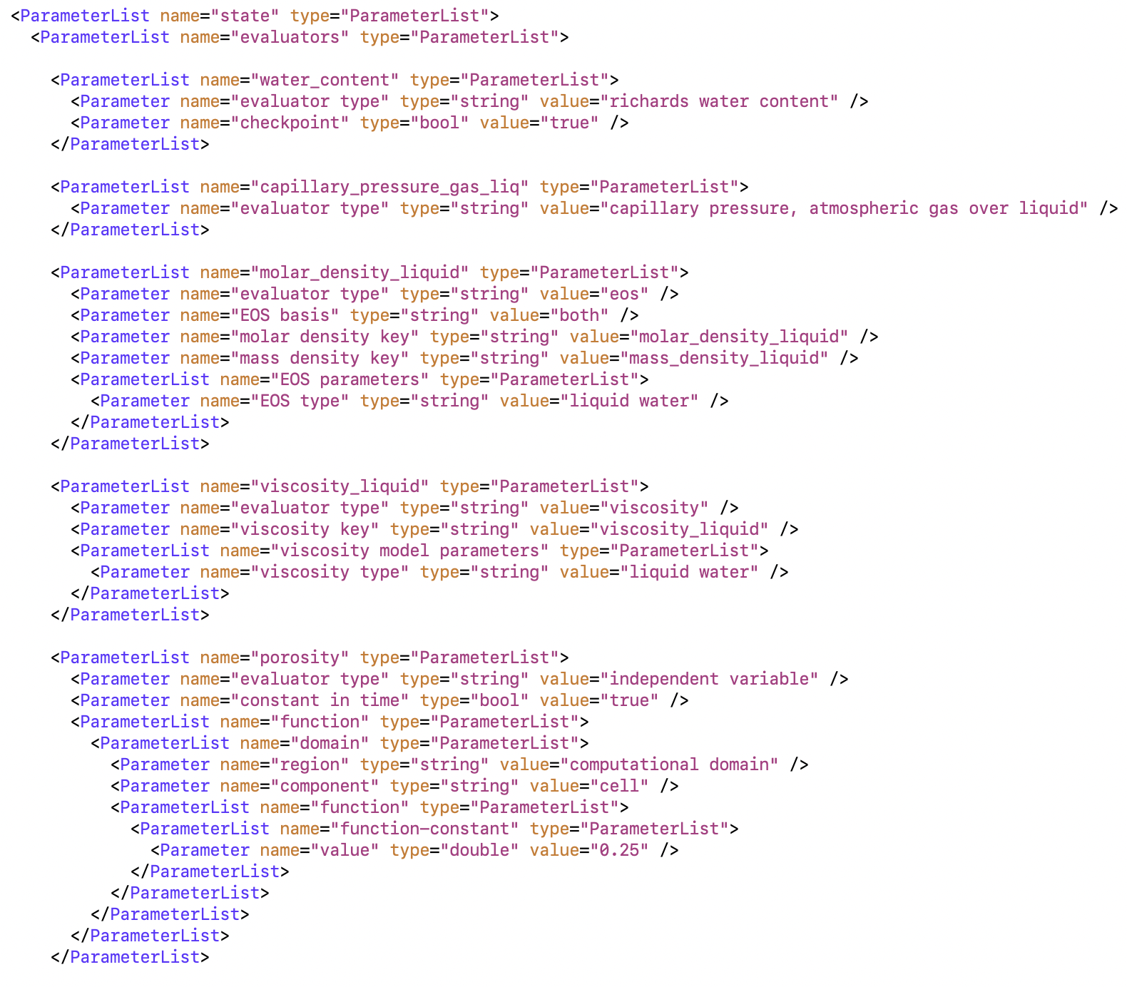
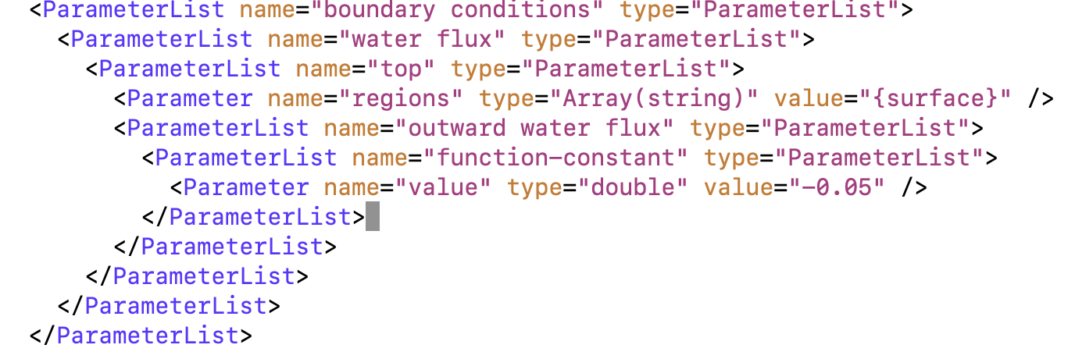
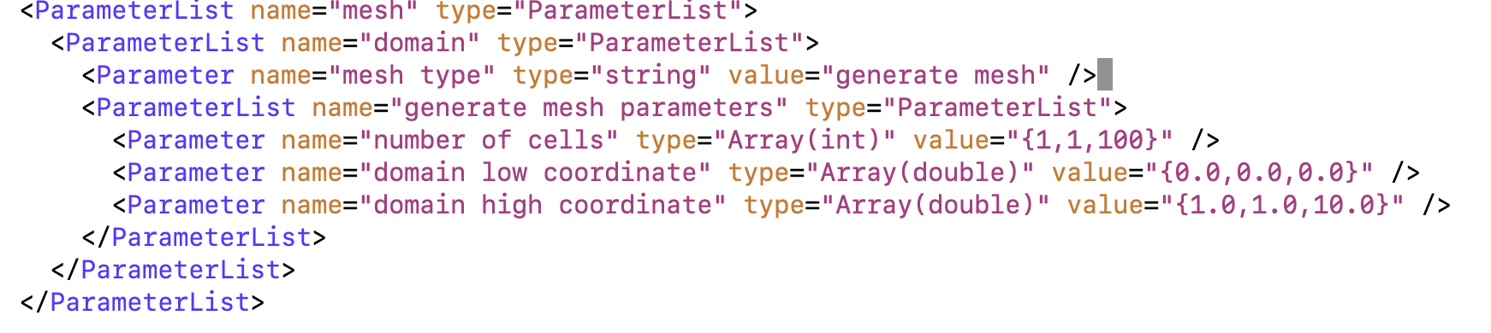
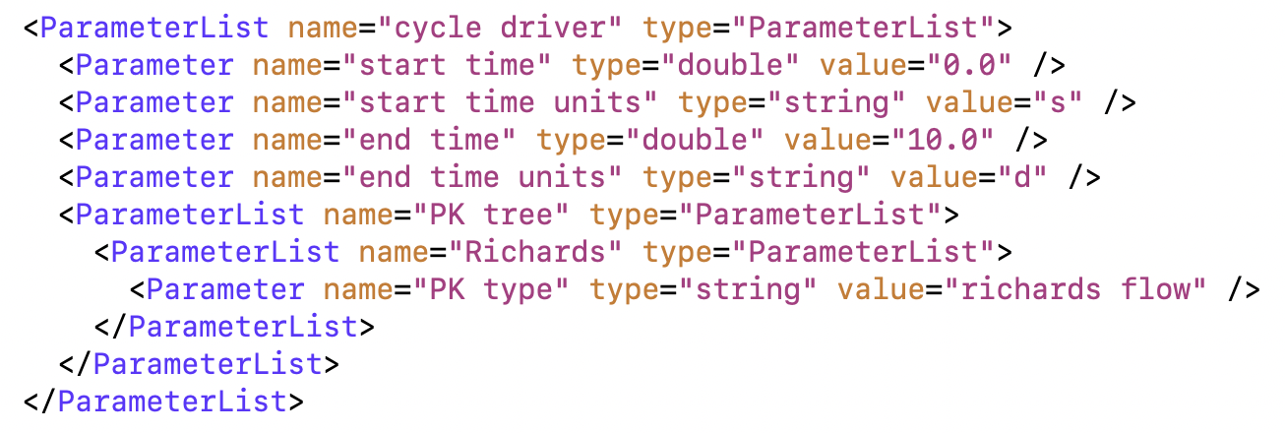
Model Setup
Simulation Domain
Process Kernel Tree
Model parameters
numerical parameters
physical parameters
Initial and Boundary conditions
Setting Forcing

Slide 10
Jump to notebook

Slide 11
Overland Flow
Diffusion Wave Model

Slide 12
Diffusive wave model (DSW)
This model has been used to simulate overland flow in wetlands and open channels.
Describe shallow water movement across land surface:
rainfall has exceeded the infiltration rate
entire soil column becomes completely saturated and water exfiltrates at the surface

Slide 13
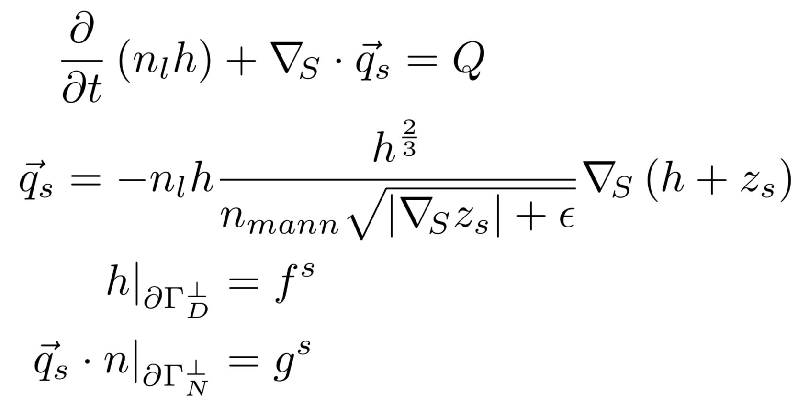
Diffusive Wave Model of Overland Flow
Wasantha Lal (1998)
Q - sources [mol m ⁻² s⁻¹ ]
n_{mann}- Manning coefficient [s m^{-1/3}]
Z_{s} - surface elevation [m⁻¹]
ε - regularization [m]
where the unknowns are the ponded depth of water h_{w} [m], and the flux of surface water q_{s} [mol m⁻¹ s⁻¹]

Slide 14
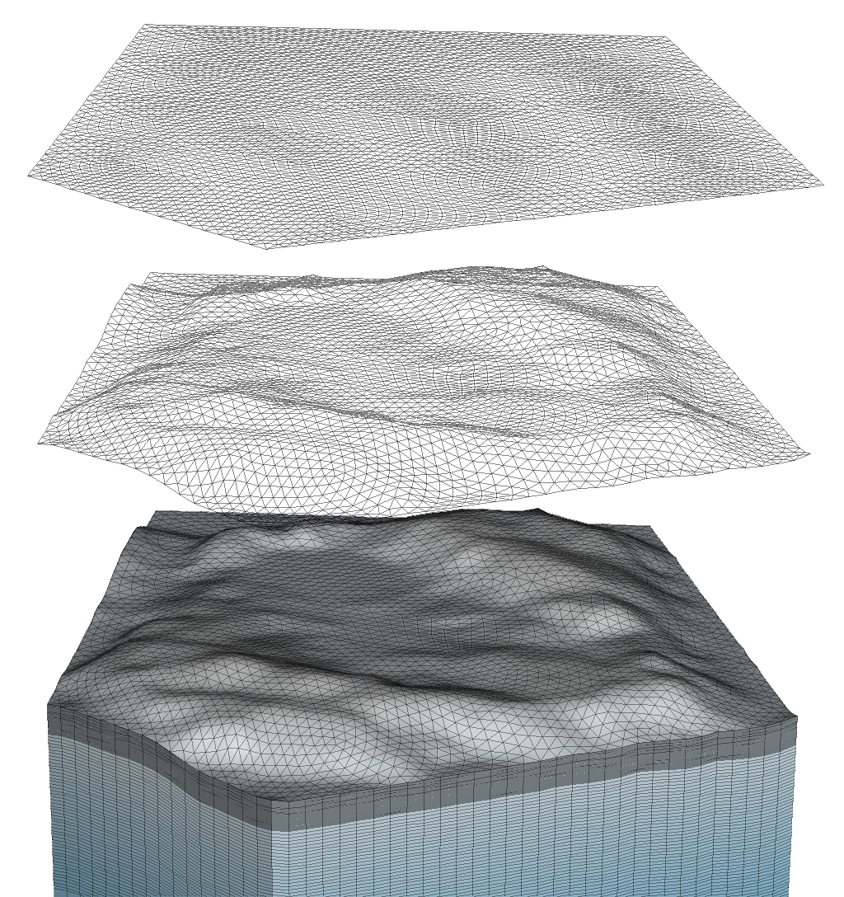
Meshes for model design
Г_{丄}
Г
Ω

Slide 15
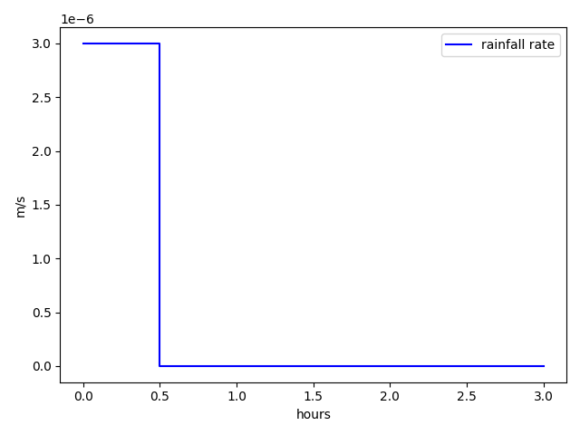
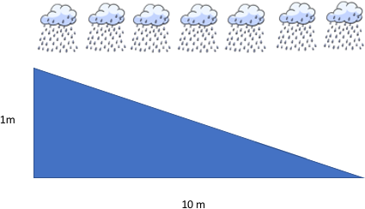
Overland Flow on a planar hillslope
Case1: no flow BC
Case2: critical depth BC
Case3: zero gradient BC
Case4: max depth BC

Slide 16
Jump to notebook

Slide 17
Integrated Hydrology
Coupled surface and subsurface flow

Slide 18

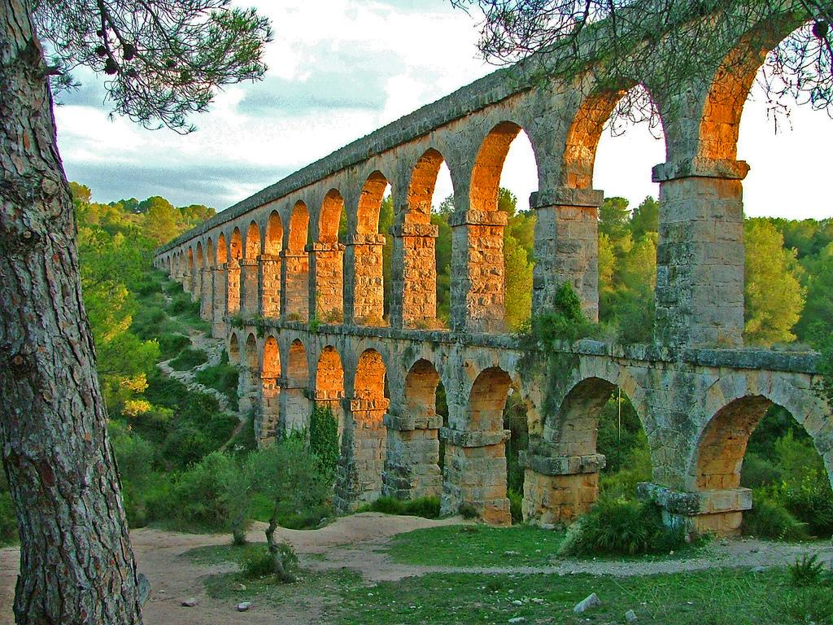
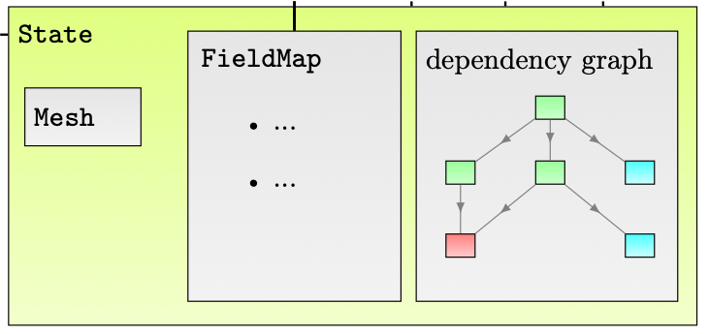
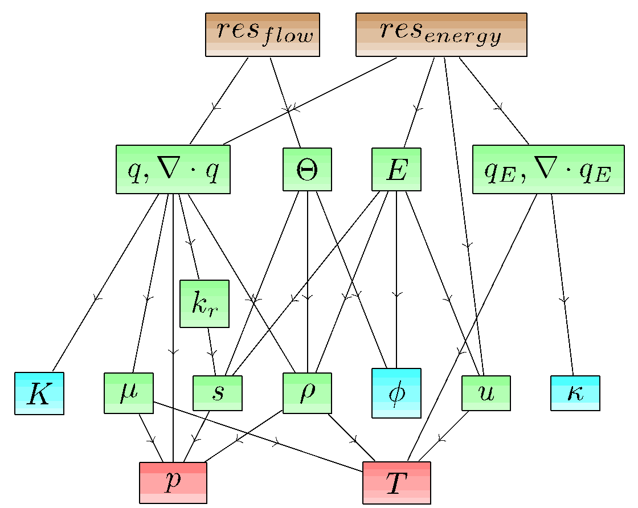
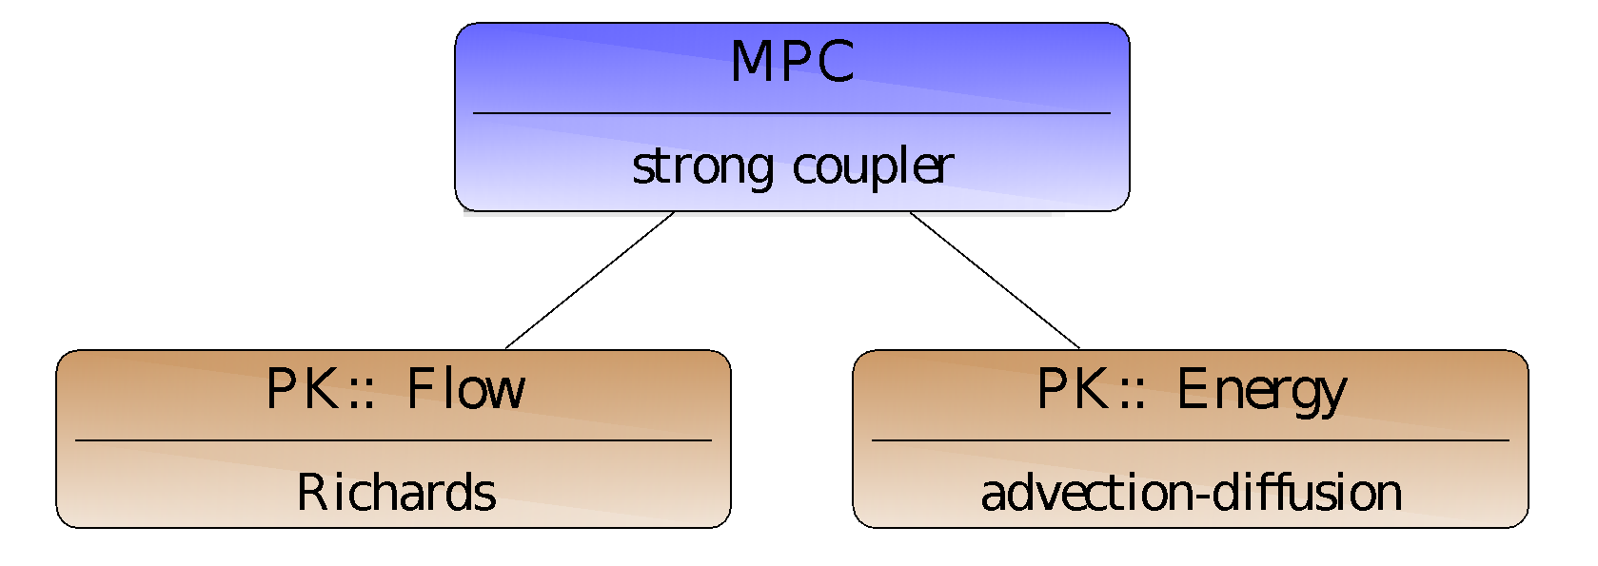
Arcos Multiphysics Framework
The Arcos multiphysics framework, is a fully functional framework serving Amanzi and ATS, but may also be viewed as a reference implementation to explore interface designs, coupling strategies and outreach to the community.
Dynamic Data Manager
Dependency Graph
Process Kernel Tree
Coon et al. Env. Model. & Soft. 2016

Slide 19
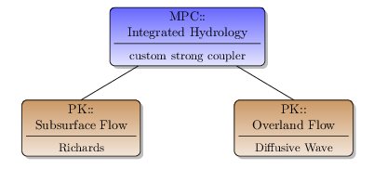
Model Coupling: Approach
The Arcos framework supports a flexible and phased approach to development and testing:
Develop and test Process Kernels (PKs), such as, flow, transport, and energy in isolation.
Develop Multi-Process Couplers (MPCs) to create and test an integrated model.
MPCs fall in two categories:
Strong: forms and solves a single system of equations (e.g., fully implicit)
Weak: sequentially steps cycles through the process kernels (typical in flow and transport)
Users are able to express the coupled model at high-level in the input file using PK-trees.
PK-tree describing integrated hydrology.

Slide 20
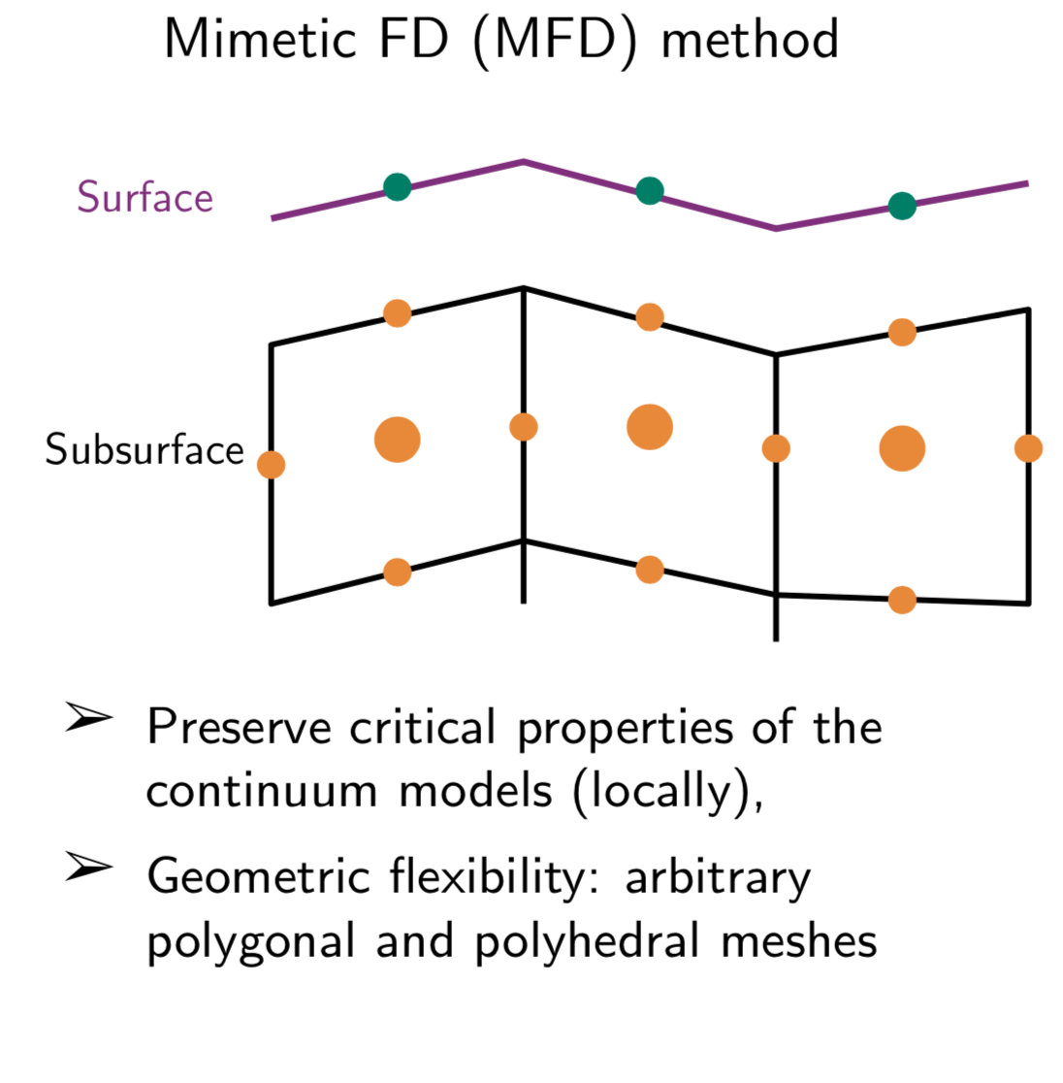
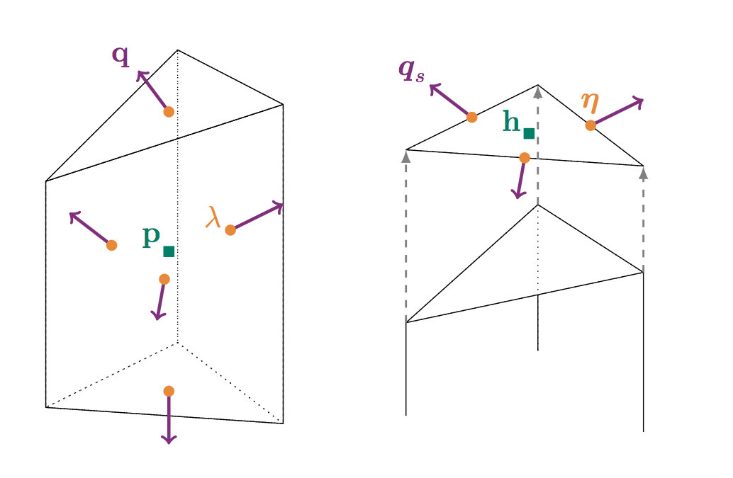
Integrated Hydrology: Coupling Details
Combine matrices (and or Jacobians) of the two models together in a single system.
Use continuity of normal flux and pressure to create this fully coupled system.
rewrite ponded depth as pressure
Appropriately match entities from one domain to the other, e.g., normal flux from a subsurface face is a source in that cell for surface flow.
Ensure conservation of mass
Schematic showing the locations on the mesh of the discrete unknowns in the subsurface flow (pressure: p - cells, 𝞴- faces ), q normal flux; and surface flow (ponded depth: h- cells, qs normal flux).
Coon E. T., et al., 2020, https://doi.org/10.1016/j.advwatres.2020.103701

Slide 21
Model Setup
Simulation Domain
Process Kernel Tree
Model parameters
Initial and Boundary conditions
Setting Forcing

Slide 22
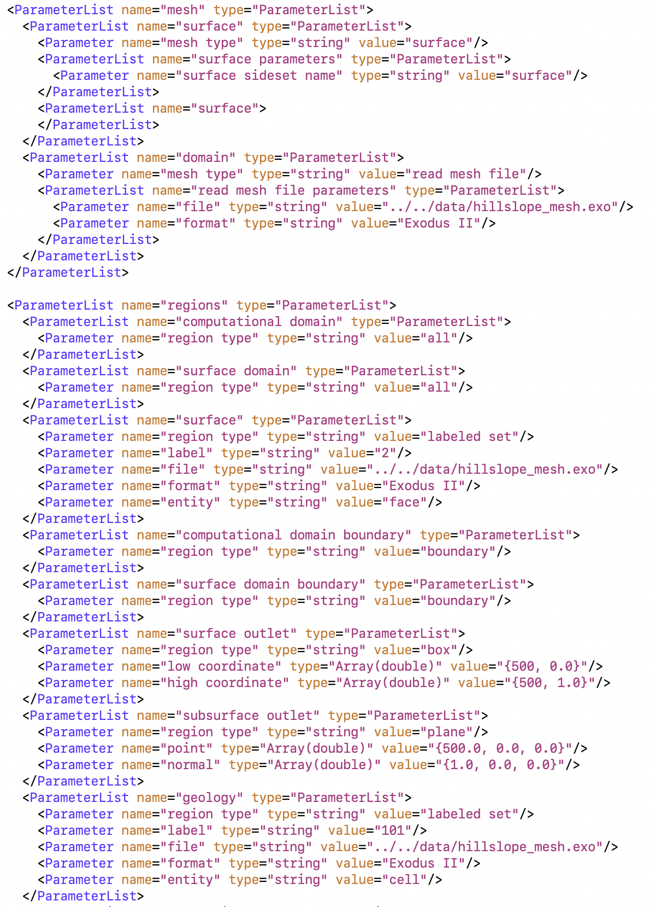
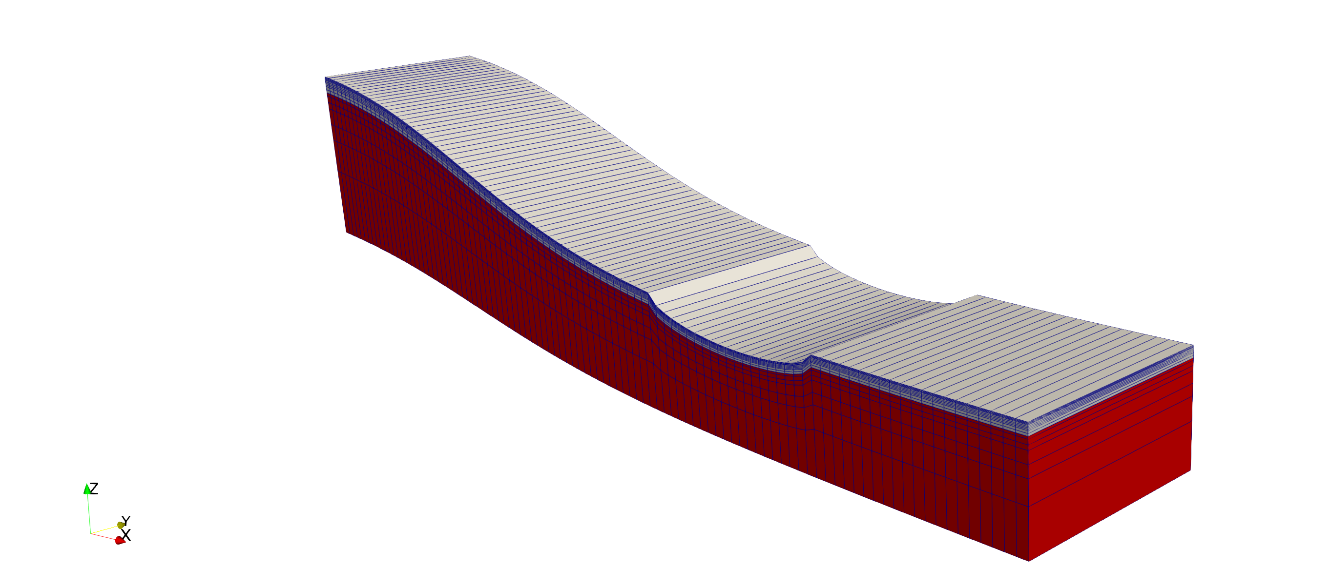
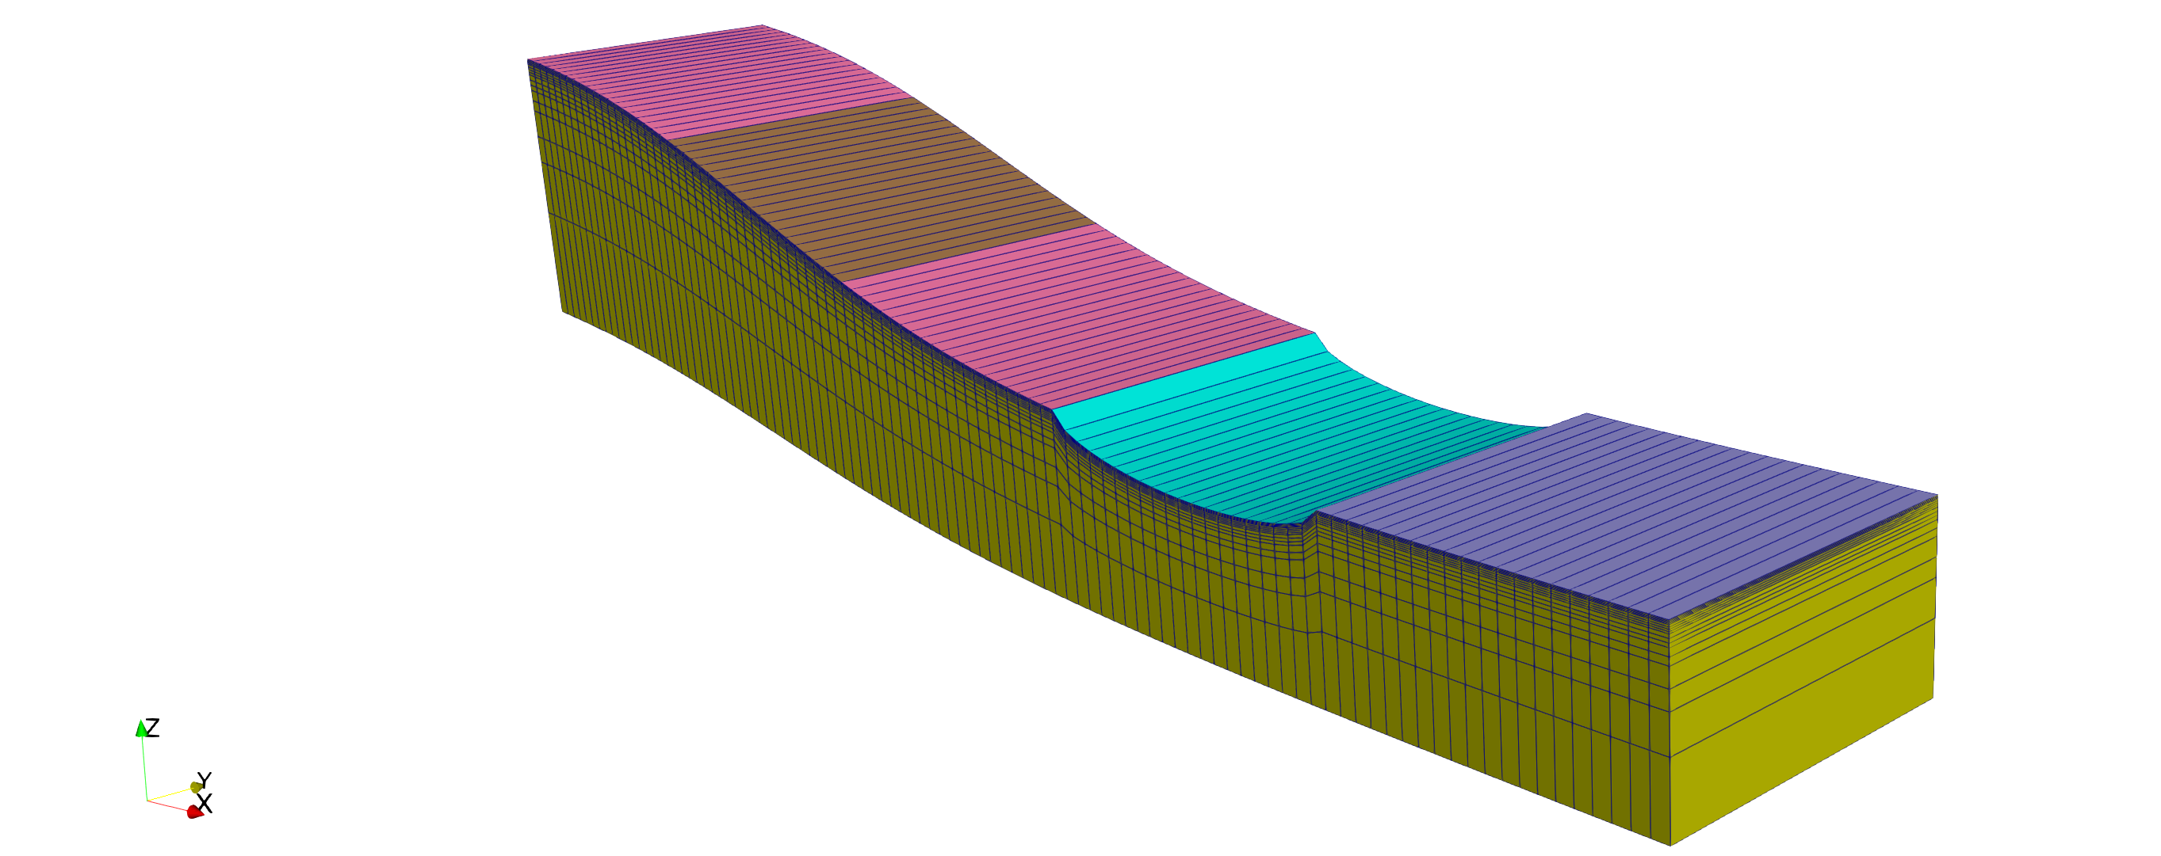
Simulation Domain

Slide 23
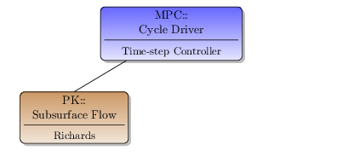
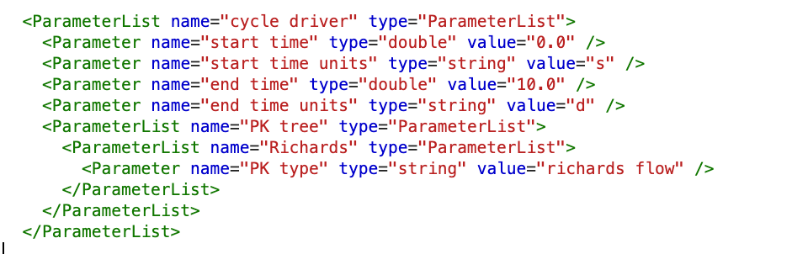
Process Kernel Tree
First, we introduced subsurface flow using Richards Equation:
Schematic of the PK-tree for subsurface flow.
Input file showing the “cycle driver” element with the PK-tree sublist for subsurface flow.
A single PK is the simplest PK-Tree you can have and doesn’t need a coupler, just the top-level cycle driver.

Slide 24
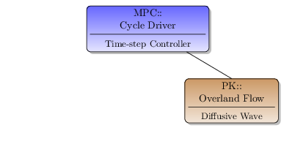
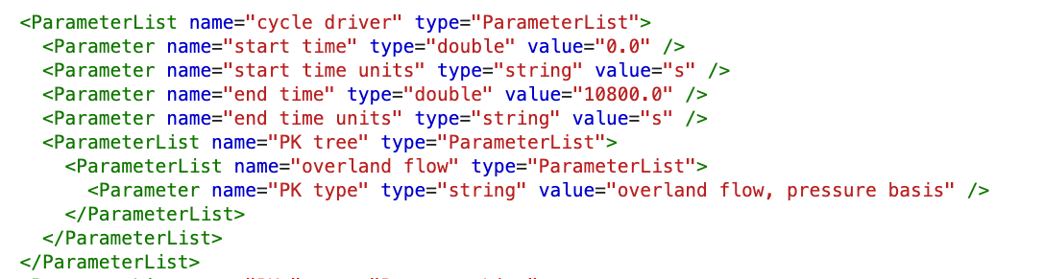
Process Kernel Tree
Second, we introduced overland flow using a Diffusion Wave Equation:
Schematic of the PK-tree for overland flow.
Input file showing the “cycle driver” element with the PK-tree sublist for overland flow.
A single PK is the simplest PK-Tree you can have and doesn’t need a coupler, just the top-level cycle driver.

Slide 25
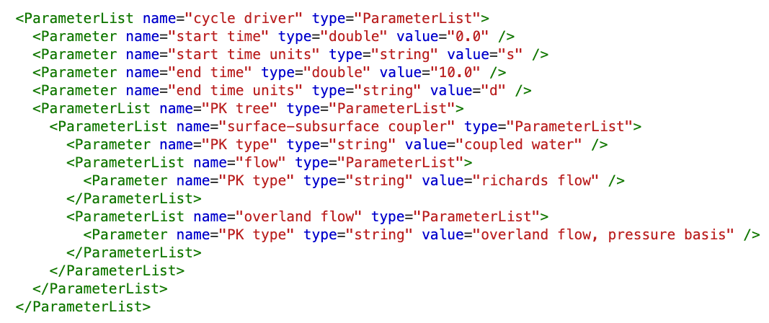
Model Coupling (PK-Trees)
Finally, we couple surface and subsurface flow models
Schematic of the PK-tree for Integrated Hydrology (coupled overland and subsurface flow).
Input file showing the “cycle driver” element with the PK-tree sublist for coupled overland and subsurface flow (integrated hydrology).
to create the Integrated Hydrology model.

Slide 26
Model Setup
Simulation Domain
Process Kernel Tree
Model parameters
Initial and Boundary conditions
Setting Forcing

Slide 27
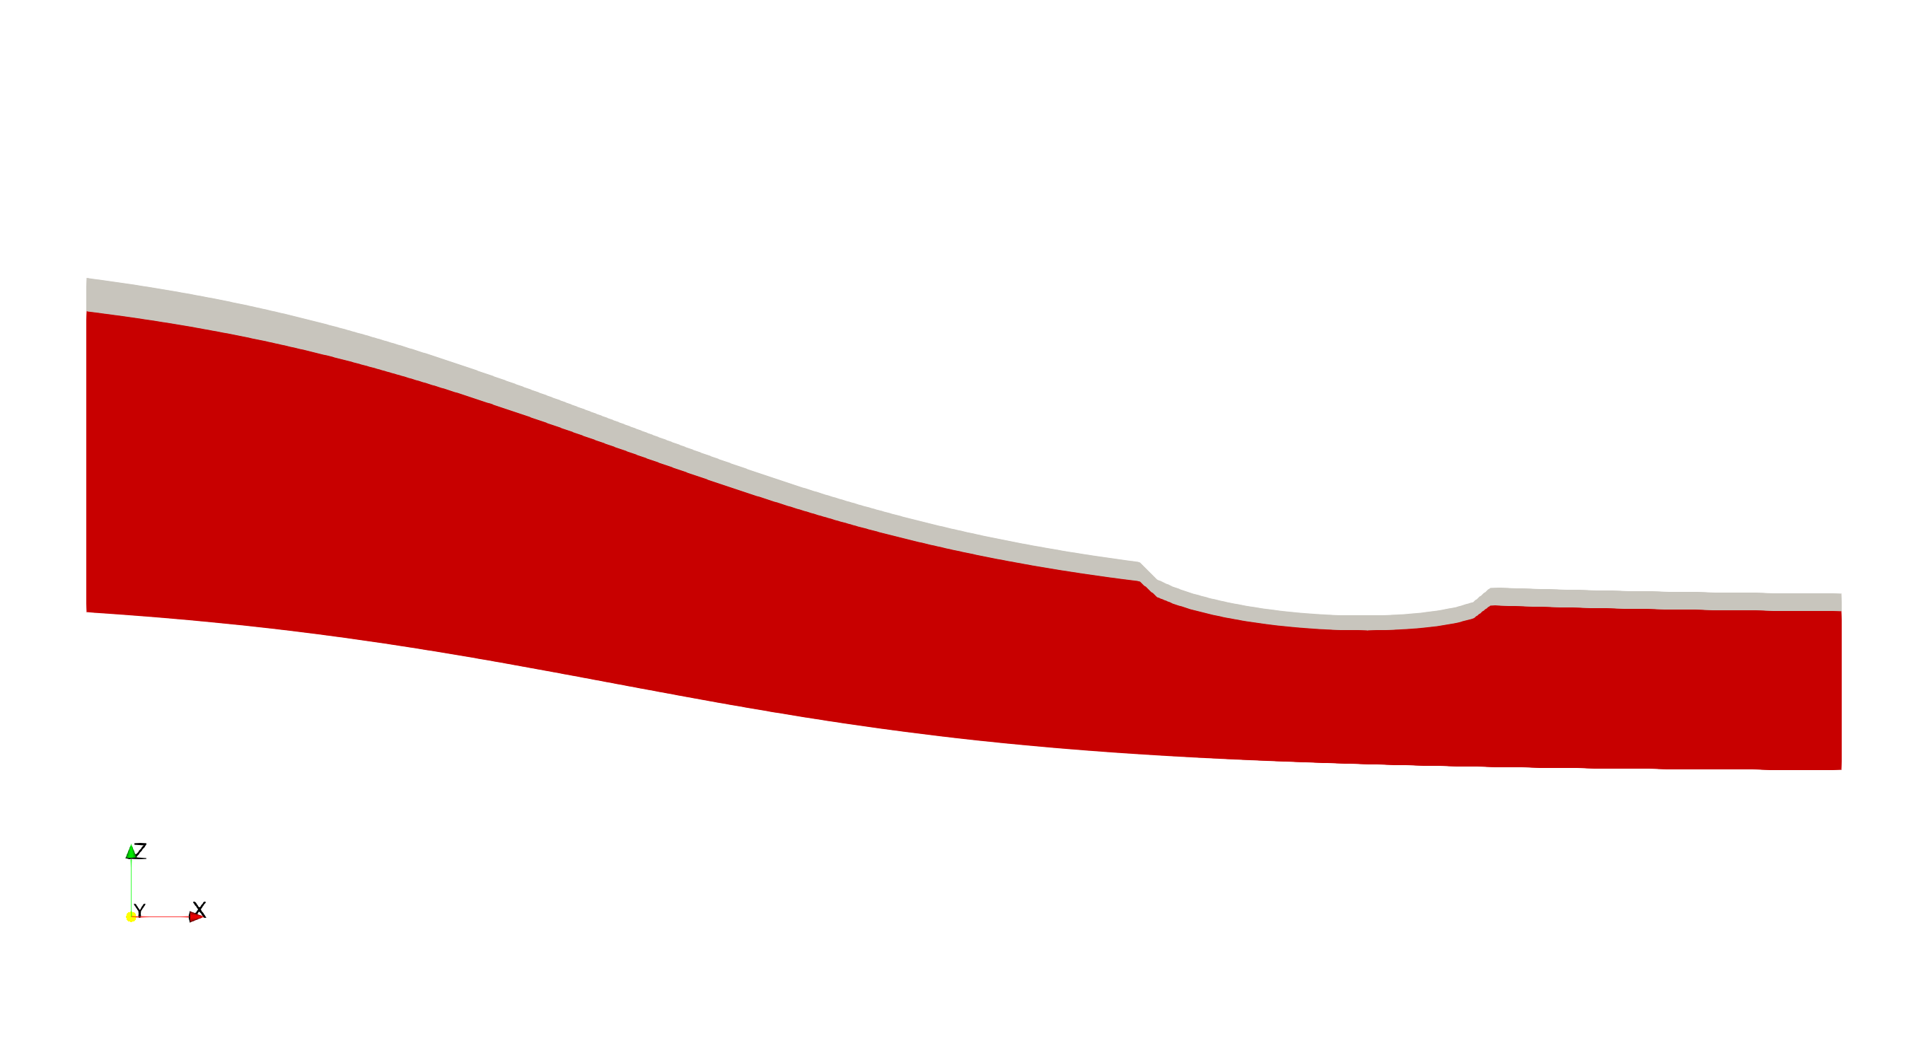

no flow
seepage head
no flow
no flow

Slide 28
Jump to the notebook
Integrated hydrology:
2D hillslope transect
explore model setup and run existing input file

Slide 29
no flow
seepage head
lake
no flow
hydrostatic pressure

Slide 30
Jump to the notebook
Integrated hydrology:
2D hillslope transect
explore model setup and run existing input file

Slide 31
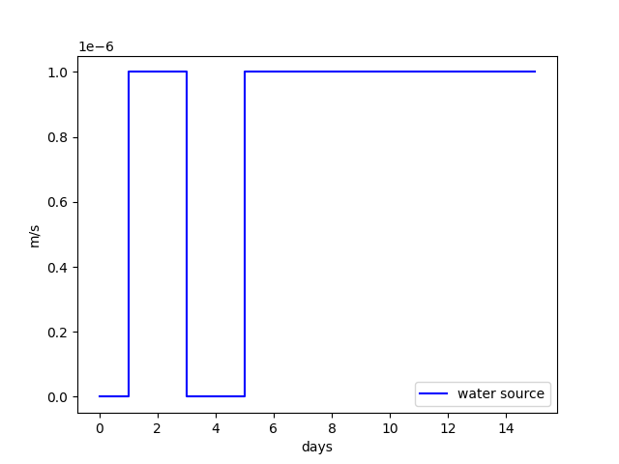

no flow
seepage head
lake
no flow
hydrostatic pressure

