Slide 1
Concepts & Fundamentals
Ethan Coon
Oak Ridge National Laboratory

Slide 2
Amanzi–ATS is a Multiphysics Model
(not a hydrologic model or reactive transport model)
Rarely is the process certain.
There is no “best model.”

Slide 3
ATS is a Multiphysics Model
*Alan Kay
”Simple things should be simple; complex things should be possible.”
An extremely customizable set of tools for combining components to form environmental models.
A rich set of demos illustrating commonly used models.

Slide 4
ATS is a Multiphysics Model
(not a hydrologic model or reactive transport model)
No “modes” – models are assembled from components
Representing almost any model concept is possible
Input files are verbose and buggy

Slide 5
Process Kernel (PK)
A single differential equation, on a single domain, (subsurface, surface, fractures, canopy) often representing conservation of a single quantity. (mass, energy, chemical component C)
Subsurface flow (conservation of water in the soil)
Surface transport (conservation of C in the stream)
Snow (conservation of water in the snowpack)

Slide 6
Process Kernel (PK)
Implement an interface related to time integration
parseParameterList()
Setup()
Initialize()
while not done:
get_dt()
failed_step = AdvanceStep()
if failed_step: FailStep()
else: CommitStep()

Slide 7
Multi-Process Couplers (MPCs)
PKs are coupled together via MPCs.
MPCs are PKs themselves
MPCs can couple other MPCs
Abstract MPCs
weak MPC: sequential, noniterative
strong MPC: globally implicit
Subcycling MPC: subcycle one PK relative to another
Custom MPCs: know about the physics of their PKs
Coupled Water MPC: integrates surface + subsurface through pressure and flux continuity
Reactive Transport MPC: operator-splitting reactions + transport

Slide 8
Process Kernel Tree
Subsurface Flow
PK: Richards

Slide 9
Process Kernel Tree
Integrated Hydrology
MPC: coupled water
PK: overland flow
PK: Richards

Slide 10
Process Kernel Tree
Subsurface Flow + Reactive Transport
MPC: weak coupler
weak = sequential, noniterative
strong = globally implicit
MPC: reactive transport
PK: Richards
PK: reactions
PK: transport

Slide 11
Process Kernel Tree
Integrated Flow + Reactive Transport
MPC: weak coupler
MPC: coupled water
MPC: coupled transport
PK: overland flow
PK: Richards
MPC: reactive transport
MPC: reactive transport
PK: surface reactions
PK: surface transport
PK: subsurface reactions
PK: subsurface transport

Slide 12
Process Kernel Tree
Arctic Hydrology
MPC: strong coupler
MPC: permafrost
PK: snow
PK: overland flow
PK: subsurface energy
PK: surface energy
PK: Richards

Slide 13
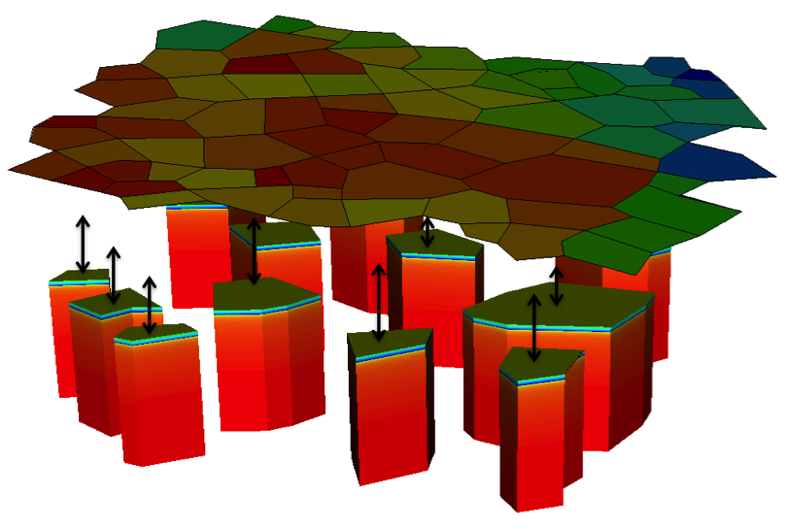
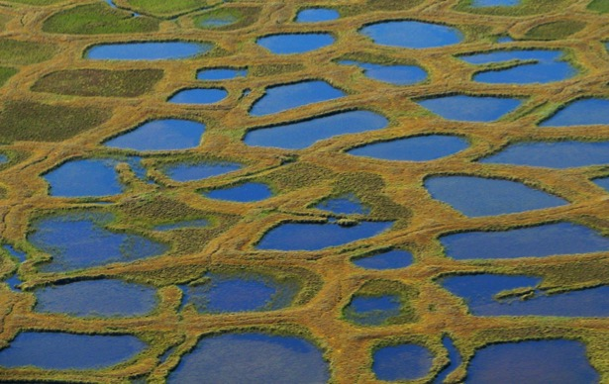
Process Kernel Tree
Polygonal Tundra Model
Ina Timling, North Slope, Alaska
Konstanze Piel, Lina River Delta, Siberia

Slide 14
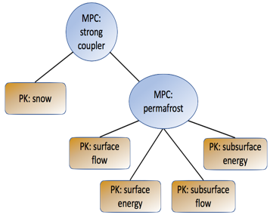
Process Kernel Tree
Polygonal Tundra Model
MPC: weak coupler
MPC: column coupler
MPC: strong coupler
PK: surface flow
PK: surface energy

Slide 15
Process Kernels & Multi-Process Couplers
Why?
Flexibility & Rapid development Create new models from existing parts by writing custom couplers.
Code Reuse One PK means one place to add features and fix bugs.
Better Testing Test in isolation, then test while coupled.

Slide 16
Dependency Graph
PKs are made up of many terms or variables in an equation
Each term is a point of customization or process uncertainty.
Conceptually, each term in an equation is one of:
Primary variable – the variable to be solved
Independent variable – data provided by the user
Secondary variable – a function of other variables
Residual – a secondary variable representing the misfit or error of an equation, given a value of the primary variables.
Alias – a secondary variable that shares memory with its only dependency

Slide 17

Dependency Graph
Richards’ Equation
$\frac{∂Θ}{∂t}=−∇⋅q+Q$
Constitutive Equation
$$Θ= ?$$

Slide 18

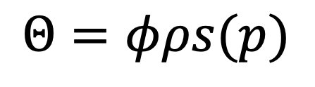
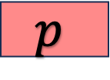
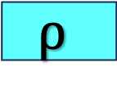

Dependency Graph
secondary variable
$$Θ=φρs(p)$$
$$Θ$$
independent variable
$$s$$
$$ρ$$
$$p$$
primary variable

Slide 19
Dependency Graph

Slide 20
Dependency Graph

Slide 21
Dependency Graph
Richards’ equation
Nonisothermal Richards’ equation
Richards’ + Energy equations

Slide 22
Dependency Graph: Evaluators
Evaluator: A class representing one node in the dependency graph.
Each evaluator only knows about its direct children.
A dependency graph is directed and acyclic.

Slide 23
Dependency Graph
*Coon et al, Env. Model. Soft 2016
Why?
Flexibility & Rapid development Create new models from existing parts by adding new evaluators.
Code Reuse Multiple PKs may reuse the same evaluator. (density of water on the surface vs density of water in the subsurface)
Better Testing Test in isolation, then test as a part of PKs.
Potential for task-based parallelism.

Slide 24
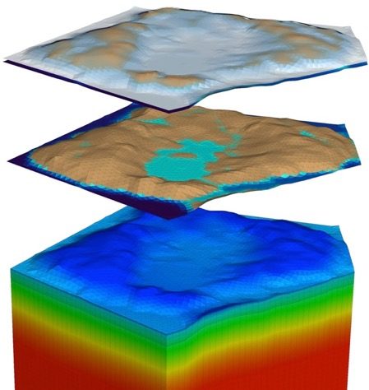
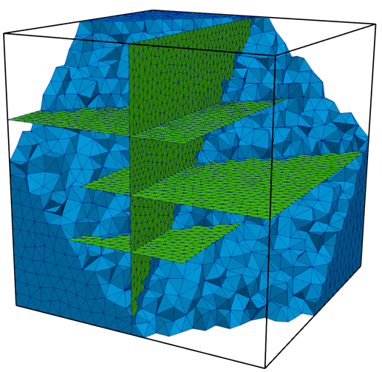
Model Domain: Mesh
*Garimella et al, Procedia Eng. 2014
Domain = conceptual, Mesh = concrete, discrete representation
Unstructured meshes (though often “extruded, terrain following”)
Arbitrary polyhedra, pinch-outs, co-planar faces, etc.
Derived meshes (extracted columns, surface meshes)

Slide 25
Model Domain: Regions
Geometric subsets of the domain (point, plane, box, boundary, labeled set)
Used to specify materials/model parameters, initial and boundary conditions, etc.
Region + Mesh + Entity type → Set of Entities

Slide 26
Time dependence
Tag: a logical point in time with respect to a reference interval
CURRENT
NEXT

Slide 27
Time dependence
Tag: a logical point in time with respect to a reference interval
CURRENT
MIDPOINT
NEXT
PREVIOUS

Slide 28
Time dependence
Tag: a logical point in time with respect to a reference interval
CURRENT
NEXT
SUBCYCLE_NEXT
SUBCYCLE_CURRENT

Slide 29
Time dependence
Tag: a logical point in time with respect to a reference interval
CURRENT
NEXT
SUBCYCLE_NEXT
During CommitStep (which is called after all PKs are successful), values may be copied from NEXT → CURRENT tags.
During FailStep, values are reset, CURRENT → NEXT
SUBCYCLE_CURRENT

Slide 30
Simulation Control: Cycle Driver
Cycle: a single timestep (the reference interval) that advances all PKs in time by a single step size dt.
ATS typically uses a variable timestep size
Often controlled by nonlinear solver performance
“Failure” of the code: time step size → 0
Cycle Driver controls the simulation:
begin and end time
end cycle, end wallclock duration
Ensures vis, checkpoint, observations happen as required
Includes the PK tree

Slide 31
Model I/O: Checkpoint/Restart
Checkpoint:
Files that contain all needed information to continue a simulation
Read by the code, not by the user
HDF5 file format
Restart:
In the “cycle driver” list, set the option: “restart from checkpoint file”=“/path/to/checkpoint.h5”
No other changes to the input file – ATS reads the time, timestep size, etc from the checkpoint file and continues the run.
Bitwise identical* to how your run stopped (except amanzi#898)

Slide 32
Model I/O: Visualization
Sparse in time, dense in space
Store all variables (by default) on time slices
Store values at all cells (but only cells) so can be big
XDMF + HDF5:
read natively by VisIt or ParaView ats_vis_data.VisIt.xmf or ats_vis_DOMAIN_data.VisIt.xmf
Python reader: $ATS_SRC_DIR/tools/utils/ats_xdmf.py
Silo:
read natively by VisIt or Paraview
Better for arbitrary polyhedral meshes

Slide 33
Model I/O: Observations
Dense in time, sparse in space
Selected by the variable name, a region, and time slices
Accumulated on regions: average, min, max, integral, extensive integral (sum)
“time integrated” option allows for better tracking of fluxes
CSV text files read via pandas, Excel, others.

Slide 34
Input File
xml – intended to be read by machines, not people
Nested ParameterList correspond to classes in the code
Input parameters are documented
Reasonably well, getting better all the time…
Converters between release versions at: $ATS_SRC_DIR/tools/input_converters
Never written from scratch – start from a demo or test
Learn your tools: fold and manipulate as XML (not text)
Script through amanzi_xml & ats_input_spec where possible

Slide 35
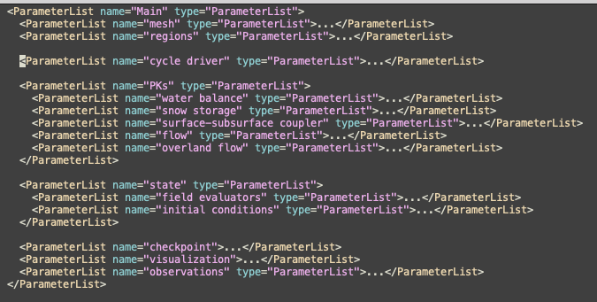
Input File

Slide 36
Variable Naming
Template for variable names:
<DOMAIN>-<VARIABLE>.<COMPONENT>.<DoF>@<TAG>
Examples:
pressure.cell
surface-ponded_depth.face
surface-area_fraction.cell.1
surface-total_component_concentration.cell.NO3-
surface-mole_fraction@transport_subcycled_next

Slide 37
Units
By default, all units are SI and, when they appear in documentation or the input spec, appear in brackets: [m], [s], [mol], [kg], [K], [Pa], [J], [W]
Derived units are spelled out without division, e.g. [mol s^-3] NOT [mol / m^3]
Exceptions: Energy [MJ]
Amanzi–ATS includes processes for density-driven flows (ice vs water, salinity):
pressure (not head)
water content in mols of H2O (not m^3)
permeability (not hydraulic conductivity)
Concentration in mol ratio [mol_{C} mol_{H20}⁻¹], similar to molality

