Slide 1
Model Setup & Watershed Workflow
Saubhayga Rathore, Pin Shuai, and Ethan Coon

Slide 2
Introduction
Overview of WW, its significance in watershed modeling and analysis, and understanding its interface and basic functionalities.

Slide 3
Watershed Workflow
Coon & Shuai, (2022)
@ Env. Model. Software
https://environmental-modeling-workflows.github.io/watershed-workflow/
The data to parameterize <100m resolution models are increasingly available, but not necessarily easy to get or work with.
Can we automate a “first simulation” in any watershed in the US?
Coweeta Hydrologic Laboratory
https://www.srs.fs.usda.gov/coweeta/

Slide 4
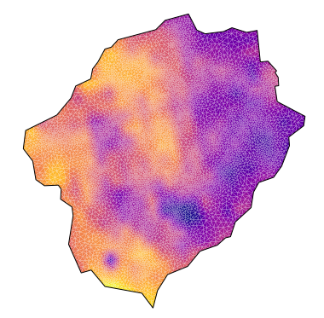
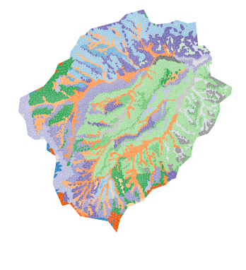
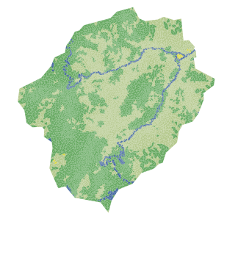
Default Workflow
Downloads NHDPlus, 3DEP, NRCS, SoilGrids, GLHYMPS, MODIS, NLCD, and AORC data on a given HUC or watershed shape
Algorithms for pit-filling, DEM smoothing, unstructured mesh generation
Generates an ExodusII mesh including all needed regions
Integrates with ATS to write input files for integrated hydrology
Completely* automated – provide a shapefile and a few parameters and let it run
Very customizable – edit the data as needed and change it to fit your model experiment

Slide 5
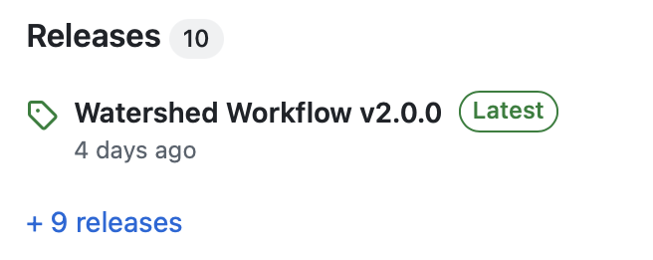
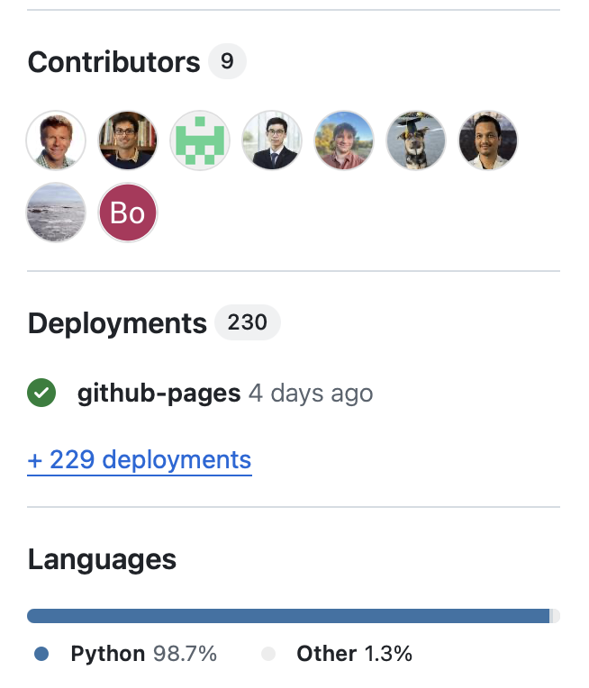
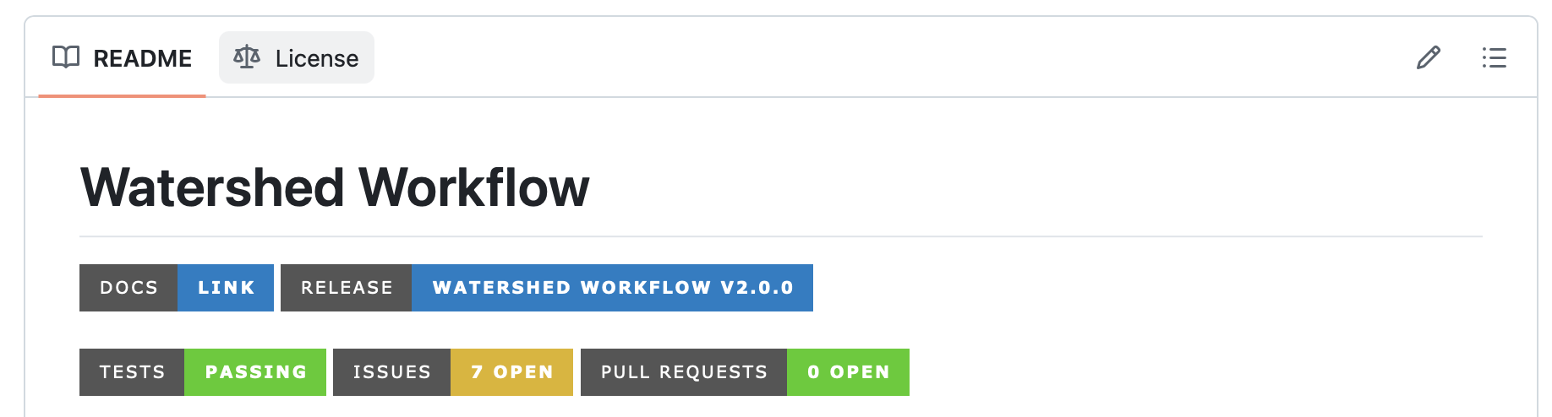
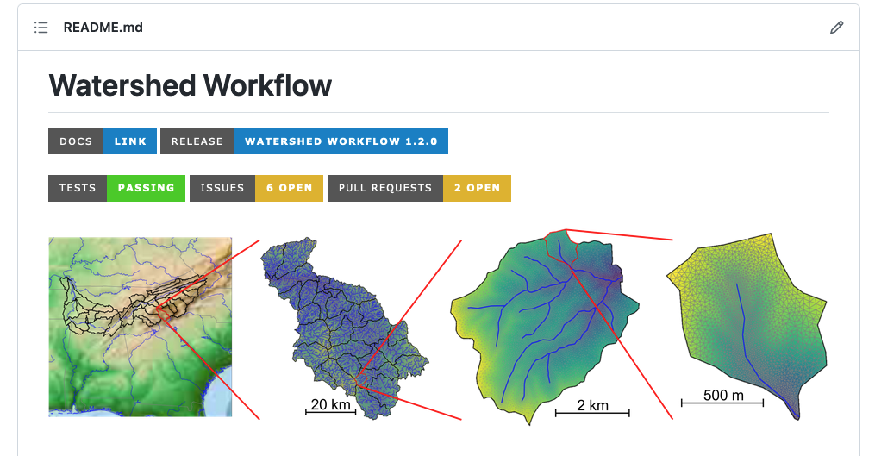
Watershed Workflow
https://github.com/environmental-modeling-workflows/watershed-workflow
A python package and a collection of Jupyter notebooks
Deployed via docker or conda environment*
Continuous Integration tests libraries and notebooks
Papermill enables scripting for many watersheds
A growing community of users and developers
SETx-UIFL,
PacWest Testbed,
IDEAS,
InteRFACE,
COMPASS-GLM,
COMPASS-FME,
ICOM,
ORNL SFA,
PNNL SFA,
LBNL SFA,
LDRD,
…

Slide 6
v2.0 Release…
Upgrades to shapely 2.0, geopandas, and xarray
Better support for ATS integration – https://github.com/ecoon/ats_input_spec
Nascent integration with ESS-DIVE and Basin-3D, more general support for integration with point data and observations
Ongoing work in representing internal gages

Slide 7
Contributions welcome
Watershed Workflow development team currently includes 9 contributors
We use an open development model leveraging github for issues, pull requests, code reviews, etc.
We welcome contributions for novel data, expanded capability, and even just galleries/examples with pretty pictures!

