Slide 1
Debugging & Getting Help
Ethan Coon
Oak Ridge National Laboratory

Slide 2
Debugging
There are a lot of ways that things can go wrong.
incorrect input spec (should error)
bad input data (could run but give the "wrong" answer)
bad parameters (could run but very slowly)
bad physics (could do anything)
incorrect code (could do anything)

Slide 3
start
Depends upon what you mean by “fix”…
0. Practice Reproducible science
Did I practice reproducible science?
No
Science!
It’s just slow overall
Yes
Perfect!
Too slow!
Did the code error?
No
1. Plot mass balance, visualize
Do I understand what is going wrong?
2. Plot Timestep History
Is the timestep crashing or just slow overall?
That’s not right!
No
Yes
It’s crashing
Yes
4. Help myself
Can I fix it?
3. Rerun with debug cells
No
Yes
5. Ask for Help

Slide 4
Debugging
0. Practice reproducible simulation science.
Understand the processes and what is happening
Plot a timestep history
Rerun with “debug cells” and “verbosity level”=“high”
How to help yourself
How to ask for help

Slide 5
Practice reproducible simulation science
Version control your input files, data, mesh, and scripts/notebooks.
Document them with a README. Document code versions and scripts to visualize the results.
Checkpoint runs regularly (Annually? Monthly?)
If you ask for help, we will ask you to send a link to your repo (and so will journals).

Slide 6
Practice reproducible simulation science
README.md
data_raw/
data_processed/
scripts/
01_spinup/
02_transient/
figures/

Slide 7
Practice reproducible simulation science
README
data_raw/
README.md
DayMet_raw.nc
DEM.tif
data_processed/
mesh.exo
DayMet_ATS.h5
scripts/
create_mesh.ipynb
process_DayMet.ipynb
01_spinup/
02_transient/
figures/
Raw data, as downloaded from the original source, with sources in the README. Note these can be omitted from the final submission for size constraints if DOIs are in order.
Data reformatted, smoothed, gap-filled, or otherwise processed for ATS.
All scripts needed to go from raw to processed. Follow good Jupyter notebook practices.
(Rule et al 2019; 10.1371/journal.pcbi.1007007 )

Slide 8
Practice reproducible simulation science
data_raw/
data_processed/
scripts/
01_spinup/
spinup.xml
spinup/{run-directory}
02_transient/
transient.xml
transient/{run-directory}
figures/
Runs grouped by concept. May include multiple runs per directory (e.g. ensembles, scenarios, test cases), each run in their own subdirectory. Save input file, observations from all runs; downsample checkpoints & visualization as needed to re-generate figures.
Note, scripts provided in $ATS_SRC_DIR/tools/utils to downsample visualization files.

Slide 9
Practice reproducible simulation science
data_raw/
data_processed/
scripts/
01_spinup/
02_transient/
figures/
figure1.py
figure1.pdf
...

Slide 10
Jupyter Notebook
See the Jupyter notebook at:
ats-short-course/05_debugging/debugging.ipynb

Slide 11
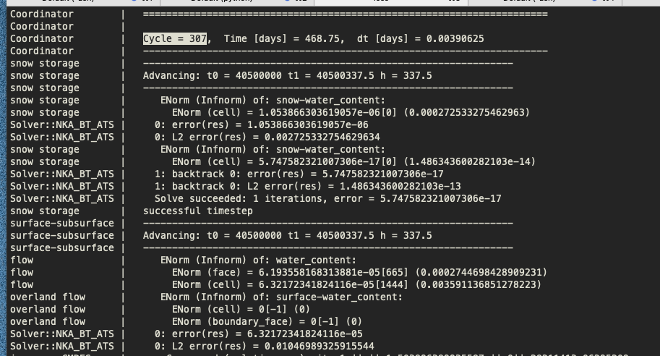
--verbosity=medium
“snow storage” solve succeeded
Starting the integrated “surface-subsurface” water solve
ErrorNorm is a custom norm based on the conserved quantity. It includes both absolute and relative terms and is always relative to the cell volume.
Inf-norm (max) of ErrorNorm on cells
Cell on which max error is attained
Value of absolute error [mol]

Slide 12
--verbosity=medium
Nonlinear iteration number
Max error across all PKs being solved.
Timestep is “converged” when this is less than the nonlinear tolerance.

Slide 13
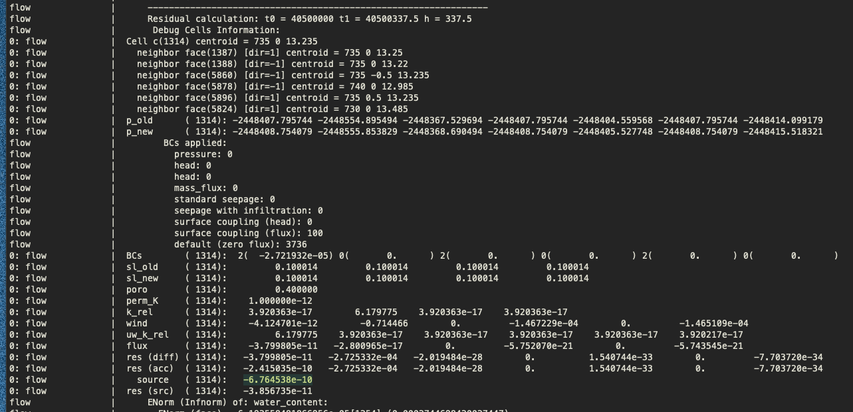
Capillary pressure very negative, no water
Saturation at residual
Source [mol / s] is negative and nonzero (small isn’t good enough).

Slide 14
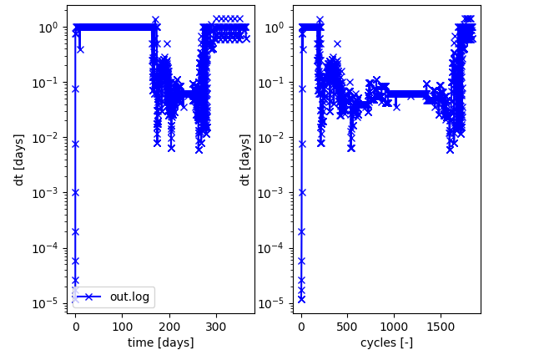
Poor timestep size
Small timesteps when:
Processes are fast (surface flow)
Forcing is fast (hourly data)
Physics is hard (cryosuction)
Model inconsistency (user error)
$> python $ATS_SRC_DIR/tools/utils/plot_timestep_history.py out.log

Slide 15

Poor timestep size
Small timesteps when:
Processes are fast (surface flow) Do you really need a small Manning coefficient (<1)?
Forcing is fast (hourly data) Do you really need to resolve the diurnal cycle?
Physics is hard (cryosuction) Do you really need that process?
Model inconsistency (user error)
Model performance problem
Can we smooth a transition between physics?
Timesteps of ~0.1 to 0.01 days are typical. Less than this is atypical.

Slide 16
How to help yourself
Input spec problems: Read the manual
https://amanzi.github.io/ats/
Our goal: any “invalid” input spec should result in an error message that hints at both what to fix and where to fix it. (We aren’t entirely there yet – send in examples of useless error messages!)

Slide 17
How to help yourself
Start from a demo or test problem.
https://github.com/amanzi/ats-demos/
https://github.com/amanzi/ats-regression-tests/
If you find a broken demo problem, we will fix it.
If you can express your issue by changing a demo problem in a small way, we will help you sooner.
If you compare your change to a known answer, you may find your own mistake!

Slide 18
How to get Help
See the Frequently Asked Questions: https://github.com/amanzi/ats/wiki/FAQs
Ask the user's mailing list: ats-users@googlegroups.com
Submit a GitHub Issue: https://github.com/amanzi/ats/issues

Slide 19
How to get Better Help…
Don’t be afraid to ask for help at conceptualization time.
Start from a demo and change one thing at a time. If something breaks, back up and try again from the demo problem changing just the last thing.
Think critically about your problem and describe not just what is your problem but why is your problem? What are you doing different from a demo problem?
How to ask:
https://stackoverflow.com/help/how-to-ask
What version of the code are you using? ats --print_version
Reproduce it on master or latest release.
Include all required input – mesh, forcing files, input data – and set it up to run out of the box (e.g. all paths are correct)

Slide 20
Debugging
Healthy skepticism will serve you well
Mass balances and other simple heuristics are extremely valuable
Predict the answer – what is your hypothesis?
Visualize the answer – does it make sense?
If things break, dig into the details. What is happening when and where the problem is occurring?

Slide 21
Closing & Wrap-Up
Ethan Coon
Oak Ridge National Laboratory

Slide 22
