Slide 1
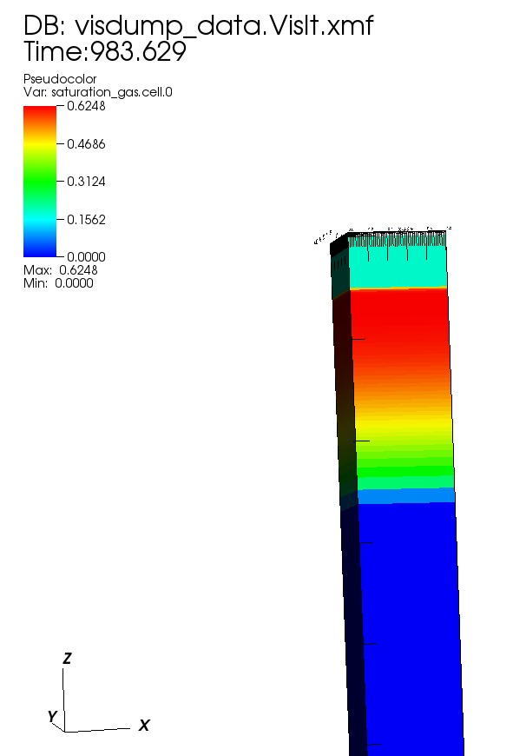
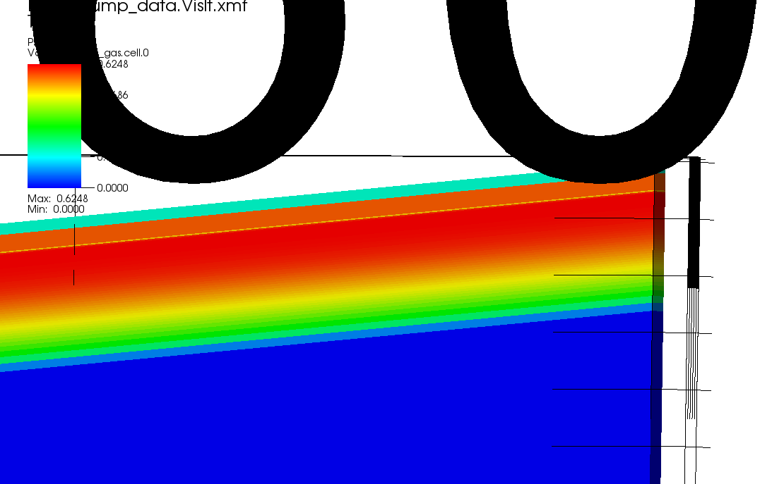
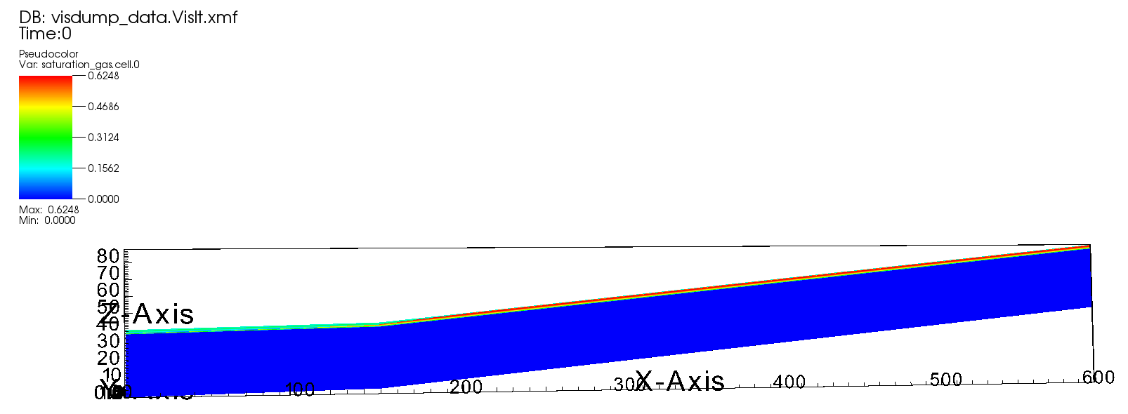
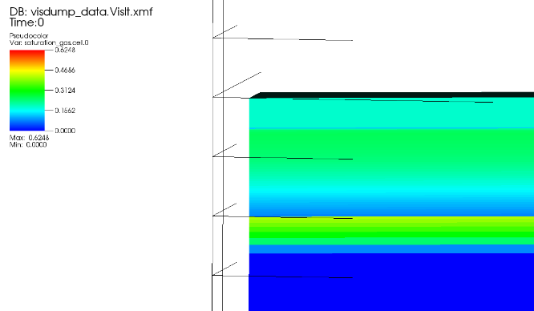
GAS SATURATION RESULTS: TEST 2 AND TEST 7
Final result: Test 2
Initial Condition: Test 7
Note that the column was not hung the same way across the entire hillslope domain; there is a transition from steeper to shallower that causes an artificial moisture layer that does not likely exist.

