Slide 1
Sensors / Transducers/ op-amps and their use in Embedded System

Slide 2
What is a Sensor?
Sensor as an input device which provides an output (signal) with respect to a specific physical quantity (input)
It is a device that converts signals from one energy domain to electrical domain

Slide 3
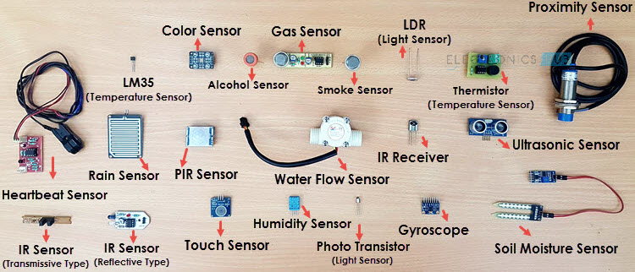

Slide 4
Classification

Slide 5
Active and Passive
Active Sensors are those which require an external excitation signal or a power signal
Passive Sensors, on the other hand, do not require any external power signal and directly generates output response.

Slide 6
Based on the means of detection used in the sensor
Detection are Electric, Biological, Chemical, Radioactive etc.

Slide 7
Based on conversion phenomenon i.e., the input and the output.
Some of the common conversion phenomena are Photoelectric, Thermoelectric, Electrochemical, Electromagnetic, Thermooptic, etc.

Slide 8
final classification of the sensors are Analog and Digital Sensors
Analog Sensors produce an analog output i.e., a continuous output signal (usually voltage but sometimes other quantities like Resistance etc.) with respect to the quantity being measured.
Digital Sensors, in contrast to Analog Sensors, work with discrete or digital data. The data in digital sensors, which is used for conversion and transmission, is digital in nature.

Slide 9
Different Types of Sensors
All these sensors are used for measuring one of the physical properties like Temperature, Resistance, Capacitance, Conduction, Heat Transfer etc.
Notes:
https://www.electronicshub.org/different-types-sensors/

Slide 10
Humidity Sensor
Position Sensor
Magnetic Sensor (Hall Effect Sensor)
Microphone (Sound Sensor)
Tilt Sensor
Flow and Level Sensor
PIR Sensor
Touch Sensor
Strain and Weight Sensor
Temperature Sensor
Proximity Sensor
Accelerometer
IR Sensor (Infrared Sensor)
Pressure Sensor
Light Sensor
Ultrasonic Sensor
Smoke, Gas and Alcohol Sensor
Touch Sensor
Color Sensor

Slide 11
What is Actuator?
An actuator is a device that moves or controls some mechanism. An actuator turns a control signal into mechanical action such as an electric motor. Actuators may be based on hydraulic, pneumatic, electric, thermal or mechanical means, but are increasingly being driven by software. An actuator ties a control system to its environment.

Slide 12
Examples of actuators include:
Electric motors
Solenoids
Hard drive stepper motors
Comb drives
Electric motor.
Hydraulic cylinder.
Piezoelectric actuator.
Pneumatic actuator.
Screw jack.

Slide 13
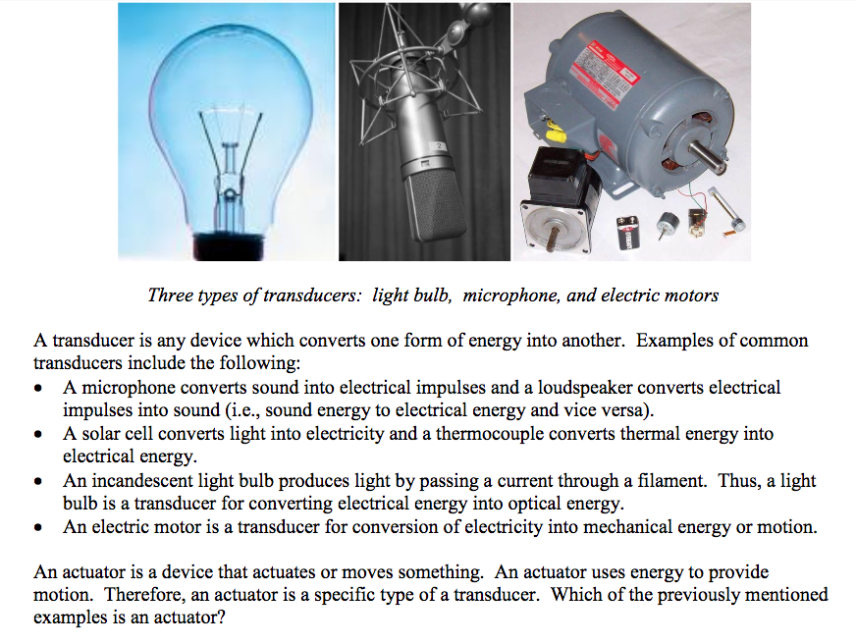

Slide 14
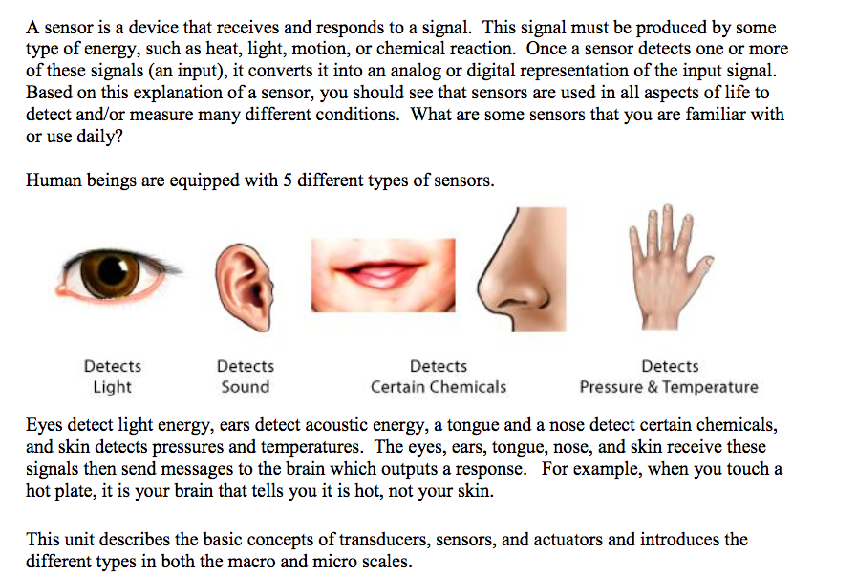

Slide 15
Both a sensor and a transducer are used to sense a change within the environment they are surrounded by or an object they are attached to. However, a sensor will give an output in the same format and a transducer will convert the measurement into an electrical signal

Slide 16
Automotive Embedded Systems
Today cars use embedded systems replacing old traditional systems.
Electronic Control Units are used in automotive embedded systems Examples.
This unit contains microcontroller, switches, sensors, drivers, etc.
All the sensors and actuators are connected to electronic control unit.
Automobiles using embedded systems may consists of hundreds of microprocessors.
Each microcontroller performs its own dedicated task. Some of them control engine. Some run dashboard devices.
The whole system is actually comprised of several small systems.
Using embedded systems in automotive has reduced the cost factor.
It has improved the overall performance and increased functionality.
It has also reduced weight and made automobile more safe and reliable.
Applications of automotive embedded systems include:
Automatic Stability Control
Traction Control System
Pre-crash Safety System
Air bag
Car Navigation System
So you can see that using embedded systems in automobiles is very useful and has increased the functionality of automotive.

Slide 17
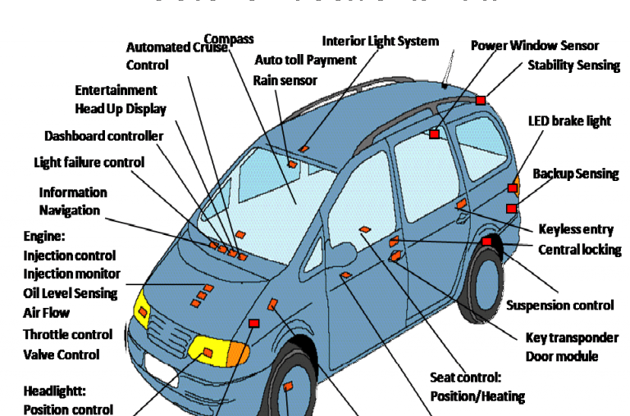

Slide 18
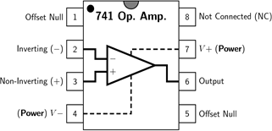
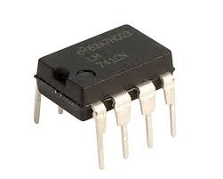
Using Op Amps in Embedded Design

Slide 19
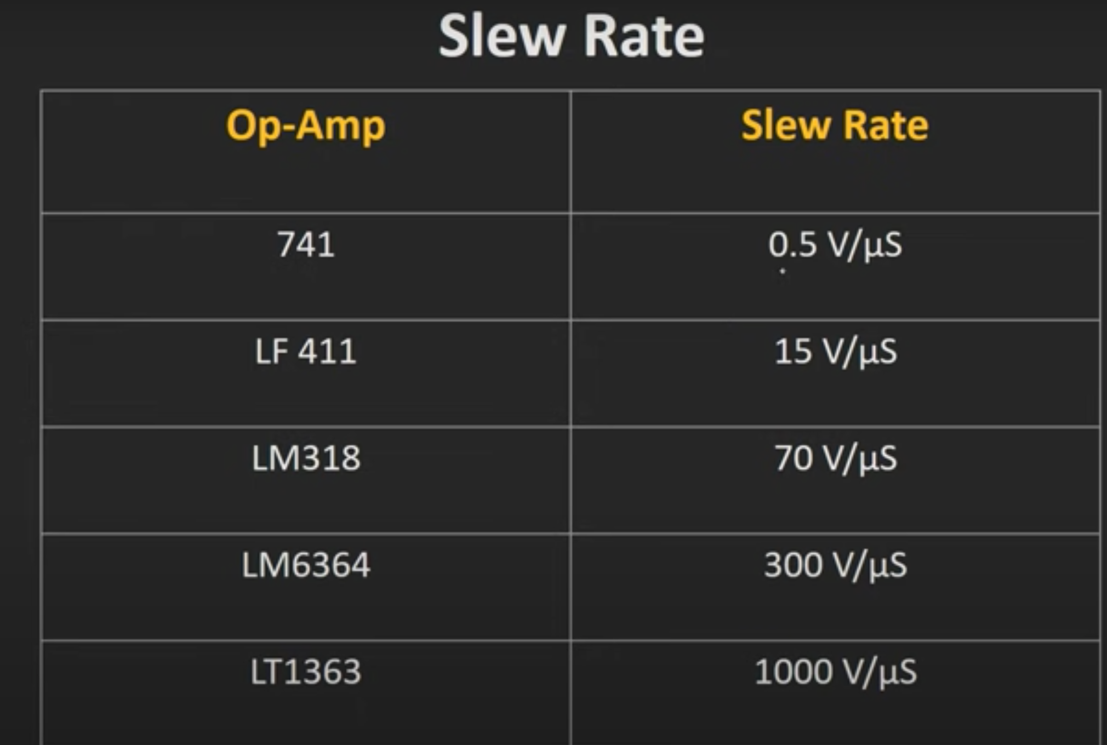
Notes:
https://www.youtube.com/watch?v=2DFIr6t1hbc
https://www.gadgetronicx.com/operational-amplifier-basics-working-applications/
https://www.youtube.com/watch?v=kiiA6WTCQn0&list=PLwjK_iyK4LLDBB1E9MFbxGCEnmMMOAXOH&index=1

