Slide 1
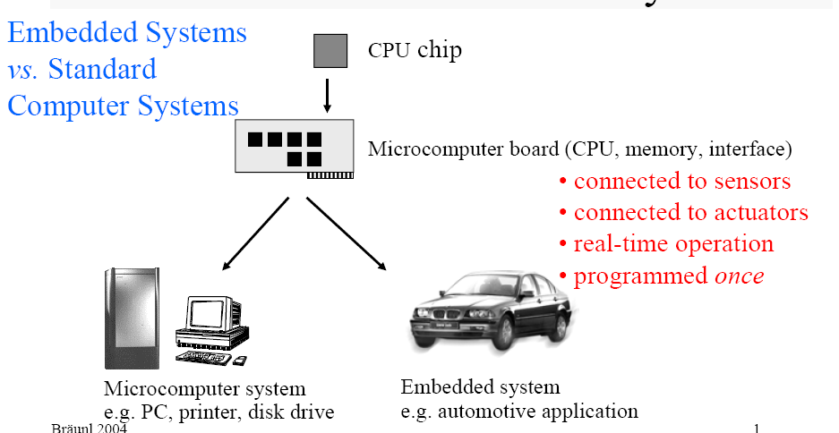
Notes:
We are embedding a computer for general purpose application

Slide 2
Embedding a computer for general purpose application
Personal Digital Assistant (PDA)
Printer
Cell Phone
Automobile: Engine, Brakes, Dash, etc.
Television
Household appliances

Slide 3
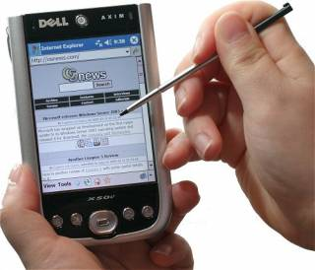
Surveillance System vs DVD player
No of microcontroller being used depends on the complexity of applications.
Ex:
Microprocessor: 32 bit Motorola

Slide 4
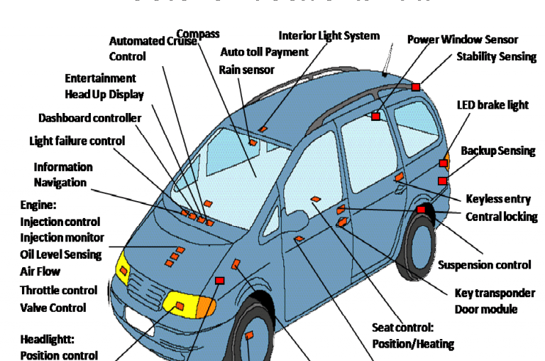

Slide 5
Automotive Embedded Systems
Today’s high-end automobile may have more than 100 microcontrollers:
- 4-bit microcontroller checks seat belt;
- microcontroller run dashboard devices;
-16/32-bit microcontroller controls engine

Slide 6
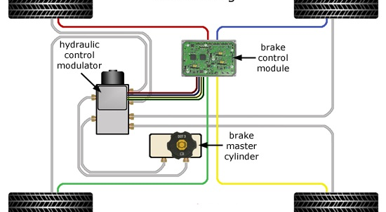
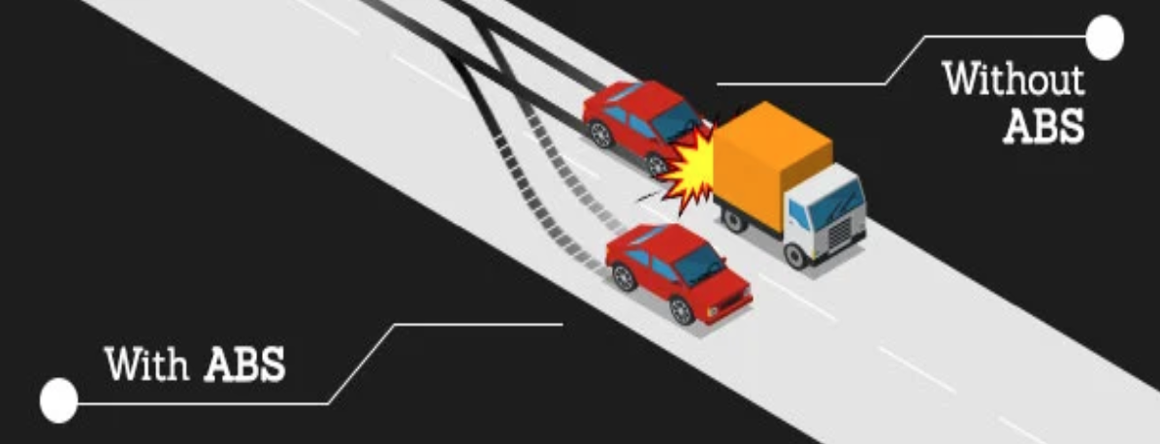
ABS

Slide 7
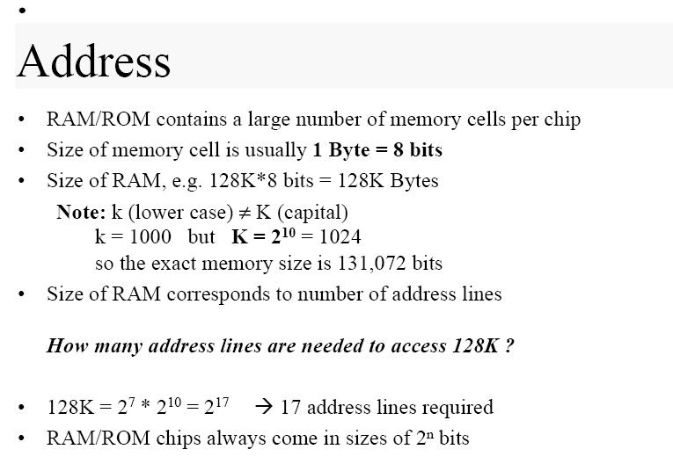

Slide 8
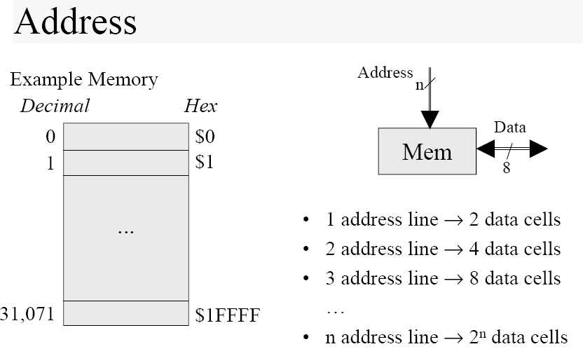

Slide 9
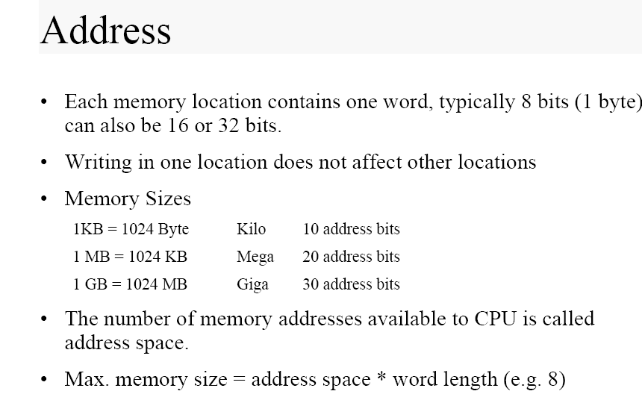

Slide 10
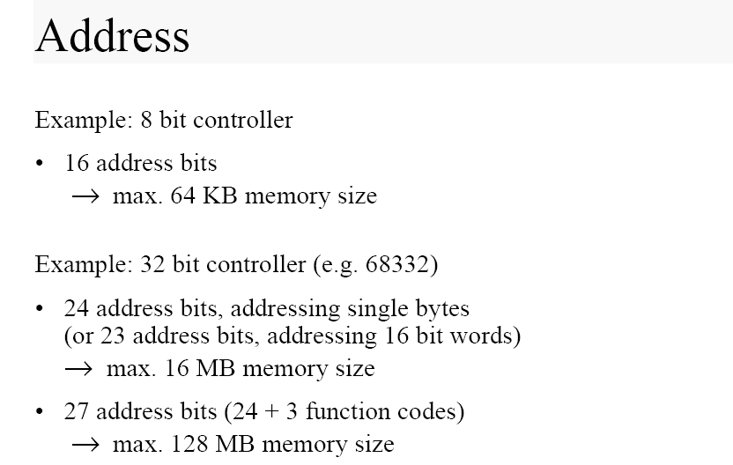

Slide 11
Characteristics of Embedded Systems
Sophisticated functionality
Real-time operation (always?)
Low manufacturing cost
Application dependent processor
Restricted Memory
Low Power
-Power consumption is critical in battery- powered devices
- Excessive poser consumption increases system cost even in wall powered devices.

Slide 12
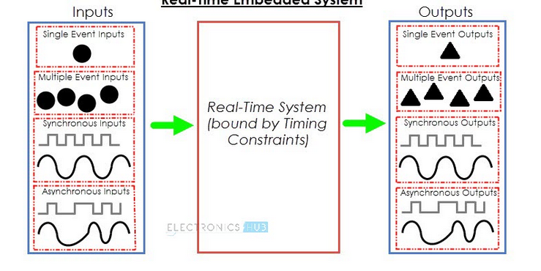
What is a Real Time Embedded System?
Type of computer system with timing constraints i.e. a system which responds to external events or input stimuli in a timely fashion (within finite and specified time).
Notes:
Here, Timing Constrains include Response Time, Start Time and Finish Time i.e. time taken to respond to the event, time at which the response to the even starts and time at which the response is given. Let us take a real world example of a Real Time System.

Slide 13
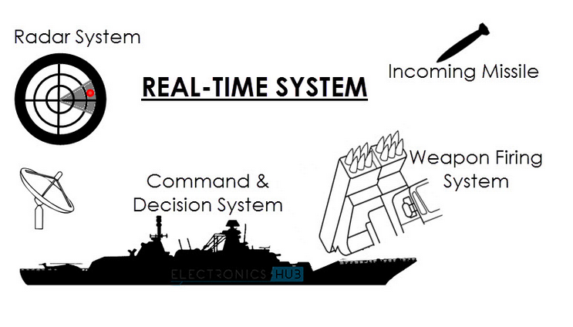
This Weapons Defense System consists of three sub-systems: a Radar System, a Control System and a Weapons Firing System.
Notes:
Consider a Weapons Defense System, whose job is to shoot down incoming missiles and protect the Naval Destroyer. This Weapons Defense System consists of three sub-systems: a Radar System, a Control System and a Weapons Firing System.

Slide 14
Characteristics of a Real Time Embedded System
There are two important characteristics of any real time embedded system. They are:
The Real Time Embedded System must generate correct computational responses to the events (functional constraints).
The responses or results must be produced within a predefined time (timing constraints).

Slide 15
Based on the degree of tolerance in the timing constraints, Real Time Systems are classified in to two types. They are:
Hard Real Time Systems
Soft Real Time Systems
In Hard Real Time Systems, there is no flexibility in timing constraints i.e. they must meet all the deadlines, failing to do will result in a catastrophic consequences.
Examples: Flight Control Systems, Missile Guidance Systems, Weapons Defense System, etc.
Notes:
A Hard Real Time System must produce accurate responses to the events within specified time period. If either of them are not achieved i.e. if the response isn’t accurate or if the response isn’t delivered in right time, the result will be extremely catastrophic, like loss of life.

Slide 16
Soft Real Time Systems have some relaxation in meeting the deadlines i.e. the degree of tolerance is non-zero. A Soft Real Time System must produce response to an event within the deadline but with some flexibility in meeting the deadlines.
Even if the response isn’t delivered in the deadline (but delivered in acceptable limit), the result won’t be catastrophic or failure in the system but will cost a delay in propagation.
Examples: Set top boxes, DVD Players, Weather Monitoring Systems etc.

Slide 17
More Features
Dedicated Systems
-Predefined functionality: Accordingly Hardware and software designed
- Programmability rarely used during lifetime of the system
-Real-time, fault-tolerant, safe

Slide 18
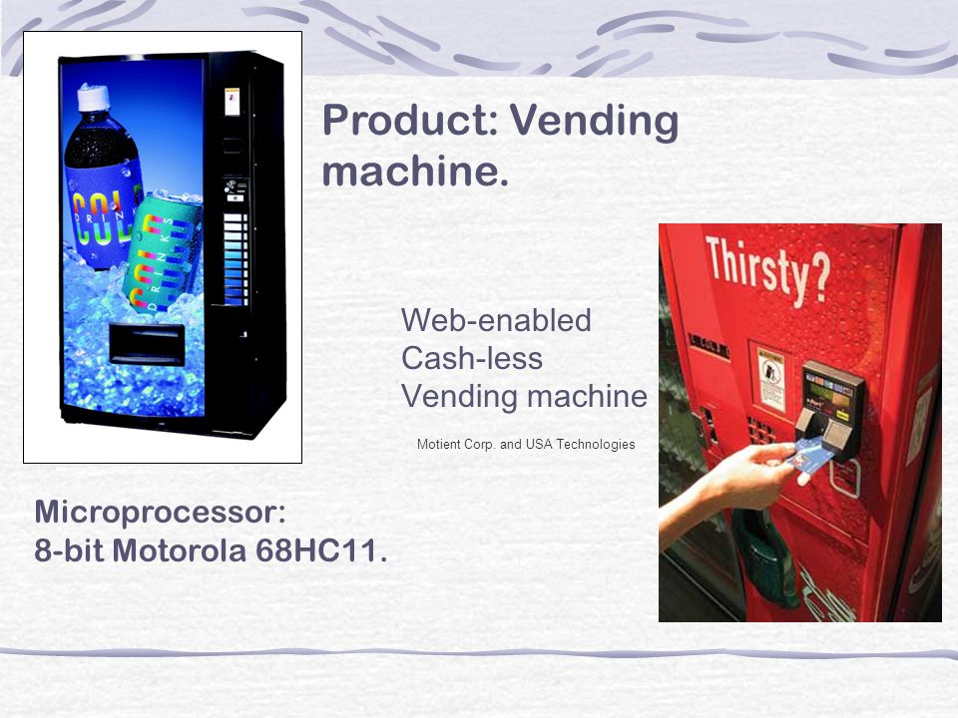
Notes:
2003 product

Slide 19
Types of Embedded System
General Computing
-PDA, Video Games, Set-top boxes, ATM
Control Systems
-Feed-back control of real time systems
-Vehicle engines, flight control, nuclear reactors
Signal Processing
- Radar, Sonar, DVD players
Communication and Networking
- Cellular Phones, Internet appliances
Notes:
Sensing and actuating

Slide 20
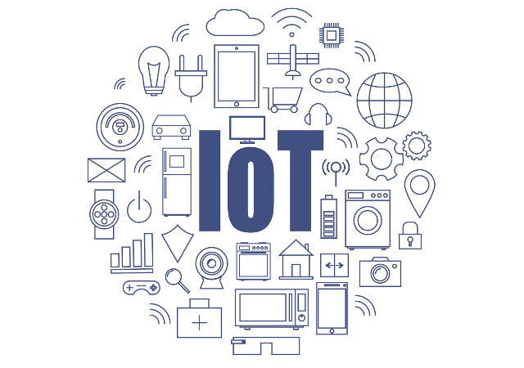

Slide 21
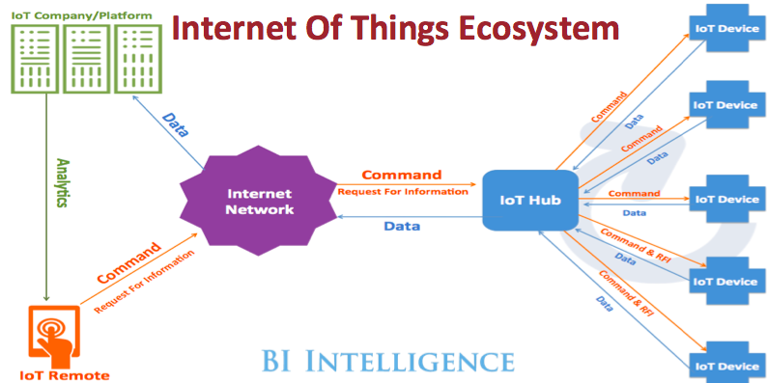

Slide 22
Embedded system is a subset of IoT
A network of Internet connected objects able to
Collect and exchange data.
IoT= Internet (Backbone of connectivity)+ Things (objects/Devices)
IoT=ET+NT+IT

Slide 23
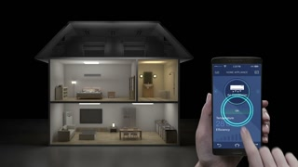
Smart Control of Home appliances

