Slide 1
Embedded System Design Considerations Elements of Co-design

Slide 2
Kinds of Functions, Embedded system intends to implement
Control Laws (has to obey sensing, actuating law)
Sequencing Logic (task specific)
Signal Processing
Application Specific Interfacing (hardware/software)
Fault Response (Graceful degradation, System should tell user that the system is failing)

Slide 3
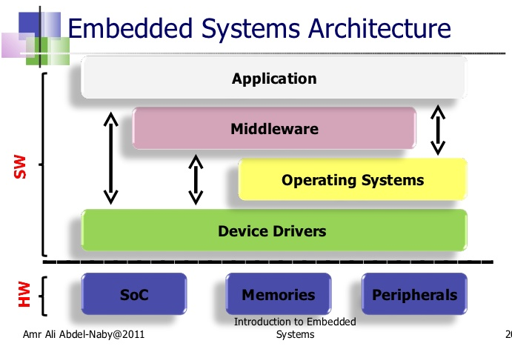
Notes:
System on Chip (SoC)
Middleware is software which lies between an operating system and the applications running on it. Essentially functioning as hidden translation layer, middleware enables communication and data management for distributed applications. ... Common middleware examples include database

Slide 4
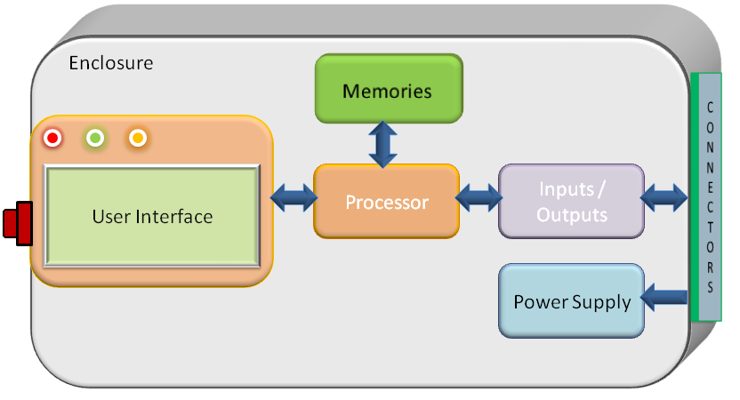
Model Based Embedded System

Slide 5
Design Challenges
Primary Design Goal
An implementation that Realizes the desired functionality
The main Design Challenges
To simultaneously optimize several design metrics
Often mutually conflicting
Design Matrix
Some feature of an implementation that can be
measured and implemented.
Speed
Cost
Quality

Slide 6
Common Design Matrics
Non-Recurring Engineering cost
Unit cost
Size
Performance
Power
Flexibility
Maintainability
Time to prototype
Time to Market
Safety
…...........

Slide 7
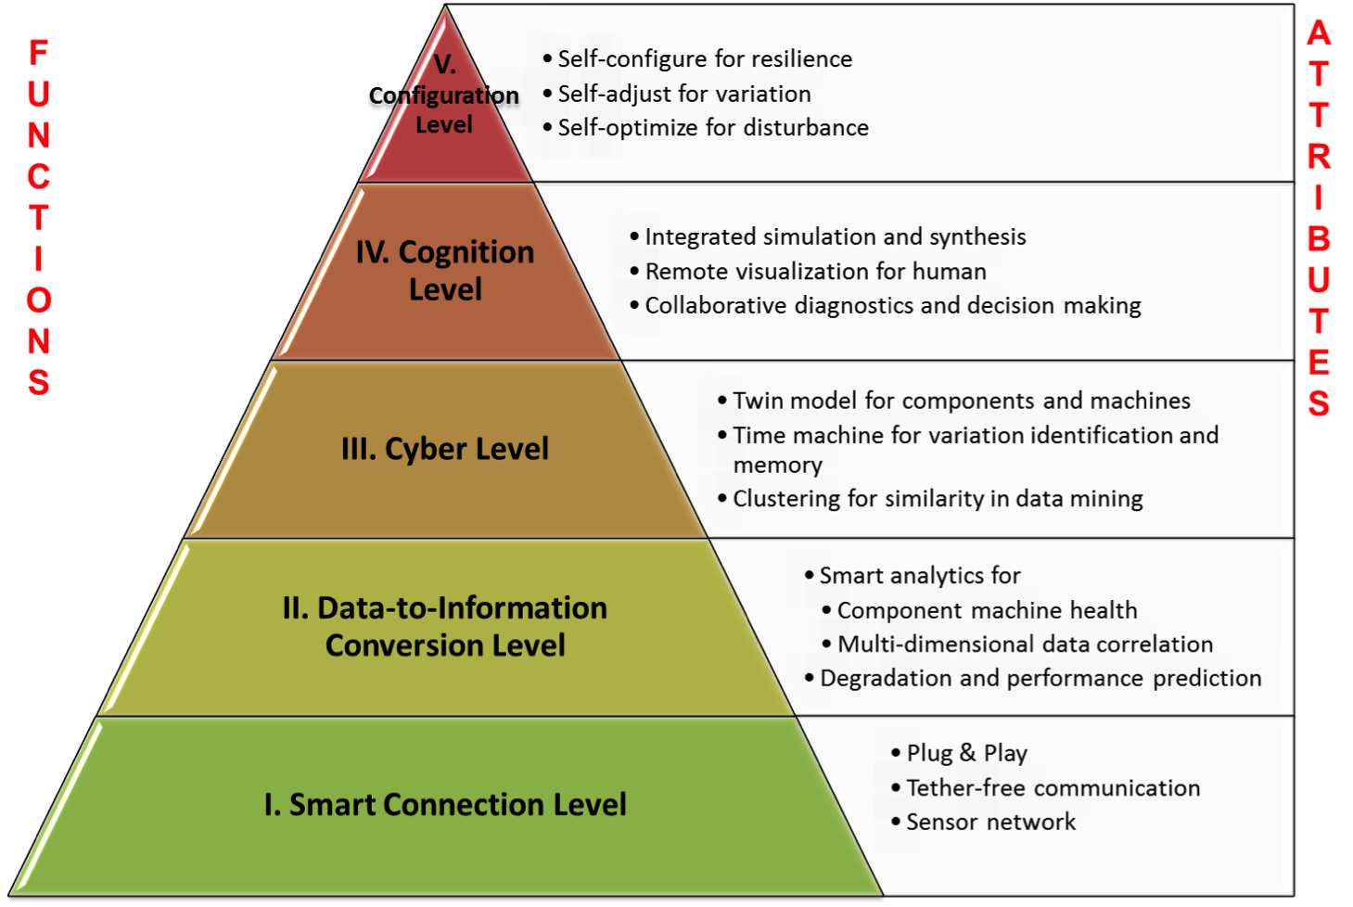
Structural rationale of Functional Blocks.

Slide 8
Functional attributes in model-based embedded system design
Security : The condition of being protected against any sort of loss, threat, damage or incomplete retrieval, defines security.
Availability and Reliability : The system’s ability to deliver services that can be trusted every time they are used, maximizing the probability of correct service for a given duration of time.
Data Quality : Quality of data refers to the non-functional properties of services at different levels.
Real-time Performance : Performance has to go through a 3-D analysis based on responsiveness measured in terms of throughput and response time.
Resource consumption : Utilization of resources can be grouped into memory, processing units, energy, communication and peripherals attached.

Slide 9
Implementing Embedded System
Hardware
Processing Element
Peripherals
- Input & Output Devices
-Interfacing Sensors & Actuators
- Interfacing Protocols
Memory
Bus
Software
System Software (Language Translator/ Operating system/Emulators & Simulators)
Application

Slide 10
Hardware Evolution
General Purpose Microprocessors & Micro-controllers
DSP
Systems-on-Chip
Application specific Processors
Faster clock rate & Higher degree of Integra-tion
Notes:
Texas Instrument OMAP processor has got an ARM (RISC processor), TI DSP chip integrated with various peripherals

Slide 11
Software
Programs must be logically and temporally correct.
Must deal with inherent physical concurrency
-Reactive systems
Reliability and fault-tolerance
Application Specific and Single Purpose

Slide 12
Multi-Tasking and Concurrency
Embedded systems need to deal with several inputs and outputs and multiple events occurring independently.
Separating tasks simplifies programming, but requires somehow switching back and forth among different tasks (multi-tasking).
Concurrency is the appearance of simultaneous execution of multiple tasks.

Slide 13
Challenges in Embedded System Design
How much hardware do we need?
What is word size of the CPU? Size of Memory?
How do we meet our deadlines?
Faster hardware or clever software?
How do we minimize power?
Turn off unnecessary logic? Reduce memory accesses?

Slide 14
Embedded System Design
Multi-Objective
Dependability
Affordability
Safety
Security
Scalability
Timeliness
Multi-Discipline
Electronics Hardware
Software
Mechanical Hardware
Control Algorithms
Humans
Society/Institutions
Life Cycle
Requirements
Design
Manufacturing
Deployment
Logistics
Retirement

Slide 15
Design Goals
Performance
Overall speed, deadlines
Functionality and user Interface
Manufacturing cost
Power consumption
Other Requirements (Physical size, etc.)

Slide 16
Functional vs. non-functional requirements
Functional requirements:
-Output as a function of input
Non-functional requirements:
- time required to compute outputs
- size, weight, etc.
-power consumption
-reliability
etc.

Slide 17
Design and Development Process
Requirements
Specifications
Architecture
Component Design
System Integration
Testing/Validation

Slide 18
Design Aspects
Top-down Design
Start from most abstract description
Work to most detailed
Bottom-up Design
Work from small components to big system
Real design uses both techniques

Slide 19
Stepwise Refinement
At each level of abstraction (both HW/SW), we must:
Analyze the design to determine characteristics of the current state of the design;
Refine the design to add details

Slide 20
Conclusions
Embedded systems are all around us
Embedded systems pose many design related challenges like design time, deadlines, power etc.
Design methodologies help us manage the design process.

