Slide 1


Graduate Destinations Statistics

Slide 2
What is Graduate Destination Statistics?
An interactive database that enables users to interrogate and extract the latest 3 years of complete destination datasets

Slide 3
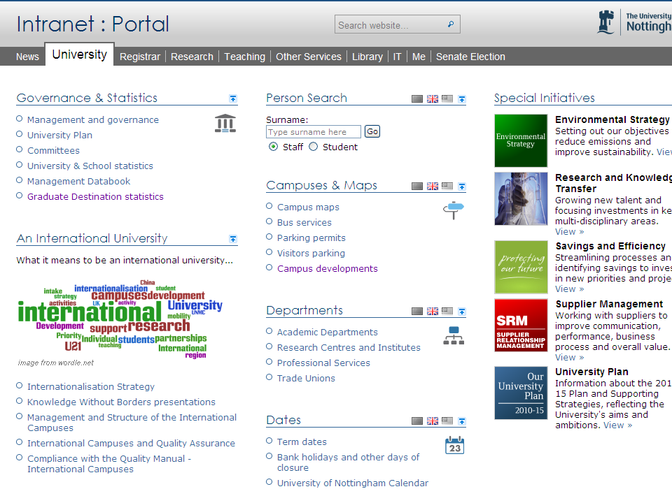

Slide 4
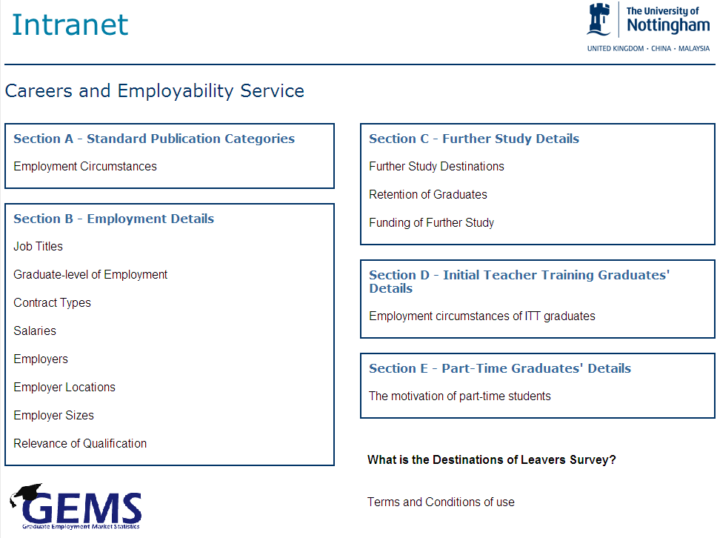

Slide 5
Employment Circumstances
Displays survey population, respondent Positive Outcomes (PO), Graduate Prospects (GP) and publication categories.

Slide 6
Job Titles
Displays Job classifications and employers using Standard Occupational Classification (SOC) codes.
** Advanced Search Options **
On the search results page you can drill-down further into the SOC information to reveal three levels of classification.

Slide 7
Graduate-level of Employment
Displays Elias and Purcell classification for graduate level employment
** Advanced Search Options **
On the search results page the SOC (HE) Classification requirements table is shown below the results.

Slide 8
Contract Types
Displays employment contract types, not a compulsory field only represents those that responded to the question.
** Advanced Search Options **

Slide 9
Salaries
Displays the mean and median salaries for graduates in full-time employment - not a compulsory field only represents those that responded to the question.
** Advanced Search Options **

Slide 10
Employers
Categorised using the Standard Industrial Classification (SIC), not a compulsory field, therefore it only represents those that answered the question. Recommend using at course level due to large datasets.
** Advanced Search Options **
On the search results page you can drill-down further into the SIC information to reveal further levels of classification.
If employer names are not shown click ‘Show Employers’ after the main results.

Slide 11
Employer Locations
Shows employer locations worldwide and UK by region.
You can drill-down on the information on each UK Region to display the county which atomically updates the map view.
To view locations on a map it is recommended to use a smaller search.

Slide 12
Employer Sizes
Displays employers by size of company, not a compulsory field only represents those that responded to the question.

Slide 13
Relevance of Qualification
Shows the Key Performance Indicator’s relating to the relevance of the qualification to the job for those in employment. Not a compulsory field only represents those that answered the question.

Slide 14
Further Study Destinations
Displays graduates who have undertaken further study only, by study classification.
You can drill-down on the Publication Categories to display the Course and Institution of the further study.

Slide 15
Retention of Graduates
Displays graduates who have undertaken further study only, by study classification .Retention of students at University of Nottingham is shown as a percentage of the total of further study destinations.
You can drill-down on the Publication Categories to display the Course and Institution of the further study.

Slide 16
Retention of Graduates
Shows how those that undertaken further study only have funded the study. Not a compulsory field only represents those that answered the question.

Slide 17
Initial Teacher Training Graduates’ Details
Shows teaching status and type of school for graduates who obtained initial Teacher Training qualification

Slide 18
Part-Time Graduates’ Details
Displays what motivated part-time study students to undertake their initial qualification.

