Slide 1

Air Quality Index

Slide 2

We are going to look at a Data set which contains 13 independent variables [object , int & float type] & 1 Target variable [int type].
2 features have different categories, however we created columns under one hot encoding. For Date object created year, month, date and hour columns.

Slide 3

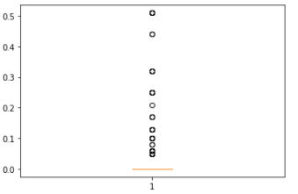
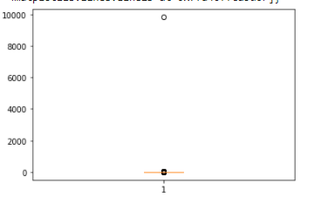
All features are already scaled using standard scaler.
There are outliers in snow_p_h & rain_p_h features, Below box plots shows it.

Slide 4

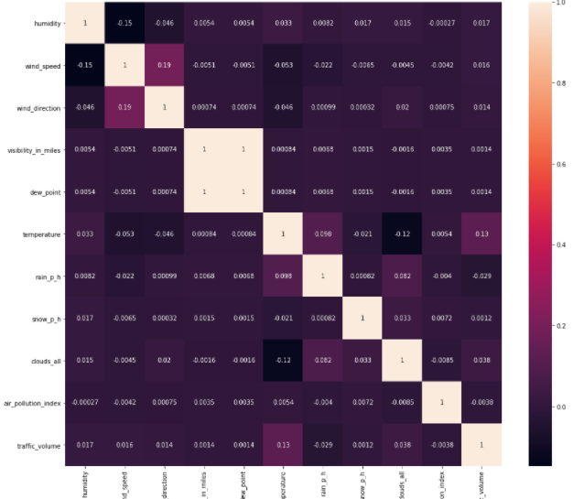
Plotted a correlation matrix
Important Features:
dew_point and visibility_in_miles are same and redundant, so removed 1 feature.

Slide 5
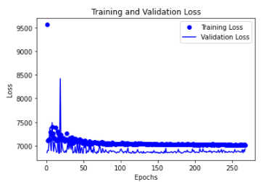
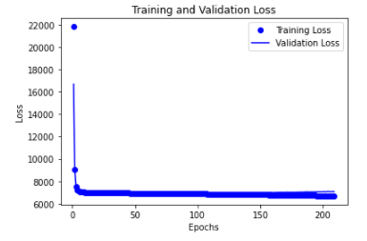
Building Model
Simple neural network with one hot encoded features
Simple neural network with one hot encoded scaled features

Slide 6
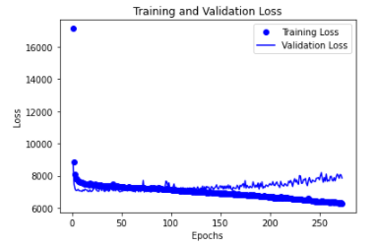
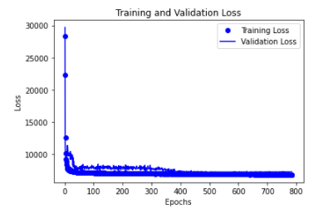
Building Model
Dense neural network with encoded scaled features
Dense neural network with selected encoded scaled features

Slide 7

Model Evaluation
Below are the different validation scores for different regression networks
model1 : 6933.0840 [Best score]
model2 : 7059.7026
model3 : 7855.0635
model4 : 7201.8007

Slide 8


I analysed the characteristics and distribution of data in brief.
I investigated in-depth the features which to retain and which to discard.
I performed model development by using an different networks of a variety of hidden layers, neurons, regularizers.
I observed mixed results as we started experimenting with different networks .
This model will help the community in predicting air pollution quality to a RMSE of 83.

