Slide 1
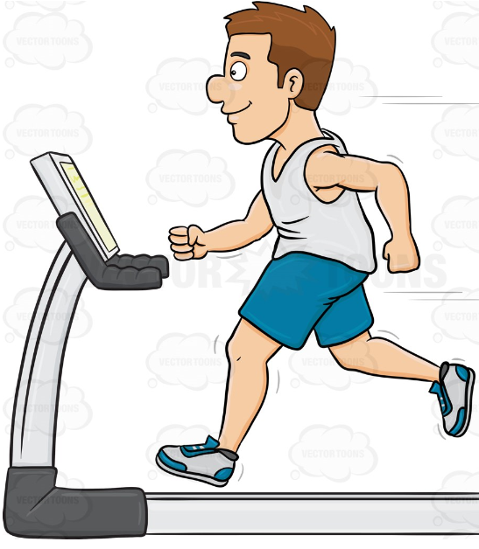
EDA of fitness product sales

Slide 2
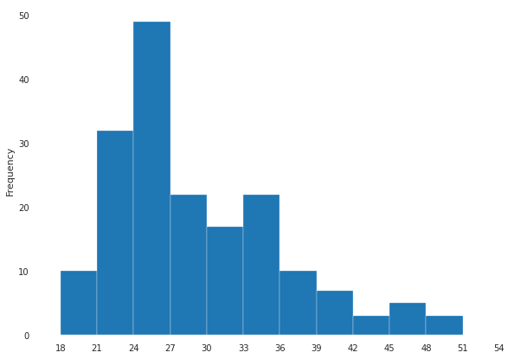
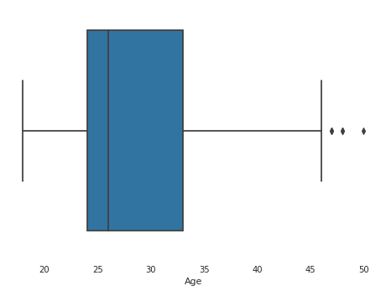
What is the Age distribution?
Age distribution is right skewed. Majority [75%] of customers are between Age of 18 and 34.

Slide 3
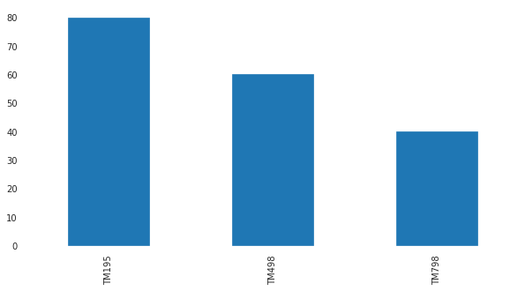
Which products are sold most ?
There are 3 product types – TM195, TM498 & TM798. This chart shows TM195 is sold more while TM798 is sold least.

Slide 4
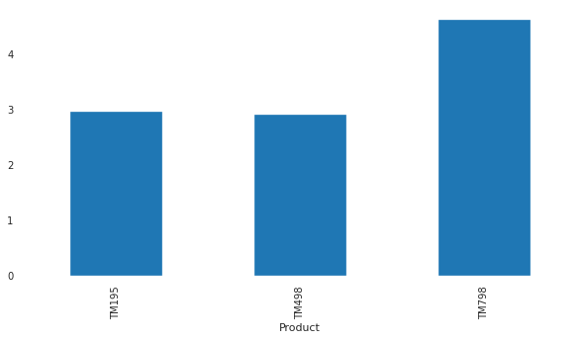
What is the Mean fitness [rating] per product?
Though TM798 were sold less, above bar chart shows that Mean fitness ratings are high for it. This shows that though its users are less this product bagged higher ratings & mean jumped up.

Slide 5
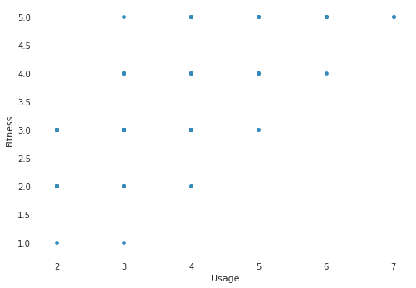
What is the relationship between usage and fitness [rating]?
Higher the usage higher the fitness ratings. Infact, customer using minimum 3 times per week gave higher ratings also. Someone using 5 times a week rated 3 and above only.

Slide 6
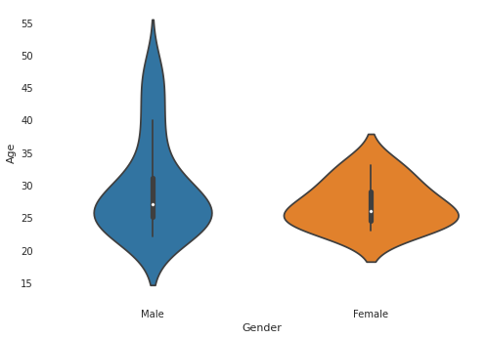
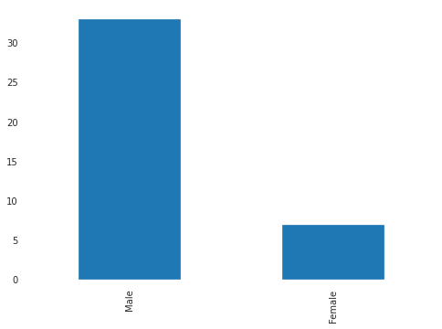
Gender Vs Age on TM798
Observed more Male customers and 75% of customers are under 33.

Slide 7
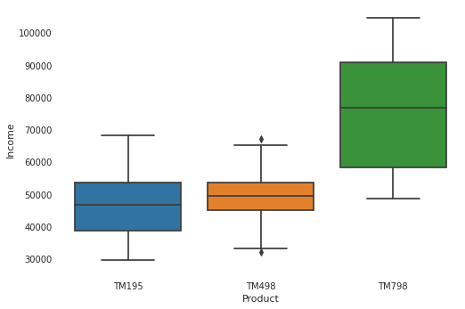
Income distribution of customers per product
As income range of TM798 customer is high & we already saw that this product was sold least so this could be costlier than other 2. 75% of TM195 & TM498 customers are under income 54K so these could be economical.

Slide 8
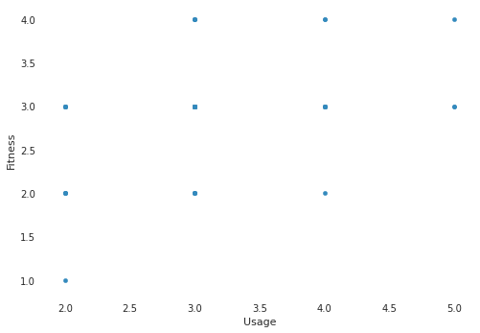
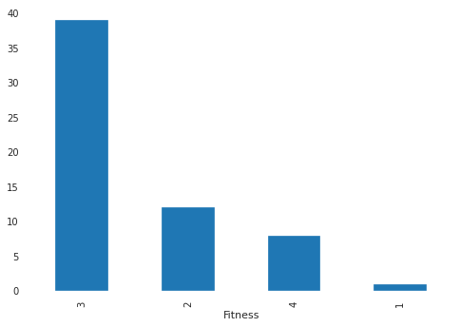
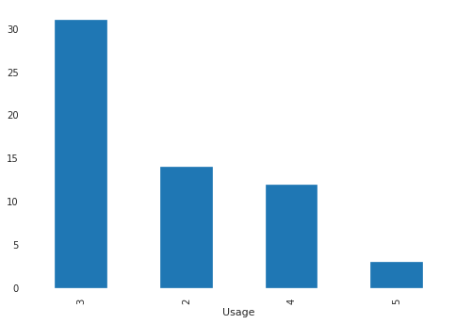
Usage vs Fitness rating on TM498
80% of customers are under Usage <3. 80% of fitness [rating] is <3. There is no 5 rating. This type possibly have opportunity to improve product features. This could be for those customers whose usage is<3 times per week.

Slide 9
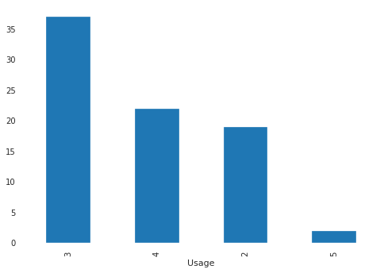
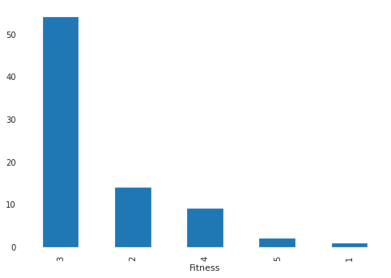
Usage vs Fitness rating on TM195
75% of customers are under Usage >3. 80% of fitness [rating] is <3. . This type possibly have opportunity to improve user experience of the product. This is for the customers whose usage is 3 and above per week.

