Slide 1

Predicting House Price

Slide 2
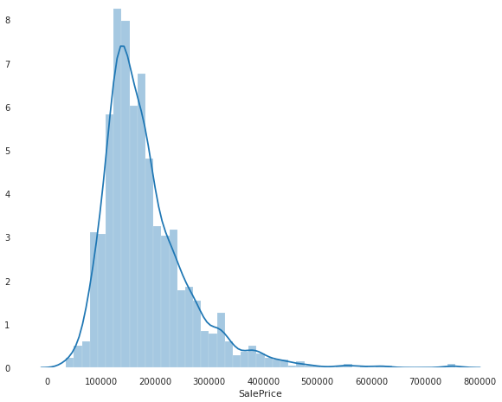
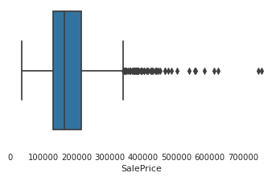
Sale Price distribution
Sale distribution is right skewed. Skewness is high so there would be more information in the tail as well.

Slide 3
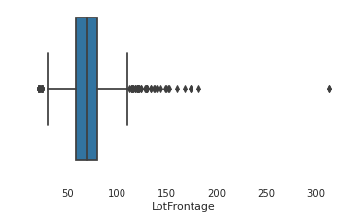
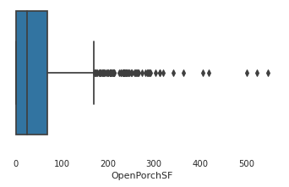
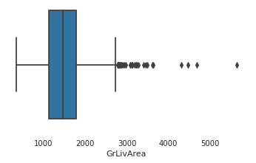
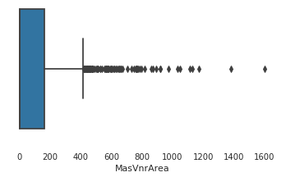
Which features have outliers more ?
There are 80 explanatory and 1 target variables with dtypes distribution : float64(3), int64(35), object(43)

Slide 4
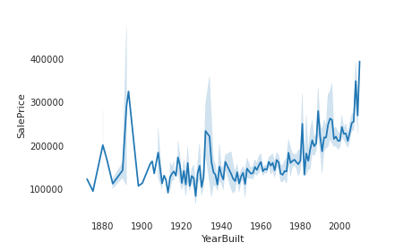
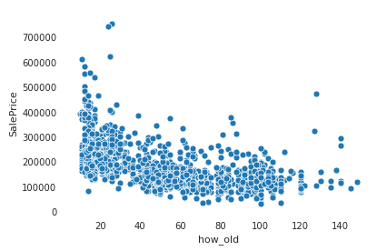
YearBuilt Vs salePrice?
Interestingly, Sales Price of few houses are high though they are built Old. They could be having unique features triggering this high value. Scatter plot brings a better view of high sales price basing on how old a property is. However, there are outliers.

Slide 5
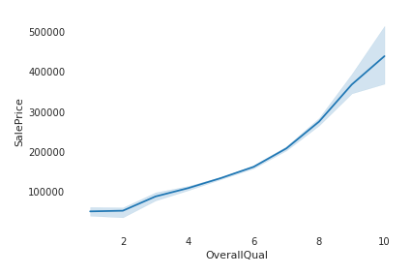
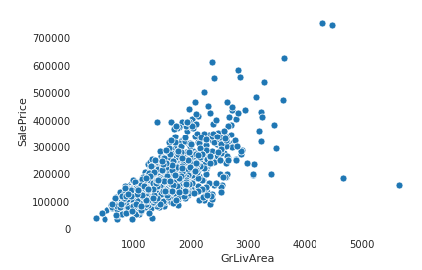
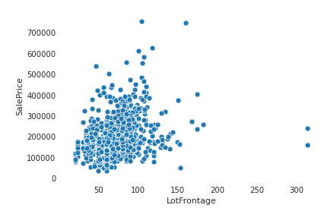
Correlation with Sale Price?
Higher the Overall Quality higher the Sale price. Similar behavior observed for GrLivArea and LotFrontage features.

Slide 6
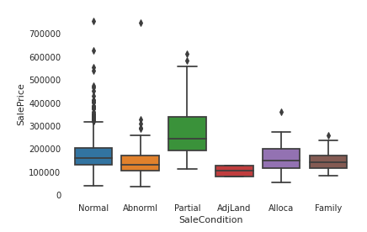
SaleCondition Vs SalePrice
This box plots gives us a view on distribution for different categories under Sales Condition Vs Sales Price. Min value of “Partial”is near to Max of “AdjLand” type. Highest Sale price registered in “Normal”, however Majority of “Partial” type have high sale price.

Slide 7
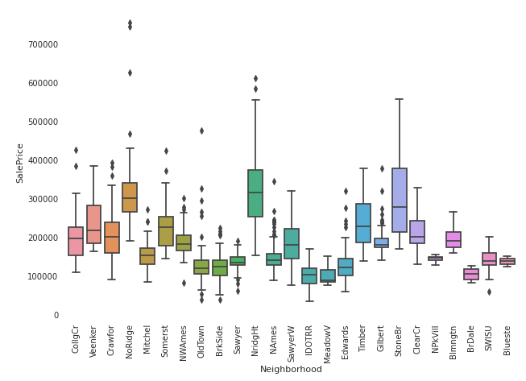
Neighborhood Vs SalePrice
This box plots gives us a view on distribution for different categories under Neighborhood Vs Sales Price. Min value of “StoneBr”is near to Max of “BlueSte” type. Highest Sale price registered in “NoRidge”, however Majority of “NridgHt” type have high sale price.

Slide 8
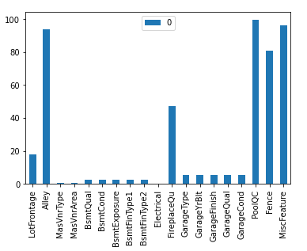
Handling Missing Values
Few columns like PoolQC, MiscFeature, Alley have 0 > 97%. These are categorical variables. Dropped these columns, along with few other ones which were analyzed based on domain reference.
For columns like BsmtCond, Electrical, LotFrontage Imputed the missing values using Mean and Mode based on datatype of the column.

Slide 9
Approach
In Feature Engineering, All Missing values are imputed, Columns are dropped which does not add much value & New Columns are created.
Dummies are created in Dataset for all categorical variables.
Outliers are removed based on appropriate value of quantiles [%]
Applied LinearRegression Model to predict the value

Slide 10
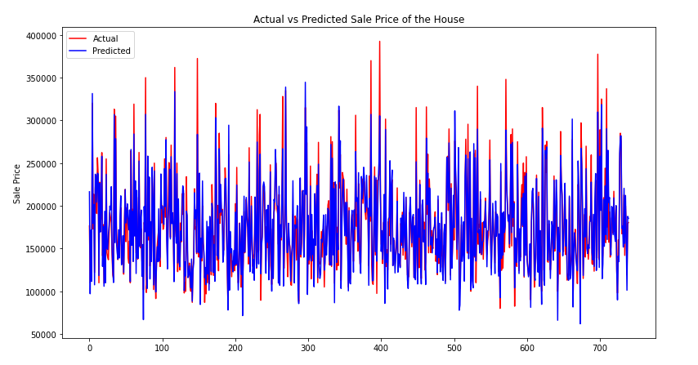
Conclusion
RMSE for training set is 17402.660491544037 RMSE for test set is 19437.46150016696
RMSE for training set is 17402.660491544037 RMSE for test set is 19437.46150016696
RMSE for training set is 17402.660491544037 RMSE for test set is 19437.46150016696
RMSE for training set is 17402.660491544037 RMSE for test set is 19437.46150016696
RMSE for training set is 17402.660491544037 RMSE for test set is 19437.46150016696

