Slide 1
Geographic
Information
System
(GIS)

Slide 2
GIS: What is it?
Any computer-based manipulation, analysis,
or presentation of geographical data
Common data for land cover applications
includes:
-roads
-lakes and rivers
-land use (forestry, mining, residential neighbourhood, etc.)
GIS now has a wide variety of applications

Slide 3
GIS: What is it?
The key to all data in a GIS is that it is
georeferenced, meaning it has a known
location.
All information in a GIS has an attribute
(What it is.) and a location (Where it is.)
GIS is ultimately a problem solving/decision
making tool.

Slide 4
GIS: Database Structure
A GIS database is comprised of layers
(themes) and attributes
Example: Layer-Forest cover
Attributes-tree species (overstory)
-height (m)
-canopy closure (%)
-understory species
-age
Can you think of attributes for a “roads” layer?

Slide 5
GIS: Database Structure
Information in a GIS is stored in four ways,
depending on the feature.
Points: hospitals, oil wells, phone booths
Lines: roads, streams/rivers, railroads
Polygons (Areas): crop fields, forest stands
Pixels: for raster-based GIS

Slide 6
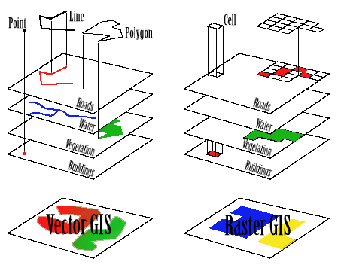

Slide 7
GIScience
GPS-the accurate collection of positional
information
Laser Altimetry-the accurate measurement
of height from the air
(trees, buildings, etc.)
Remote Sensing-the science of Earth
observation from space
Image Processing-the science of analyzing
imagery to gain useful
information

Slide 8
Areas of Practical Application
Natural-Resource Applications
*natural resource inventories (FRI)
*water quality, level, flow management
*environmental assessment and EIA
*viewshed/viewscape analysis
*groundwater modelling, hydrology analysis
*wildlife habitat analysis, migration routes, etc.

Slide 9
Areas of Practical Application
Land (Parcel) Applications
*zoning, tracking urban sprawl
*land acquisition, land ownership
Facilities/Utilities Management
*locating underground cables and pipes
*municipal telephone systems
*tracking energy use

Slide 10
Areas of Practical Application
Network Analysis
*web/network analysis and mapping
*least cost path analysis (ambulance, other services)
*address matching
*vehicle scheduling and routing (delivery)
*location analysis/site selection

Slide 11
GIS Subsystems
Data Processing Subsystem
*data acquisition - from maps, images or field surveys
*data input - data must be input from source material to the digital database
*data storage - how often is it used, how should it be updated, is it confidential?

Slide 12
GIS Subsystems
Data Analysis Subsystem
*retrieval and analysis - may be simple responses to queries, or complex statistical analyses of large sets of data
*information output - how to display the results? as maps or tables? Or will the information be fed into some other digital system?

Slide 13
GIS Subsystems
Information Use Subsystem
*users may be researchers, planners, managers
interaction needed between GIS group and users to plan analytical procedures and data structures
Management Subsystem
*organizational role - GIS section is often organized as a separate unit within a resource management agency offering spatial database and analysis services
*error management
*GIS management staff

