Slide 1
Business Performance Report
Fix-It Fast Services
Operational & Marketing Analysis

Slide 2
Executive Summary
This presentation analyzes the operational and marketing performance of Fix-It Fast Services. The dashboard provides insights into customer behavior, service performance, conversion trends, and marketing channel effectiveness to support data-driven decision-making.

Slide 3
Data Model & Dimensions
Dimensions:
- Customer Type (New / Returning)
- Service Type (Basic / Package / Premium)
- Marketing Channel
- Time of Day
Key Measures:
- Total Revenue, Ad Spend, Conversions, Cost per Conversion, ROI

Slide 4
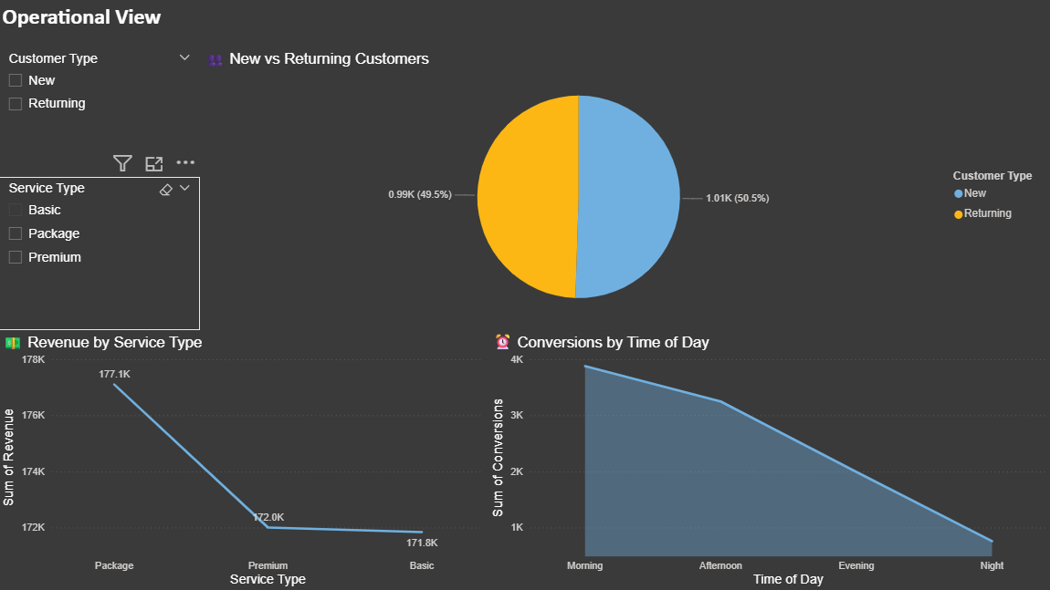
Operational Performance Dashboard

Slide 5
Operational Insights
- Balanced distribution between New and Returning customers.
- Package services generate the highest revenue.
- Morning period shows the highest number of conversions.
- Night time performance is the weakest.

Slide 6
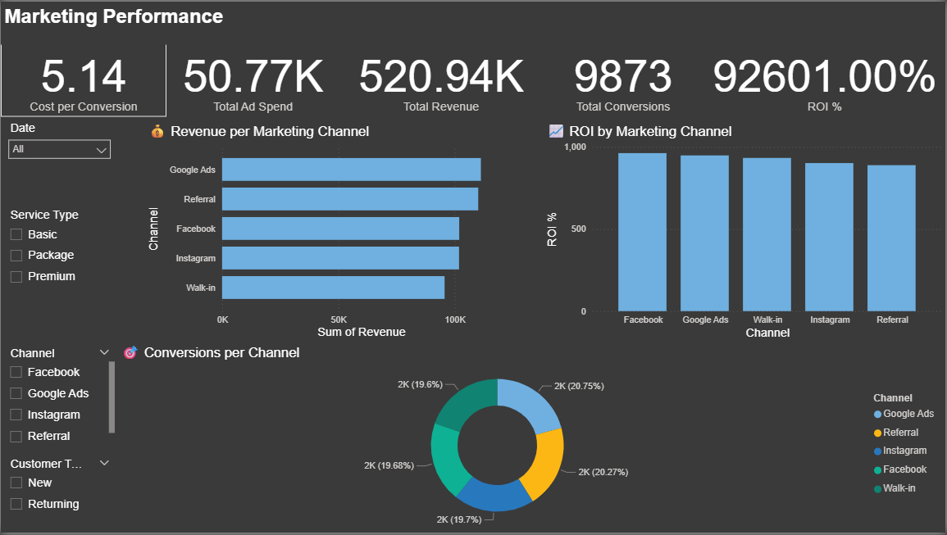
Marketing Performance Dashboard

Slide 7
Marketing Performance Insights
- Google Ads is the top revenue-generating channel.
- Facebook achieves the highest ROI.
- Conversion distribution is balanced across channels.
- Overall marketing ROI is exceptionally high.

Slide 8
Key Performance Indicators
- Total Revenue: 520.94K
- Total Ad Spend: 50.77K
- Total Conversions: 9,873
- Cost per Conversion: 5.14
- ROI: 92,601%

Slide 9
Strategic Recommendations
- Increase investment in Google Ads and Facebook.
- Promote Package services more aggressively.
- Focus marketing campaigns on morning time slots.
- Optimize or reassess Instagram spending.

Slide 10
Conclusion
The dashboards demonstrate strong operational and marketing performance. The data model enables scalable analysis and provides clear insights that support strategic planning and business growth.

