Slide 1
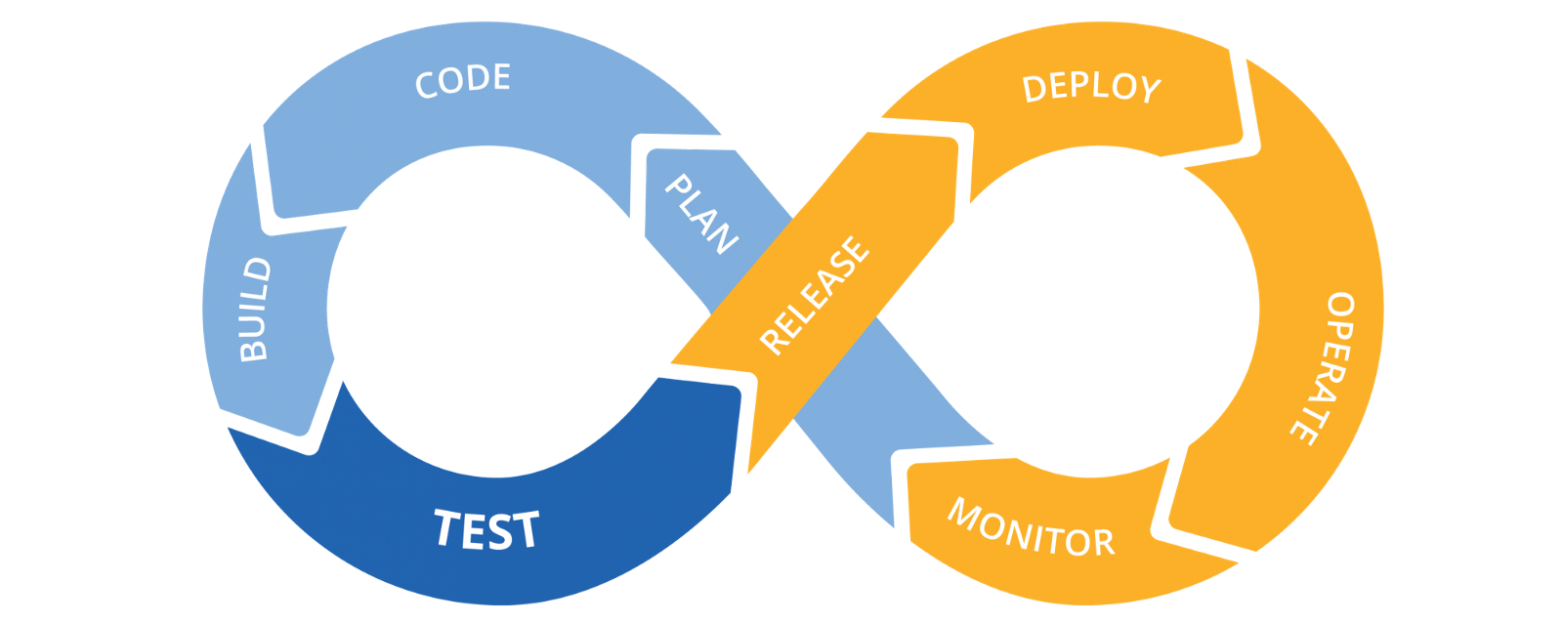

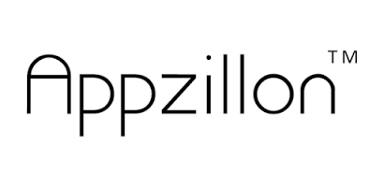
Appzillon Devops Implimentation
Appzillon Plateform Team

Slide 2
CD/CI
What CDCI ?
Continuous integration
Developers practicing continuous integration merge their changes back to the main branch as often as possible.
The developer's changes are validated by creating a build and running automated tests against the build.
By doing so, you avoid the integration hell that usually happens when people wait for release day to merge their changes into the release branch..
Continuous delivery
Continuous delivery is an extension of continuous integration to make sure that you can release new changes to your customers quickly in a sustainable way.
This means that on top of having automated your testing, you also have automated your release process and you can deploy your application at any point of time by clicking on a button.

Slide 3
Jenkins
What Jenkins ?
Jenkins is an open source automation server written in Java.
Jenkins helps to automate the non-human part of the software development process, with continuous integration and facilitating technical aspects of continuous delivery.
Why Jenkins ?
It is open source and it is user-friendly
Platform Independent. Jenkins is available for all platforms and different operating systems, whether OS X, Windows or Linux.
Rich Plugin ecosystem.
Issues are detected and resolved almost right away which keeps the software in a state where it can be released at any time safely.

Slide 4







MavenBuildProcess
Build AppzillonPlateform
Appzillon Build Pipeline
9
Notification
Checkout
Clean
Versioning
SetCustID&Licence
Build
JarDistribution
Packaging
BinarySharing
1
2
3
4
5
6
7
8
.exe
.exe
Sharig
Testing
Binary
.deb
.dmg

Slide 5




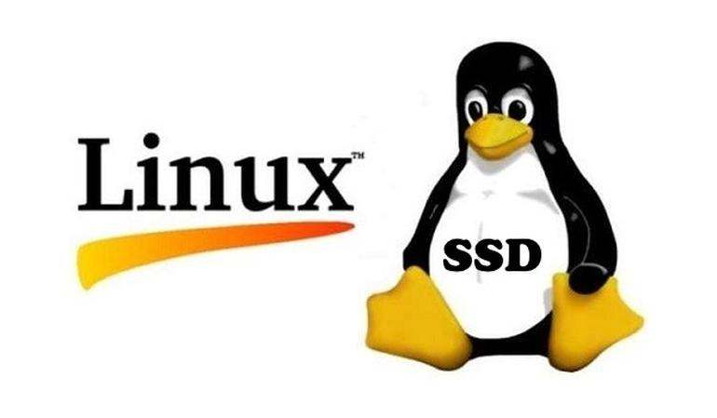
SeliniumFrameWork
Testing with Appzillon
AppzillonTesting Pipeline
ProjectBuild
TomcatHealth
DeployWebApp
VirtualDisplay
RunTestcase
HtmlReport
Email
10
11
12
13
14
15
16
HC
VD
Test-Slave
Skip
Start
Skip
Start

Slide 6
Pipline Steps Details
1.Checkout:
Svn source code export to Jenkins job workspace from url http://192.168.1.1/svn/Appzillon/3.6.0.S1/Studio
2.Clean:
Meven clean to clean out
3.Versioning:
Applying version for binary appropriately
4.Set CustID&Licence
As per customer specific Barclay/ibpb and licence details are setting up
5.Build
Mvn build to create jars
6:Jar Distribution
On successful creation of jars distributing across Linux and mac.
7.Packaging
Distributed jars goes for ant packaging in all three platform like mac,Linux and window.
8.Binary Sharing
Once the binary is generated successfully they can be share in common area for further testing along with Appzillon command line build

Slide 7
9.Declarative: Post Actions
Email notification for users like testing team and dev team along with management with specifying binary location and status details
10.HealthCheck Tomcate:
Checking if tomcat on testing slave is up or not if not then starting tomcat
11.CommandLineBuild
Creation of web app using command line build jar with server and app param specification.
12.Deploy App
Checking again apache http status if its 200 OK then deploying web and server app for regration testing.
13.Virtual Display
Check if xvfb server is running or not if not then staring xvfb server on display :99
14.Reg Testing
Exporting virtual display to :99 for headless mode of testing.
15.Html Report Generation:
Using log of test case generating html report pragmatically and exposing static html page behind apache.
16.Email Notification

Slide 8

CD/CI Appzillon

