Slide 1
Team : Pegasus
Guide : Prof. Sandeep Shukla
Ankit Raja(21111012)
Akanksha Singh(21111005)
Ayush Singh(21111020)
Ayush Sahni(21111019)
Amar Raja(21111009)
Advances In Intrusion Detection System Using Different Classifiers
T

Slide 2
Problem Statement:
Intrusion detection system is an important prerequisite in any computer network.
Problem with Anomaly based IDS is that it generates more
false positive alarm.
To overcome the limitations of anomaly detection, a classifier based on an intelligent hidden Markov model, is used and designed to differentiate the actual attacks from faults. We are proposing a model with combining the Multimodel based Anomaly IDS with Neural Network (NN),Machine learning,LSTM based Systems.

Slide 3
Introduction :
Network based Intrusion detection/prevention system (NIDPS) protects a network of hosts and systems.
Based on the intrusion detection method, IDS can be Signature based and Anomaly based.
Signature based IDS can only detect an intrusion attempt if it matches a pattern that is in the database, therefore the databases need to constantly
be updated to detect the new attacks.
Anomaly based IDS has its own limitations
We need to come up with more robust solution to safeguard networks and systems.

Slide 4
Training Dataset : CIC-IDS2017
This dataset contains benign and most up-to-date common attacks which resembles the true real-world data(PCAPs) like :
DDoS
PortScan
Bot
Infiltration
Web_Attack_Brute_Force
Web_Attack_XSS
Web_Attack_Sql_Injection
FTP_Patator
SSH_Patator
DoS_slowloris
DoS_Slowhttptest
DoS_Hulk
DoS_GoldenEye
'Heartbleed'.
The size of the dataset is 2GB .

Slide 5
Real-time Packet sniffing :
Real-time Packets are being captured using CICFlowMeter
Internally, sniffed packets are stored in pcap format .
pcap files are then read and stored into csv format by CICFlowMeter.
Using this output csv file as an input to trained model to predict attack type .
Simulating Realtime Dos(Denial Of Service) Attack.

Slide 6
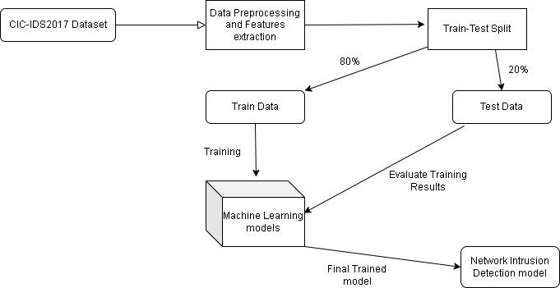
Proposed Model: Model Training phase

Slide 7
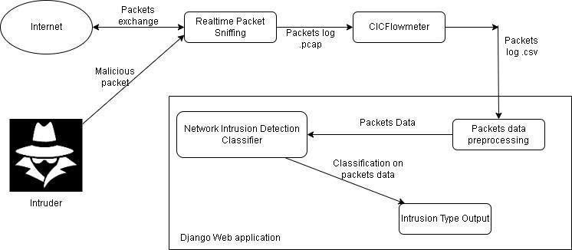
Proposed Model: Model Implementation Phase

Slide 8
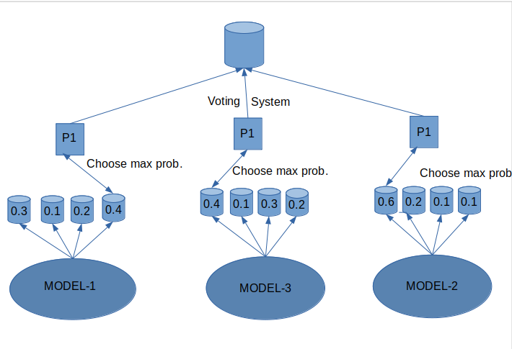
Architecture
Architecture :

Slide 9

Data Preprocessing :
Data Cleaning
Feature Extraction
Data Normalization
SMOTE Analysis
(Resampling)

Slide 10
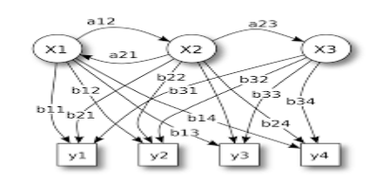
Hidden Markov Model :
Improves the accuracy of sequences of prediction when combined with regular base Classifier.
Hidden states are drawn from the categorical distribution of classification class labels
State Transition Matrix Estimated from unlabeled data using the Viterbi Algorithm.
Possible distributions are drawn from the categorical distribution of the classification class labels.
Emission probabilities are estimated by the prediction probability estimates.

Slide 11
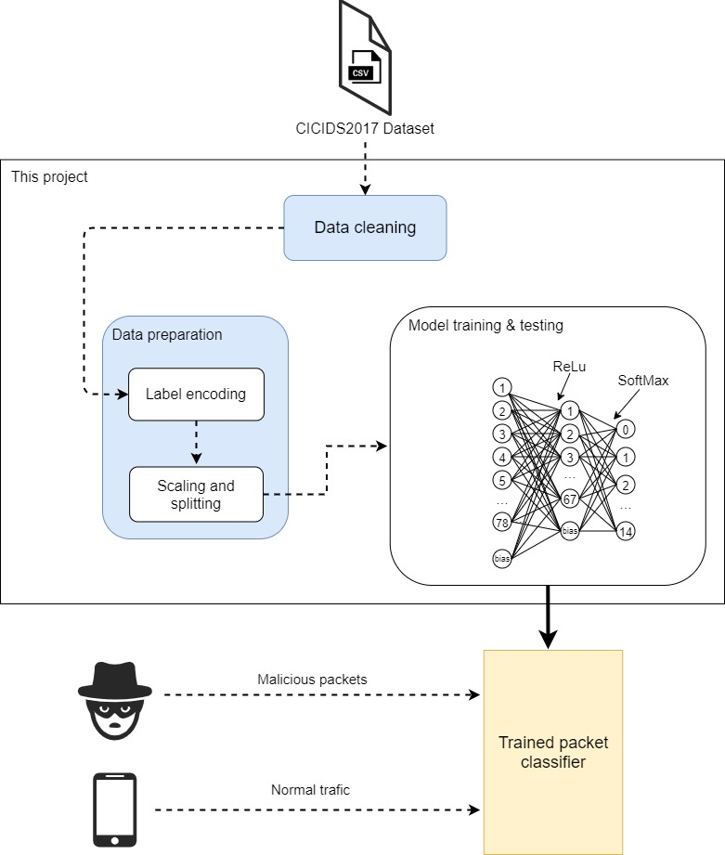
Model 1 - Anomaly Detection with Neural Network
Number of nodes in Input Layer:78
Number of nodes in hidden layer : 67
Activation Function : Relu
Number of nodes in Output Layer : 15
Activation Function : softmax
Output label : argmax

Slide 12
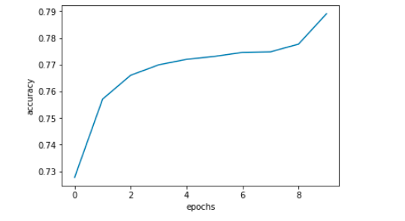
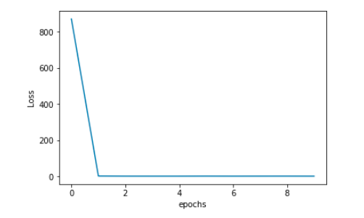
Loss Function and Accuracy :
Accuracy vs epoch
Loss vs Epoch

Slide 13
Model 2 : LSTM for Anomaly Based Network Intrusion Detection System
Single LSTM.
Properties :-
Loss Functions = Sparse Categorical Cross Entropy
Batch Normalization
Activation Function = Relu
Activation Function = softmax
Optimizer = Adam

Slide 14
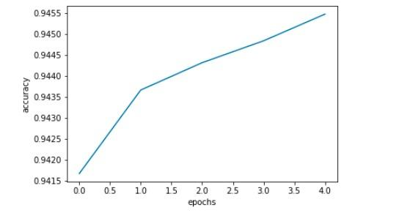
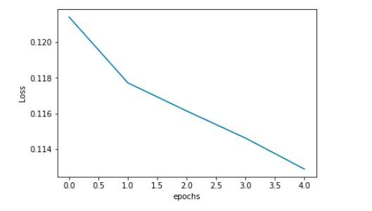
Loss Function and Accuracy:
Accuracy vs epoch
Loss vs Epoch

Slide 15
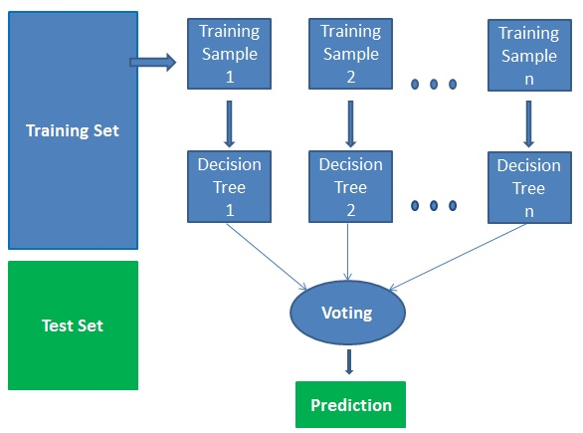
Model 3 : Random forest Algorithm
Self supervised learning algorithm.
It builds decision trees on different samples and takes their majority vote for classification.
Used to compare accuracy
with Neural Network
based model.
Accuracy: 64 %

Slide 16
Ensembling Models :Voting Classifier
Combines the power of all three models.
Improves Accuracy and F1 score.
Improve efficiency of our IDS model..

Slide 17
Comparison :
Models | F1 Score | Accuracy
Model1(NN) | 0.71 | 81%
Model2(LSTM) | 0.78 | 87%
Model3(RF) | 0.64 | 63%
Ensemble model | 0.97 | 98 %

Slide 18
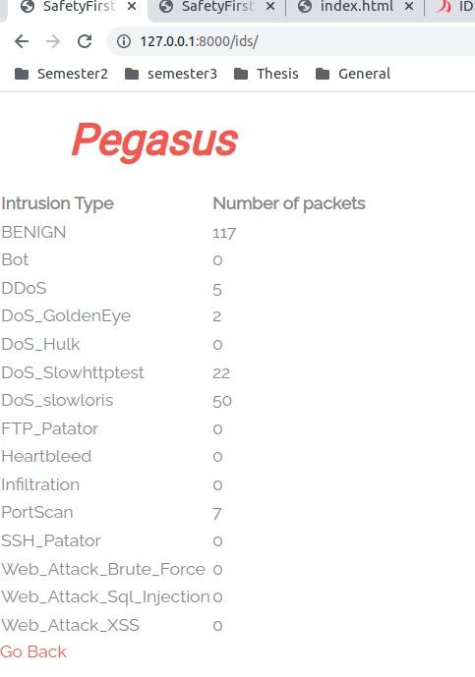
Final Output

Slide 19
Limitations :
Some false positive detection is still there while predicting on Realtime sniffed packets.
Not accurate enough to detect all Zero-day attacks.
We have reached to our goal with certain flaws which can be rectified in our future work.

Slide 20
Challenges
Learning Neural Network and its application from scratch
Implementation of Hidden Markov Model
And its integration with various used models
Developing Django based web Interface to showcase the output obtained.
Performing Realtime packet sniffing

Slide 21
Future Scope
Operate on Realtime Packet capturing for an Organization
HMM Integration can be improved
to increase overall accuracy of models
Improving model to have more categorization of malwares after analysing new attacks

Slide 22
Team Contributions:
Work | Ankit | Ayush Singh | Ayush Sahni | Akanksha | Amar
Literature Survey | ✔️ | ✔️ | ✔️ | ✔️ | ✔️
Real time packet capturing |  | ✔️ | ✔️
NN Model | ✔️ |  |  |  | ✔️
LSTM Model |  |  |  | ✔️ | ✔️
RF Model | ✔️ |  |  | ✔️
Model Integration | ✔️ | ✔️ | ✔️ | ✔️ | ✔️
Web Interface development |  | ✔️ | ✔️
PPT | ✔️ | ✔️ | ✔️ | ✔️ | ✔️
Final Contribution | 20 % | 20 % | 20 % | 20 % | 20 %

Slide 23
Thank You
Any Questions?

