Slide 1

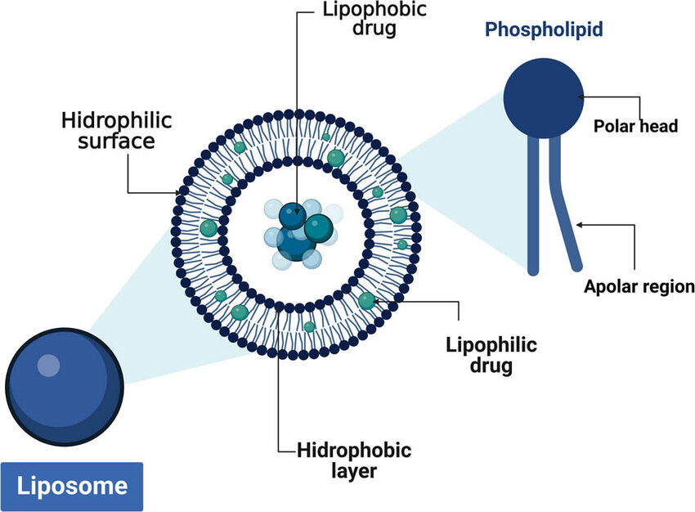
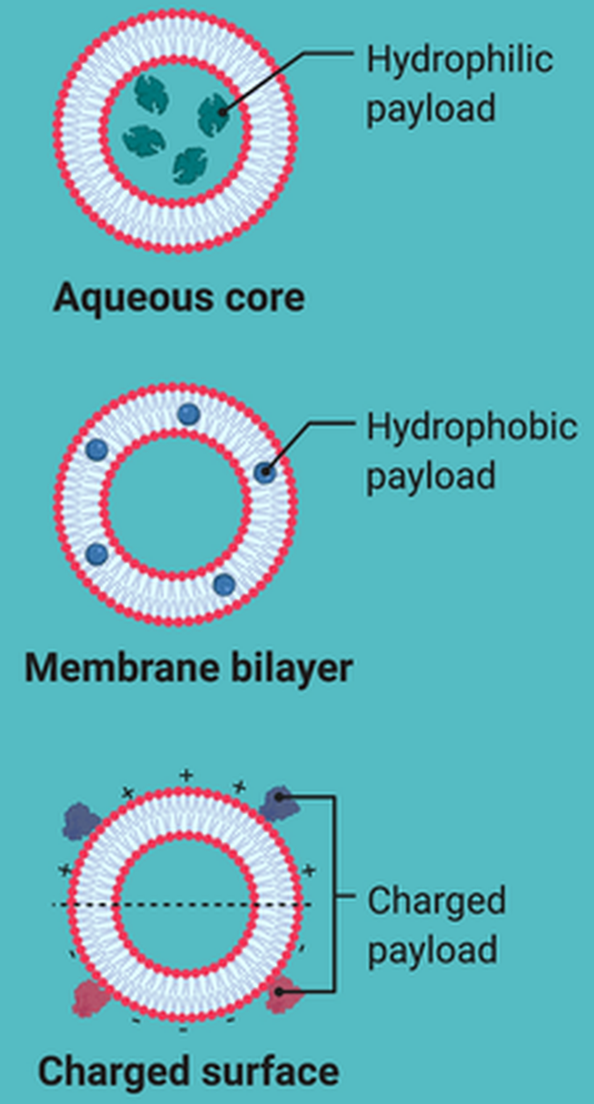
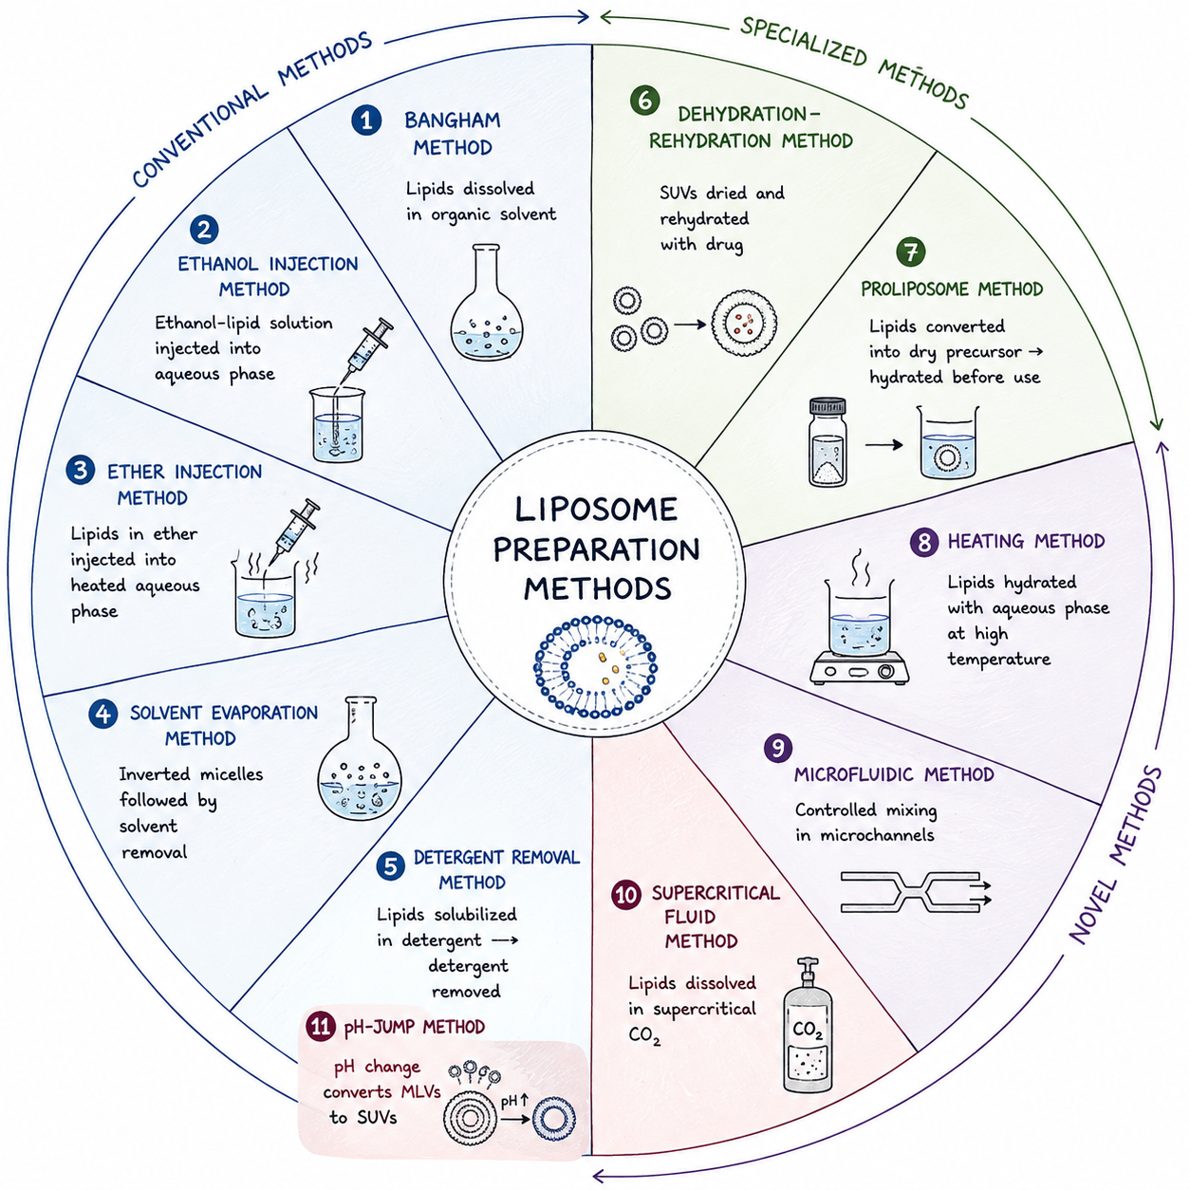
























Harnessing Liposome Technology for Precision Medicine: Design, Delivery, and Clinical Impact
Department of Pharmaceutics, RR College of Pharmacy, Bengaluru-560090, Karnataka, India
Since 1993
Correspondence e-mail: singhrashmi295pharma@gmail.com
01
ABSTRACT
KEYWORDS
Liposomes are biocompatible drug carriers enabling targeted delivery with reduced toxicity. Surface modification enhances their efficiency in cancer therapy and gene delivery. Recent advances include optimized, stimuli-responsive systems under clinical study. These systems show strong potential for improved and precise therapeutic outcomes.
Antineoplastic agents
Drug delivery systems
Gene therapy
Liposomes
Nanomedicine
02
INTRODUCTION
Liposomes are spherical vesicles composed of phospholipid bilayers, capable of encapsulating both hydrophilic and hydrophobic drugs. They were first described in 1964 as self-assembling colloidal structures formed by amphiphilic lipids in aqueous media. Liposomes enhance therapeutic efficacy by reducing drug toxicity and minimizing side effects on normal tissues. Due to their versatility and biocompatibility, they are widely studied for applications in cancer therapy, gene delivery, and other targeted treatments.
1964
BILAYER
DUAL
First described as
self-assembling colloids
Phospholipid vesicle
architecture
Hydrophilic +
hydrophobic payload
Figure 1. Liposome architecture — hydrophilic surface, hydrophobic bilayer, phospholipid polar head and apolar region.
Figure 2. Drug loading strategies.
03
METHODOLOGY
STEP 01
Literature Review
STEP 02
Preparation methods
STEP 03
Optimization
STEP 04
Evaluation of advanced liposomes
STEP 05
Clinical applications
STEP 06
Future perspective
Figure 3. Conventional, specialized and novel liposome preparation methods.
04
ANALYTICAL TECHNIQUES
Table 1: Different analytic techniques are used for the assessment of liposomes.
Evaluation Test | Analytical Techniques
Particle Shape | TEM (Transmission Electron Microscopy), AFM, Cryo -TEM
Particle Size | AFM, TEM
Zeta Potential | Laser Doppler Electrophoresis (LDE), Capillary Electrophoresis
Lamellarity | Cryo -TEM
Phase Behavior | DSC, TGA, Fluorescence Probe Polarization, NMR, FTIR, XRD
Entrapment Efficiency | HPLC, UPLC, LC-MS
In vivo Release | HPLC, UPLC
05
APPLICATIONS
Therapy
Reduced toxicity
Improved Stability
Antiviral Drug Delivery
Minimize Exposure
Enhanced Bioavailability
Cancer Therapy
Reduced side effects
Controlled release
Gene Therapy
Reduced Enzymatic Degradation
06
RESULTS
07
PROS vs CONS
Liposomes technology is an evolving and versatile drug-delivery platform, with continued advances in targeting, surface modification, stimuli-responsive delivery, and formulation optimization supporting its future role in precision medicine.
PROS
CONS
Targeted drug delivery
Physical instability
Precision Medicine Benefits
Enhanced drug solubility
Drug leakage
Drug Targeting Improvements
Drug protection
Chemical instability
Surface Modification Advantages
Controlled release
High production cost
Stimuli Responsive Systems
Versatile platform
Scale up difficulties
Clinical Impact
Reduced toxicity
Storage limitation
08
CONCLUSION
Liposomes demonstrated strong potential in cancer therapy, gene delivery, and antiviral applications. liposome technology is an evolving and versatile drug-delivery platform, with continued advances in targeting, surface modification, stimuli-responsive delivery, and formulation optimization supporting its future role in precision medicine.
ACKNOWLEDGEMENTS
REFERENCES
The authors are thankful to the college staff and management for the encouragement and support.
1. Nsairat H, et al. Heliyon. 2022;8. 2. Ricci A, et al. Antioxidants. 2024;13:1516. 3. Hamad I, et al. Pharmaceutics. 2024;16:400. 4. Huang Z, et al. J Liposome Res. 2024;34:715–727. 5. Paramshetti S, et al. Life Sci. 2024;342:122616.
6. Pal R, et al. J Adv Med Med Res. 2023;35:7–15. 7. Singh H, et al. J Drug Deliv Sci Technol. 2024;94:105526. 8. Jain A, et al. Chem Phys Lipids. 2019;222:115–119. 9. Hadjou H, et al. ACS Appl Mater Interfaces. 2022;14:48530–48540.

