Slide 1

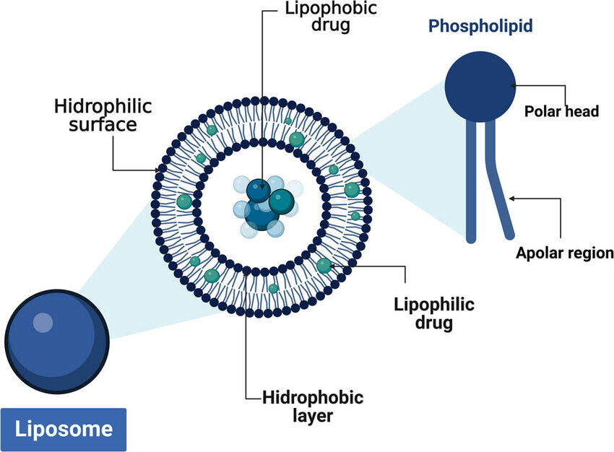
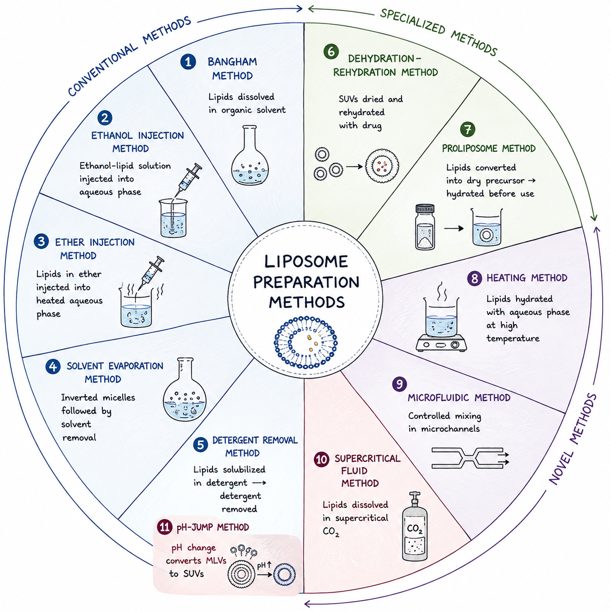
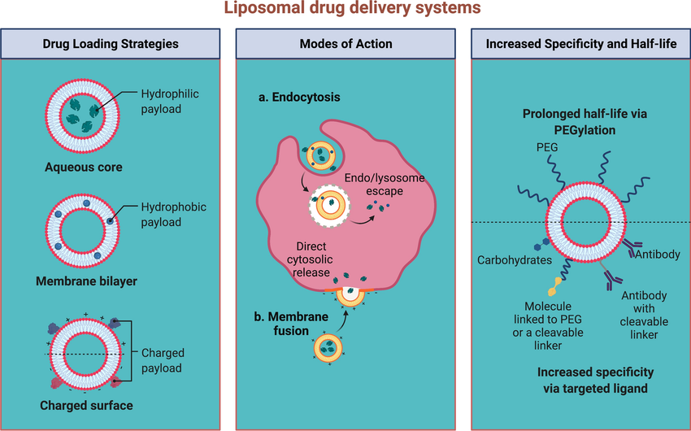
Harnessing Liposome Technology for Precision Medicine: Design, Delivery, and Clinical Impact
Since 1993
Department of Pharmaceutics, RR College of Pharmacy, Bengaluru-560090, Karnataka, India
Correspondence e-mail: singhrashmi295pharma@gmail.com
ABSTRACT
Liposomes are biocompatible drug carriers enabling targeted delivery with reduced toxicity. Surface modification enhances their efficiency in cancer therapy and gene delivery. Recent advances include optimized, stimuli-responsive systems under clinical study. These systems show strong potential for improved and precise therapeutic outcomes.
KEYWORDS Antineoplastic agents, Drug delivery systems, Gene therapy, Liposomes, Nanomedicine
INTRODUCTION
Liposomes are spherical vesicles composed of phospholipid bilayers, capable of encapsulating both hydrophilic and hydrophobic drugs. They were first described in 1964 as self-assembling colloidal structures formed by amphiphilic lipids in aqueous media. Liposomes enhance therapeutic efficacy by reducing drug toxicity and minimizing side effects on normal tissues. Due to their versatility and biocompatibility, they are widely studied for applications in cancer therapy, gene delivery, and other targeted treatments.
Drug encapsulation
Stealth circulation
(PEGylated surface)
Receptor-mediated uptake
& intracellular release
Fig. 1 Liposome architecture and drug-loading regions.
METHODOLOGY
1
2
3
4
5
6
Literature Review
Preparation Methods
Optimization
Evaluation of Advanced Liposomes
Clinical Applications
Future Perspective
APPLICATIONS
Therapy
Reduced Toxicity
Improved Stability
Antiviral Drug Delivery
Cancer Therapy
Gene Therapy
Minimize Exposure
Reduced Side Effects
Enhanced Bioavailability
Controlled Release
Reduced Enzymatic Degradation
PROS vs CONS
PROS
CONS
Targeted Drug Delivery
Enhanced Drug Solubility
Drug Protection
Controlled Release
Versatile Platform
Reduced Toxicity
Physical Instability
Drug Leakage
Chemical Instability
High Production Cost
Scale-Up Difficulties
Storage Limitations
ANALYTICAL TECHNIQUES
Table 1: Different analytic techniques are used for the assessment of liposomes.
Evaluation Test | Analytical Techniques
Particle Shape | TEM (Transmission Electron Microscopy), AFM, Cryo-TEM
Particle Size | AFM, TEM
Zeta Potential | Laser Doppler Electrophoresis (LDE), Capillary Electrophoresis
Lamellarity | Cryo-TEM
Phase Behavior | DSC, TGA, Fluorescence Probe Polarization, NMR, FTIR, XRD
Entrapment Efficiency | HPLC, UPLC, LC-MS
In vivo Release | HPLC, UPLC
Fig. 2 Conventional, specialized and novel liposome preparation methods.
RESULTS
Liposomes technology is an evolving and versatile drug-delivery platform, with continued advances in targeting, surface modification, stimuli-responsive delivery, and formulation optimization supporting its future role in precision medicine.
01
02
03
04
05
Precision
medicine benefits
Enhanced
targeting
Surface modification
advantages
Stimuli-responsive
delivery
Clinical
impact
Fig. 3 Drug loading strategies, modes of action and surface engineering.
CONCLUSION
Liposomes demonstrated strong potential in cancer therapy, gene delivery, and antiviral applications. liposome technology is an evolving and versatile drug-delivery platform, with continued advances in targeting, surface modification, stimuli-responsive delivery, and formulation optimization supporting its future role in precision medicine.
Acknowledgements: The authors are thankful to the college staff and management for the encouragement and support.
References: 1. Nsairat H, et al. Heliyon. 2022;8. 2. Ricci A, et al. Antioxidants. 2024;13:1516. 3. Hamad I, et al. Pharmaceutics. 2024;16:400. 4. Huang Z, et al. J Liposome Res. 2024;34:715–727. 5. Paramshetti S, et al. Life Sci. 2024;342:122616. 6. Pal R, et al. J Adv Med Med Res. 2023;35:7–15. 7. Singh H, et al. J Drug Deliv Sci Technol. 2024;94:105526. 8. Jain A, et al. Chem Phys Lipids. 2019;222:115–119. 9. Hadjou H, et al. ACS Appl Mater Interfaces. 2022;14:48530–48540.

