Slide 1

ABSTRACT
INTRODUCTION
PROPOSED MODEL
DATASET(OPTIONAL)
ARCHITECTURE(too specific to your project)
DATA FLOW DIAGRAM(optional)
UML DIAGRAM
USECASE DIAGRAM
ACTIVITY DIAGRAM
SEQUENCE DIAGRAM
REFERENCES

Slide 2

Sign language is one of the oldest and most natural form of language for communication, but most people do not know sign language and interpreters are very difficult to come by. Sign Language Recognition is one of the most growing fields of research area. Many new techniques have been developed recently in this area. This project shows the sign language recognizing of 26 hand gestures in Indian sign language in real time using neural networks. In our method, the hand is first passed through a filter and after the filter is applied the hand is passed through a classifier which predicts the class of the hand gestures. The proposed system contains four modules such as: pre-processing and hand segmentation, feature extraction, sign recognition and sign to text. By using image processing the segmentation can be done. Some of the features are extracted such as Eigen values and Eigen vectors which are used in recognition. The Linear Discriminant Analysis (LDA) algorithm was used for gesture recognition and recognized gesture is converted into text format. The proposed system helps to dimensionality reduction.

Slide 3

Sign Language is the most natural and expressive way for the hearing impaired people. People, who are not deaf, never try to learn the sign language for interacting with the deaf people. This leads to isolation of the deaf people
Indian sign language (ISL) uses both hands to represent each alphabet and gesture. ISL alphabets are derived from British Sign Language (BSL) and French Sign Language (FSL). Most of the researchers in this area concentrate on the recognition of American Sign Language (ASL) since most of the signs in ASL are single handed and thus, complexity is less.

Slide 4

Image processing algorithms are used in Vision based technique to detect and track hand signs of the signer.
The model is based on neural networks and OpenCV techniques.
Appearance-based systems use images as inputs. They directly interpret from these images. They don’t use a spatial representation of the body

Slide 5

dataset :
train : https://drive.google.com/drive/u/1/folders/1-XTAjPPRPFeRqu3848z8dMXaolILWizn
test : https://drive.google.com/drive/u/1/folders/18e1F1n1SWPF8lUF8pCKdUzSzKAbmSbVN

Slide 6

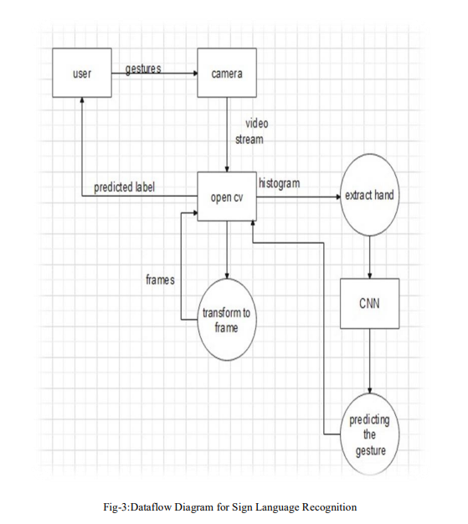

Slide 7

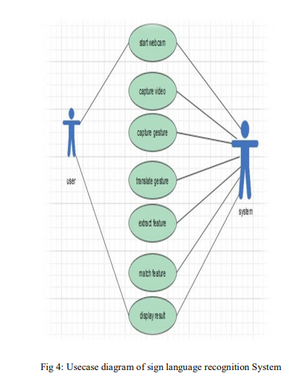
Use case diagram

Slide 8
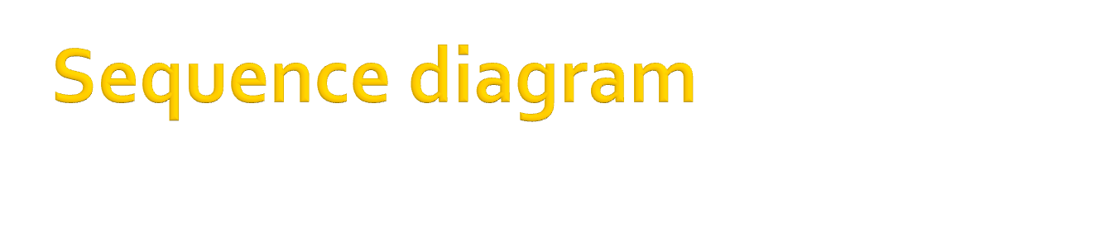
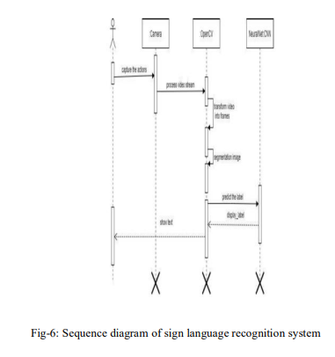

Slide 9

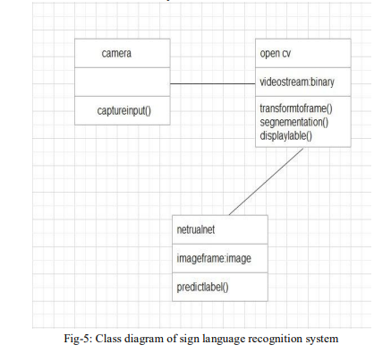
.

Slide 10

Pratyusha Thumiki, 16311A0546

