Slide 1
AgriTech

Slide 2
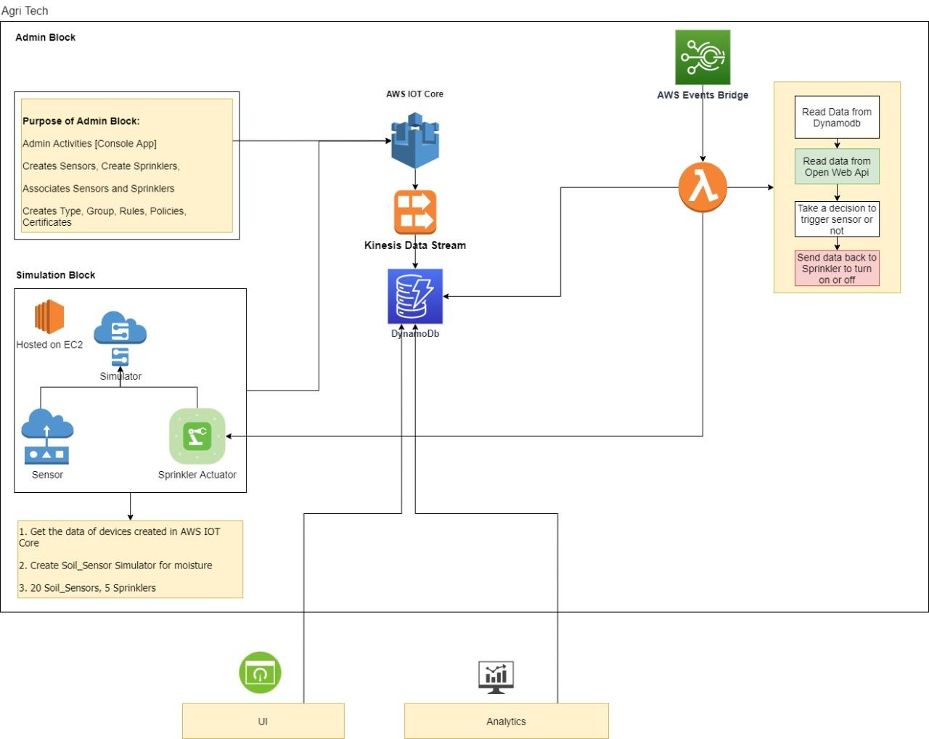
Architecture

Slide 3
Tools
AWS IOT Core | Create and manage things, types and groups
AWS Kinesis | Processing and populating the stream data
AWS DynamoDB | NoSQL db for storing write intensive application
AWS Lambda | Processing the incoming data and generating alert
Python | Scripting language
React/NodeRed | UI application
Code Repository | GitLab

Slide 4
Team Members
Amarjeet Prajapati
Mahendra Sonwane
Sandesh Salunke
Sarvesh Sawant
Mahesh S

Slide 5
THANK YOU

