Slide 1

Agri Tech

Slide 2
Problem Statement
This is a simple system to manage and actuate sprinklers based on soil temperature and moisture in a large farm. This can be replicated across various farms as needed, so scale is one of the key factors.
Real and simulated soil temperature & moisture sensors need to continuously feed data which can be streamed and acted upon accordingly.
The farm has a predetermined topology when it comes to sensor and sprinkler locations. Each soil sensor comes under the range of a particular sprinkler. This can be directly mapped in the system.
The system needs to continuously monitor the incoming soil and air readings. Based on a reasonable linear difference algorithm that you can define; it should decide whether a particular soil sensor location requires water. If enough soil sensors (based on a predefined percentage) mapped to a sprinkler raise an alarm, the system should send a command to the sprinkler to turn on. Similarly, it should decide when to turn them off

Slide 3
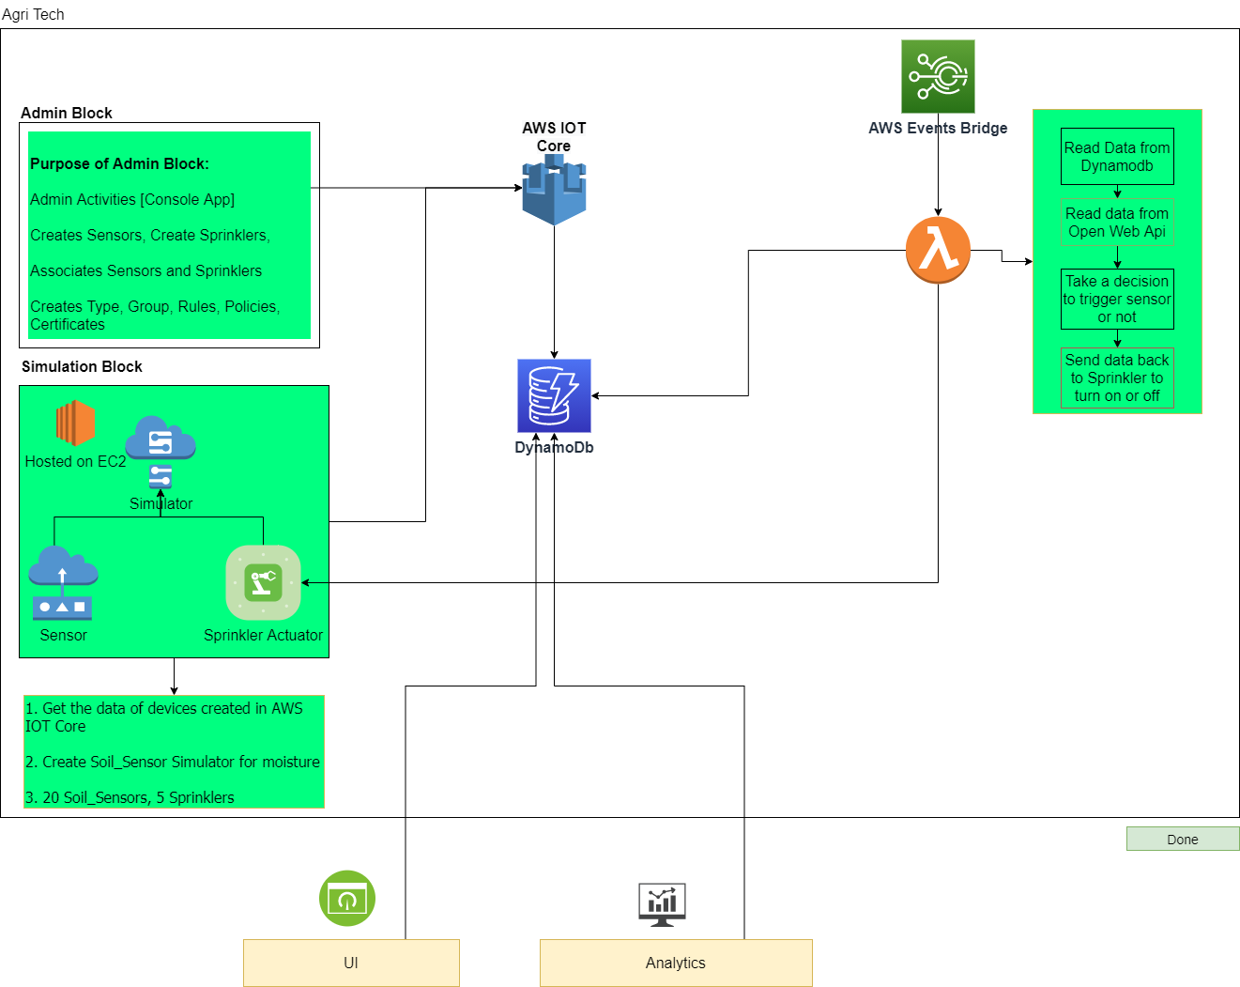
Architecture Diagram

Slide 4
Tools
AWS IOT Core | Create and manage things, types and groups
AWS DynamoDB | NoSQL db for storing write intensive application
AWS Lambda | Processing the incoming data and generating alert
Python | Scripting language
React/NodeRed | UI application
Code Repository | GitLab

Slide 5
Benefits
Higher crop productivity
Decreased use of water, fertilizer, and pesticides, which in turn keeps food prices down
Reduced impact on natural ecosystems
Gives producers greater control over plant and animal production, processing, distribution, and storage
Greater efficiencies and lower prices
Safer growing conditions and safer foods
Reduced environmental and ecological impact

Slide 6
Team
Amarjeet Prajapati
Mahendra Sonwane
Sandesh Salunke
Sarvesh Sawant
Mahesh S

