Slide 1
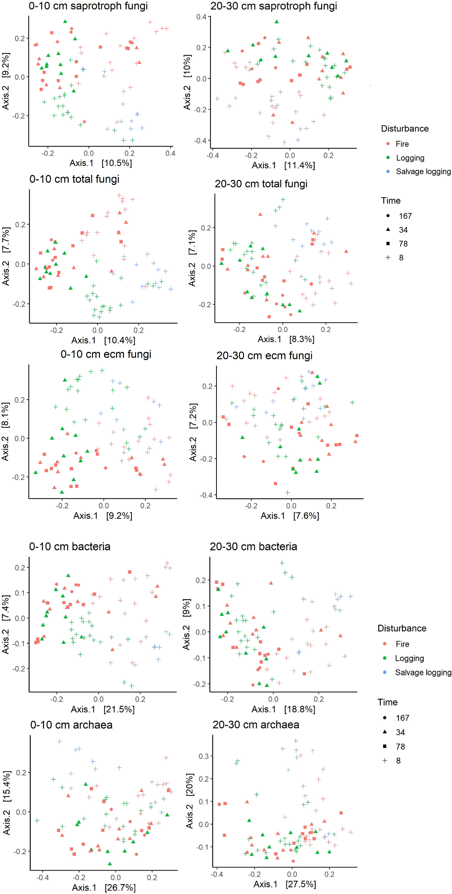
Disturbance alters the forest soil microbiome
Molecular Ecology, Volume: 31, Issue: 2, Pages: 419-447, First published: 23 October 2021, DOI: (10.1111/mec.16242)
Notes:
Principal coordinate analysis (PCoA) plots detailing the community composition of each microbial community and soil depth across 80 study sites, with respect to time since last disturbance and disturbance type. Axes depict the percentage of variance explained
IF THIS IMAGE HAS BEEN PROVIDED BY OR IS OWNED BY A THIRD PARTY, AS INDICATED IN THE CAPTION LINE, THEN FURTHER PERMISSION MAY BE NEEDED BEFORE ANY FURTHER USE. PLEASE CONTACT WILEY'S PERMISSIONS DEPARTMENT ON PERMISSIONS@WILEY.COM OR USE THE RIGHTSLINK SERVICE BY CLICKING ON THE 'REQUEST PERMISSIONS' LINK ACCOMPANYING THIS ARTICLE. WILEY OR AUTHOR OWNED IMAGES MAY BE USED FOR NON-COMMERCIAL PURPOSES, SUBJECT TO PROPER CITATION OF THE ARTICLE, AUTHOR, AND PUBLISHER.

