Slide 1
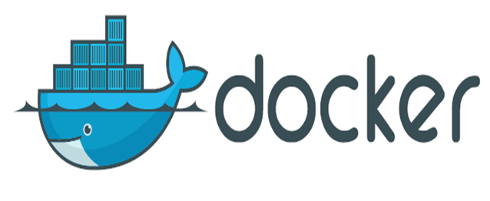

Slide 2
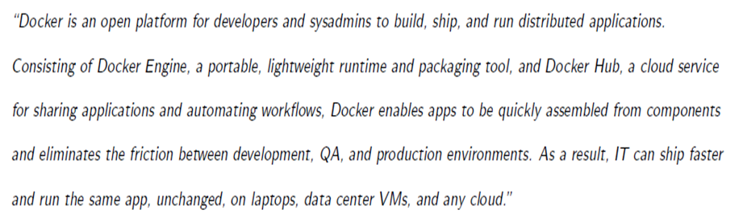

Slide 3
a build system
• images may be build from sources
• using a simple DSL (Dockerfile)
• a set of REST APIs
• Engine API (control the docker engine)
• Plugin API (extend the engine ! network, storage,
authorisation)
• Registry API (publish/download images)
• Swarm API (manage a clusted of docker machines)

Slide 4
Overview: About Docker
• Docker Inc. (the company)
• Docker (the Open Source project)
• Containers (how and why they are useful)

Slide 5
What does Docker Inc. do?
• Docker Engine - open source container management.
• Docker Hub - online home and hub for managing your Docker containers.
• Docker Enterprise Support - commercial support for Docker.
• Docker Services & Training - professional services and training to help you get the best out of Docker.

Slide 6
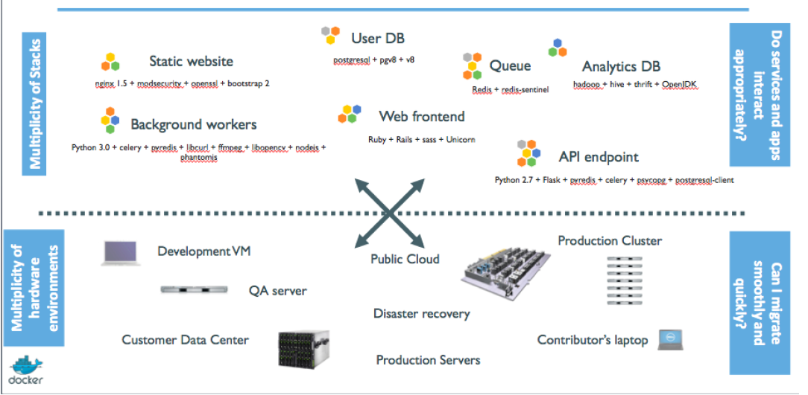
Why Docker?

Slide 7
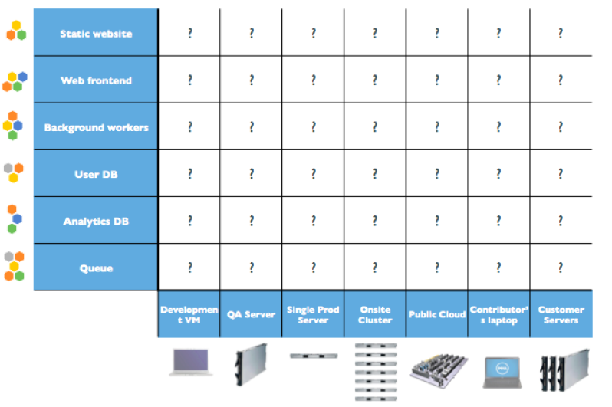
The Matrix from Hell

Slide 8
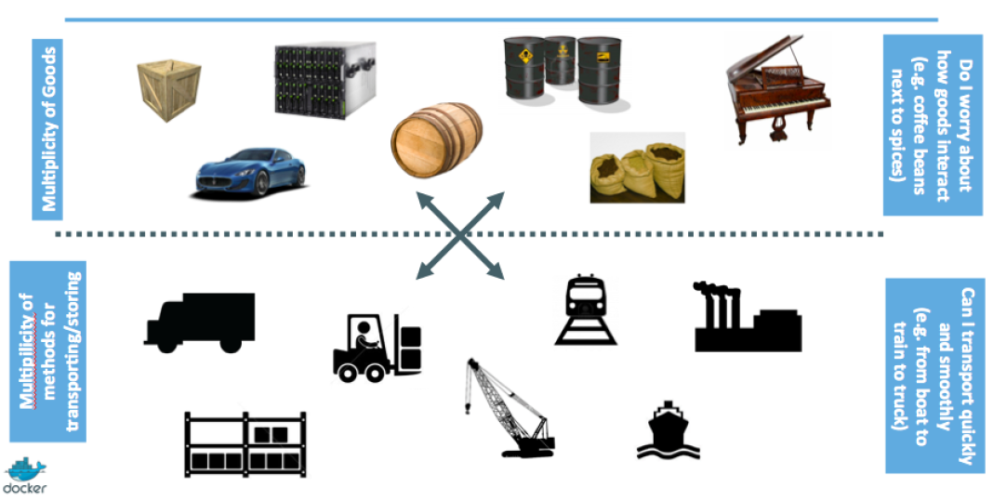
An inspiration and some ancient history!

Slide 9
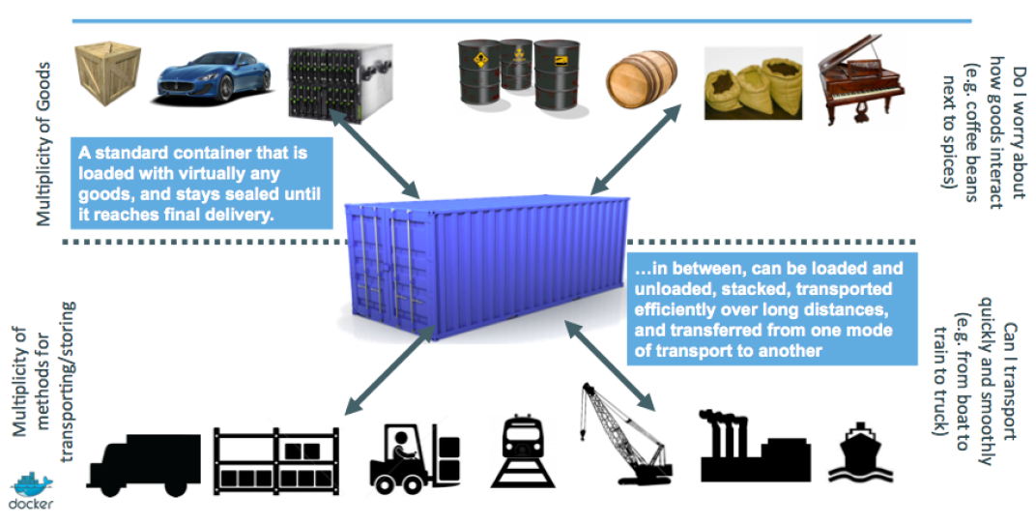
Intermodal shipping containers

Slide 10
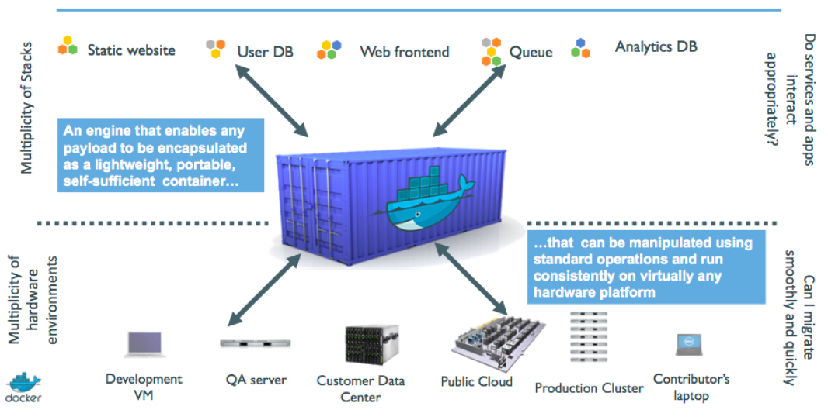
A shipping container system for applications

Slide 11
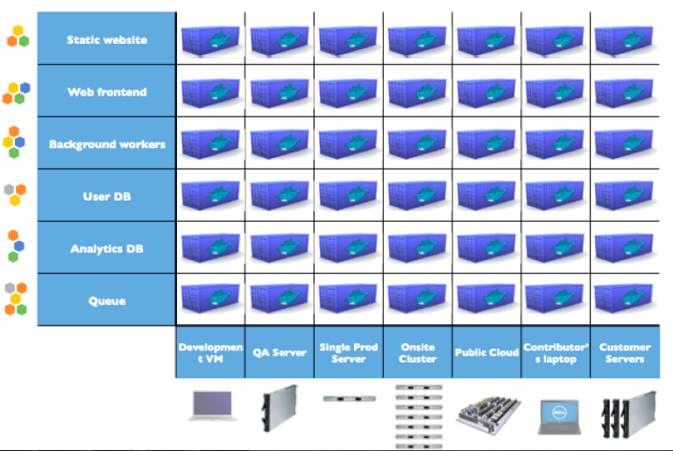
Eliminate the matrix from Hell

Slide 12
Docker high-level roadmap
Step 1: containers as lightweight VMs
Step 2: commoditization of containers
Step 3: shipping containers efficiently
Step 4: containers in a modern software factory

Slide 13
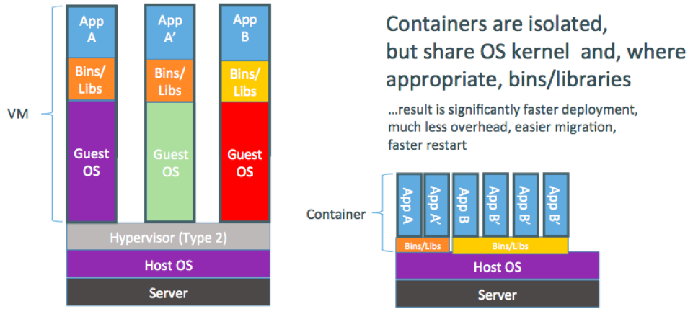
Step 1: containers as lightweight VMs
This drew attention from hosting and PAAS industry.
Highly technical audience with strong ops culture.

Slide 14
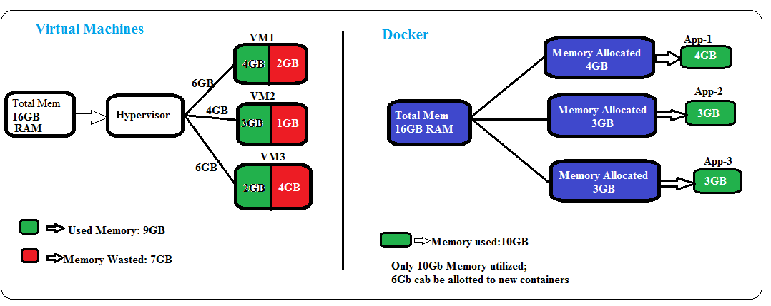

Slide 15
Step 2: commoditization of containers
Container technology has been around for a while.
(c.f. LXC, Solaris Zones, BSD Jails, LPAR...)
So what's new?
Standardize the container format, because containers were not portable.
Analogy:
shipping containers are not just steel boxes
they are steel boxes that are a standard size, with the same hooks and holesMake containers easy to use for developers.
Emphasis on re-usable components, APIs, ecosystem of standard tools.
Make containers easy to use for developers.
Improvement over ad-hoc, in-house, specific tools.

Slide 16
Running containers everywhere
Maturity of underlying technology (cgroups, namespaces, copy-on-write systems).
Ability to run on any Linux server today: physical, virtual, VM, cloud, OpenStack...
Ability to move between any of the above in a matter of seconds-no modification or delay.
Ability to share containerized components.
Self contained environment - no dependency hell.
Tools for how containers work together: linking, discovery, orchestration...

Slide 17
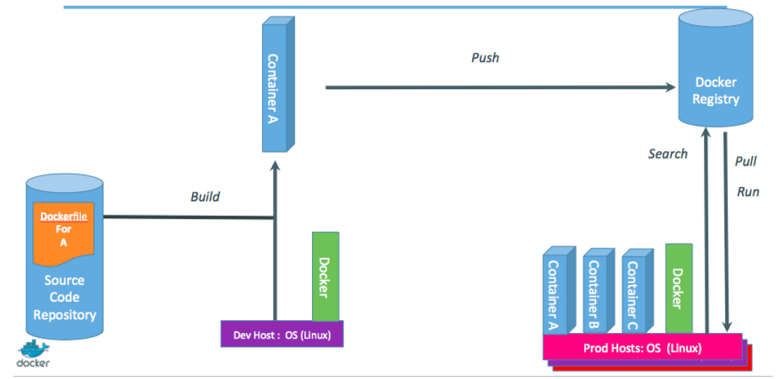
Step 4: containers in a modern software factory
The container becomes the new build artefact.
The same container can go from dev, to test, to QA, to prod.

Slide 18
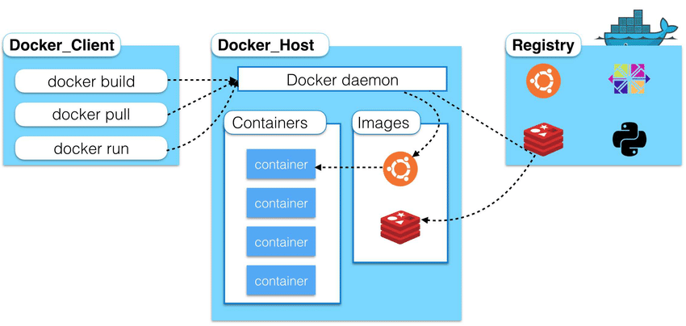
Docker architecture

Slide 19
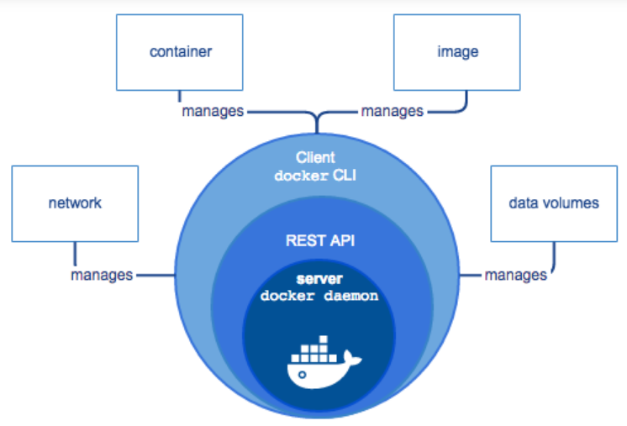

Slide 20
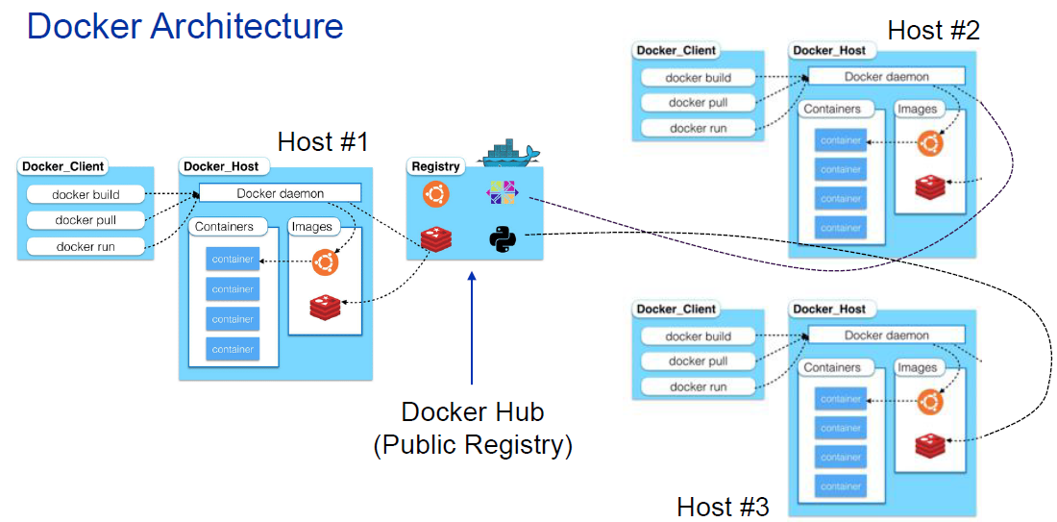

Slide 21
Docker is a client-server application
The Docker daemon
Receives and processes incoming Docker API requests.
The Docker client
Command line tool - the docker binary.
Talks to the Docker daemon via the Docker API.
Docker Hub Registry
Public image registry.
The Docker daemon talks to it via the registry API.

Slide 22
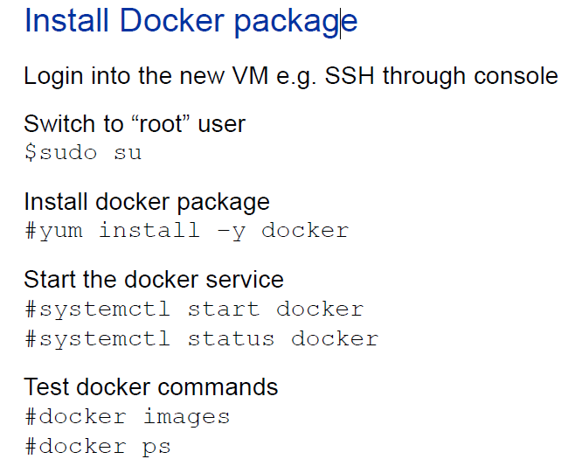

Slide 23
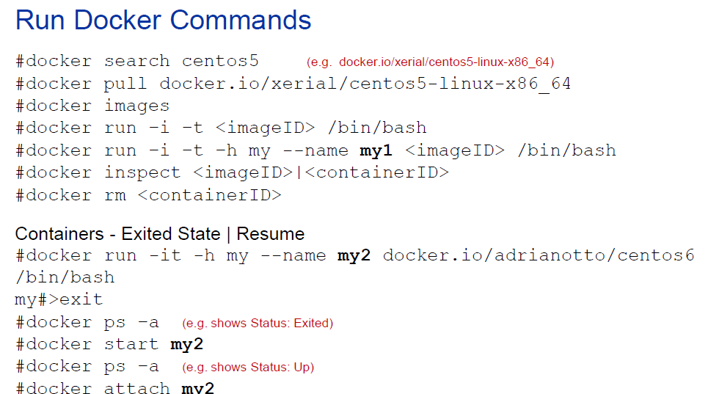

Slide 24
