Slide 1
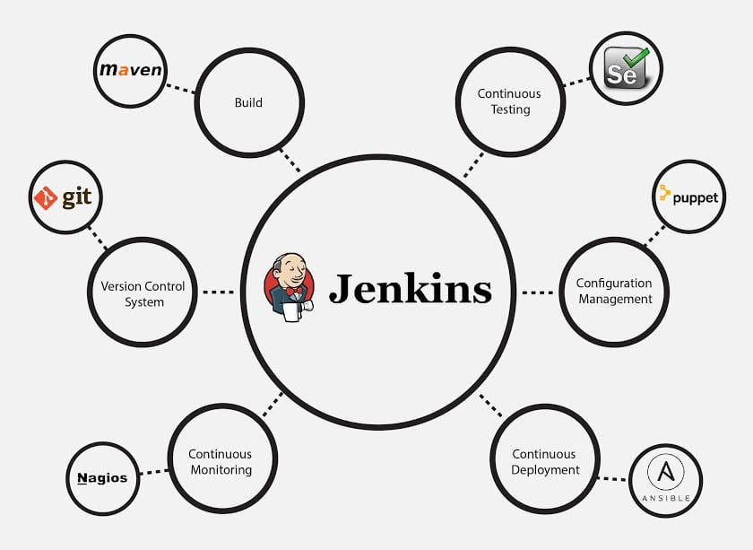

Slide 2
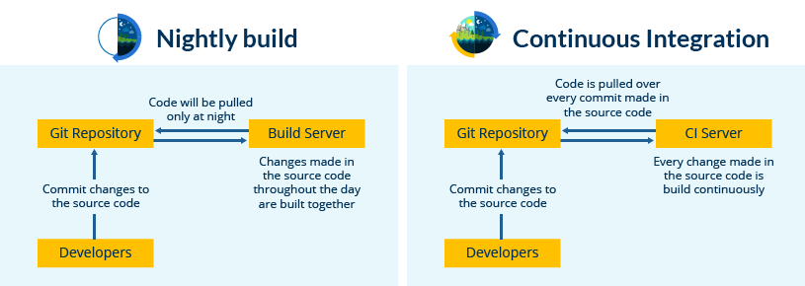

Slide 3
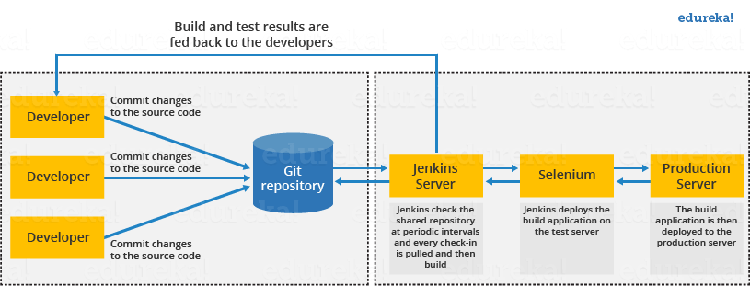

Slide 4
Jenkins Pipeline
Jenkins has proven to be an expert in implementing continuous integration, continuous testing and continuous deployment.
When it comes to continuous delivery, Jenkins uses a feature called Jenkins pipeline.

Slide 5
Continuous Delivery ?

Slide 6
Continuous delivery is the capability to release a software at all times. It is a practice which ensures that the software is always in a production-ready state.
It means that every time a change is made to the code or the infrastructure, the software team must work in such a way that these changes are built quickly and tested using various automation tools after which the build is subjected to production.
Continuous delivery ensures that the software is built, tested and released more frequently. It reduces the cost, time and risk of the incremental software releases.

Slide 7
Jenkins pipeline?

Slide 8
A pipeline is a collection of jobs that brings the software from version control into the hands of the end users by using automation tools
multiple Jenkins pipeline releases including, Jenkins Build flow, Jenkins Build Pipeline plugin, Jenkins Workflow, etc

Slide 9
key features of these plugins?
They represent multiple Jenkins jobs as one whole workflow in the form of a pipeline.

Slide 10
What do these pipelines do?

Slide 11
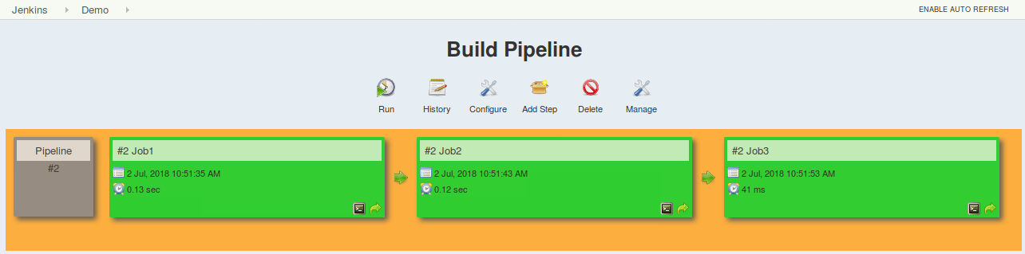
These pipelines are a collection of Jenkins jobs which trigger each other in a specified sequence.

Slide 12
This approach is effective for deploying small applications. But what happens when there are complex pipelines with several processes (build, test, unit test, integration test, pre-deploy, deploy, monitor) running 100’s of jobs?

Slide 13
To overcome this issue, a new feature called Jenkins Pipeline Project was introduced.
The key feature of this pipeline is to define the entire deployment flow through code.
What does this mean?

Slide 14
It means that all the standard jobs defined by Jenkins are manually written as one whole script and they can be stored in a version control system.
It basically follows the ‘pipeline as code’ discipline.
Instead of building several jobs for each phase, you can now code the entire workflow and put it in a Jenkinsfile.

Slide 15
Jenkins Pipeline Advantages
It models simple to complex pipelines as code by using Groovy DSL (Domain Specific Language)
The code is stored in a text file called the Jenkinsfile which can be checked into a SCM (Source Code Management)
Improves user interface by incorporating user input within the pipeline
It is durable in terms of unplanned restart of the Jenkins master
It can restart from saved checkpoints
It supports complex pipelines by incorporating conditional loops, fork or join operations and allowing tasks to be performed in parallel
It can integrate with several other plugins

Slide 16
What is a Jenkinsfile?
A Jenkinsfile is a text file that stores the entire workflow as code and it can be checked into a SCM on your local system. How is this advantageous? This enables the developers to access, edit and check the code at all times.
The Jenkinsfile is written using the Groovy DSL and it can be created through a text/groovy editor or through the configuration page on the Jenkins instance.
It is written based on two syntaxes, namely:
Declarative pipeline syntax
Scripted pipeline syntax

