Slide 1
HoloCollab EduMeet
AI-Powered AR Collaborative Learning Platform
Working Application Showcase

Slide 2
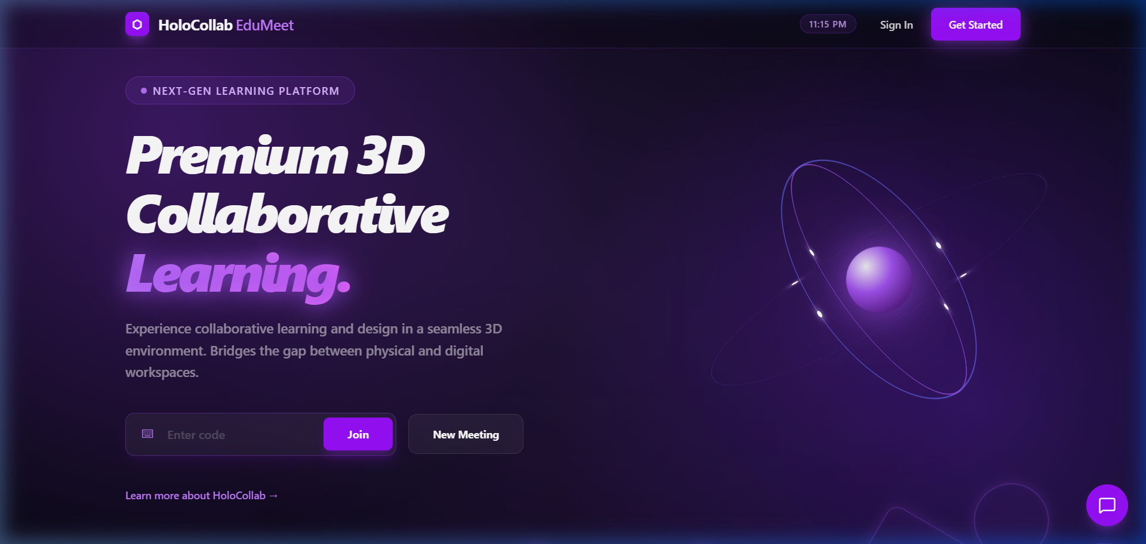
Landing Page
The gateway to collaborative learning with AR and AI.

Slide 3
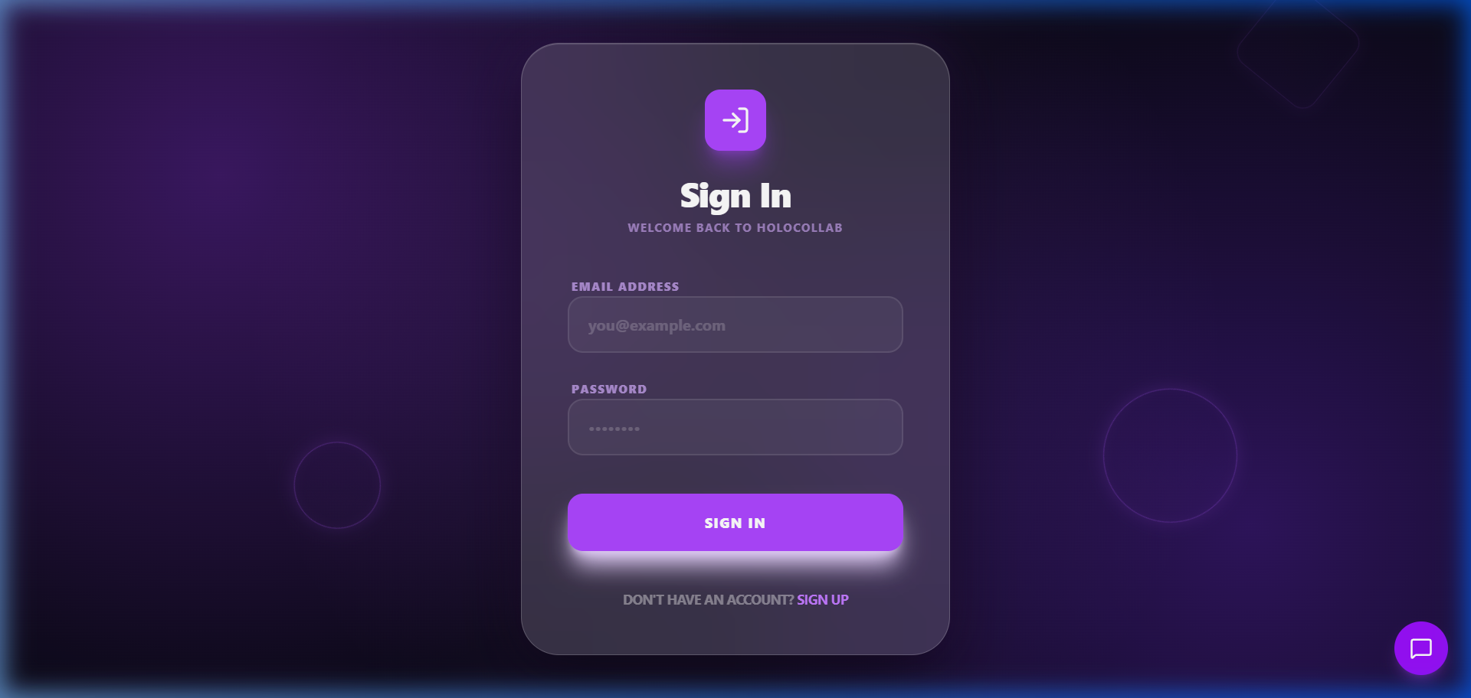
Login Page
Secure access with email authentication and form validation.

Slide 4
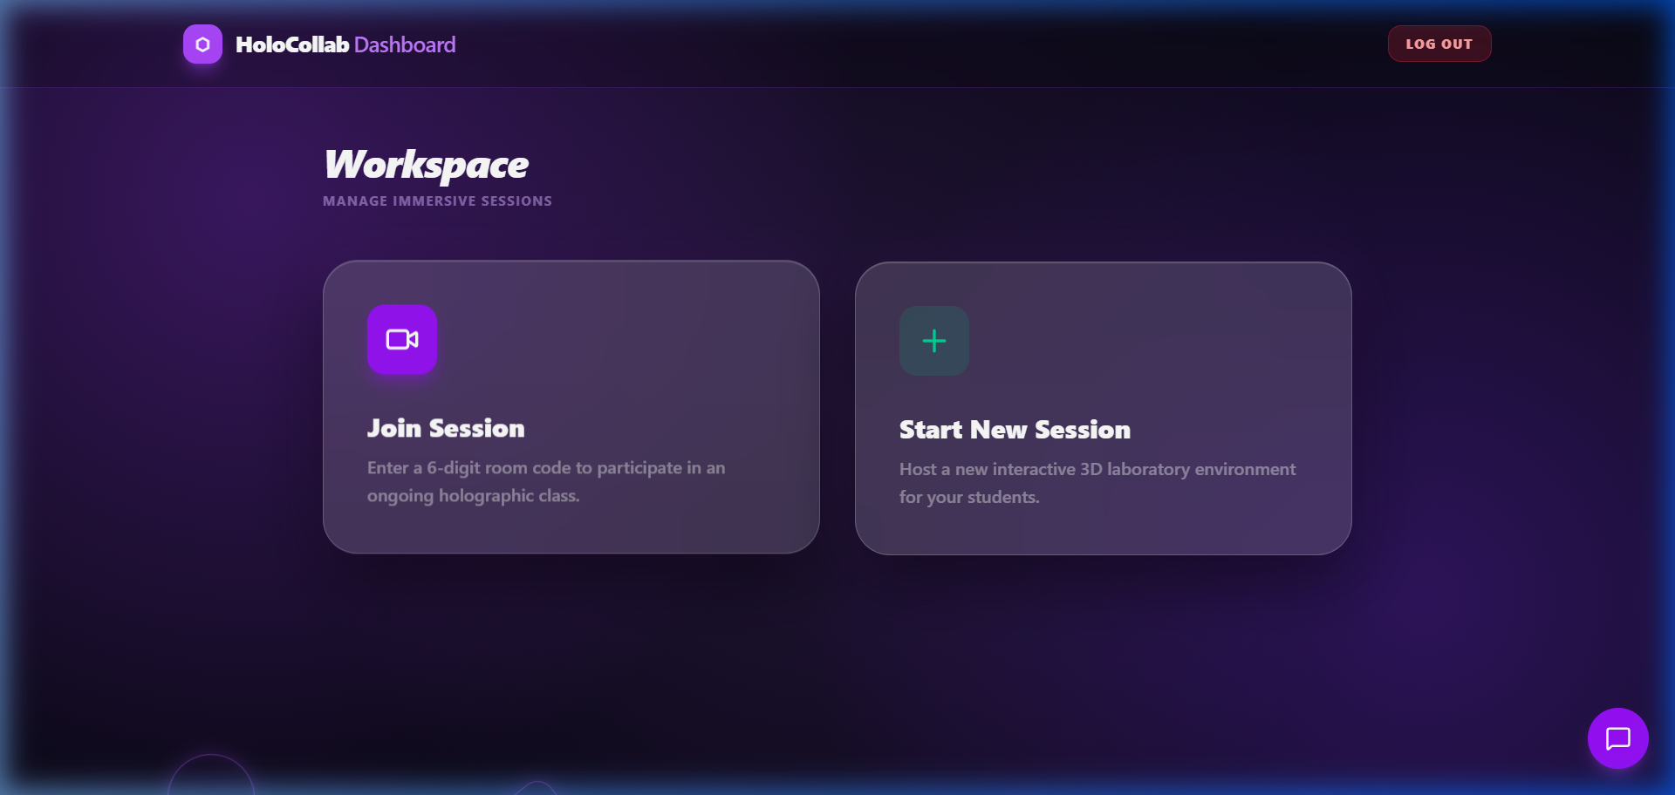
User Dashboard
Central hub for managing meetings, sessions, and learning content.

Slide 5
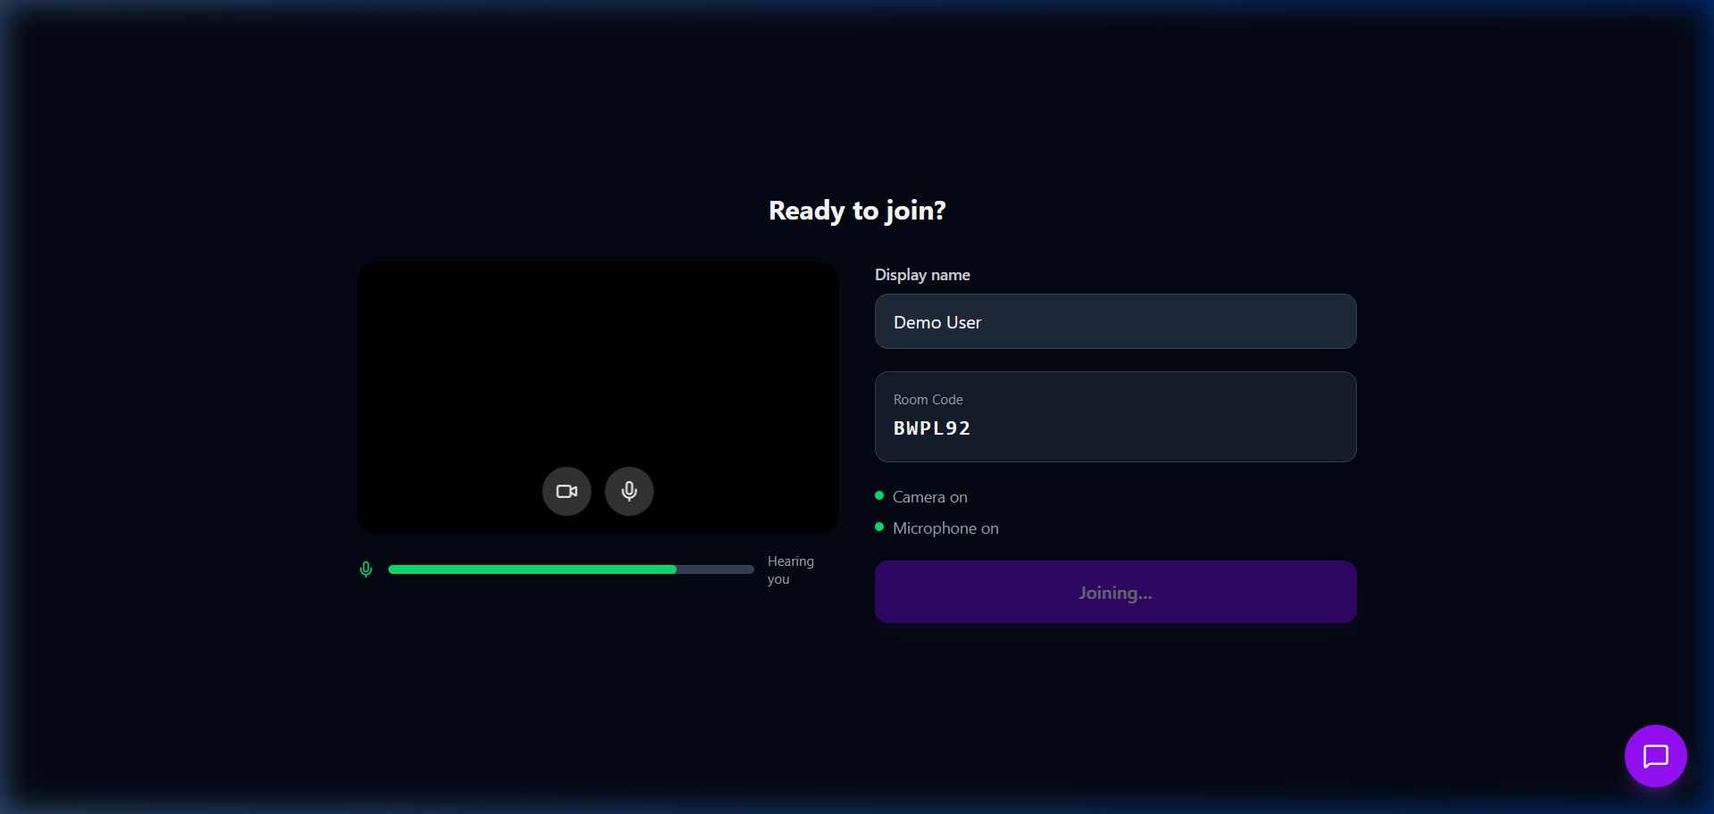
Pre-Join Lobby
Preview camera and mic settings before entering the collaborative space.

Slide 6
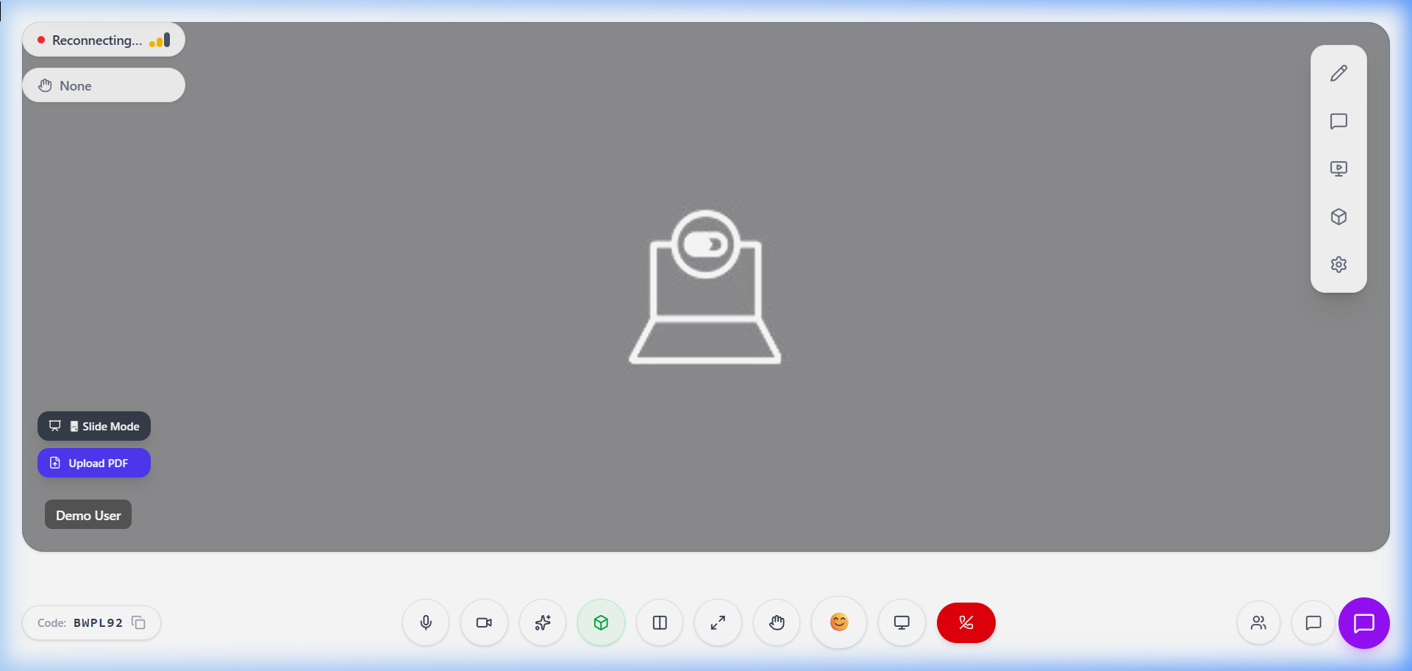
Interactive session
Real-time 3D model interaction, AI chat assistant, and AR collaboration.

