Slide 1
AMARANTH BROWN BAG
AI as editorial assistant
AI reads. You write.
Brief the reader
Save your rules and style guide
Compare different readers
Reliable AI for Humanists
01
Notes:
SLIDE 1. 0–1 minutes (1 minutes)
Welcome. Today has the three topics promised on the flyer: teaching the assistant how to read your work, keeping rules and a style guide, and trying different reader perspectives. You can participate by watching and judging the examples. People with a laptop can use the webpage. This is a practice boundary for this session, not a claim that all other uses are wrong.

Slide 2
Shared example
One paragraph we can all judge
Students may use generative AI tools in this course where appropriate, but should not use them to complete assignments for them. Any use of AI should be disclosed. Work that is substantially produced by AI will not receive credit and may be referred as an academic integrity violation. Students are responsible for the accuracy of everything they submit. If you are unsure whether a particular use is permitted, ask before submitting. The goal of this policy is to support learning rather than to prohibit technology, and I expect students to use their judgment.
What would a student need to know before acting on this?
Invented practice text from the workshop webpage
02
Notes:
SLIDE 2. 1–3 minutes (2 minutes)
Give the room 30 seconds to read. Ask for one phrase that seems open to interpretation. Do not turn this into a debate over the ideal AI policy. We are examining how an assistant reads a familiar text. The example is invented and makes no claim about university policy. Participants may use their own shareable paragraph instead.
COMPANION
https://amaranth.unm.edu/reliable-ai/practice-texts#3-a-syllabus-policy

Slide 3
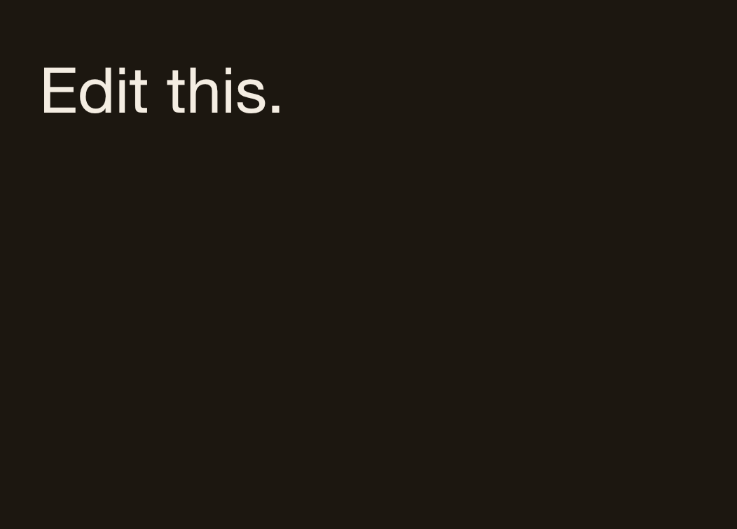
Teach AI to read like you do
A broad request leaves choices open
Prompt from the webpage
Response excerpt
Any use of AI must be disclosed.
[…]
“should” → “must.” “Any use of AI should be disclosed” states a preference where the rest of the paragraph states requirements.
Would you accept “should” becoming “must”?
Existing provisional reply, 22 Sep 2026
03
Notes:
SLIDE 3. 3–6 minutes (3 minutes)
Display the source sentence first by pointing back to the prior slide, then show this response. Ask for a show of hands before you explain. The assistant carried out an underspecified editing request. Its proposed change may be reasonable, but choosing the strength of a requirement belongs to the author. It also explained the change. Avoid describing every rewrite as a malfunction. This is a task-definition problem. The source data attributes this reply to Claude Opus 5 on 2026-09-22. Its provenance note says it was generated in the authoring conversation, with prior discussion of the intended lesson. This is a provisional source example, not an independently rerun demonstration. Selected excerpts preserve the source wording and order. […] marks an internal cut.
DISPLAYED PROMPT
Edit this.
COMPANION
https://amaranth.unm.edu/reliable-ai/sessions/editorial-assistant#step-1
SOURCE IDS
baseline, policy-baseline
Source files: /Users/fwgibbs/Dropbox/websites/amaranth/reliable-ai/_data/prompts.yml and /Users/fwgibbs/Dropbox/websites/amaranth/reliable-ai/_data/demos.yml

Slide 4
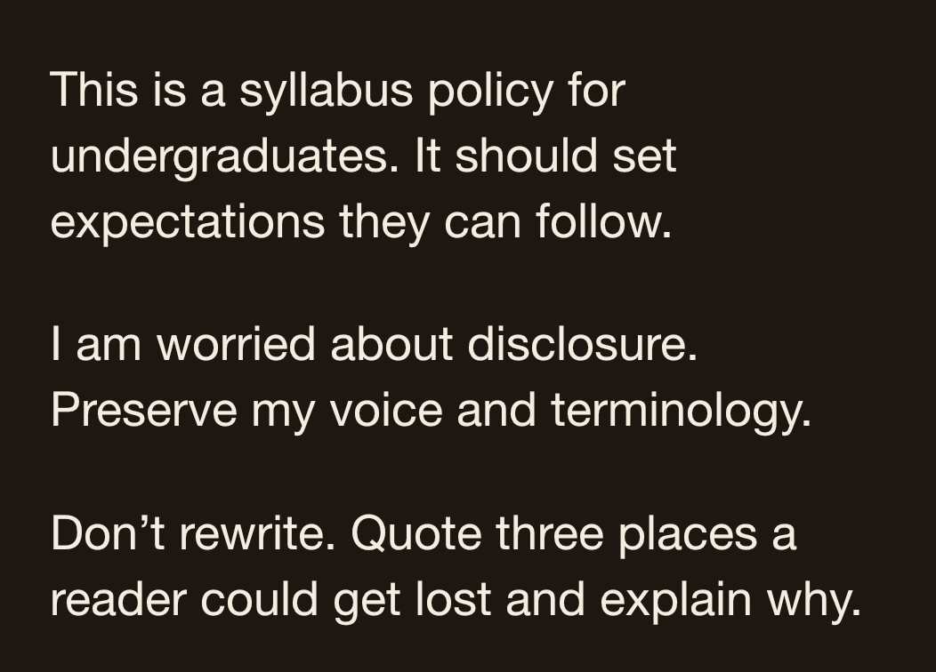
Teach AI to read like you do
The editorial brief gives the reading a purpose
Editorial brief, shortened for display
One finding from the response
“Any use of AI should be disclosed.”
Disclosed how, to whom, in what form? A footnote, a cover note, an appendix listing prompts? The sentence creates an obligation and specifies no way to discharge it, so a conscientious student either over-discloses or guesses.
Does this identify a decision the writer needs to make?
Existing provisional reply, 22 Sep 2026
04
Notes:
SLIDE 4. 6–10 minutes (4 minutes)
Point out genre, audience, purpose, concern, and scope as they appear in the prompt. Do not explain a general prompting formula at length. Ask the room whether the disclosure comment is useful. The author could add an example or a procedure. We have not yet asked the assistant to write one. The prompt shown is an adapted, filled-in version of editorial-brief, not a claim to reproduce every keystroke of the original run. The source data attributes this reply to Claude Opus 5 on 2026-09-22. Its provenance note says it was generated in the authoring conversation, with prior discussion of the intended lesson. This is a provisional source example, not an independently rerun demonstration. Selected excerpts preserve the source wording and order. […] marks an internal cut.
DISPLAYED PROMPT
This is a syllabus policy for undergraduates. It should set expectations they can follow.
I am worried about disclosure. Preserve my voice and terminology.
Don’t rewrite. Quote three places a reader could get lost and explain why.
FULL PROMPT
This is a syllabus policy for undergraduates in a history course. It is trying to set expectations students can actually follow.
I am worried about enforceability and disclosure. Do not change my voice or terminology.
Don’t rewrite anything. Tell me the three places a reader is most likely to get lost. Quote the exact sentence and explain why.
COMPANION
https://amaranth.unm.edu/reliable-ai/sessions/editorial-assistant#step-2
SOURCE IDS
editorial-brief, policy-briefed
Source files: /Users/fwgibbs/Dropbox/websites/amaranth/reliable-ai/_data/prompts.yml and /Users/fwgibbs/Dropbox/websites/amaranth/reliable-ai/_data/demos.yml

Slide 5
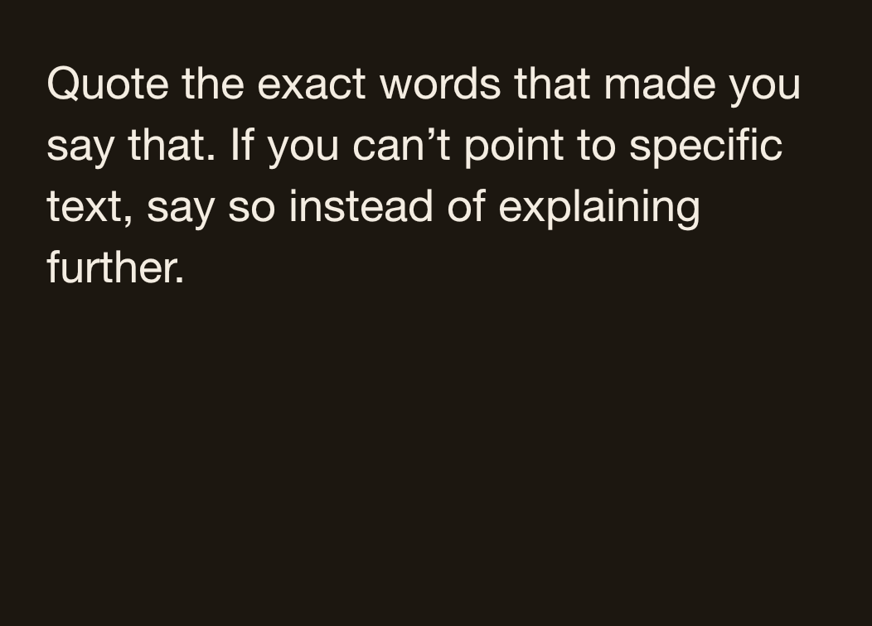
Teach AI to read like you do
A quotation gives you something to check
Follow-up prompt from the webpage
Response excerpt after a vague comment
“Students respond better to guidelines when they understand the reasoning” is a general belief about teaching, not something I read in your text.
[…]
Neither was a finding about your paragraph.
Is this an observation about the text, or advice added to it?
Existing provisional reply, 22 Sep 2026
05
Notes:
SLIDE 5. 10–13 minutes (3 minutes)
Context: the prior loose follow-up had asserted that students respond better when they understand a policy’s reasoning. This reply distinguishes that general belief from a finding in the paragraph. Ask the room to make that distinction before explaining. Do not claim that a quotation proves a criticism correct, or that an omission cannot be a problem. If time permits, mention the briefed response’s separate claim that disclosure depends on substantially: the policy actually says any use should be disclosed. This is a concrete finding to reject. The source data attributes this reply to Claude Opus 5 on 2026-09-22. Its provenance note says it was generated in the authoring conversation, with prior discussion of the intended lesson. This is a provisional source example, not an independently rerun demonstration. Selected excerpts preserve the source wording and order. […] marks an internal cut.
DISPLAYED PROMPT
Quote the exact words that made you say that. If you can’t point to specific text, say so instead of explaining further.
COMPANION
https://amaranth.unm.edu/reliable-ai/sessions/editorial-assistant#step-2
SOURCE IDS
quote-it, policy-vague, policy-quoted
Source files: /Users/fwgibbs/Dropbox/websites/amaranth/reliable-ai/_data/prompts.yml and /Users/fwgibbs/Dropbox/websites/amaranth/reliable-ai/_data/demos.yml

Slide 6
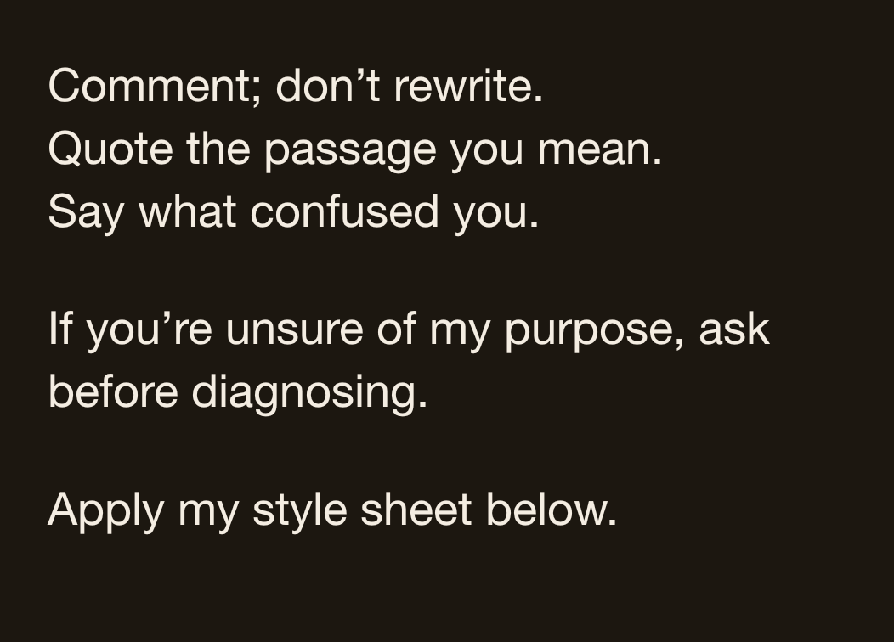
Set up rules and style guides
A short instruction file carries your rules forward
Standing instruction, shortened from webpage
Example file you save and reuse
MY STYLE GUIDE
Preserve terms I define.
Keep uncertainty such as “may” and “suggests.”
Distinguish a textual observation from an inference.
Ask when a missing fact affects the reading.
Which instruction would matter most for your writing?
Worked instruction-file example, not a recorded reply
06
Notes:
SLIDE 6. 13–16 minutes (3 minutes)
This is the rules-and-style-guide topic promised on the flyer. The right side is an example of a file the author chooses and saves. It is not an AI transcript. Explain the difference between the brief for a particular document and standing preferences. Copying this short file into a new conversation is enough to start. Optional platform-specific project setup belongs in the full tutorial. Ask for one recurring annoyance from the room. A style guide can begin with four lines and grow from actual corrections.
DISPLAYED PROMPT
Comment; don’t rewrite.
Quote the passage you mean.
Say what confused you.
If you’re unsure of my purpose, ask before diagnosing.
Apply my style sheet below.
FULL PROMPT
When I bring you my writing, you are my editor, not my ghostwriter.
Comment; don’t rewrite.
Quote the text you’re commenting on.
Say what confused you.
If you’re unsure what I’m trying to do, ask before diagnosing.
Then apply my style sheet below.
COMPANION
https://amaranth.unm.edu/reliable-ai/sessions/editorial-assistant#step-5
SOURCE IDS
standing-instruction
Source files: /Users/fwgibbs/Dropbox/websites/amaranth/reliable-ai/_data/prompts.yml and /Users/fwgibbs/Dropbox/websites/amaranth/reliable-ai/_data/demos.yml

Slide 7
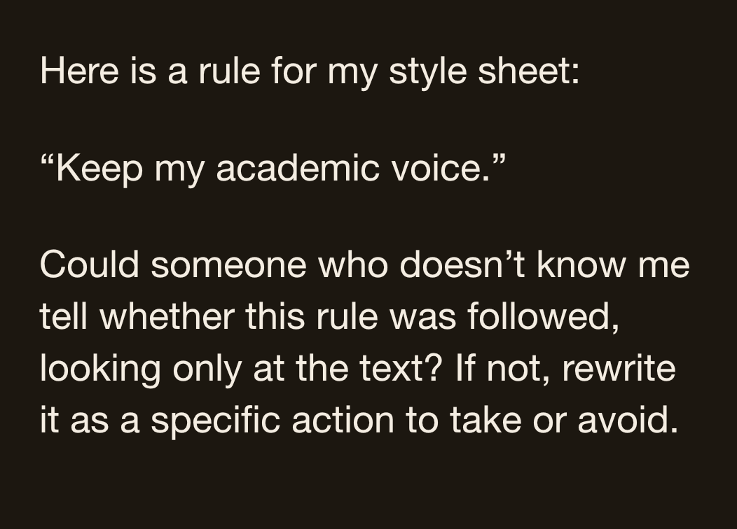
Set up rules and style guides
Specific rules are easier to evaluate
Rule-sharpening prompt, adapted
Worked example of a revised rule
VAGUE PREFERENCE
Keep my academic voice.
CHECKABLE RULE
Preserve qualifications such as “may” and “suggests.” Flag a concern in a comment rather than silently strengthening the claim.
What could you point to if this rule were broken?
Worked rule example, not a recorded reply
07
Notes:
SLIDE 7. 16–18 minutes (2 minutes)
Ask the audience how they would know the first rule had been followed. Then discuss the concrete test in the second. The right side is a prepared example, not an observed model response. Mention that rules are instructions to evaluate, not guarantees of compliance. If someone asks about extracting style from their writing, point to style-extract in the tutorial: supply a few representative passages, review the proposed rules, and retain only those you endorse.
DISPLAYED PROMPT
Here is a rule for my style sheet:
“Keep my academic voice.”
Could someone who doesn’t know me tell whether this rule was followed, looking only at the text? If not, rewrite it as a specific action to take or avoid.
COMPANION
https://amaranth.unm.edu/reliable-ai/sessions/editorial-assistant#step-4
SOURCE IDS
rule-sharpen, style-extract
Source files: /Users/fwgibbs/Dropbox/websites/amaranth/reliable-ai/_data/prompts.yml and /Users/fwgibbs/Dropbox/websites/amaranth/reliable-ai/_data/demos.yml

Slide 8
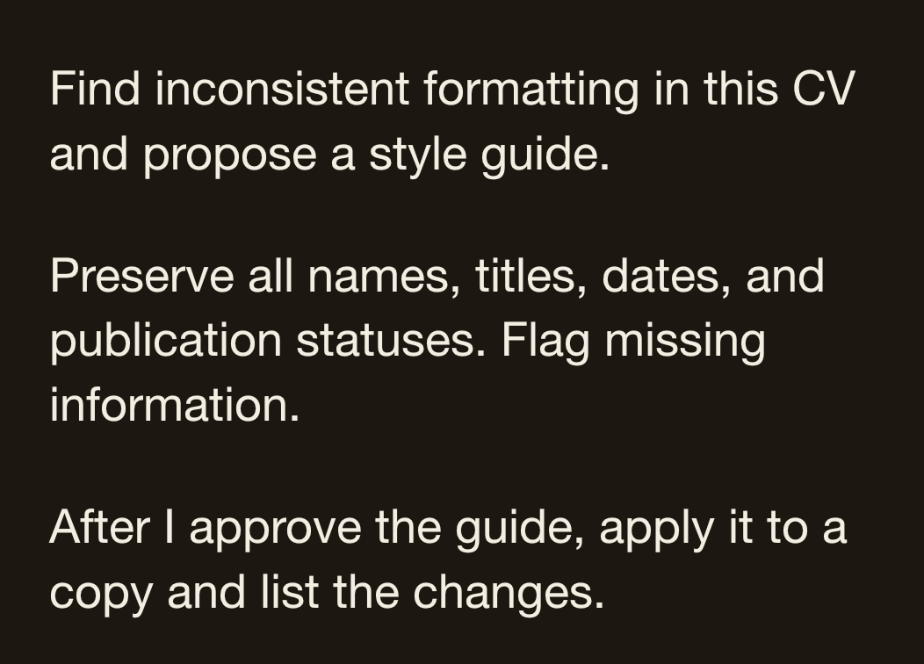
Set up rules and style guides
A CV makes formatting rules visible
New prompt for the companion tutorial
Prepared formatting example
ORIGINAL ENTRIES
2024 Community Memory lecture
Archives and Access, seminar, 2023
AFTER APPLYING THE GUIDE
2024. Community Memory. Lecture.
2023. Archives and Access. Seminar.
What may change? What information must stay exactly the same?
Fictional entries and prepared result, not an AI transcript
08
Notes:
SLIDE 8. 18–21 minutes (3 minutes)
This is a brief application of explicit rules. The talk entries are fictional. The approved guide is year first, title second, event type third, periods between fields, and initial capitals for event types. Dates and titles remain unchanged. Do not invent missing venues or other facts. Show how an audit leads to a style decision and then a controlled formatting pass. An assistant may change layout after you approve the rule. The reader-first theme concerns who makes the decision. The display is a prepared before/after example, not an observed model output. File manipulation depends on the tool, so use a copy and inspect the result. Full two-stage prompts and a larger fictional specimen are in the presenter guide.
DISPLAYED PROMPT
Find inconsistent formatting in this CV and propose a style guide.
Preserve all names, titles, dates, and publication statuses. Flag missing information.
After I approve the guide, apply it to a copy and list the changes.
FULL PROMPT
Review this CV for inconsistent formatting. List the inconsistencies and propose a short style guide.
Preserve every name, title, date, and publication status. Flag missing information.
After I approve the guide, apply formatting changes to a copy and list what changed.
COMPANION
New CV example; full prompts in presenter guide

Slide 9
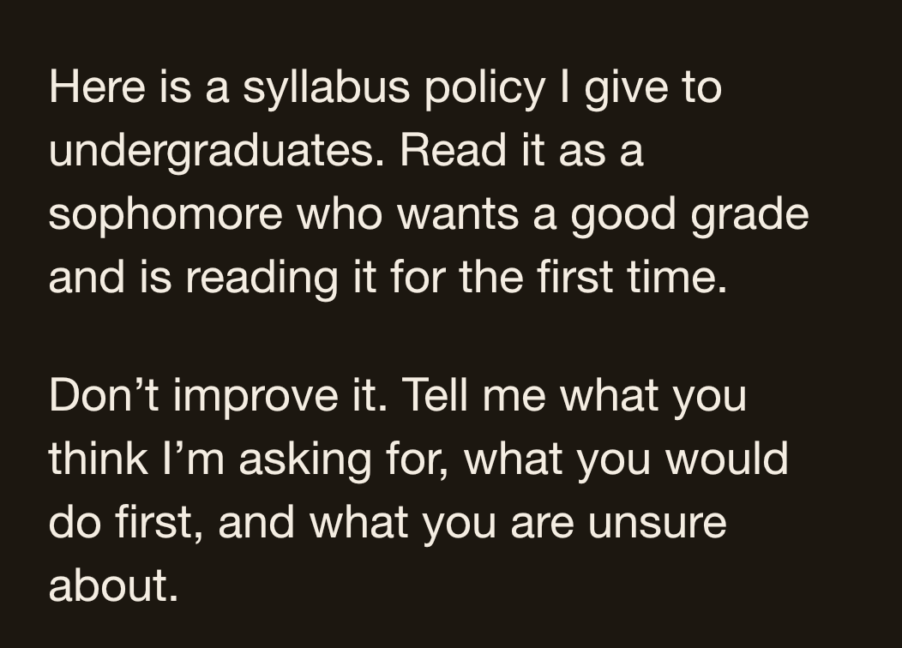
Role-play as different readers
A student reader notices the cost of asking
Student-reader prompt, adapted to the policy
Student-role response excerpt
How do I disclose? Do I write it at the end, email you, is there a form? And if I disclose something that turns out not to be allowed, have I just reported myself?
If I ask you beforehand, does that go on a record anywhere?
Which concern would you want to check with actual students?
Existing provisional reply, 22 Sep 2026
09
Notes:
SLIDE 9. 21–24 minutes (3 minutes)
Reintroduce the same policy from slide 2. Ask what this perspective helps the author notice. Treat the response as a possible reaction, not evidence of what actual students think. The original source run adapted assignment to syllabus policy; the displayed prompt is a shorter adaptation. The source excerpt is unchanged. The source data attributes this reply to Claude Opus 5 on 2026-09-22. Its provenance note says it was generated in the authoring conversation, with prior discussion of the intended lesson. This is a provisional source example, not an independently rerun demonstration. Selected excerpts preserve the source wording and order. […] marks an internal cut.
DISPLAYED PROMPT
Here is a syllabus policy I give to undergraduates. Read it as a sophomore who wants a good grade and is reading it for the first time.
Don’t improve it. Tell me what you think I’m asking for, what you would do first, and what you are unsure about.
COMPANION
https://amaranth.unm.edu/reliable-ai/sessions/editorial-assistant#step-3
SOURCE IDS
role-confused-student, policy-student
Source files: /Users/fwgibbs/Dropbox/websites/amaranth/reliable-ai/_data/prompts.yml and /Users/fwgibbs/Dropbox/websites/amaranth/reliable-ai/_data/demos.yml

Slide 10
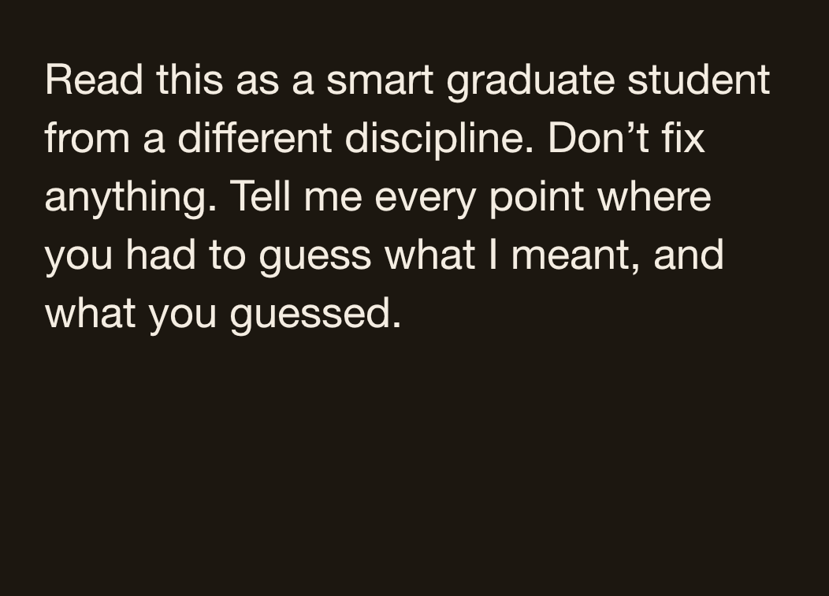
Role-play as different readers
An outsider reader notices the missing definition
Outsider-reader prompt from the webpage
Outsider-role response excerpt
“substantially produced” — I guessed a proportion of words, maybe more than half. But it could mean the intellectual contribution regardless of word count. The two tests would sort different students differently.
What does “substantially” mean in the policy you intended?
Existing provisional reply, 22 Sep 2026
10
Notes:
SLIDE 10. 24–27 minutes (3 minutes)
Ask the audience to identify the actual authorial decision: what definition or examples would make the policy actionable? The reader role helps generate a question, but its guesses are not evidence about students or the institution. Use the same text and brief when comparing roles. Do not promise that two runs will produce these exact differences. The source data attributes this reply to Claude Opus 5 on 2026-09-22. Its provenance note says it was generated in the authoring conversation, with prior discussion of the intended lesson. This is a provisional source example, not an independently rerun demonstration. Selected excerpts preserve the source wording and order. […] marks an internal cut.
DISPLAYED PROMPT
Read this as a smart graduate student from a different discipline. Don’t fix anything. Tell me every point where you had to guess what I meant, and what you guessed.
COMPANION
https://amaranth.unm.edu/reliable-ai/sessions/editorial-assistant#step-3
SOURCE IDS
role-outsider, policy-outsider
Source files: /Users/fwgibbs/Dropbox/websites/amaranth/reliable-ai/_data/prompts.yml and /Users/fwgibbs/Dropbox/websites/amaranth/reliable-ai/_data/demos.yml

Slide 11
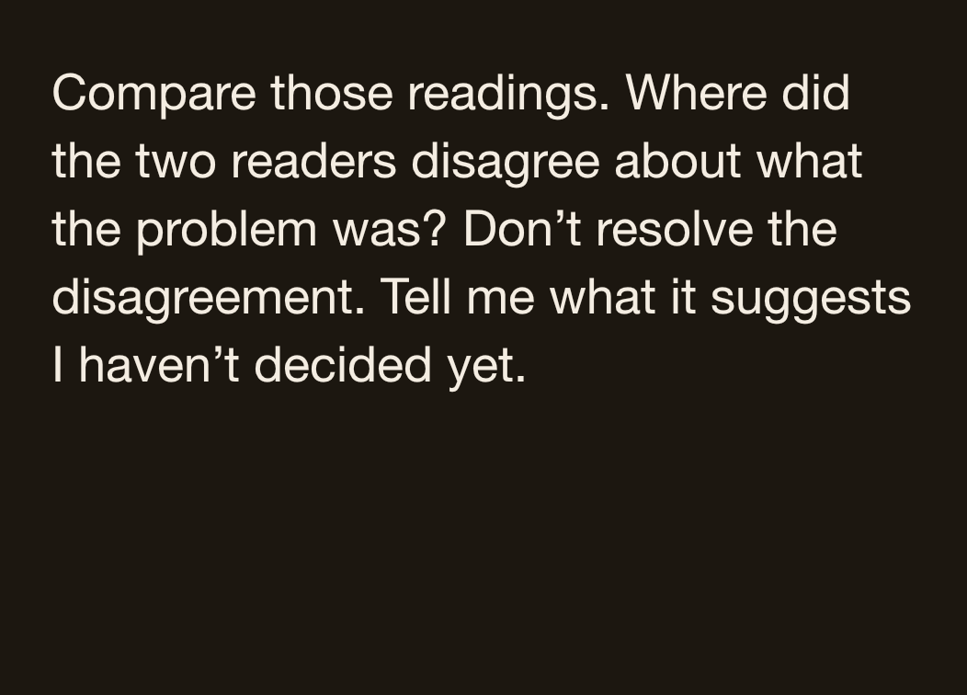
Role-play as different readers
The comparison still needs your judgment
Comparison prompt, lightly shortened
Comparison response excerpt
What that suggests you have not decided: whether this policy is instruction or enforcement.
[…]
The present text is trying to be both, which is why “ask before submitting” reads as an open door to one reader and a tripwire to the other.
Could a policy reasonably do both?
Existing provisional reply, 22 Sep 2026
11
Notes:
SLIDE 11. 27–30 minutes (3 minutes)
Let the room challenge the apparent choice. The response may raise a useful tension, but instruction and enforcement are not necessarily incompatible. The outsider reply also did not explicitly say it accepted ask before submitting as a remedy. Do not silently adopt the comparison’s interpretation. Return to the two source readings. These are generated perspectives, not independent human reviewers whose agreement validates a claim. This is the second deliberate accept-or-reject moment. The source data attributes this reply to Claude Opus 5 on 2026-09-22. Its provenance note says it was generated in the authoring conversation, with prior discussion of the intended lesson. This is a provisional source example, not an independently rerun demonstration. Selected excerpts preserve the source wording and order. […] marks an internal cut.
DISPLAYED PROMPT
Compare those readings. Where did the two readers disagree about what the problem was? Don’t resolve the disagreement. Tell me what it suggests I haven’t decided yet.
COMPANION
https://amaranth.unm.edu/reliable-ai/sessions/editorial-assistant#step-3
SOURCE IDS
compare-readers, policy-compare
Source files: /Users/fwgibbs/Dropbox/websites/amaranth/reliable-ai/_data/prompts.yml and /Users/fwgibbs/Dropbox/websites/amaranth/reliable-ai/_data/demos.yml

Slide 12
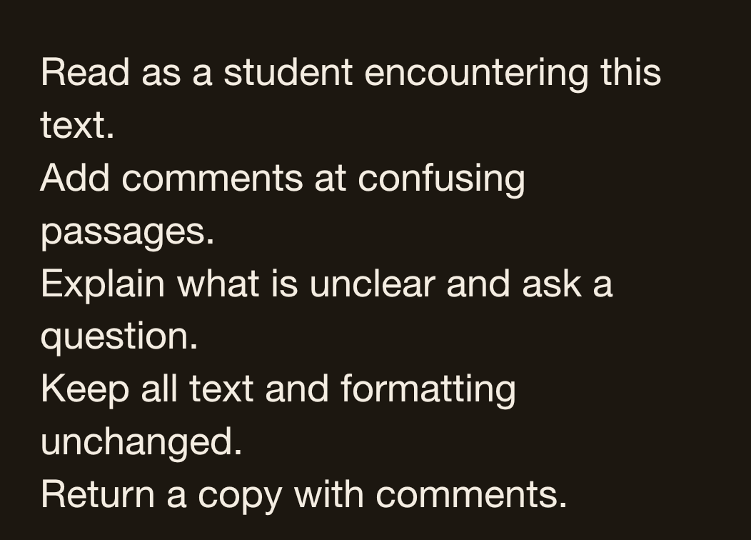
Application in Word
Reader comments can stay beside the passage
Document-comment prompt, shortened
Illustration of an anchored comment
PASSAGE IN THE DOCUMENT
“Any use of AI should be disclosed.”
READER COMMENT
I don’t know how to disclose my use. Should I add a note to the assignment, send an email, or use another method?
Does the comment help the author make a decision?
Prepared annotation example, not a screenshot of Word
12
Notes:
SLIDE 12. 30–33 minutes (3 minutes)
Explain the requested artifact: a copy of the document whose original text is intact and whose comments attach to exact phrases. The prepared annotation shows the desired form. Do not claim that every assistant or free tier can create native Word comments. Test the intended tool with a non-sensitive copy first. If it can only return text, a passage/comment table preserves the reading workflow. The user should inspect each comment and make their own revision. This slide illustrates a proposed demonstration; it does not document a completed live product run.
DISPLAYED PROMPT
Read as a student encountering this text.
Add comments at confusing passages.
Explain what is unclear and ask a question.
Keep all text and formatting unchanged.
Return a copy with comments.
FULL PROMPT
Read the attached document as a first-time student reader. Add comments anchored to the exact passages that confuse you.
Describe the uncertainty and ask a question for the author. Preserve the text and formatting. Return a copy with comments.
If you can’t add Word comments, return a passage/comment table.
COMPANION
New Word example; full prompt in presenter guide

Slide 13
Try it or discuss it
One finding you would use, one you would question
With a laptop
Use the editorial brief on one shareable paragraph. Choose one finding to inspect.
Watching the presentation
Choose a finding from our examples. Would you accept it, reject it, or ask a follow-up?
What in the text supports your decision?
Reliable AI for Humanists
13
Notes:
SLIDE 13. 33–36 minutes (3 minutes)
Allow about 90 seconds of quiet work or discussion with a neighbor, then hear two responses. Nobody needs to log in to contribute. People who already have an output can try an alternate reader perspective. Keep the task to a judgment about one finding, rather than racing through the entire tutorial. Use only material appropriate to share with the selected tool.

Slide 14
What to keep
The next editorial session
A brief for this piece
What it is, who reads it, and what you want examined.
A short file of standing rules
The habits and boundaries you want to carry forward.
A reader perspective
A way to surface questions you can check against the text.
You decide which comments deserve a revision.
Reliable AI for Humanists
14
Notes:
SLIDE 14. 36–38 minutes (2 minutes)
Reconnect the three promised topics. Ask participants to save the brief or rule they would actually reuse. The page contains additional prompts, style extraction, rule testing, and file workflow advice. The live session has sampled the method. Avoid an additional lecture on product setup here.

Slide 15
Continue at your own pace
The webpage is the full walkthrough
amaranth.unm.edu/reliable-ai
The complete sequence
Copyable prompts
Practice texts
More rules and reader roles to try
Reliable AI for Humanists
15
Notes:
SLIDE 15. 38–39 minutes (1 minutes)
The webpage is the durable tutorial for people who missed the session or want to go farther. The slide sequence highlights selected prompts and need not reproduce the full tutorial. The CV and Word prompts are new draft additions in the presenter guide. They can join the tutorial after the examples and selected tools have been tested.
COMPANION
https://amaranth.unm.edu/reliable-ai

Slide 16
Questions and discussion
What would you ask a reader to notice?
A passage you are unsure about
A recurring editing frustration
A reader whose reaction you want to explore
Reliable AI for Humanists
16
Notes:
SLIDE 16. 39–45 minutes (6 minutes)
Invite questions grounded in a real task. If the discussion turns into a general debate about AI, connect it to one observable choice from the demonstration: what was asked, what came back, and how we judged it. Close at 45 minutes.

