Slide 1



Slide 2


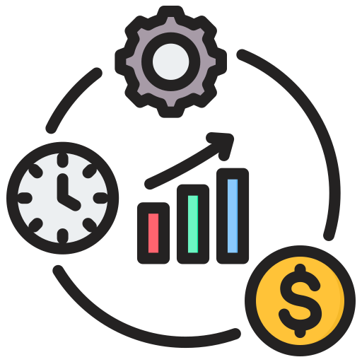


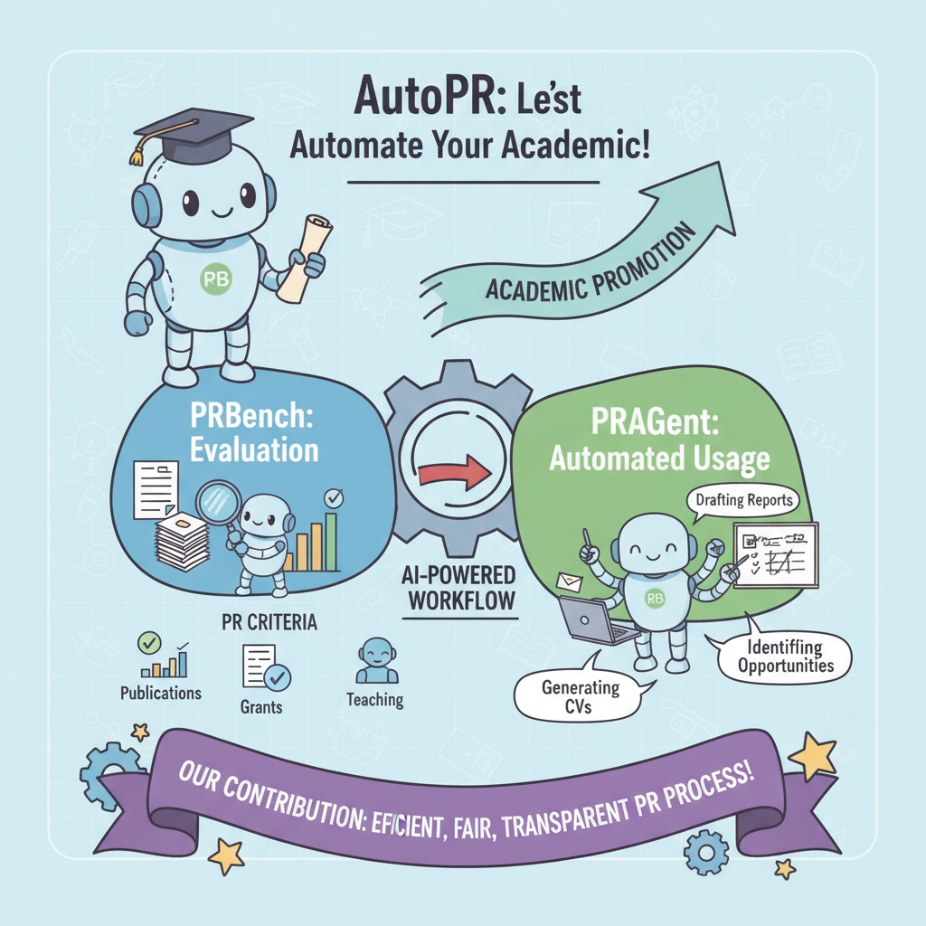





Writing
Paper
Year
(a) 各个会议的发文数量统计
Writing
Paper
Year
(b) 各个平台的知名博主发post量

Slide 3










Influence
Citation
Number of Publications
Time
Money
Human Writing
Paper
(c) Traditional Manual Promotion
Automatic Promotion
Time: 7k⁺s $→$ 1s
Year
Quality
Fidelity: ?
Engagement: ?
Alignment: ?
(a) The trend of the number of publications from various conferences from 2018 to 2024.
PRBench
Paper
(d) Automatic Promotion Task & PRBench
Citation
Content Extraction
Multi-Agent Content Synthesis
Platform-Specific Adaptation
Year
(b) The trend of citations brought about by promotions of 20 researchers with 200 papers (2023-2025).
(e) PRAgent Framework

Slide 4

Influence
Citation
Number of Publications
Human Writing
Time
Money
Paper
(c) Traditional Manual Promotion
Automatic Promotion
Time: 7k⁺s $→$ 1s
Year
Quality
Fidelity: ?
Engagement: ?
Alignment: ?
(a) The trend of the number of publications from various conferences from 2018 to 2024.
PRBench
Paper
Paper w/ PR
(d) Automatic Promotion Task & PRBench
Paper w/o PR
Citation
Content Extraction
Multi-Agent Content Synthesis
Platform-Specific Adaptation
Year
(b) The trend of citations brought by promotions of 20 researchers with 200 papers (2023-2025).
(e) PRAgent Framework

Slide 5

Influence
Citation
Number of Publications
Human Writing
Time
Money
Paper
(c) Traditional Manual Promotion
Automatic Promotion
Time: 7k⁺s $→$ 1s
Year
Quality
Fidelity:
Engagement:
Alignment:
(a) The trend of the number of publications from various conferences from 2018 to 2024.
?
?
PRBench
Paper
?
Paper w/ PR
(d) Automatic Promotion Task & PRBench
Paper w/o PR
Citation
Content Extraction
Multi-Agent Content Synthesis
Platform-Specific Adaptation
Year
(b) The trend of citations brought by promotions of 20 researchers with 200 papers (2023-2025).
(e) PRAgent Framework

