Slide 1
Business Analytics Case Study
Bank Marketing Campaign Analysis
Who subscribes to a term deposit — and why?

Slide 2
Problem Statement
Only 47.4% of contacted customers subscribe to a term deposit.
Every unsuccessful call costs staff time and campaign budget with no return.
This analysis identifies why some customers subscribe while others do not.
Goal: help the bank prioritize calling lists toward the segments most likely to convert.
AnalystLab Africa · Week 5 · 2

Slide 3
Dataset Overview
11,162
17
47.4%
0
Customer Contacts
Features
Subscription Rate
Missing Values
Dataset covers direct marketing campaigns of a Portuguese bank: demographics, financial profile, contact details, and campaign history.

Slide 4
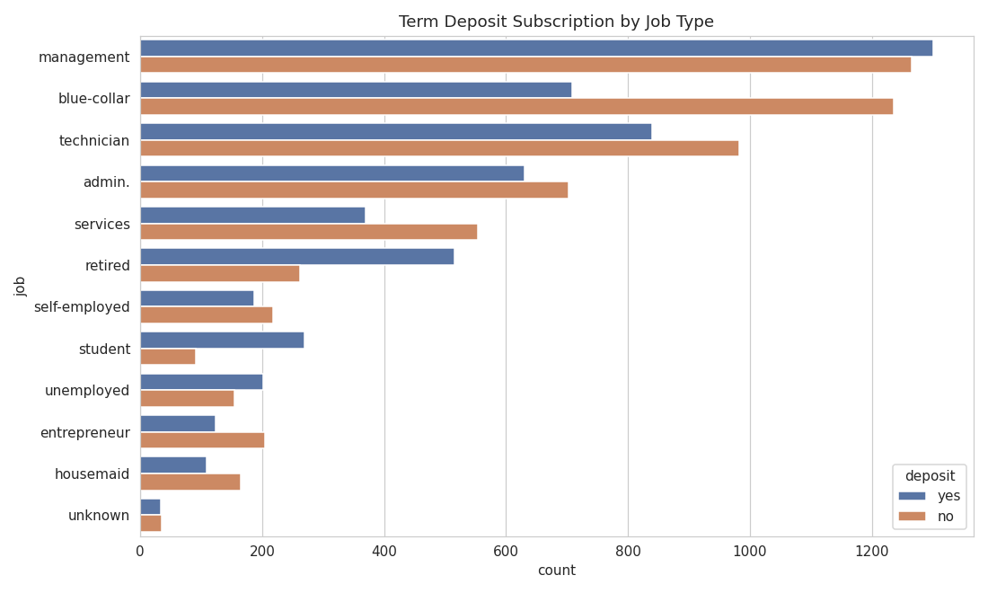
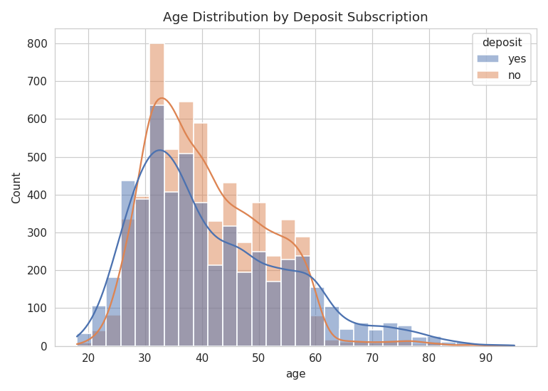
Key Driver: Job Type & Age
Students (74.7%) and retirees (66.3%) subscribe far more than blue-collar workers (36.4%)

Slide 5
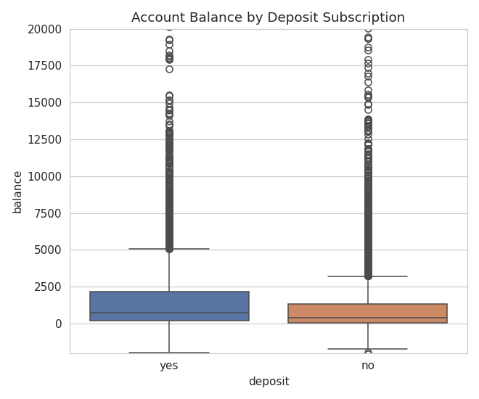
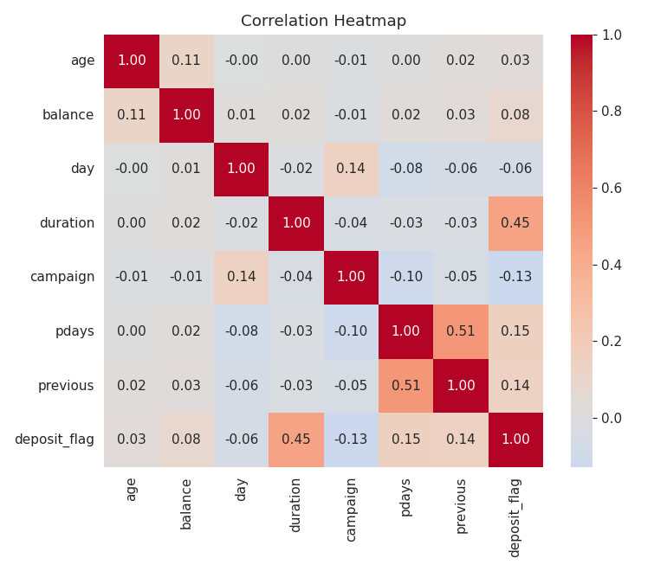
Key Driver: Balance & Correlation
Call duration has the strongest correlation with subscription (0.45) among all numeric variables

Slide 6
Major Findings
Job Type
Students (74.7%) and retirees (66.3%) subscribe far more than working-age groups
Prior Campaign
Prior success predicts a 91.3% re-subscription rate vs 40.7% with no history
Contact Method
Cellular contact converts at 54.3% vs 22.6% for unknown methods
Call Duration
Subscribers spend 537 sec on calls vs 223 sec for non-subscribers
Account Balance
Subscribers average $1,804 balance vs $1,280 for non-subscribers

Slide 7
Recommendations
1
Prioritize recontacting past campaign responders (91.3% re-subscription rate)
2
Target students and retirees with life-stage-specific offers
3
Invest in agent training to extend meaningful call engagement
4
Improve contact data quality — prioritize verified cellular numbers
5
De-prioritize low-yield segments during high-volume campaign periods

Slide 8
Conclusion
Subscription is shaped by identifiable factors: job type, age, prior campaign history, and especially the quality of phone engagement.
Focusing on past responders, life-stage targeting, and call quality can meaningfully improve on the current 47.4% subscription rate.
Thank you

