Slide 1
Kubernetes: Service Discovery Pattern
t: amar_mca

Slide 2
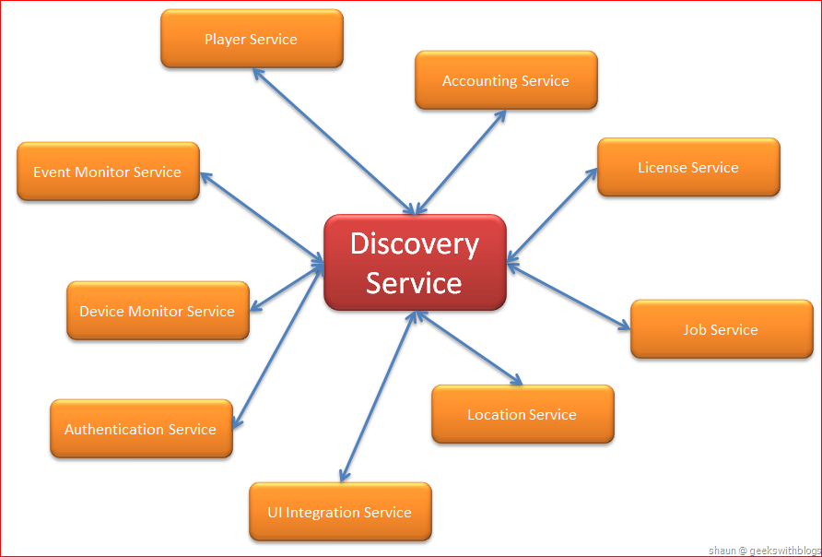

Slide 3
Why Do We Need Service Discovery?
Kubernetes deploys applications through Pods
Pods can be placed on different hosts (nodes), scaled up, scaled down, and moved from one node to another
All those dynamic actions must occur while ensuring that the application remains reachable at all times
Notes:
Kubernetes deploys applications through Pods.
Pods can be placed on different hosts (nodes), scaled up by increasing their number, scaled down by killing the excess ones, and moved from one node to another.
All those dynamic actions must occur while ensuring that the application remains reachable at all times.
To address this critical requirement, we use the Service Discovery pattern.

Slide 4
Client Side Discovery
In this mode, the client is responsible for determining which service instance it should connect to.
It does that by contacting a service registry component, which keeps records of all the running services and their endpoints.
It is the client’s responsibility to load-balance and distribute its request load on the available services.
Notes:
When a new service gets added or another one dies, the Service Registry is automatically updated.

Slide 5
Server Side Discovery
In this mode, a load-balancing layer exists in front of the service instances.
The client connects to the well-defined URL of the load balancer and the latter determines which backend service it shall route the request too.

Slide 6
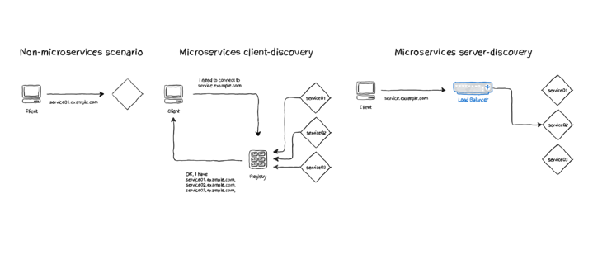
Service Discovery

Slide 7
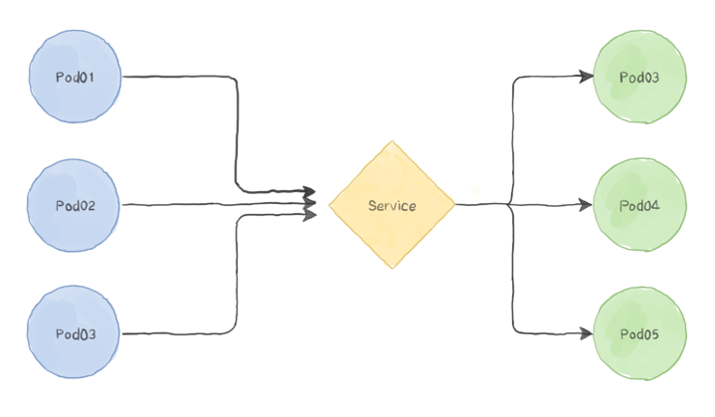
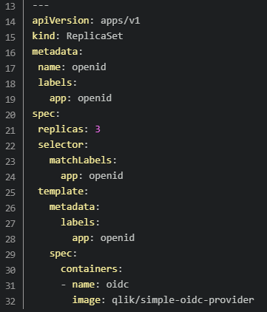
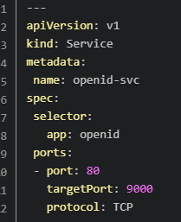
Inter-App Communication
Auth Service
Replica Set
Order Service
Credit Service
Kind: service
Despatch Service

Slide 8
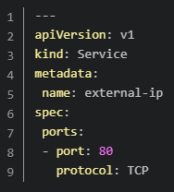
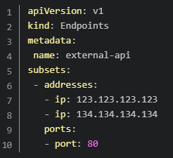
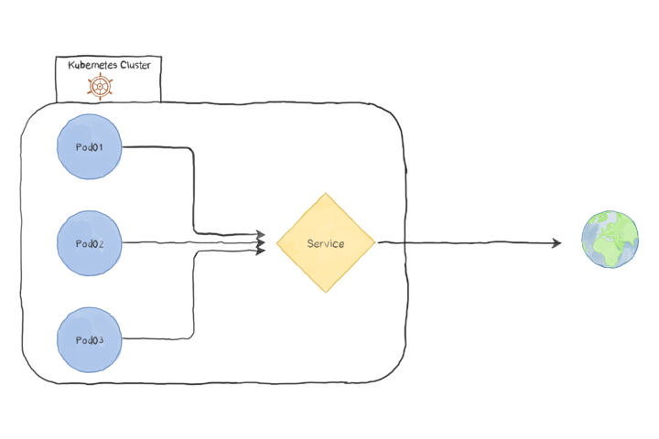
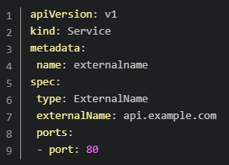
Connecting To an Outside Resource
+
or

Slide 9
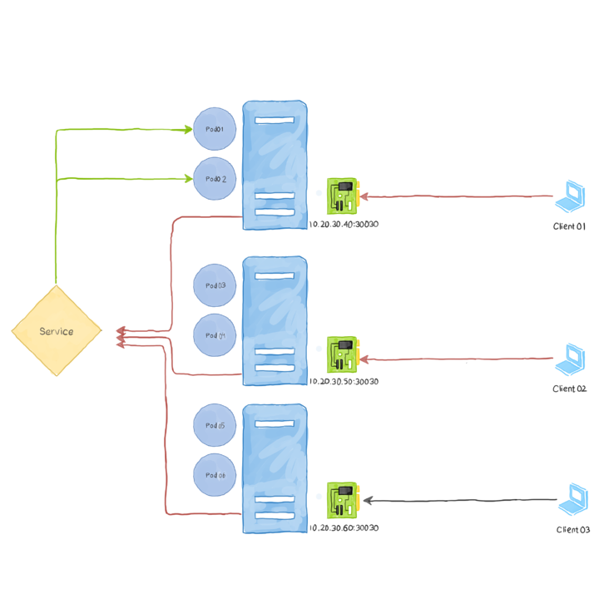
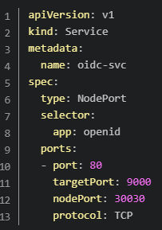
Accepting Outside Connections: Node Port

Slide 10
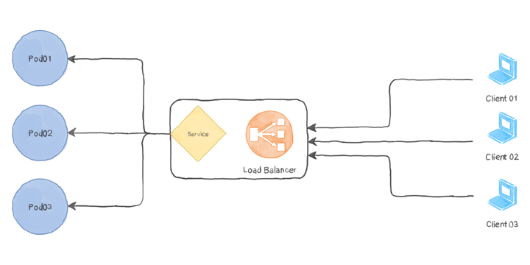
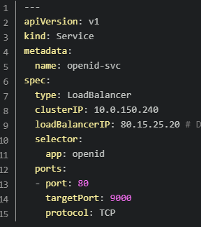
Accepting Outside Connections: Load Balancer

Slide 11
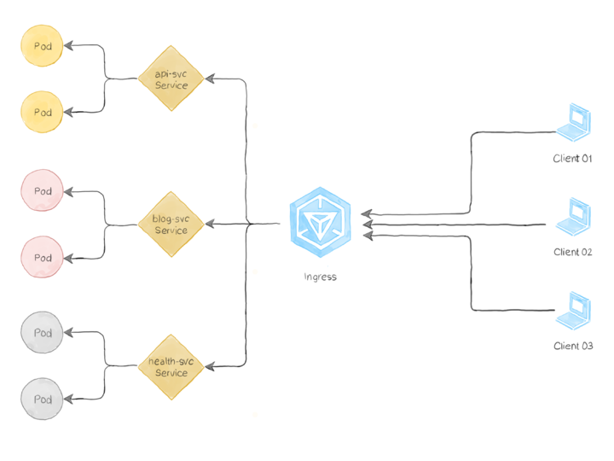
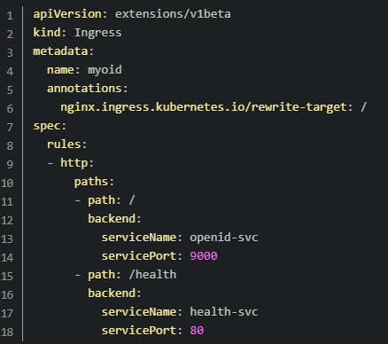
Serving Multiple Services Ingress

Slide 12
Service Registry & Mesh
Service Discovery with Consul - https://cloud.spring.io/spring-cloud-consul/reference/html/#spring-cloud-consul-install
Eureka - https://spring.io/guides/gs/service-registration-and-discovery/
Envoy a Service Mesh - https://www.weave.works/blog/is-envoy-a-service-mesh-or-a-platform
Consul Service Mesh - https://www.hashicorp.com/products/consul/multi-platform-service-mesh
Istio Service Mesh - https://istio.io/latest/docs/concepts/what-is-istio/

Slide 13
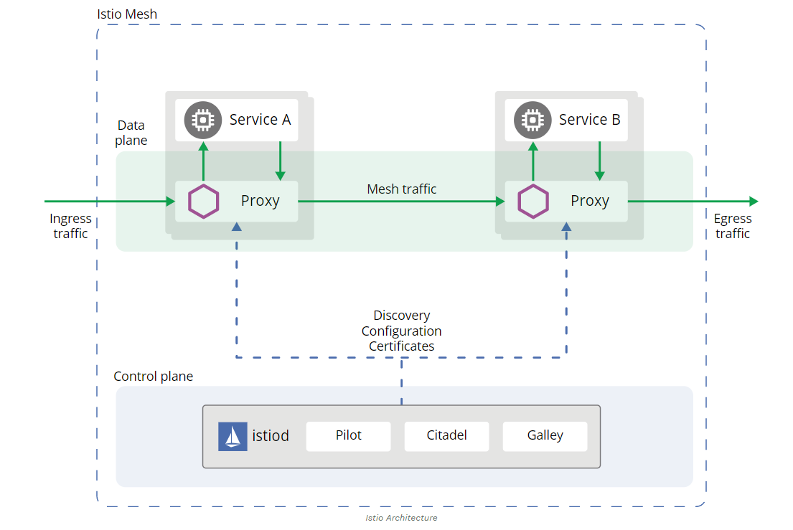
Istio Service Mesh
Notes:
he Istio Service Mesh provides the following functionalities:
Routing. For example 90% of the traffic goes to the version 1 of a microservice and the remaining 10% goes to the version 2. Or some specific requests go to the version 1 and all the others to the version 2, according to some condition. And also: a) rewrite b) redirect
Support for microservices development, deployment and testing: a) timeouts b) retries c) circuit breakers d) load balancing e) fault injection for testing
Reporting: Logging, Distributed Tracing, Telemetry
Policy enforcement
Secure communication between micro services and strong identity.
Pilot is responsible for the items 1 and 2. Mixer is responsible for the items 3 and 4. Citadel (previously CA, previously Auth) is responsible for the item 5.
Envoy, the sidecar proxy, gets its routing and configuration tables from Pilot to implement the items 1 and 2. Envoy reports to Mixer about each request, to implement the item 3. Envoy asks Mixer to allow or forbid requests, to implement the item 4. Envoy gets certificates from Citadel to implement the item 5.
Galley
The galley is responsible for providing configuration validation, ingestion, processing, and distribution for your service mesh. It’s the interface for the underlying APIs with which the Istio control plane interacts.
For example, if you apply a new policy, the galley ingests it, validates it, processes it, and pushes it to the right components of the service mesh.
Data Plane Components
The data plane component comprises of Envoy proxies. Istio fosters service discovery based on these proxies.
These are Layer 7 proxies that allow critical decisions based on the content of the messages it receives. The only components that interact with business traffic are the Envoy proxies.
They help provide the following:
Dynamic service discovery.
Load balancing.
TLS termination.
Staged rollouts with percentage-based metrics.
Fault injection.
Health checks.
Circuit breaking.
Gathering telemetry data.
https://stackoverflow.com/questions/48639660/difference-between-mixer-and-pilot-in-istio
https://medium.com/better-programming/how-istio-works-behind-the-scenes-on-kubernetes-aeb8003f2cb5

Slide 14
References
https://www.magalix.com/blog/kubernetes-patterns-the-service-discovery-pattern

