Slide 1
Short-Hand Programming Language
Amar Banerjee, SERC

Slide 2
Objective
Reduce Syntax
Remove unecessary syntax
Reduce block structures
Seperation of Concerns
Data Block
Function Block
Logic Block
Struct Programming Structure
Data
Functions
Logic / Calls

Slide 3
Scope - As of now
Simple Programmes
No Pointers
No Classes
No File Includes
No Break Statements

Slide 4
Syntax
int / float/ bool / string
loop
read
print
goto
def
if - else

Slide 5
Semantics
Programme
Data Declaration
Integers / Decimals/ Strings
Variables Declaration
Funtion Declaration
Programme Logic
Loops / Conditions
Read / Print
Data Initialization

Slide 6
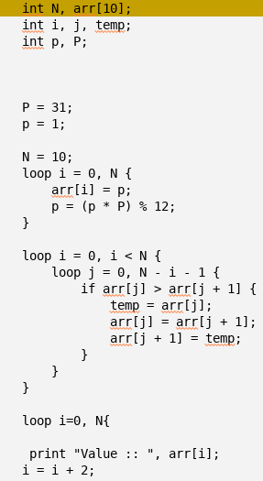
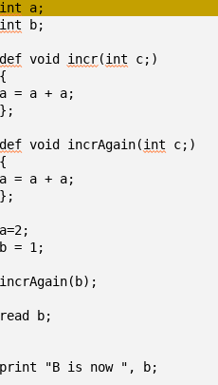
Example

