Slide 1
MAHARISHI INTERNATIONAL UNIVERSITY
1971-1995
MAHARISHI UNIVERSITY
of
MANAGEMENT
Engaging the Managing
Intelligence of Nature

Slide 2
Lab 1:
Strategy pattern

Slide 3
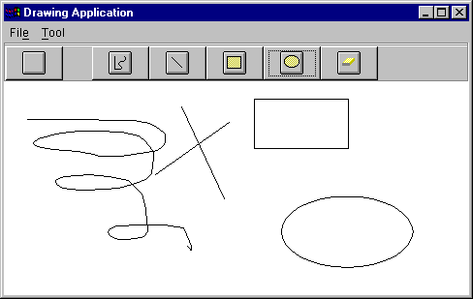
Strategy lab

Slide 4
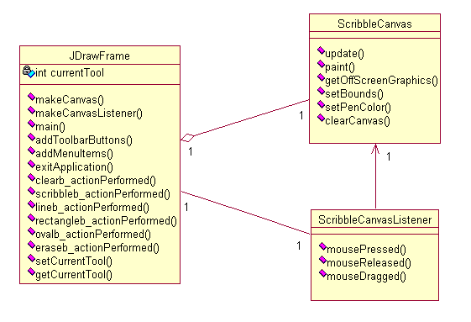
Strategy lab

Slide 5
public class ScribbleCanvasListener implements MouseListener, MouseMotionListener {
public void mousePressed(MouseEvent e) {
switch (drawframe.getCurrentTool()){
case 0: // handle mouse pressed for scribble tool
case 1: // handle mouse pressed for line tool
case 2:// handle mouse pressed for rectangle tool
case 3:// handle mouse pressed for oval tool
case 4:// handle mouse pressed for eraser tool
}
}
public void mouseReleased(MouseEvent e) {
switch (drawframe.getCurrentTool()){
case 0: // handle mouse released for scribble tool
case 1:// handle mouse released for line tool
case 2:// handle mouse released for rectangle tool
case 3:// handle mouse released for oval tool
case 4:// handle mouse released for eraser tool
}
}
public void mouseDragged(MouseEvent e) {
switch (drawframe.getCurrentTool()){
case 0: // handle mouse dragged for scribble tool
case 1:// handle mouse dragged for line tool
case 2:// handle mouse dragged for rectangle tool
case 3:// handle mouse dragged for oval tool
case 4:// handle mouse dragged for eraser tool
}
}
}

Slide 6
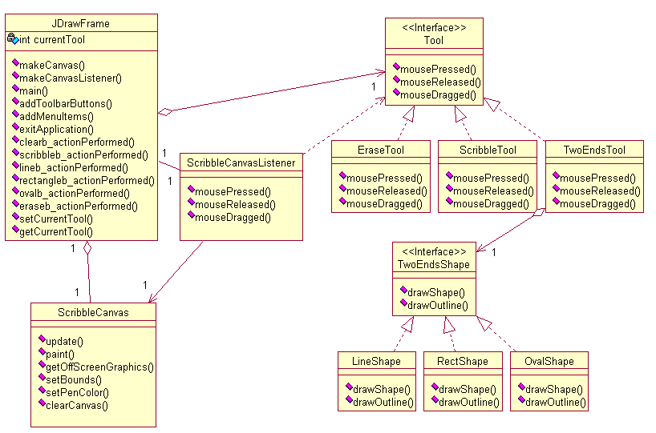
Strategy lab

Slide 7
© 2000 Maharishi University of Management, Fairfield, Iowa, USA
This tape may not be copied, duplicated, or distributed without written consent from Maharishi University of Management, Fairfield, Iowa, USA.

Slide 8
® Science of Creative Intelligence is a service mark registered in the United States Patent and Trademark Office, licensed to Maharishi Vedic Education Development Corporation, and is used under sublicense.

