Slide 1

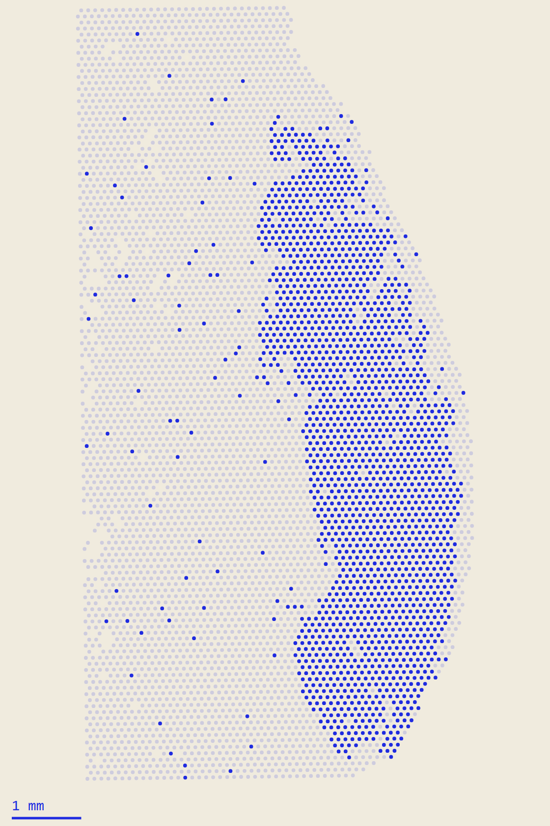
SPACE-MEL DC9 — SPATIAL REASONING
WEEK 2 · 2–8 NOVEMBER 2026
Grounding spatial questions in tested, µm‑scale operations
Can an LLM answer spatial questions about melanoma tissue when its answers are grounded in quantitative spatial analysis?
39,483
21 / 21
14 / 15
spots kept by the paper's QC
(paper: 39,481)
tests pass for three
spatial operations
benchmark questions
with a reference answer
REPRODUCED
TESTED · SYNTHETIC
PRELIMINARY
Patient A24 · PRAME > 1.5 (provisional)
Aitor · supervised by Myles Tan
01 / 08

Slide 2
The paper shows where immune cells sit; this project builds tools to measure it
KREUGER ET AL. 2026
Published
NOT RE-CLAIMED
This project
METHOD
A
More immune cells around melanoma than nevus, few inside
1
Spatial operations in µm, per patient and section
IMC protein · Fig. 5A–B, 5D
src/space_mel/operations.py
B
Distances measured once, in pixels, lesions pooled
2
Every operation tested against known answers
Fig. 4E
tests/test_operations.py
C
Nevus / melanoma spot labels inferred from expression
3
Natural-language questions with reference answers
STdeconvolve topics, K = 15 · not public
02_spatial_operations/benchmark/
THE CONTRIBUTION
A checkable reasoning framework — not a new biological finding.
Kreuger et al. 2026, Cancer Res 86(17):4400–4413 · roderickslieker/NevusMelanomaVisium · docs/paper_worksheet/
02 / 08

Slide 3
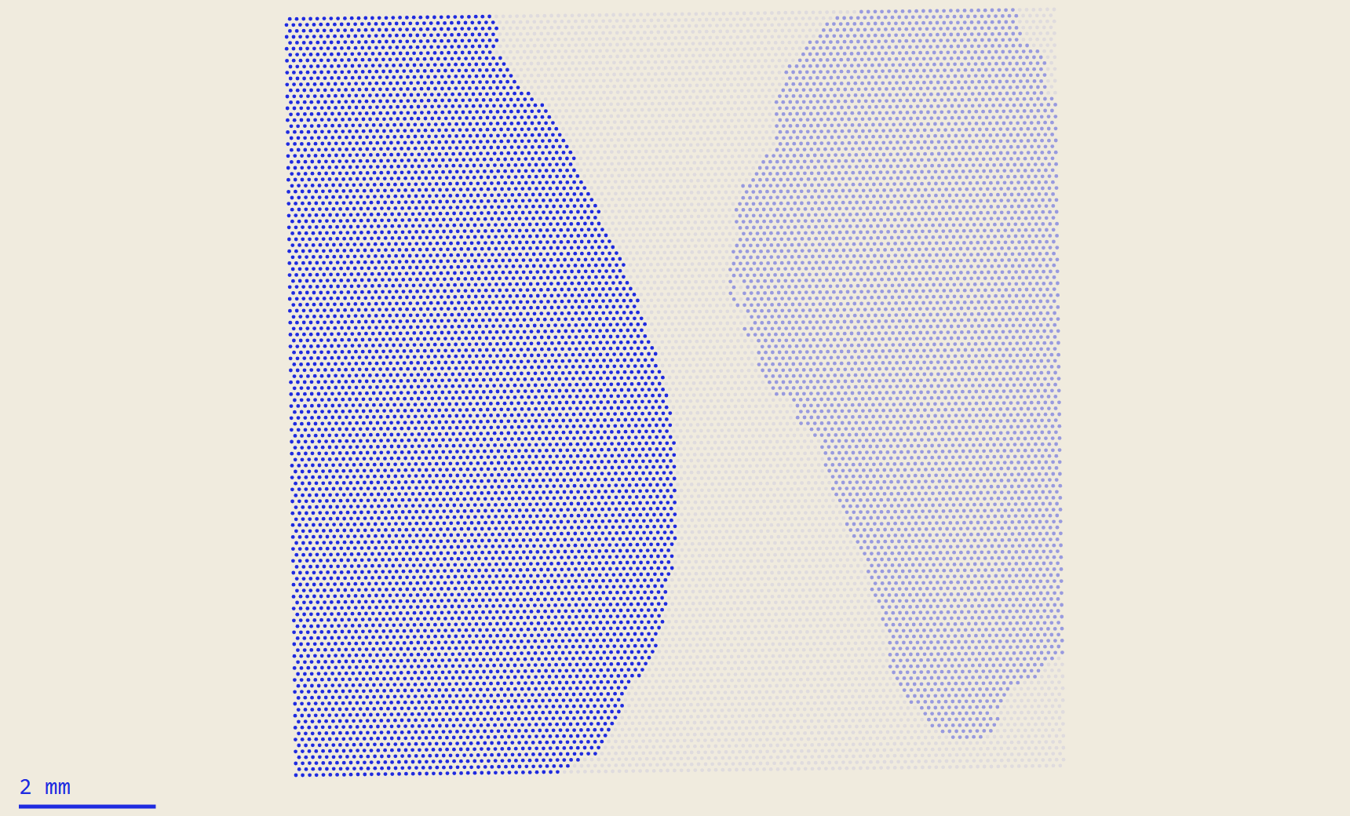
One GEO sample can hold several patients, so everything runs per patient, in µm
GSE298774 · VISIUM
Capture area
GSM9022967
one GEO sample · 11 hold 19 patients
Patient / section
A24
unit of analysis · 18 usable
Tissue region
PRAME > 1.5
no independent label → provisional
Spot
6,059 in A24
55 µm · centres 100 µm apart
A24
A22
neither patient
· one capture area, GSM9022967
> 500
µm
0
genes per spot,
< 30% MT (paper QC)
from the 100 µm spot grid,
never pixels
links between
different sections
GEO GSE298774 · Space Ranger 2.1.1 · QC thresholds: Kreuger et al. 2026, Methods · A2 excluded (no barcode file)
03 / 08

Slide 4
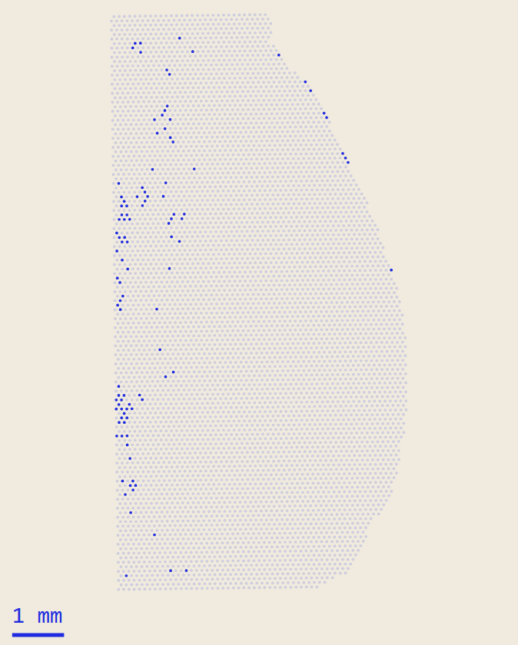
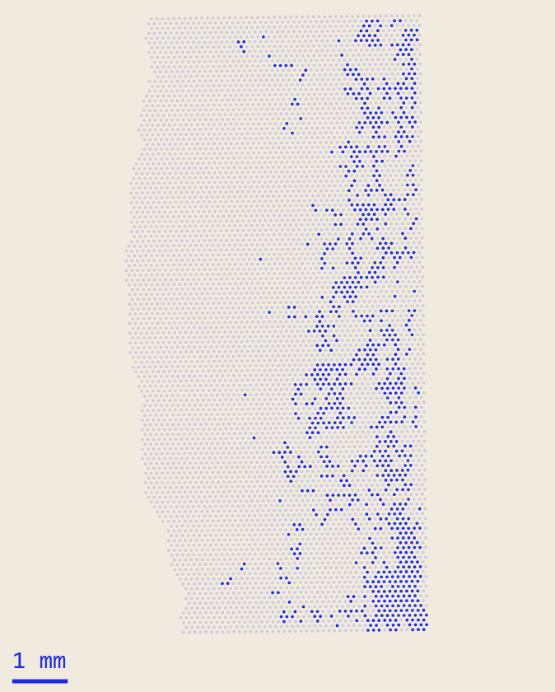
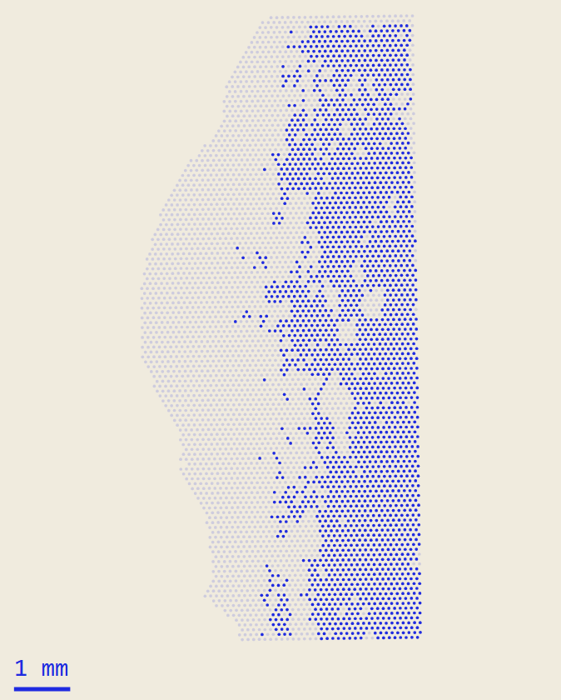
QC reproduces the paper's count, but removes low‑RNA tissue, not the lesion
REPRODUCED
% SPOTS KEPT · 18 PATIENTS
A24
1.7%
B4
15.5%
A16
46.7%
106 of 6,165 removed
996 of 6,415 removed
2,427 of 5,195 removed
A24 CLUSTERING AFTER QC
63% stay together
25% → antibody
12%
IFN-γ / T-cell cluster, 265 spots
TESTED
Paper thresholds, all 18 patients
SHOWS
39,483 kept vs 39,481; melanocytic clusters lose 0%
OPEN
500 genes may be too strict for dermis, fat, blood
Maps: solid = removed (≤ 500 genes), faint = kept · notebooks/03_explore_GSE298774.ipynb · cluster names provisional
04 / 08

Slide 5
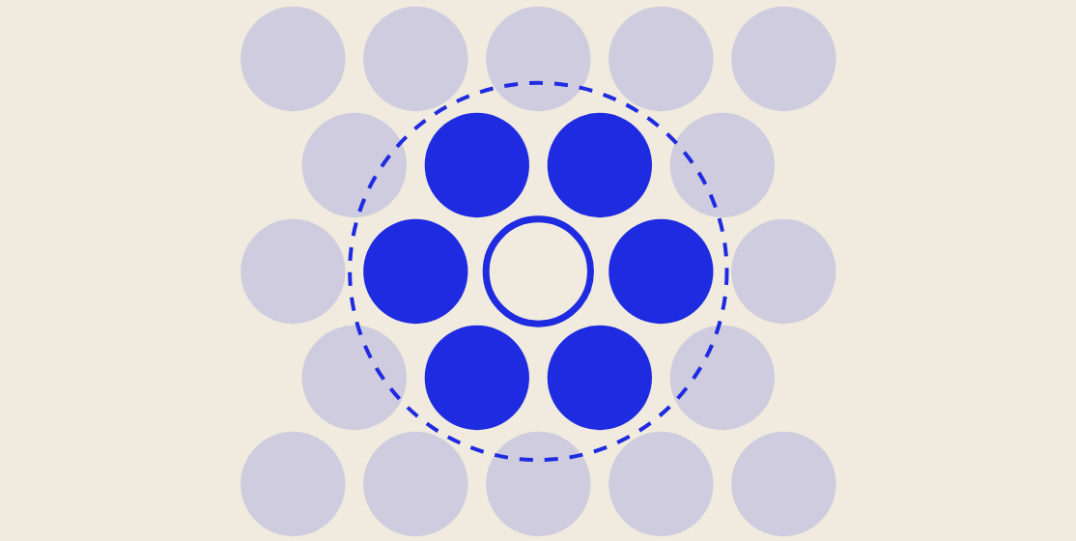
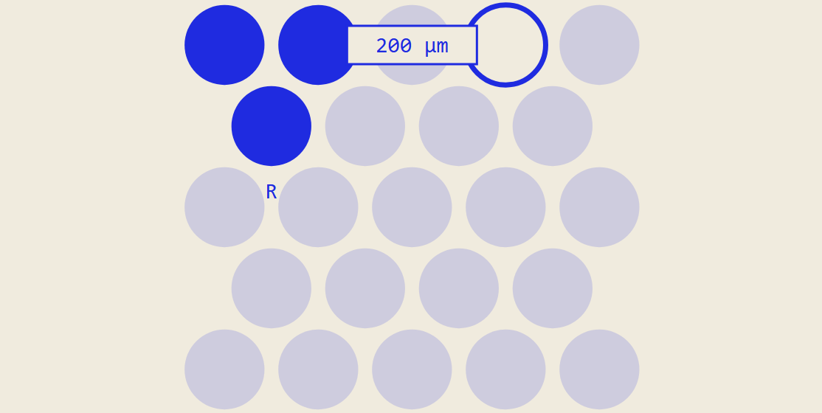
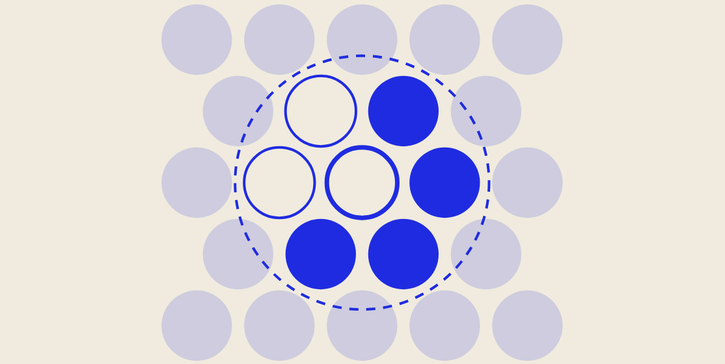
Three spatial operations return the known answer: 21 of 21 tests pass
TESTED · SYNTHETIC
Spots within a radius
Distance to a region
Neighbourhood fraction
spots_within_radius
distance_to_region
neighbourhood_fraction
neighbours of the ringed spot within 100 µm
6
ringed spot to the nearest spot of region R
200 µm
neighbours of the ringed spot in category C
4 / 6
EDGE CASES THE TESTS PIN DOWN
ON REAL A24 COORDINATES, R MUST SIT BETWEEN GRID RINGS
exactly at r
no neighbours
the spot itself
two sections
bad input
r = 100 µm
r = 150 µm · used for “touching”
counted
empty · NaN
excluded
never linked
error
x-axis: neighbours per spot · touching spots are 99.8–101.2 µm apart, so “touching” uses r = 150 µm · src/space_mel/operations.py · tests/
05 / 08

Slide 6
A first benchmark: 15 questions, 9 tasks asked in two wordings
PRELIMINARY · NEW
Spots within
a radius
5
Distance to
a region
6
Neighbourhood
fraction
4
spots_within_radius
distance_to_region
neighbourhood_fraction
B01
B02
B03
B04
B13
B05
B06
B07
B08
B14
B15
B09
B10
B11
B12
“Which spots touch spot AACTGCCGCTACATCT-1?”
“How far is spot GACGCTCGAGGAGTGC-1 from the nevus?”
“What fraction of the spots touching AACTGCCGCTACATCT-1 are CXCL9-high?”
A24 · touching = within 150 µm
B15 · needs a per-spot nevus label
A24 · CXCL9-high = CXCL9 > 2
answered · A24
answered · synthetic
awaiting independent annotation
RECORDED
Inputs, operation, parameters + units, assumptions
CHECKED
By hand (toy) and brute force (A24): all match
NOT YET
Signature enrichment; no LLM has been run
02_spatial_operations/benchmark/benchmark.csv · docs/02_benchmark.md
06 / 08

Slide 7
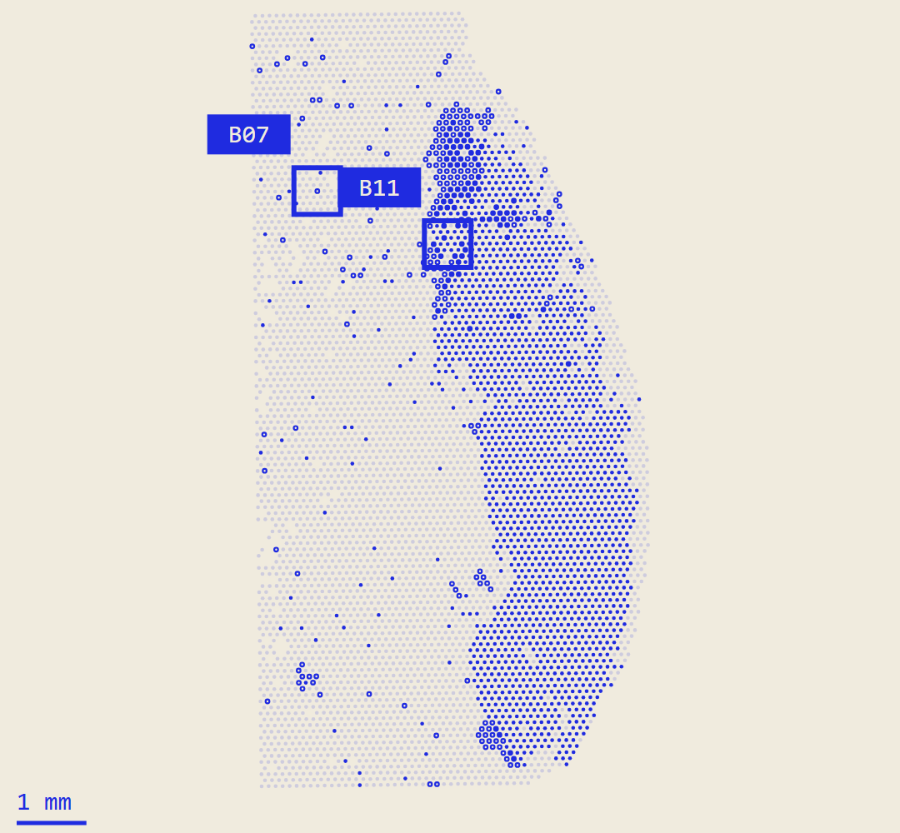
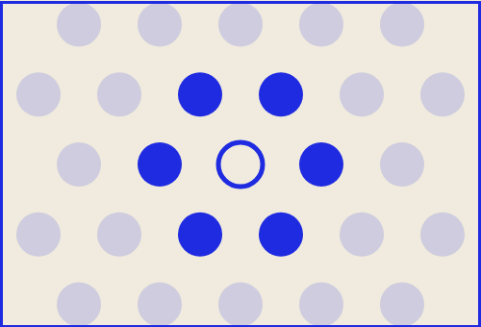
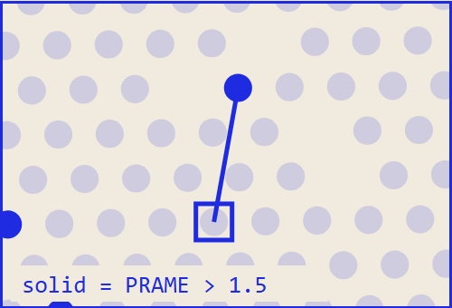
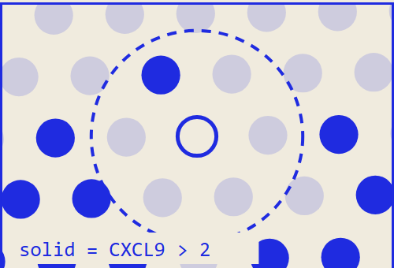
Three worked reference answers, computed by tested code
CHECKED TWICE
B01 · synthetic
6 spots
“Which spots are within 100 µm of spot r0c0?”
exact · count by hand
B07 · A24
265.3 µm
“How far is GACGCTCGAGGAGTGC-1 from the nearest PRAME-high spot?”
region is provisional
B11 · A24
1 / 6
PRAME > 1.5
CXCL9 > 2
other
“What fraction of the spots touching AACTGCCGCTACATCT-1 are CXCL9-high?”
= 0.17 · provisional category
TESTED
Operations vs an independent calculation
SHOWS
Exact answer given the stated definition
OPEN
Is PRAME > 1.5 a defensible tumour proxy?
benchmark.csv rows B01, B07, B11 · recomputed in presentation_week2/make_figure_data.py and asserted equal to the table
07 / 08

Slide 8
The main blocker is ground truth for regions
LIMITATIONS · NEXT STEP
1
No independent nevus / melanoma label per spot
MOST IMPORTANT NEXT STEP
regions are expression thresholds · B15 waits
Independent region labels for A24
2
The 500-gene threshold leaves holes around the lesion
From a pathologist on the H&E, or from the authors. Unblocks B15 and any tumour / nevus validation.
A16 loses 47% · B8, B14, A17 keep < 900 spots
3
Signature enrichment not implemented yet
then 02
then 03
later
“is gene X higher near region Y?”
Gentler or per-patient QC threshold
Benchmark on a second patient (B4)
First LLM test: does it pick the right operation?
4
Real-data examples cover one patient only
A24, one threshold per gene
Feedback needed
Q1 · labels
Q2 · QC
Q3 · benchmark
Three decisions
Who could give per-spot ground truth: the authors or a pathologist?
Relax 500 genes for low-RNA tissue, or drop B8, B14, A17?
Is this format right before adding more questions?
Status note: docs/status_note_week2.md · all code and figures in spatial-reasoning/
08 / 08

