Slide 1

SPACE-MEL DC9 · Multimodal tissue-region retrieval
Week 2 · 2–8 November 2026
Verified H&E–RNA pairs, built on a corrected dataset
Project question Does adding spatial gene expression to H&E improve the retrieval of biologically meaningful melanoma tissue regions?
This week correct the manifest and labels, rerun the replication against the exact published results, revise the immune interpretation, and build a first paired H&E–RNA dataset.
39,483
80
6 / 6
spots pass the paper's QC
(paper: 39,481)
H&E patch – spot RNA pairs
(A24 and B1, 40 each)
pairing checks pass
in both sections
APPROX. REPRODUCED
PRELIMINARY
TESTED
Kinga Kerekes · DC9, Student 2
Kreuger IZM et al. Cancer Res 2026;86:4400–13 · GEO GSE298774 · repository: SpaCe-Mel_DC9/multimodal-retrieval
01 / 08
Notes:
Objective as in the project instructions. This week was about correcting last week's audit, not about new biology. 39,483 spots pass the paper's QC thresholds (> 500 genes, < 30 % mitochondrial); the paper reports 39,481 for a section set that cannot be identified exactly. 80 pairs = 40 in A24 + 40 in B1; all six programmatic checks passed in both.

Slide 2

SPACE-MEL DC9 · Multimodal tissue-region retrieval
Week 2 · 2–8 November 2026
The paper labels regions from RNA; this project tests what H&E adds
CONTEXT · NOT RE-CLAIMED
PUBLISHED · KREUGER ET AL. 2026
THIS PROJECT
A
Spot labels come from RNA
Nevus / Melanoma 1 / … = most abundant of 15 STdeconvolve profiles · Fig. 1F–G, Methods · not public
1
Compare H&E-patch and spot-RNA descriptions
of the same spots, per patient (M1)
B
CDK2 higher in melanoma than nevus spots
log2FC 3.86; detected in 92.8 % vs 20.0 % of spots · Table S4; HHATL / SNX10 maps · Fig. 2D
2
Test simple fusion for region retrieval
including patients never seen in training (M2–M3)
C
Immune cells around melanoma, confirmed by protein
imaging mass cytometry on adjacent sections, 9 lesions · Fig. 5B, 5D
3
This week: the prerequisite only
verified spot-level pairs; no retrieval or similarity result yet
Contribution an evaluation of whether two modalities describe tissue regions in complementary ways — not a new biological finding.
Kreuger IZM et al. Cancer Res 2026;86:4400–13 · Fig. 1F–G, 2D, 5B/D; Supp. Table S4 · docs/part_I_worksheet.md
02 / 08
Notes:
A: spot labels in the paper are the most abundant of 15 STdeconvolve profiles and are not public. B: CDK2 avg_log2FC 3.86, detected in 92.8 % of Melanoma 1 and 20.0 % of nevus spots (Table S4). C: immune findings validated with imaging mass cytometry on adjacent sections. Our contribution is an evaluation of complementarity, not a new finding.

Slide 3
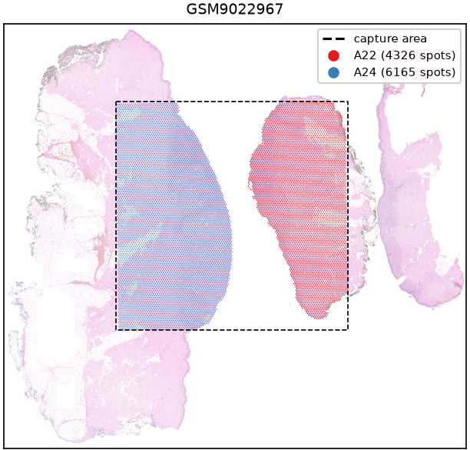
SPACE-MEL DC9 · Multimodal tissue-region retrieval
Week 2 · 2–8 November 2026
One capture area holds several patients, so the manifest separates four levels
CORRECTED
Capture area
GSM9022967
one GEO sample = one sequencing library · 11 in GEO
Patient / section
A24 (A22 shares the area)
19 sections, 18 patients in GEO · used: 18 sections, 17 patients · A2 excluded (no barcode file) · B38ex + B38_2 = patient B38
Tissue region
no independent label
region_label = “not available” · GEO title words (“nevus and melanoma”) are not used as labels
Spot
GSM9022967:ATGTACTTACTGACGC-1
spot_uid = capture area + barcode · 55 µm, 100 µm apart · A24: 6,165 in tissue, 6,059 pass QC
GSM9022967: two patients' sections on one capture area (dashed); spots drawn at 55 µm on the faded hires H&E
QC as in the paper: > 500 genes and < 30 % mitochondrial counts, spots flagged, not deleted · µm from the 100 µm spot grid
GEO GSE298774 · patients: Supp. Table S1 · QC: Kreuger et al. 2026, Methods p. 4401 · manifests/tissue_sections.csv, spots.csv.gz
03 / 08
Notes:
GEO sample = capture area, not patient. GSM9022967 holds A22 and A24. Each section's tissue_positions file marks its own spots with in_tissue = 1; 0 barcodes are shared between sections on one capture area. A2 is excluded because GEO has no barcode file. B38ex and B38_2 are one patient (Table S1). No region label is assigned to any spot.

Slide 4
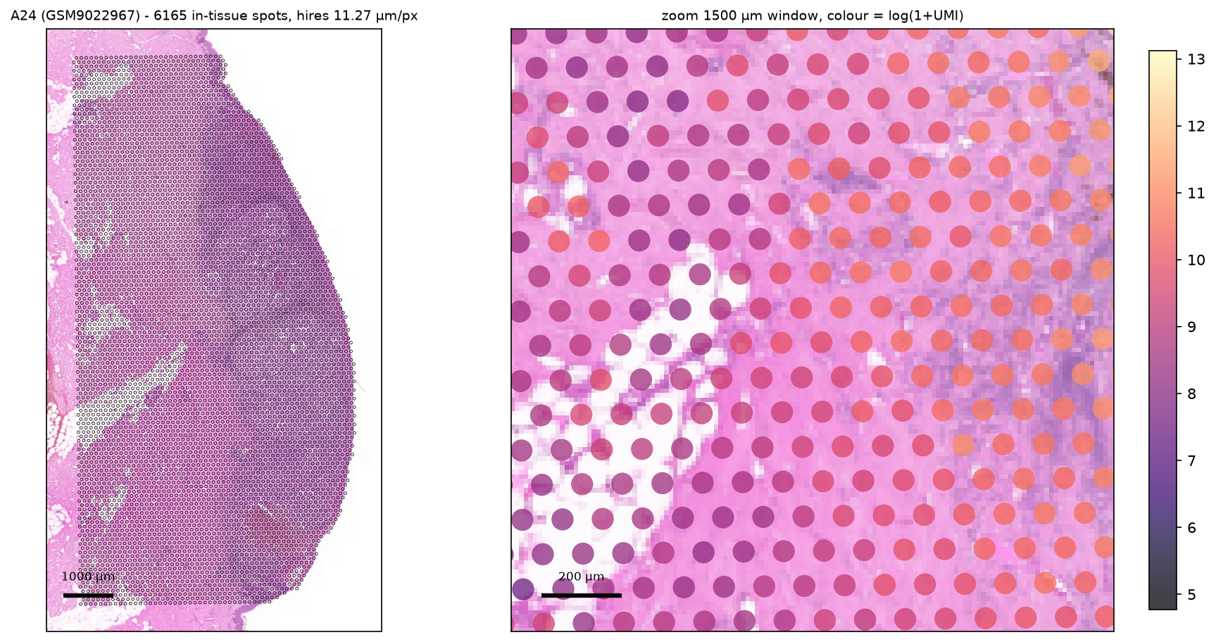

SPACE-MEL DC9 · Multimodal tissue-region retrieval
Week 2 · 2–8 November 2026
Spots sit on the H&E at true size; the paper's QC total is matched within 2 spots
R1 · APPROX. REPRODUCED
39,483
of 61,734 in-tissue spots pass QC · paper: 39,481
11.27 µm/px
A24 hires image: one 55 µm spot = 4.9 px, no single cells
0–63.8 %
of spots fall inside aligned_fiducials.jpg with its scale factor → not used
A24 hires H&E · left: 6,165 in-tissue spots · right: 1.5 mm window, colour = log(1 + UMI)
TESTED
SHOWS
UNCERTAIN
All 18 sections drawn with 55 µm circles on the hires H&E; the paper's QC re-applied
Spots follow tissue edges; counts are higher in denser tissue; QC total within 2 of the paper
Offsets under one spot are not visible at 11 µm/px; published panels name no patient, so none could be matched to A24
figures/03_registration/GSM9022967_A24_hires_overlay.png · notebooks 02, 03 · Kreuger et al. 2026, Fig. 1G, Supp. Fig. S1E, S4
04 / 08
Notes:
The overlay is drawn with circles of the true 55 µm diameter in image pixels, so the drawing itself checks the scale. The zoom shows spots stopping at the tissue edge. aligned_fiducials.jpg was tested and not used: with its scale factor only 0–63.8 % of spots fall inside the image. Published panels A–O carry no patient IDs, so no panel was matched.

Slide 5
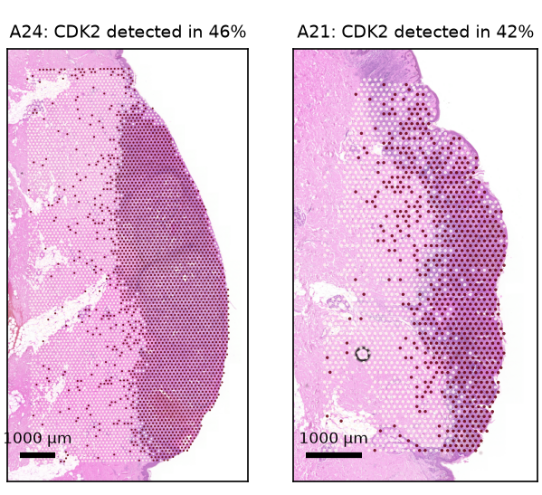
SPACE-MEL DC9 · Multimodal tissue-region retrieval
Week 2 · 2–8 November 2026
CDK2 follows PRAME, but the nevus-vs-melanoma test cannot be repeated
R2 · NOT REPRODUCED
% OF SPOTS WITH CDK2 DETECTED
 | Published Table S5, ≥ 75 % purity | Ours · A24 / A21 RNA-defined groups
Melanoma 1 spots / PRAME detected | 99.8 % | 92.1 % / 86.0 %
Nevus spots / PRAME not detected | 10.7 % | 10.5 % / 27.0 %
17 of 18 sections: CDK2 detected more often where PRAME is detected (21–92 % vs 8–28 % of spots).
Removed: the old CDK2 violin by capture area — it called every spot “melanoma” from the GEO title.
≥ 1 CDK2 count
0 counts
TESTED
SHOWS
UNCERTAIN
CDK2 detection (≥ 1 count) per QC-passing spot in all 18 sections; co-detection with PRAME, the paper's IHC melanoma marker
Same direction as Tables S4/S5 at RNA level; detection rises with depth (11.5 % in A34 to 46.8 % in D20)
“PRAME detected” is not a melanoma label; the authors' spot labels are not public, so the published comparison cannot be repeated
Kreuger IZM et al. Cancer Res 2026;86:4400–13, Supp. Tables S4–S5, Fig. 2D · manifests/r2_detection_by_section.csv · notebook 04 (4.3–4.7)
05 / 08
Notes:
Table values: Table S5 (≥ 75 % purity) vs our groups defined by PRAME RNA detection, which is not a pathology label. In 17 of 18 sections CDK2 is detected more often in PRAME-detected spots; A7 is the exception (PRAME in 1.5 % of spots). Detection rates depend on sequencing depth. The old GSM-level violin was removed.

Slide 6
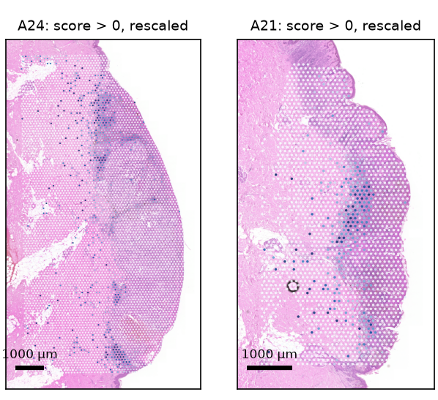

SPACE-MEL DC9 · Multimodal tissue-region retrieval
Week 2 · 2–8 November 2026
Our immune maps are single-gene RNA or provisional scores, not cell counts
R3 · NOT REPRODUCED
EVIDENCE LEVEL OF EACH IMMUNE OUTPUT
T-cell-associated score
CD3D + CD3E
4
Protein-level cell identity
paper: IMC, adjacent sections · Fig. 5B, 5D
0
3
Inferred cell composition
1
paper: reference-based estimate · Fig. 5A, 5C, S9D
0 = score ≤ 0; 1 = 99th percentile or above, rescaled per section, so colours do not compare across sections. Scale bars 1000 µm.
2
Provisional gene score
ours: CD3D + CD3E (T-cell-associated); CD14 + CD68 + CD163
1
Single marker RNA
ours: 8 marker maps, e.g. PTPRC (CD45) = all white blood cells
Removed: CD163 + PTPRC “macrophage score” (old notebook)
TESTED
SHOWS
UNCERTAIN
8 marker genes present in both gene panels for all 18 sections; two gene scores (scanpy score_genes)
T-cell-associated RNA signal in band-like areas next to densely stained tissue (A24, A21)
Not validated against cell counts or protein; position relative to nevus / melanoma unknown (no region labels)
Kreuger IZM et al. Cancer Res 2026;86:4400–13, Fig. 5A–D, Supp. Fig. S9, Supp. Table S3 · manifests/r3_evidence_levels.csv · docs/annotation_caveats.md
06 / 08
Notes:
Every immune output has an evidence level. Ours are levels 1–2 only. PTPRC (CD45) marks all white blood cells, so the old CD163 + PTPRC average was removed. The map shows the T-cell-associated score (CD3D, CD3E) rescaled per section, so colours are not comparable between sections.

Slide 7
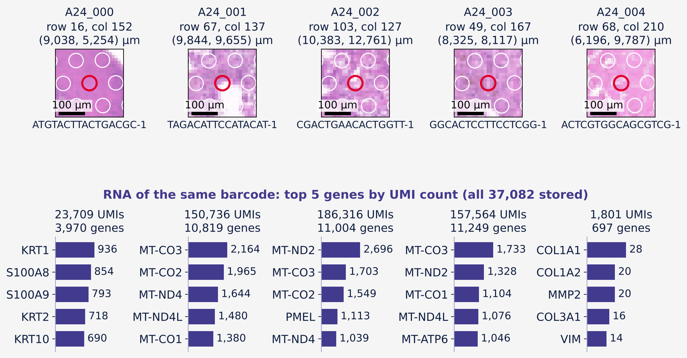
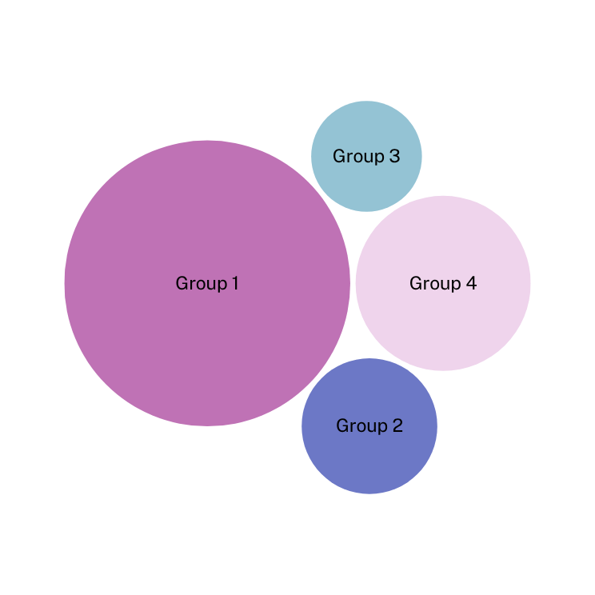
SPACE-MEL DC9 · Multimodal tissue-region retrieval
Week 2 · 2–8 November 2026
Each H&E patch is cut at the position of the barcode whose RNA it is paired with
NEW · PRELIMINARY
HOW ONE PAIR IS MATCHED
1
Key
spot_uid = GSM9022967 + barcode
2
Position
full-res pixel × hires scale factor
3
Patch
23 × 23 native px = 259 µm
4
RNA
same barcode → row in rna_counts.npz, 37,082 genes
40 pairs × 2 sections
A24, B1 · ≥ 255 µm apart · 6 / 6 checks
TESTED
SHOWS
UNCERTAIN
6 programmatic checks (spot_uid order, QC, patch = image crop, spacing, non-zero RNA) and a visual check of 8 pairs
Image and RNA come from the same barcode for 80 spots in 2 patients
A spot is ~5 px, so no cells are visible; some circles touch unstained gaps (A24_001); RNA is a 55 µm mixture of cells
A24_000–004 = first 5 of 40 pairs, not chosen by appearance · re-plotted from manifests/paired_spots/GSM9022967_A24/ · notebook 05
07 / 08
Notes:
The first five A24 pairs, not chosen by appearance. Patch = 23 × 23 native hires pixels (259 µm) centred on the spot's image position; red circle = the 55 µm spot, white = neighbouring in-tissue spots. Bars = top 5 genes of the same barcode's counts. A24_001's circle touches an unstained area; it passed QC because QC uses RNA only. No similarity is claimed.

Slide 8

SPACE-MEL DC9 · Multimodal tissue-region retrieval
Week 2 · 2–8 November 2026
The main blocker is an independent region label for each spot
LIMITATIONS · NEXT STEP
1
No pathology or region label per spot
no relevance labels for retrieval; “PRAME detected” is an RNA grouping, not pathology
MOST IMPORTANT NEXT STEP
Independent region labels for A24 and B1
2
H&E is 5–12 µm per pixel
full-resolution scans are not in GEO; aligned_fiducials.jpg does not align as given
From the authors' per-spot labels or a pathologist's H&E annotation; retrieval relevance is then defined from them, not from RNA.
3
Published panels name no patient
R1–R3 comparisons stay approximate or not reproduced
4
Pairs cover 2 patients, 80 spots
enough to check pairing, not to evaluate across patients
Then: pairs for more patients (patient-level splits) · ask for full-resolution H&E
FEEDBACK NEEDED
Q1 · labels
Ask the authors for per-spot labels and full-res H&E, or is a pathologist available?
Q2 · shared manifest
Agree B38ex + B38_2 = one patient (Table S1) in shared/, so both projects split by the same patients?
Q3 · patches
Is a 255 µm patch on the hires image acceptable as the first baseline?
STATUS.md · docs/annotation_caveats.md · code, manifests and figures in SpaCe-Mel_DC9/multimodal-retrieval/
08 / 08
Notes:
Main blocker: no independent region label per spot, so retrieval relevance cannot be defined without using RNA. Questions for the meeting: who can provide labels and full-resolution H&E; agree on the shared patient definition (B38 = one patient) with spatial-reasoning; whether the 255 µm hires patch is acceptable as the first baseline.

