Slide 1
Li-Fi Based Automatic Traffic Signal Control For Ambulance
RNS INSTITUTE OF TECHNOLOGY
BENGALURU - 98
DEPARTMENT OF INFORMATION SCIENCE & ENGINEERING
Final Year Project Work Presentation
Amardeep Kumar 1RN19IS020
Amartya 1RN19IS021 Anushka Jaiswal 1RN19IS035
Devendra UpadhYAY 1RN19IS056
Internal Guide
Ms. Vanishri S
Asst. Prof., Dept. of ISE, RNSIT
Panel
Dr. Bhagyashree Ambore
Asst. Prof., Dept. of ISE, RNSIT

Slide 2
AGENDA
Abstract
Introduction
Literature Review
Analysis
System Design
Implementation
Testing
Discussion of Results
National Conference Paper
Conclusion and Future Enhancements
References
Q & A

Slide 3
ABSTRACT
India is a fast-developing country, but its traffic management is ineffective, leading to road congestion in metropolitan cities like Bengaluru.
Ambulance services are severely affected by traffic jams, resulting in loss of lives as they fail to reach their destination on time.
Li-Fi, a form of bi-directional Visible Light Communication, can be used to implement an efficient and feasible traffic management system.
Li-Fi-based communication systems can provide faster communication for emergency vehicles such as ambulances, firefighting trucks, and police vehicles, especially in traffic-dense areas.
The use of Li-Fi in emergency vehicle communication can potentially reduce response time, save lives, and improve emergency services.

Slide 4
INTRODUCTION
BACKGROUND
Wireless communication relies solely on radio waves, but the spectrum is congested and an alternative is needed.
Visible light communication (VLC) is an emerging platform that uses visible light frequencies between 400 and 800 THz.
Li-Fi is a VLC protocol that uses LED bulbs as the principle source of light, which can be modulated at very high speeds to transmit data.
Li-Fi allows transmission of thousands of data streams in parallel at high speeds and is economically viable.
Gamma rays, X-rays, infra-red, and ultraviolet rays cannot be used for V2V communication due to their harmful effects on human body.
The associated circuitry for radio wave communication is expensive.

Slide 5
INTRODUCTION
EXISTING SYSTEM
Manual control: involves human operator who changes signal timing based on judgment of traffic flow, but is susceptible to human error leading to inefficiencies and delays.
Fixed-time control: pre-determined and fixed signal timing regardless of traffic volume, easy to implement but can cause delays and congestion during peak traffic periods.
Actuated control: Actuated control is a method that utilizes sensors to detect the presence of vehicles or pedestrians at the intersection and adjust the signal timing based on real-time traffic flow. However, this method is not specifically focused on emergency vehicles and their need for priority in traffic signal control. Therefore, alternative methods such as GPS-based pre-emption control systems or Li-Fi-based automatic traffic signal control systems have been proposed to provide priority to emergency vehicles.

Slide 6
INTRODUCTION
PROPOSED SYSTEM
LED-based LiFi transmitters will be installed in emergency vehicles, which will communicate with LiFi receivers installed in the traffic signal poles.
The system will use LiFi communication technology to transmit information about the emergency vehicle's location and direction to the traffic signal controller.
The traffic signal controller will analyze the received data and automatically adjust the signal timing to give priority to the emergency vehicle.
The system can be integrated with other emergency services such as fire and police vehicles for seamless traffic management.
The proposed system is cost-effective, reliable, and efficient compared to traditional traffic signal control systems.

Slide 7
LITERATURE SURVEY
Sl No | Title of the paper | Authors and year of publication | Summary | Future Enhancement
1. | A GPS based traffic light pre-emption control system for emergency vehicles | Abubakr S. Eltayeb; Halla O. Almubarak; Tahani Abdalla Attia 2013 | The design and implementation of an automatic preemption traffic control system, based on the global positioning system satellites. | Gps requires a lot of energy.
2. | Implementing Intelligent Traffic Control System for Congestion Control, Ambulance Clearance and Stolen Vehicle Detection | Rajeshwari S., Santhoshs Hebbar, Varaprasad Golla 2015 | Each individual vehicle is equipped with special radio frequency identification (RFID) tag (placed at a strategic location).They used RFID reader, NSK EDK-125-TTL, and PIC16F877A system-on-chip to read the RFID tags attached to the vehicle. | Low security offered where RFID messages are prone to unauthorized access.

Slide 8
LITERATURE SURVEY
Sl No | Title of the paper | Authors and year of publication | Summary | Future Enhancement
3. | GPS and ZigBee Based Traffic Signal Preemption | Vineeth Kodire, Sreebha Bhaskaran, Vishwas H.N. 2016 | The proposed system uses GPS method to get the location data and employs ZigBee for communicating efficiently with the intersection module. | Since the technology used in Zigbee is of low bit rate, the transmission rate of this technology is also low.
4. | Advanced Automation Control in an Ambulance under Emergency Condition | Leila Sai Krishna; Samineni Vijay Chowdary; M. Pushpavalli; P. Sivagami 2017 | The ambulance is implemented with embedded system units, which finds the accident spot and delivers the spot to the close by ambulance through GSM.The ambulance guides the traffic lights in the roadway to the hospital and it also checks the next consecutive signal to shorten the time loss. | Gsm is congested and requires high bandwidth.

Slide 9
LITERATURE SURVEY
Sl No | Title of the paper | Authors and year of publication | Summary | Future Enhancement
5. | Emergent vehicle tracking system using IR sensor | Manjunath Managuli; Abhaya Deshpande; Sudha H Ayatti 2017 | During object motion IR sensors detect the ambulance, pass the message to main controller which reflects the LED bulb to glow leading to closing of all the signals track, and immediately the emergent vehicle pass the signal track. | Sunlight can cause interference with IR signals.
6. | Leveraging Emergency Response System Using the Internet of Things. A Preliminary Approach | Luz A. Magre Colorado; Jorge Franco Ibañez; Juan Carlos Martinez-Santos 2020 | Hybrid system that uses both QR code detection and a GPS/GPRS tracking system. With this mixed implementation we are trying to lower the chances of getting errors when detecting the current location and improve the times of response of the emergency vehicle. | At the moment, a simple test over an intersection of the city is ongoing, but not finished. For future experiments, we expect to include more extensive areas and integrate MATLAB to the simulation to measure times.

Slide 10
LITERATURE SURVEY
Sl No | Title of the paper | Authors and year of publication | Summary
7. | Efficiency of opportunistic cellular/LiFi traffic offloading | Vishnu Raj RS,Athi Narayanan S,Kamal Bijlani 2016 | This offloading efficiency is a measure of the ratio of traffic carried by light fidelity (LiFi) network to total traffic carried by both LiFi and cellular networks. The effect of LiFi-signal blocking and channel characteristics are considered. Different LiFi offloading timing cases are discussed.
8. | Li-Fi technology in traffic light | V.K.G. Kalaiselvi; A. Sangavi; Dhivya 2017 | The proposed paper aims in using the Li-Fi technology and enabling communication of vehicles with the traffic light system in order to prioritize the vehicles and change the signals accordingly rather than by a process of pre-defined order or by manual order.

Slide 11
LITERATURE SURVEY
Sl No | Title of the paper | Authors and year of publication | Summary
9. | Li-Fi Based Smart Traffic Network | A. Correa; A. Hamid; E. Sparks 2018 | Using Li-Fi, a visible light communications system, autonomous cars will be able to communicate with each other and with the traffic network to eradicate any human error that might occur while driving today.
10. | Li-Fi Based Automatic Traffic Signal Control for Emergency Vehicles | R Shanmughasundaram; S Prasanna Vadanan; Vivek Dharmarajan 2018 | In this paper, a V2V communication system is proposed in which the headlight and tail light of a vehicle are made as Li-Fi transmitter and Li-Fi receiver respectively. Using the proposed system, when a traffic signal receives an alert regarding an emergency vehicle, the traffic signal would immediately turn green. Thus, decreasing the waiting time of emergency vehicles in traffic dense lanes.

Slide 12
ANALYSIS
PROBLEM IDENTIFICATION
Cities with continually growing populations but the same infrastructure cause more traffic through the same points, making it difficult to follow the recommended 8-10 minute response time for medical emergencies like cardiac arrest or stroke.
There are specific critical points in every city where traffic slows down, making emergency response time longer than it should be.
The existing traffic signal control systems are not designed to prioritize emergency vehicles like ambulances, firefighting, and police vehicles, resulting in delayed response times, which can have catastrophic consequences, especially in cases of medical emergencies.
The current systems are based on fixed timers or sensors and do not take into account the priority of emergency vehicles.

Slide 13
ANALYSIS
OBJECTIVES
Reduce response time of emergency vehicles, especially ambulances, by providing them with priority passage through traffic signals.
Improve overall traffic flow in the city while providing emergency vehicles with priority passage.
Minimize risks of accidents and loss of lives due to delayed response times of emergency vehicles.
Provide maximum communication for ambulance from environment and hospitals.
Provide immediate response from hospital side for emergency vehicle and connect all hospitals to one platform using IoT.
Increase adoption of LiFi technology for communication and traffic management in smart cities.

Slide 14
ANALYSIS
METHODOLOGY
Li-Fi protocol represents data by varying the intensity of LED light.
High intensity represents a binary 1, while low intensity represents a binary 0.
Any LED fixture with a signal processing circuit can work as a Li-Fi transmitter, while a photodiode with a demodulation circuit can work as a receiver.
Li-Fi achieves high-speed data transmission, up to several gigabits per second.
The working of Li-Fi involves modulating a light source, typically an LED, to encode data in light pulses.
The photodetector receives the light pulses and converts them back into electrical signals.
The receiver then detects changes in light intensity and decodes the data from the light signals.

Slide 15
ANALYSIS
SYSTEM REQUIREMENTS
HARDWARE:
Controller - Arduino Uno ATmega328
Lifi Transmitter - LED lamp
Lifi Reciever - Solar panel
Traffic lights - LED lights
Information display - LCD display
Wifi module - NodeMCU ESP8266
Transformer - 12V-0-12V
SOFTWARE:
Arduino IDE
Adafruit IO

Slide 16
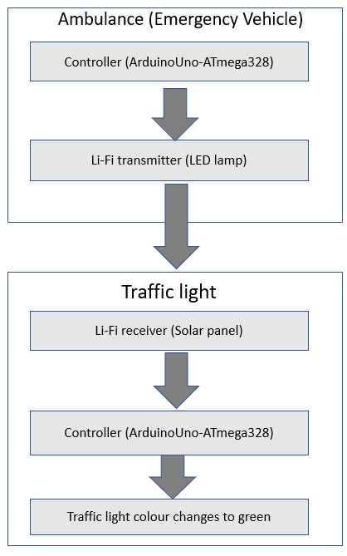
SYSTEM DESIGN
ARCHITECTURE
The proposed traffic management system that utilizes Li-Fi technology consists of two main nodes: the ambulance (emergency vehicle) and the traffic signal control.
The nodes are powered by microcontrollers, specifically the ArduinoUno ATmega328, which control the transmission and reception of data.
The ambulance node includes a Li-Fi transmitter, such as an LED lamp, that receives command signals from the microcontroller indicating the direction from which the ambulance is approaching the traffic signal.
The traffic signal node is equipped with a Li-Fi receiver, for example, a solar panel, that receives signals from the ambulance's transmitter.
The microcontroller located within the traffic signal node decrypts the received signal and triggers the traffic signal LED light to change the color of a particular direction to green, allowing the ambulance to pass through smoothly.

Slide 17
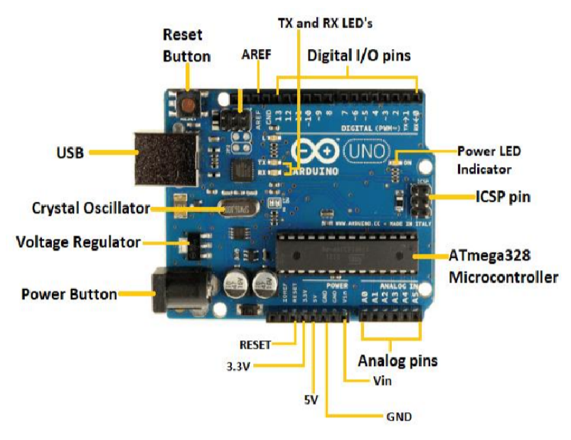
IMPLEMENTATION
COMPONENTS:
Controller-Arduino Uno ATmega328: The ATmega328-based Arduino Uno microcontroller board includes several components such as 14 digital input/output pins (with 6 that can function as PWM outputs), 6 analog inputs, a 16 MHz ceramic resonator, a USB connection, a power jack, an ICSP header, and a reset button. The board can run on an external power supply of 6 to 20 volts, but if less than 7V is supplied, the 5V pin may output less than 5 volts and the board may be unstable. The power pins on the board include VIN, which is the input voltage when using an external power source; 5V, which outputs a regulated 5V from the onboard regulator.

Slide 18
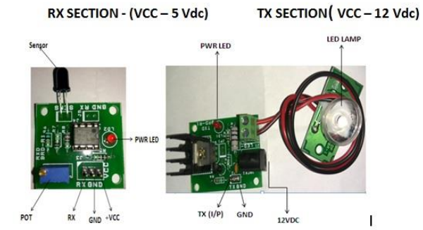
IMPLEMENTATION
COMPONENTS:
Li-Fi transmitter - LED lamp: The use of LED lamps as Li-Fi transmitters in a traffic signal control system can provide reliable and efficient communication, especially when the baud rate is set at 1200. With this baud rate, the LED lamp can transmit data at a faster rate than lower baud rates, ensuring quick and accurate transmission of information. Moreover, the LED lamp is an affordable and low-power option for a Li-Fi transmitter, making it an ideal choice for traffic signal control systems. Additionally, it can easily be installed in existing traffic lights, simplifying the setup process.

Slide 19
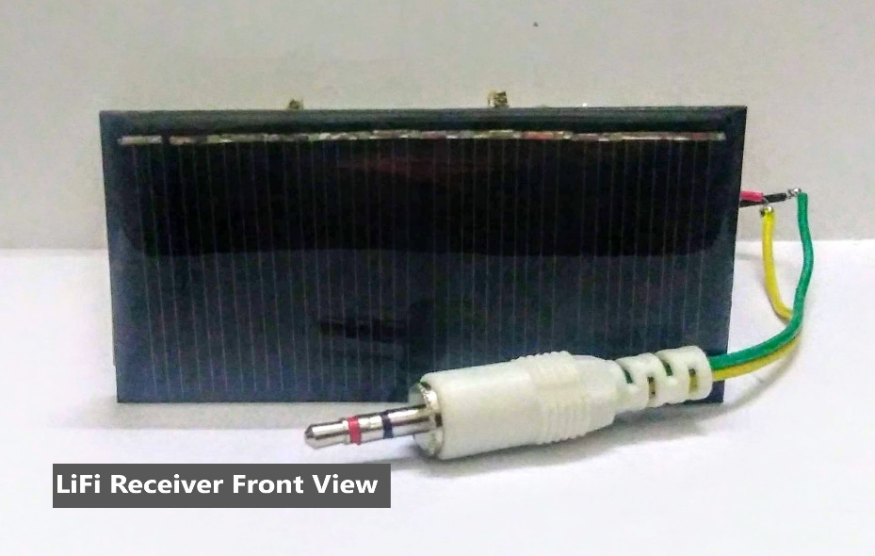
IMPLEMENTATION
COMPONENTS:
Li-Fi receiver - Solar Panel: In a Li-Fi based traffic management system for ambulances, a solar panel can function as a Li-Fi receiver for the traffic signal control node. As the Li-Fi transmitter in the ambulance emits modulated light signals, the solar panel receives these signals by detecting the variations in light intensity. This ability to detect and interpret light signals enables the solar panel to act as a receiver of data. The signals are then decrypted and processed by the microcontroller in the traffic signal control node to direct the traffic light accordingly. The use of a solar panel ensures a self-sufficient and sustainable power source for the traffic signal control node. This makes it an energy efficient and cost-effective option for a reliable means of data transmission.

Slide 20
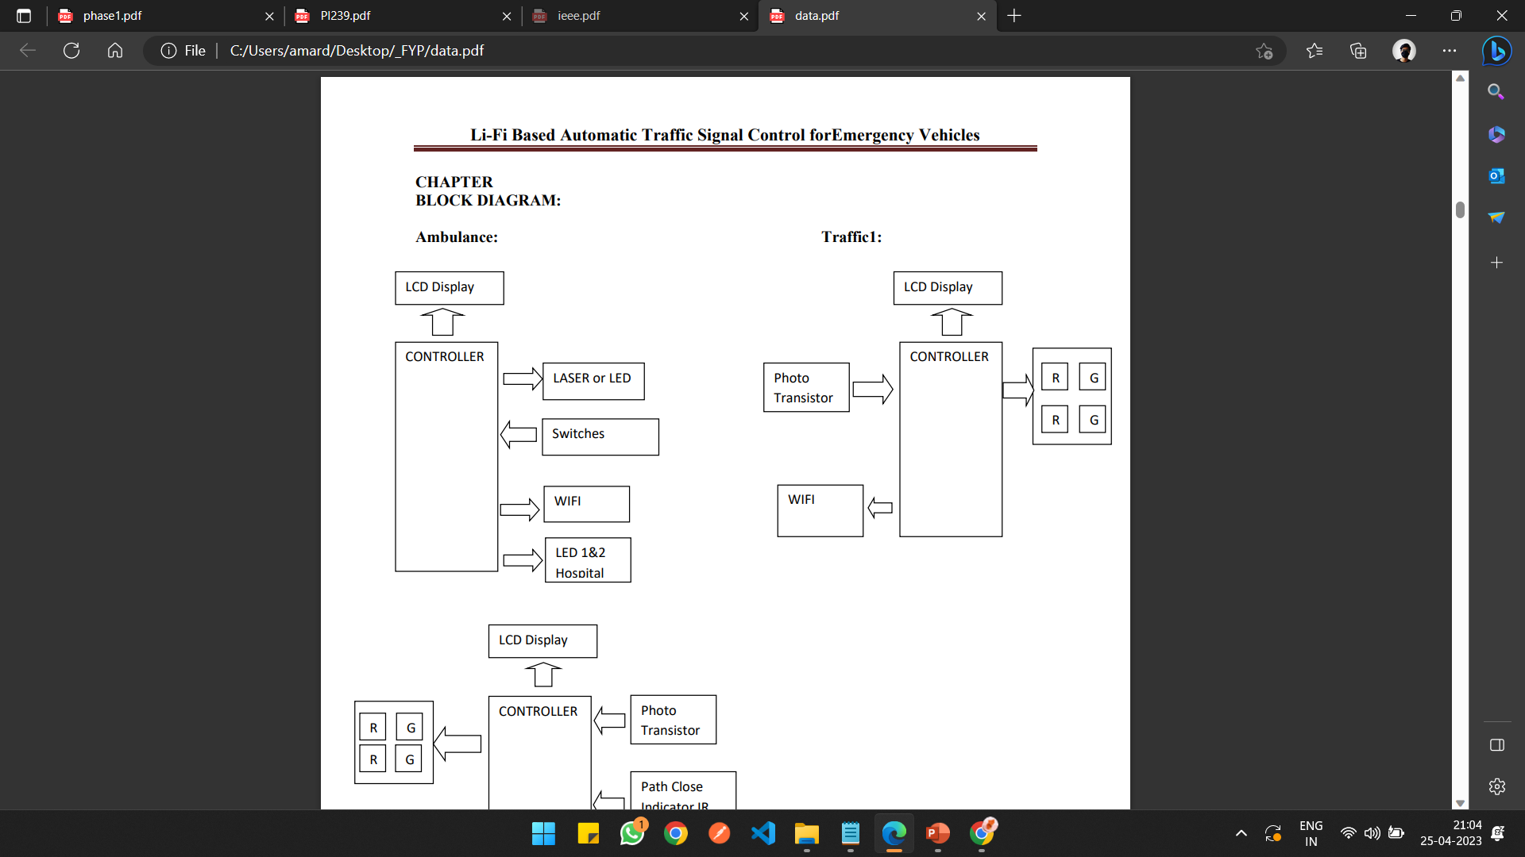
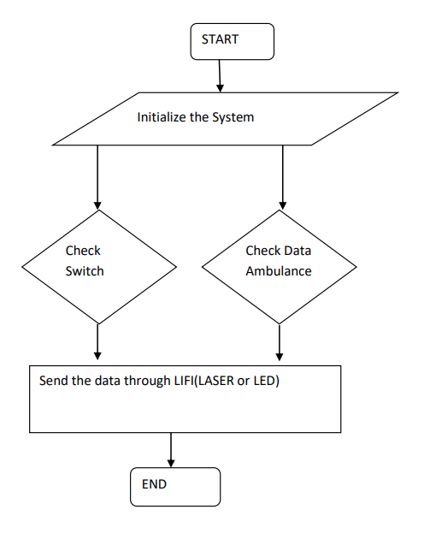
IMPLEMENTATION
Block diagram of ambulance module
Flow chart of ambulance module

Slide 21
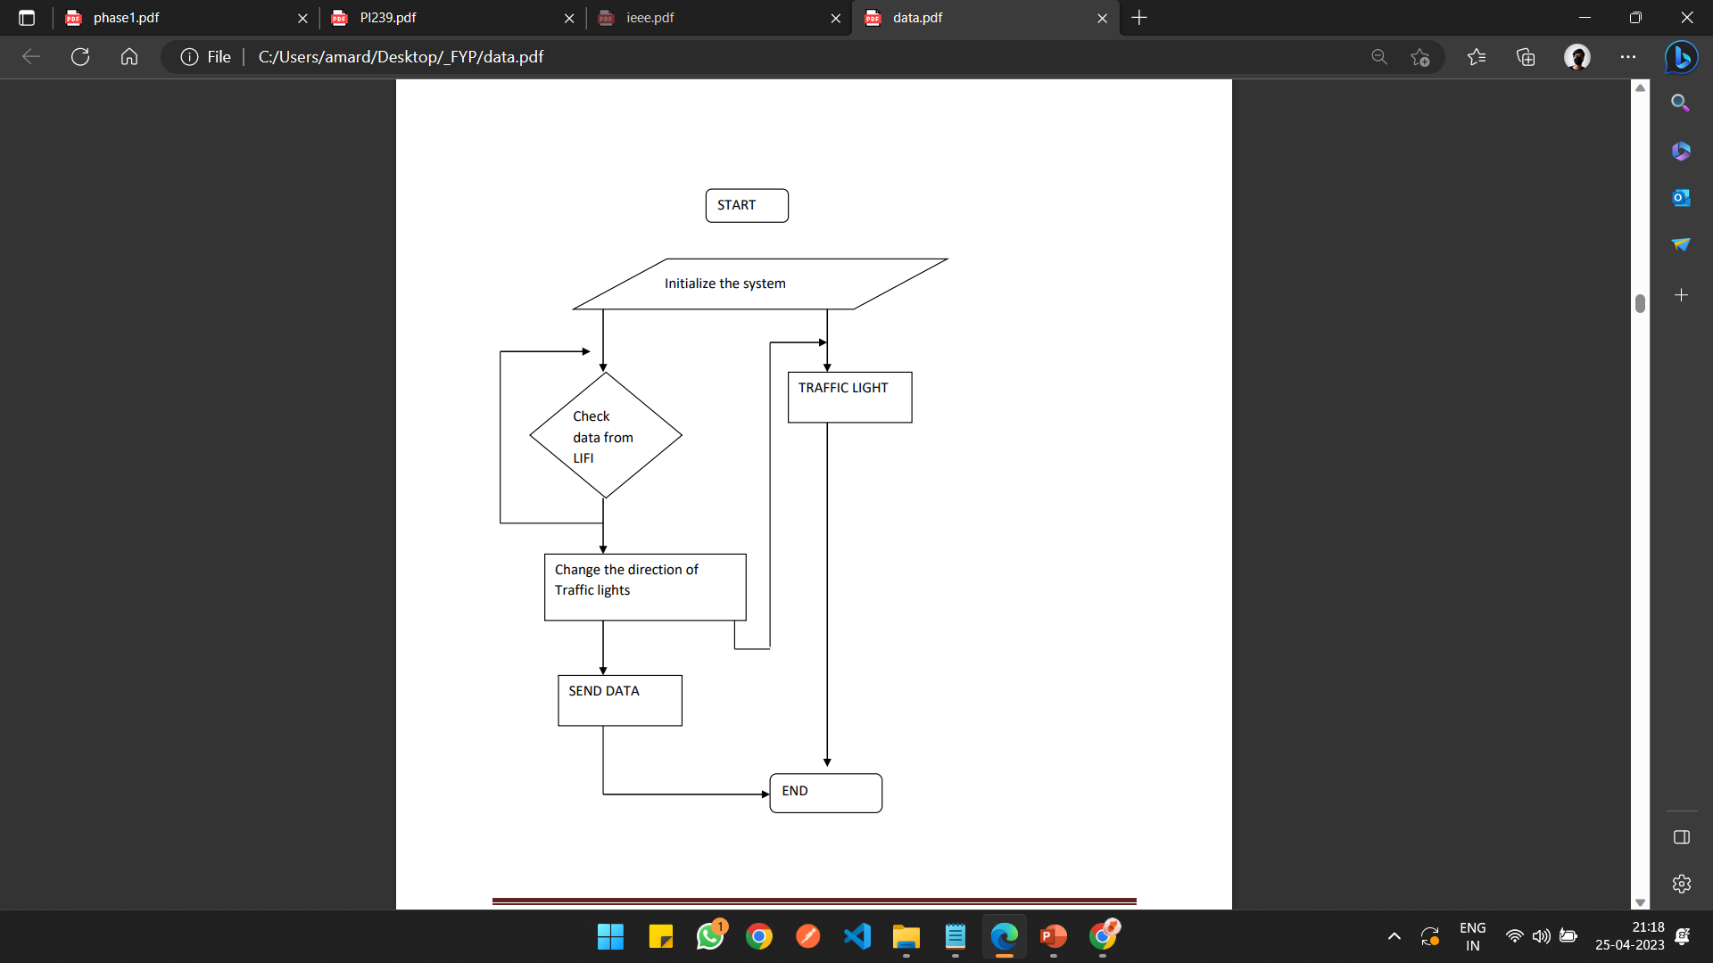
IMPLEMENTATION
Block diagram of traffic light1 module
Flow chart of traffic light1 module

Slide 22
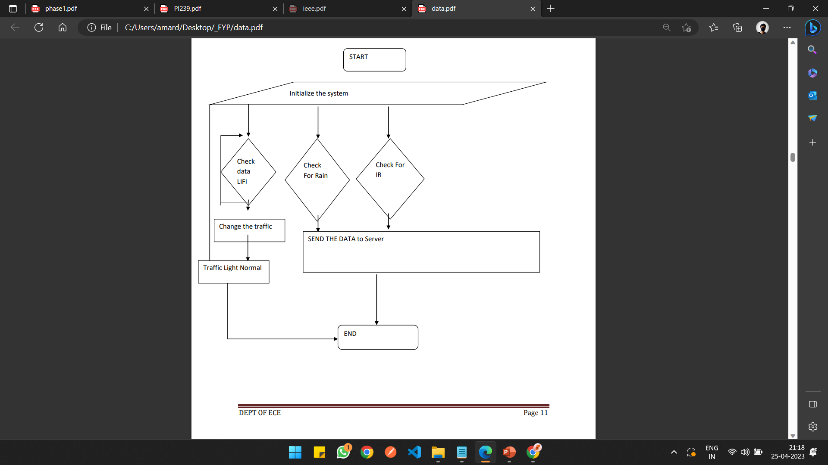
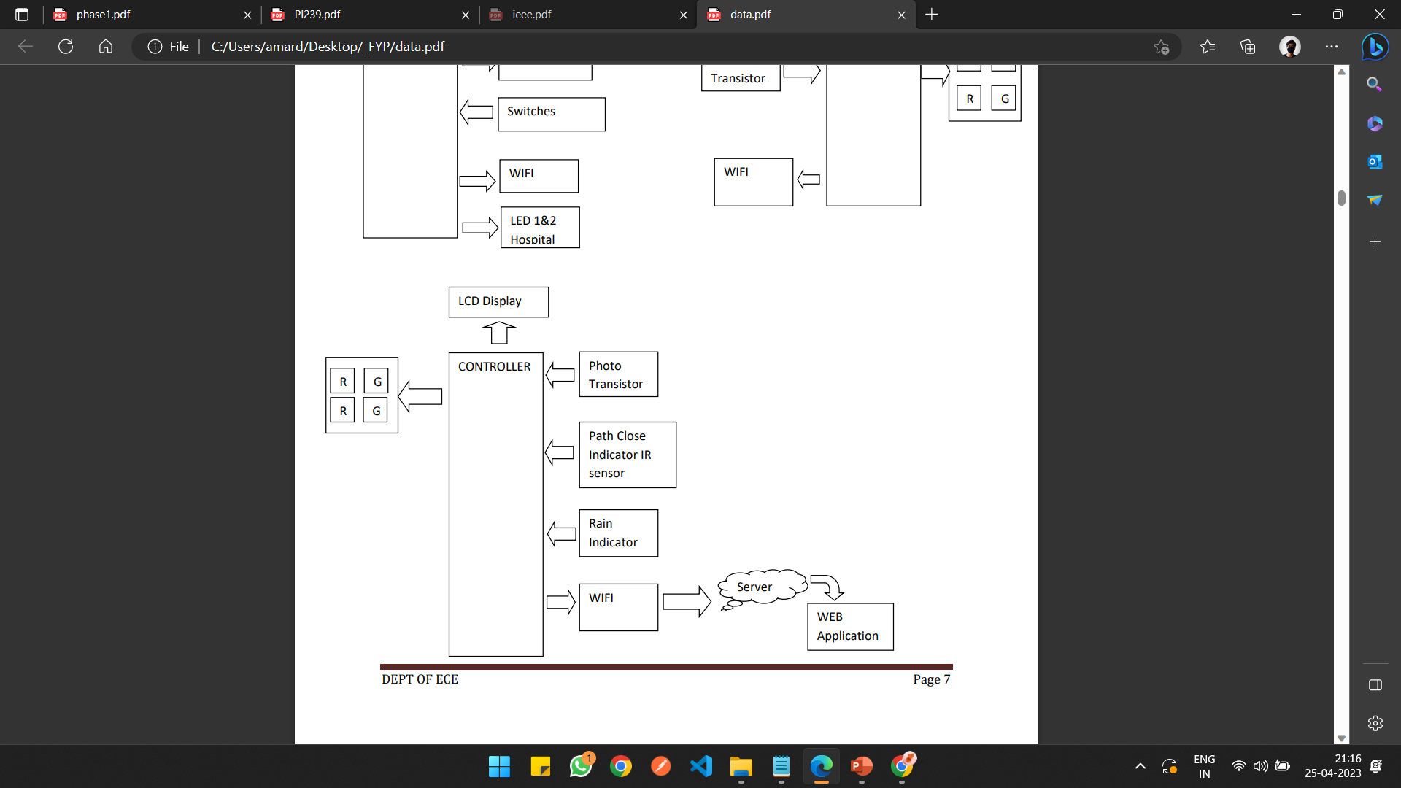
IMPLEMENTATION
Block diagram of traffic light2 module
Flow chart of traffic light2 module

Slide 23


IMPLEMENTATION
Pseudocode
Ambulance: sending north side direction signal
Ambulance: receiving hospital1 response
Receiving Hospital Signal from Adafruit

Slide 24


IMPLEMENTATION
Pseudocode
Traffic1 receiving north side ambulance incoming signal
Traffic 2 detecting rain

Slide 25
Testing
Test Case No. | Description | Test Steps | Expected Results | Actual Results | Pass / Fail
1. | Checking the transmission of direction signal from ambulance to traffic light. | Send the direction signal using switches on ambulance module. | Traffic light receives the direction signal from the ambulance. | The direction signal was received by the traffic light. | Pass
2. | Checking the transmission of hospital availability signal from server to ambulance. | Send the hospital availability signal from server. | Message received by the ambulance. | Ambulance receives the hospital availability signal from server. | Pass
3. | Checking the working of rain sensor. | Dip the rain sensor in cup of water. | Traffic light displays the rain indication. | Traffic light displays the rain indication. | Pass
4. | Checking the working of blockage sensor. | Place an object infront of the blockage sensor. | Traffic light displays the blockage indication. | Traffic light displays the blockage indication. | Pass

Slide 26
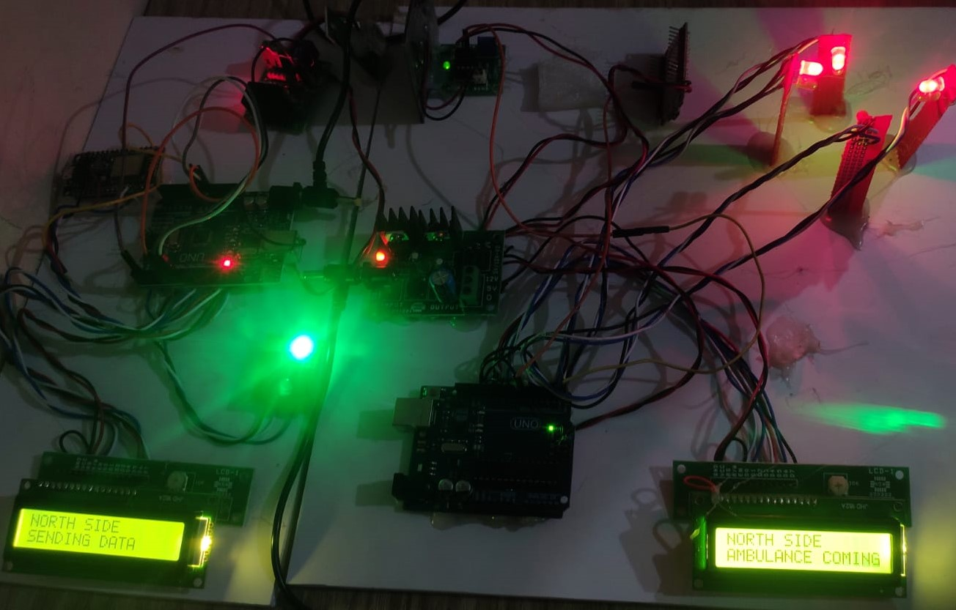
Results and Discussions
Figure showing ambulance sending north direction signal and traffic light receiving it.

Slide 27
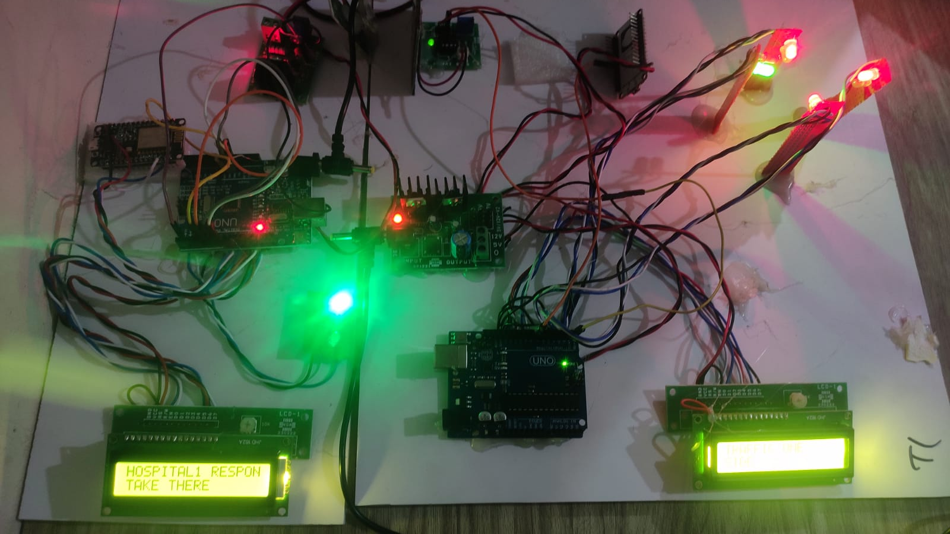
Results and Discussions
Figure showing ambulance receiving hospital1 response.

Slide 28
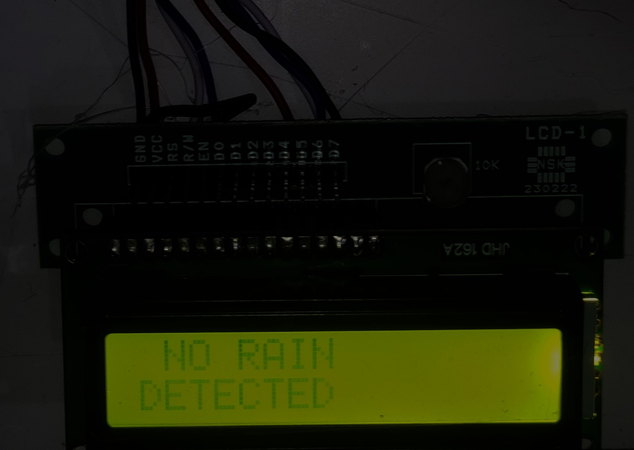
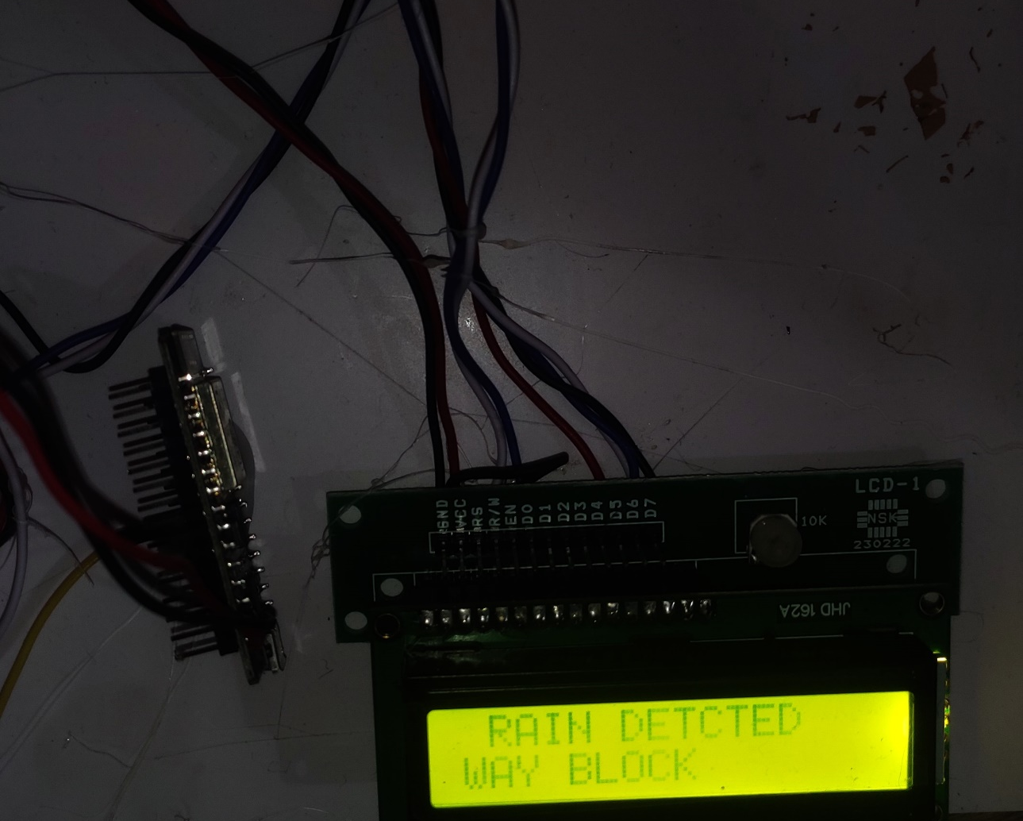
Results and Discussions
Figure showing no rain detection
Figure showing rain detection

Slide 29
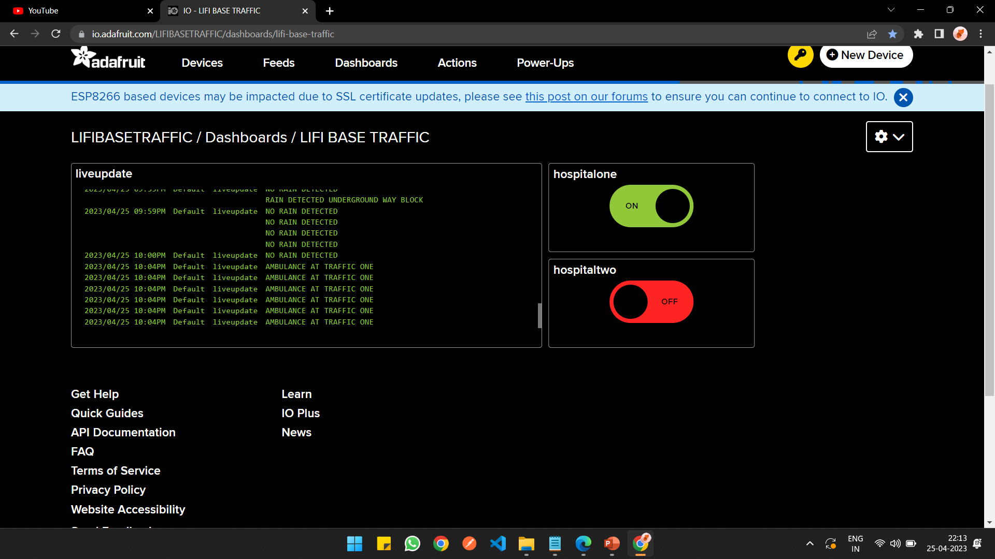
Results and Discussions
Adafruit dashboard showing hospital1 availability and live-updates log

Slide 30
National Conference Paper
Find the link below to access the National Conference Paper:
https://drive.google.com/file/d/13Iw-8qkun4O3GxB2cbds4Ozg9MHzTcaP/view?usp=sharing

Slide 31
CONCLUSION
To conclude, the experimental implementation of the LiFi based traffic signal control system for ambulance has demonstrated significant improvements in emergency response times compared to the existing system.
The cost-effectiveness of Li-Fi technology makes it an efficient and environmentally friendly alternative to existing cellular-based traffic management systems.
Using the Li-Fi communication infrastructure various other data can also be sent from one vehicle to another.
If this system is implemented in the real world, many lives can be saved as the emergency vehicles would wait for very less time in traffic jams.
This can be further implemented to other emergency vehicle such as firefighter trucks and police vehicles.

Slide 32
Future Enhancements
Implementation of Machine Learning: By analyzing data from previous emergencies, the system can learn to predict traffic patterns and optimize traffic signal timings accordingly, allowing for faster response times and better emergency management.
Expansion to other emergency vehicles: While the LiFi system is currently designed to work with ambulances, it could be expanded to other emergency vehicles, such as fire trucks and police cars.
Improved accuracy and reliability: While LiFi technology has the potential to be very accurate, there are still some limitations to its range and reliability. To make the system even more effective, researchers could work on improving the accuracy and reliability of the LiFi signals, so that they can be detected by traffic signals from even greater distances.
V2V smart connection enhancements: Another possible area for improvement would be to enhance the V2V communication capabilities of the system. This could involve incorporating additional sensors and communication protocols to enable more robust data exchange between vehicles. For example, vehicles could share information about their speed, direction, and location in real-time, allowing the traffic signal system to make more informed decisions about when to change signals.

Slide 33
REFERENCES
[1] H. Noori, “Modeling the Impact of VANET-Enabled Traffic Lights Control on the Response Time of Emergency Vehicles in Realistic LargeScale Urban Area,” 2013.
[2] A. S. Eltayeb, H. O. Almubarak, and T. A. Attia, “A GPS Based Traffic Light Pre-emption Control System for Emergency Vehicles,” 2013.
[3] R. S. Rajeshwari, S. Hebbar, and V. Golla, “Implementing Intelligent Traffic Control System for Congestion Control, Ambulance Clearance and Stolen Vehicle Detection,” 2015.
[4] V. Kodire, S. Bhaskaran, and V. H.N., “GPS and ZigBee Based Traffic Signal Preemption,” 2016.
[5] L. Sai Krishna, S. Vijay Chowdary, M. Pushpavalli, and P. Sivagami, “Advanced Automation Control in an Ambulance under Emergency Condition,” 2017.
[6] M. Managuli, A. Deshpande, and S. H. Ayatti, “Emergent vehicle tracking system using IR sensor,” 2017.
[7] P. Devi and S. Anila, “Intelligent Ambulance with Automatic Traffic Control,” 2020.
[8] L. A. Magre Colorado, J. Franco Ibanez, and J. C. Martinez-Santos, “Leveraging Emergency Response System Using the Internet of Things,” 2020.

Slide 34
REFERENCES
[9] V.K.G. Kalaiselvi, A. Sangavi, and Dhivya, “Li-Fi technology in traffic light,” 2017
[10] V. Raj, A. Narayanan, and K. Bijlani, “Efficiency of opportunistic cellular,LiFi traffic offloading,” in 2017 2nd IEEE International Conference on Recent Trends in Electronics, Information and Communication Technology (RTEICT), 2017.
[11] A. Correa, A. Hamid, and E. Sparks, “Li-Fi Based Smart Traffic Network,” in 2018 IEEE 88th Vehicular Technology Conference (VTCFall).
[12] R. Shanmughasundaram, S. Prasanna Vadanan, and V. Dharmarajan, “LiFi Based Automatic Traffic Signal Control for Emergency Vehicles,” in 2018 IEEE Global Conference on Wireless Computing and Networking (GCWCN), 2018.
[13] A. Patni, B. Mishra, H. Aditya, Y. Kumar, and R. Sharma, “Highway Navigation Using Light Fidelity Technology,” in 2015 IEEE 12th International Conference on Mobile Ad Hoc and Sensor Systems (MASS), 2015.
[14] J. Saradha, G. Vijayshri, and T. Subha, “Intelligent traffic signal control system for ambulance using RFID and cloud,” in 2017 International Conference on Innovations in Information, Embedded and Communication Systems (ICIIECS), 2017.
[15] J. I. Janjua, T. A. Khan, M. S. Khan, and M. Nadeem, “Li-Fi Communications in Smart Cities for Truly Connected Vehicles,” in 2021 International Conference on Information Networking (ICOIN), 2021

Slide 35
Question and Answer

Slide 36
THANK YOU

