Slide 1

Online Marketplace
RNS INSTITUTE OF TECHNOLOGY
BENGALURU - 98
DEPARTMENT OF INFORMATION SCIENCE & ENGINEERING
Presentation on Internship
Amardeep Kumar
USN: 1RN19IS020
Devendra Upadhyay
USN: 1RN19IS056
TechieAid
Internal Guide
Ms. Shyla N
Asst. Prof, Dept of ISE, RNSIT
External Guide
Girish
Instructor, TechieAid,Bengaluru

Slide 2
AGENDA
Abstract
About the Company
Certificate
Introduction
Objective
Tools
System Design
Implementation
Result
Conclusion and Future Enhancements
References
Q & A

Slide 3
ABSTRACT
This project is on Online Marketplace.
It helps the user(seller) to post advertisement of their old products.
Other users(buyer) can look at these ads and get in contact with the seller.
For frontend, we have used HTML, CSS, EJS.
For database, we have used MongoDb.
For backend,we have used NodeJs.
For storing images, we have used cloudinary services.

Slide 4
About the Company
TechieAid is Bengaluru based service providing company helps tech-enabled companies leverage talent so they can scale quickly to meet their growth ambitions.
Kiran Gopalakrishna is the Founder & CEO . He founded the company in 2018.
Their skilled technology engineers partner with clients, enabling them to achieve complex technical objectives and create business value.
They design, develop and support innovative custom software, full stack web and mobile applications, guiding the clients on the journey to realize their vision.
Domain: Full stack web development.
Duration: August 2022 - September 2022.

Slide 5
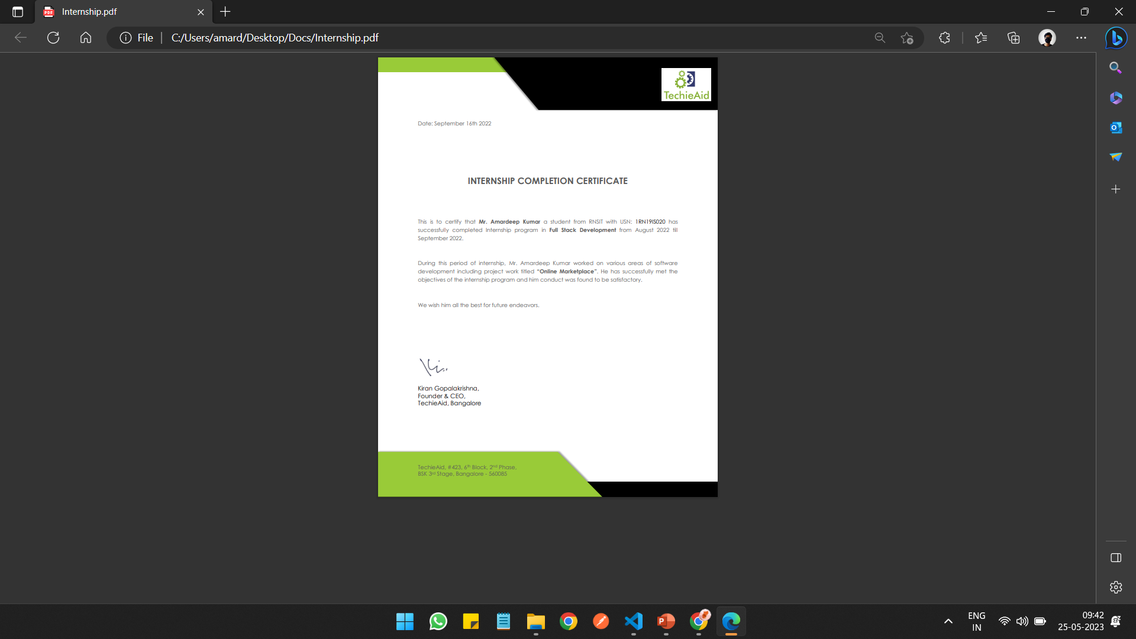
CERTIFICATE

Slide 6
INTRODUCTION
Online Marketplace is classified ads website.
The purpose of this project is to develop a fully functional classified ad website, which will provide users with a platform to create accounts, post ads with images, and connect with potential buyers or sellers.
The classified ad website will offer key features such as user registration, ad posting with images, ad browsing, messaging system via email for communication between buyers and sellers, ad update and deletion options for sellers.
Admin moderation to ensure content quality and safety.
The project was implemented as a full stack web application, utilizing a combination of front-end and back-end technologies.
This project was made using the industry standard MVC architecture for better optimization, cloudinary service for media storage control and use of hash and salt to store encrypted user password such that it is prone to attacks.

Slide 7
OBJECTIVES
To understand how MVC architecture is implemented in real world project.
To understand how different parts of a full stack web project communicate and works.
To understand how authentication and authorization works using hash encryption.
To understand how third party cloud service can be implemented within web development projects.
Connect Buyers and Sellers
Enable Easy Ad Posting
Provide a User-Friendly Experience
Facilitate Effective Browsing
Promote User Safety and Trust

Slide 8
TOOLS
HTML: HTML (Hypertext Markup Language) is the foundation of the web, allowing the creation and structuring of web pages through the use of tags and elements. It provides a standardized structure for content and enables the integration of multimedia elements, forms, and interactive features within a browser.
CSS: CSS, short for Cascading Style Sheets, is a fundamental web technology used to define the visual appearance and layout of HTML elements, allowing developers to customize the colors, fonts, spacing, and overall design of a website to create engaging and visually appealing user experiences.
JS: JavaScript (JS) is a versatile programming language commonly used for adding interactivity and dynamic functionality to websites, allowing developers to create interactive web experiences and build powerful web applications.
EJS: EJS (Embedded JavaScript) is a powerful templating engine for JavaScript that allows seamless integration of dynamic content into HTML templates. With its simple syntax and extensive functionality, EJS enables developers to build dynamic web pages with ease.

Slide 9
TOOLS
NodeJS: Node.js is a powerful, server-side JavaScript runtime environment that allows developers to build scalable and efficient web applications. With its event-driven architecture and extensive package ecosystem, Node.js has become a popular choice for creating high-performance server-side applications.
MongoDB: MongoDB is a highly popular and flexible NoSQL database system that offers scalability, high performance, and a document-oriented data model, making it ideal for managing and storing large volumes of unstructured data in a schema-less fashion.
Cloudinary: Cloudinary is a powerful cloud-based media management platform that simplifies the process of storing, optimizing, and delivering images and videos for websites and applications. It offers a comprehensive set of features, including seamless integration, intelligent image transformation, and reliable content delivery, making it an essential tool for managing media assets in the cloud.

Slide 10
TOOLS
Middleware/Library Used:
Express: Express.js is a fast and minimalist web application framework for Node.js, widely used for building robust and scalable server-side applications and APIs.
Mongoose: Mongoose is a powerful Object Data Modeling (ODM) library for Node.js, simplifying the usage of MongoDB by providing a schema-based solution for managing relationships, validations, and querying operations.
EjsMate: EJSMate is a powerful templating engine for Node.js that simplifies the process of rendering dynamic web pages with EJS (Embedded JavaScript) syntax.
Session: Sessions are a crucial component of web development that enables the storage and retrieval of user-specific information, allowing for personalized and secure interactions between users and websites.
Passport: Passport is a popular authentication middleware for Node.js that simplifies user authentication and provides a flexible and secure way to handle login and access control in web applications.
Helmet: The usage of Helmet in Node.js enhances web application security by providing essential HTTP headers and protection against common security vulnerabilities.
Flash: Flash is a module in Node.js that enables the creation and management of temporary messages or notifications to enhance user experience in web applications.

Slide 11
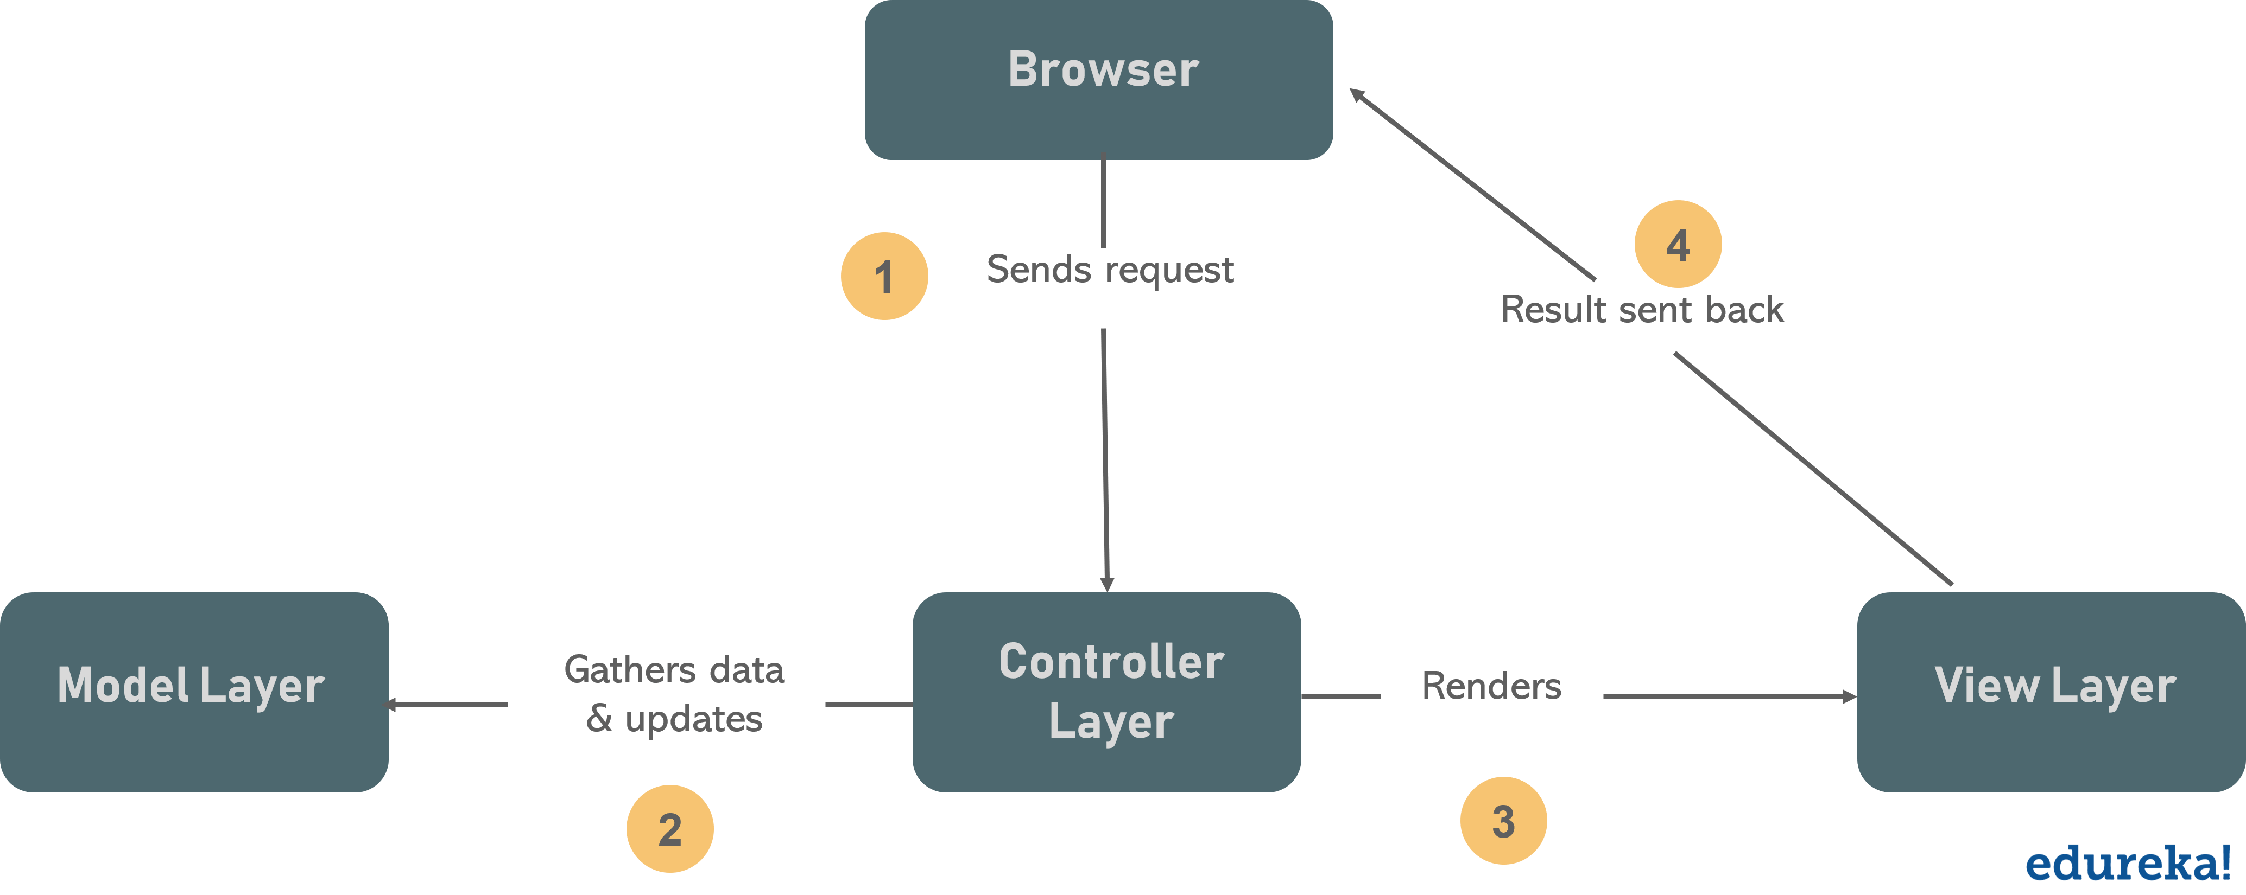
System Design
This project is based on MVC architecture.
Model controls the database related logic.
View controls the UI related logic.
Controller controls the routing and business logic.

Slide 12
Baic system flow diagram for new user
User creates account
User
Logins
Home page
View all ad
Post new ad
Open a particular ad
If owns the ad
If do not owns the ad
Edit/Delete the ad
Make contact with seller

Slide 13
Implementation / Coding
module.exports.renderRegister = (req, res) => {res.render("users/register");};
module.exports.register = async (req, res, next) => {res.redirect("register");}};
module.exports.renderLogin = (req, res) => {res.render("users/login");};
module.exports.login = (req, res) => {res.redirect(redirectUrl);};
module.exports.logout = (req, res) => {req.logout();};
const UserSchema = new Schema({
username: String,
email: {
type: String,
required: true,
unique: true
},
});

Slide 14
Implementation / Coding
const ImageSchema = new Schema({
url: String,
filename: String,
});
const AdsSchema = new Schema(
{
title: String,
images: [ImageSchema],
price: Number,
description: String,
location: String,
author: {
type: Schema.Types.ObjectId,
ref: "User"})
module.exports.index = async (req, res) => {res.render("ads/index", { ads });};
module.exports.renderNewForm = (req, res) => {res.render("ads/new");};
module.exports.createAd = async (req, res, next) => {res.redirect(`/ads/${ad._id}`);};
module.exports.showAd = async (req, res) => {res.render("ads/show", { ad });};
module.exports.renderEditForm = async (req, res) => {res.render("ads/edit", { ad });};
module.exports.updateAd = async (req, res) => {res.redirect(`/ads/${ad._id}`);};
module.exports.deleteAd = async (req, res) => {res.redirect("/ads");};

Slide 15
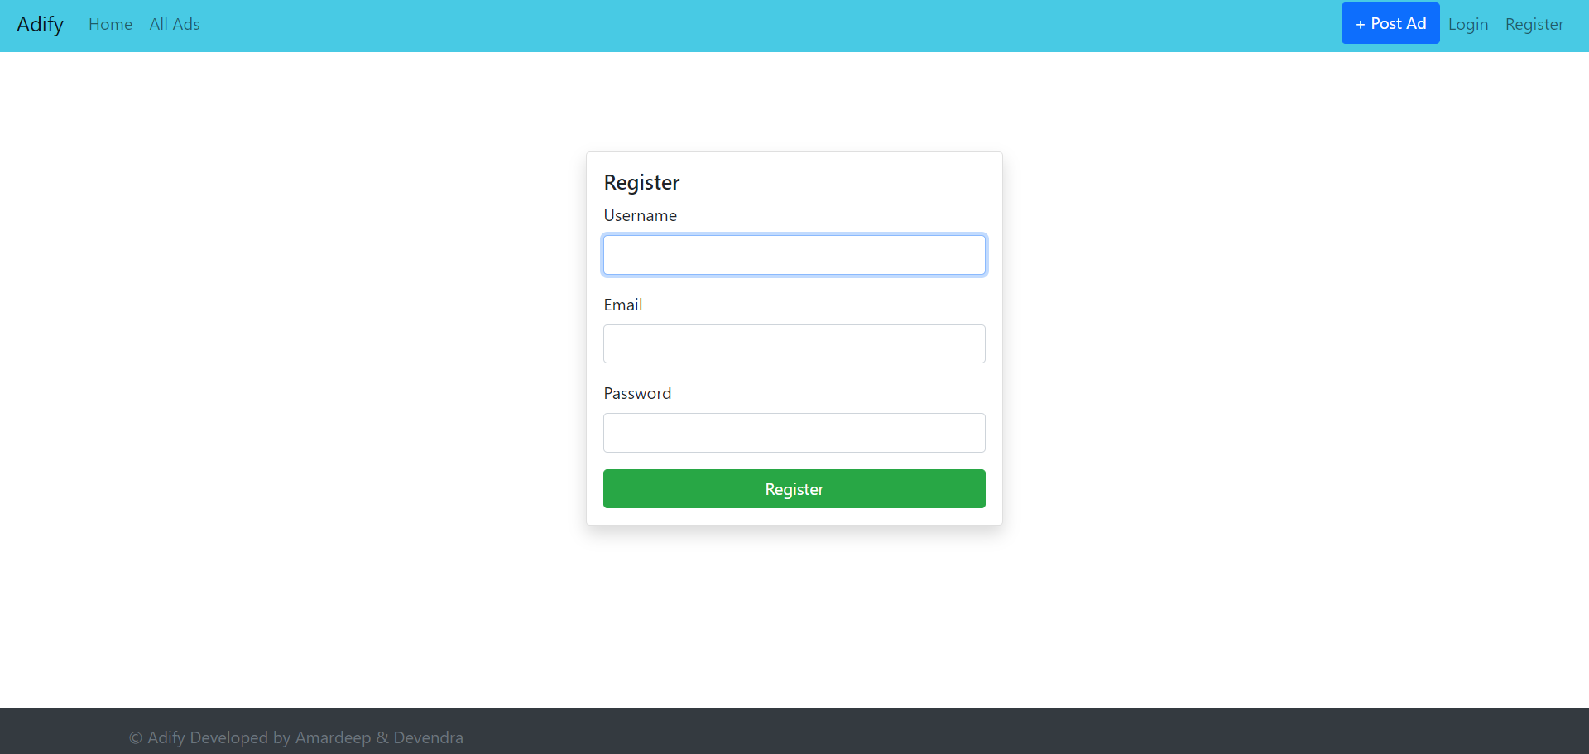
Screenshots
New user registration page

Slide 16
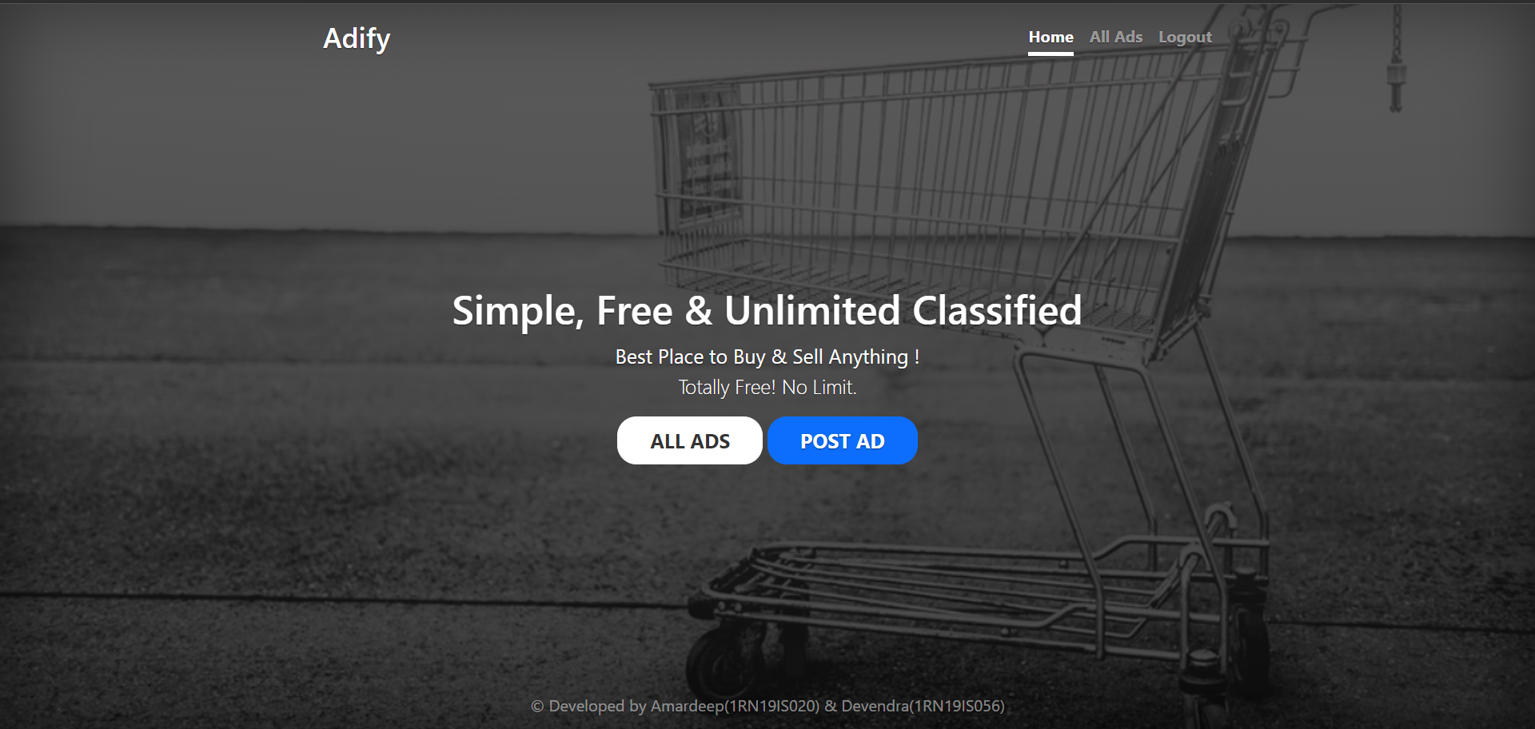
Screenshots
Home page

Slide 17
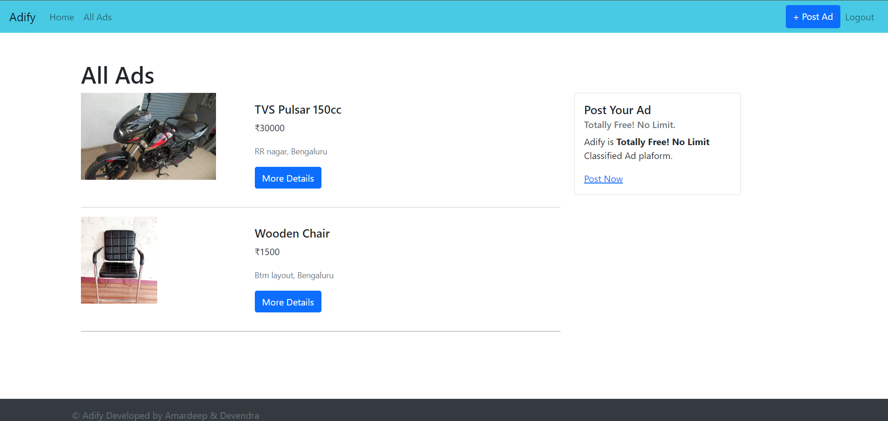
Screenshots
All ads page

Slide 18
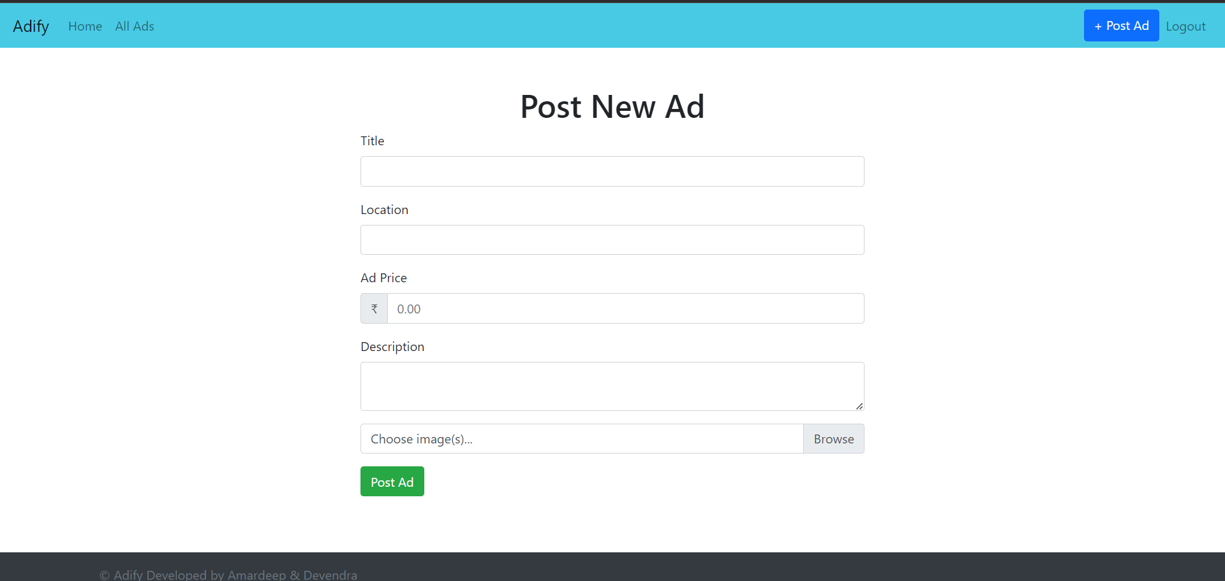
Screenshots
Post new ad page

Slide 19
Conclusion and Future Enhancement
CONCLUSION
This project was an attempt to make the structure and working of an Classified website simple and user-friendly.
This was an attempt to make it similar to the real world implementation.
In this scenario, all the undertakings of the Online Marketplace was achieved in a constructive manner.
Given the right guidance and support its applications and availability can be enhanced.
FUTURE ENHANCEMENT
Making the UI more interactive.
Adding new features such as review system, where the buyer can rate the seller.
Making the project more real time based by adding in app chat and transanction system.
Hosting it on an online web server.

Slide 20
REFERENCES
[1] Raghu Ramakrishnan and Johannes Gehrke, Database Management Systems, McGRAW HILL, 3rd Edition.
[2] Ramez Elmasri and Shamkant B. Navathe, Fundamentals of Database Systems, Pearson, 7th Edition.
[3] www.stackoverflow.com
[4] www.mysql.com/doc
[5] https://docs.microsoft.com
[6] https://www.geeksforgeeks.org
[7] https://www.rapidapi.org

Slide 21
Question and Answer

Slide 22
THANK YOU

