Slide 1
Automating Procurement Contracts in Healthcare Supply Chain Using Blockchain Smart Contracts
RNS INSTITUTE OF TECHNOLOGY
BENGALURU - 98
DEPARTMENT OF INFORMATION SCIENCE & ENGINEERING
Presentation on Technical Seminar
Amardeep Kumar
USN: 1RN19IS020
Guide
Ms. Vanishri S
Asst. Prof, Dept of ISE, RNSIT
Panel Member
Ms. Sudha V
Asst. Prof, Dept of ISE, RNSIT

Slide 2
AGENDA
Abstract
Introduction
Literature Survey
Existing System
Proposed System
System Design
Results and Discussion
Limitations
Conclusion and Future Enhancements
References
Q & A

Slide 3
ABSTRACT
Managing the healthcare supply chain (HCSC) process is crucial for healthcare providers, even in normal operations, and is especially important during pandemics like COVID-19.
Despite significant advances in new technologies and treatment options providers still suffer from poor procurement, ordering, forecasting, and distribution practices.
Group Purchasing Organizations (GPOs) are an important stakeholder in HCSC and benefit providers with cost savings, volume discounts, and vendor selection. It is well known that more than 90% hospitals in the United States are members of GPOs, thereby making GPOs an important part of HCSC.
Proposed solution :blockchain-based smart contract approach for automating procurement.
Solution combines blockchain technology with decentralized storage for increased transparency, trust, and security.

Slide 4
INTRODUCTION
HCSC suffers from highly fragmented structures, obsolete processes and systems, and disconnectedness in information sharing among stakeholders. The issue does not limit itself to fragmented information but extends to a lack of trust and transparency among trading partners.
A blockchain consists of a chain of blocks that contains a record of transactions. Each block contains a cryptographic hash of the previous block, which makes it difficult to modify any block without changing the entire chain.
Smart contracts are self-executing computer programs that automatically enforce the terms of a contract when certain predetermined conditions are met. They are designed to eliminate the need for intermediaries such as lawyers, bankers, or brokers, and to create a more efficient, secure and transparent way of doing business.
Blockchain technology can be used to connect suppliers and retailers in a trusted environment to encourage inventory sharing, enhancing trust, efficiency, and coordination while reducing disruptions and enhancing transparency.
The proposed solution is a private blockchain-based solution that uses Ethereum smart contracts and a decentralized storage system to facilitate inventory sharing among supply chain stakeholders, validated through testing and cost and security analysis.

Slide 5
LITERATURE SURVEY
"A Survey on Blockchain for Supply Chain Management" by He Huang, Sheheryar Malik(2019): This paper presents a survey of the use of blockchain in supply chain management. The authors review the literature on blockchain in supply chain management and discuss its potential applications, such as traceability, transparency, and efficiency. They also identify the challenges and opportunities for future research in this area.
"A survey on smart contract: architectures, applications, and future trends" by Ali Dorri, Salil S. Kanhere, and Raja Jurdak, published in IEEE Communications Surveys & Tutorials in 2019: This paper provides a comprehensive overview of smart contract technology, including its architecture, applications, challenges, and future trends. This paper also provides an overview of blockchain consensus algorithms, including those used in smart contract platforms, and examines their properties, advantages, and limitations.
"Blockchain Technology in Healthcare: A Systematic Review" (Ahmed, I., Ahmed, M., & Hossain, S., 2020): This systematic review examines the potential of blockchain technology in healthcare, including its use in supply chain management. The authors highlight the benefits of using blockchain-based smart contracts to automate procurement contracts, reduce costs, and improve transparency and accountability. They also discuss the challenges associated with implementing blockchain technology, such as interoperability and data privacy.

Slide 6
LITERATURE SURVEY
"A Blockchain-based Smart Contract Solution for Healthcare Procurement Contracts" (Chen, Y., Zhang, W., & Wang, B. ., 2020): This paper proposes a blockchain-based smart contract solution for automating procurement contracts in the healthcare supply chain. The authors describe the architecture of the proposed solution, which includes a blockchain network, a smart contract engine, and a user interface. They highlight the benefits of using the proposed solution, including reduced transaction costs, improved transparency and accountability, and automated contract execution. They also discuss the challenges associated with implementing the solution, such as interoperability, data privacy, and regulatory compliance.
"Blockchain-Based Smart Contracts for Healthcare Supply Chain Management: A Systematic Review" (Kumar, R., Tripathi, S., & Sethi, A., 2020): This systematic review examines the potential of blockchain-based smart contracts in healthcare supply chain management. The authors highlight the benefits of using blockchain-based smart contracts to automate procurement contracts, reduce costs, and improve transparency and accountability. They also discuss the challenges associated with implementing blockchain technology, such as data privacy, interoperability, and regulatory compliance.

Slide 7
EXISTING SYSTEM
The existing process of contract negotiation between a drug manufacturer and GPO involves several steps, including disputes, rebate payments, chargebacks, and adjudication.
The system relies on a centralized database, which may be prone to security breaches or data manipulation.
There may be concerns about the confidentiality of proprietary information shared among supply chain partners.
Moreover, the process is time-consuming and usually takes more than a month to finalize the contract that will be administered to healthcare providers.
Another important challenge in the current process involves ensuring that all stakeholders are simultaneously informed regarding the contracts and pricing updates.

Slide 8
PROPOSED SYSTEM
The proposed system is a blockchain-based solution designed to automate procurement contracts in the healthcare supply chain. The system will utilize smart contracts to automate the entire procurement process, from order placement to payment and delivery.
By eliminating intermediaries and reducing the administrative burden of procurement contracts, the proposed system will significantly reduce transaction costs in the healthcare supply chain.
The use of blockchain technology will create a transparent and auditable record of all transactions and interactions, providing greater visibility into the procurement process and ensuring that all parties are held accountable.
Solution combines blockchain technology with decentralized storage for increased transparency, trust, and security.

Slide 9
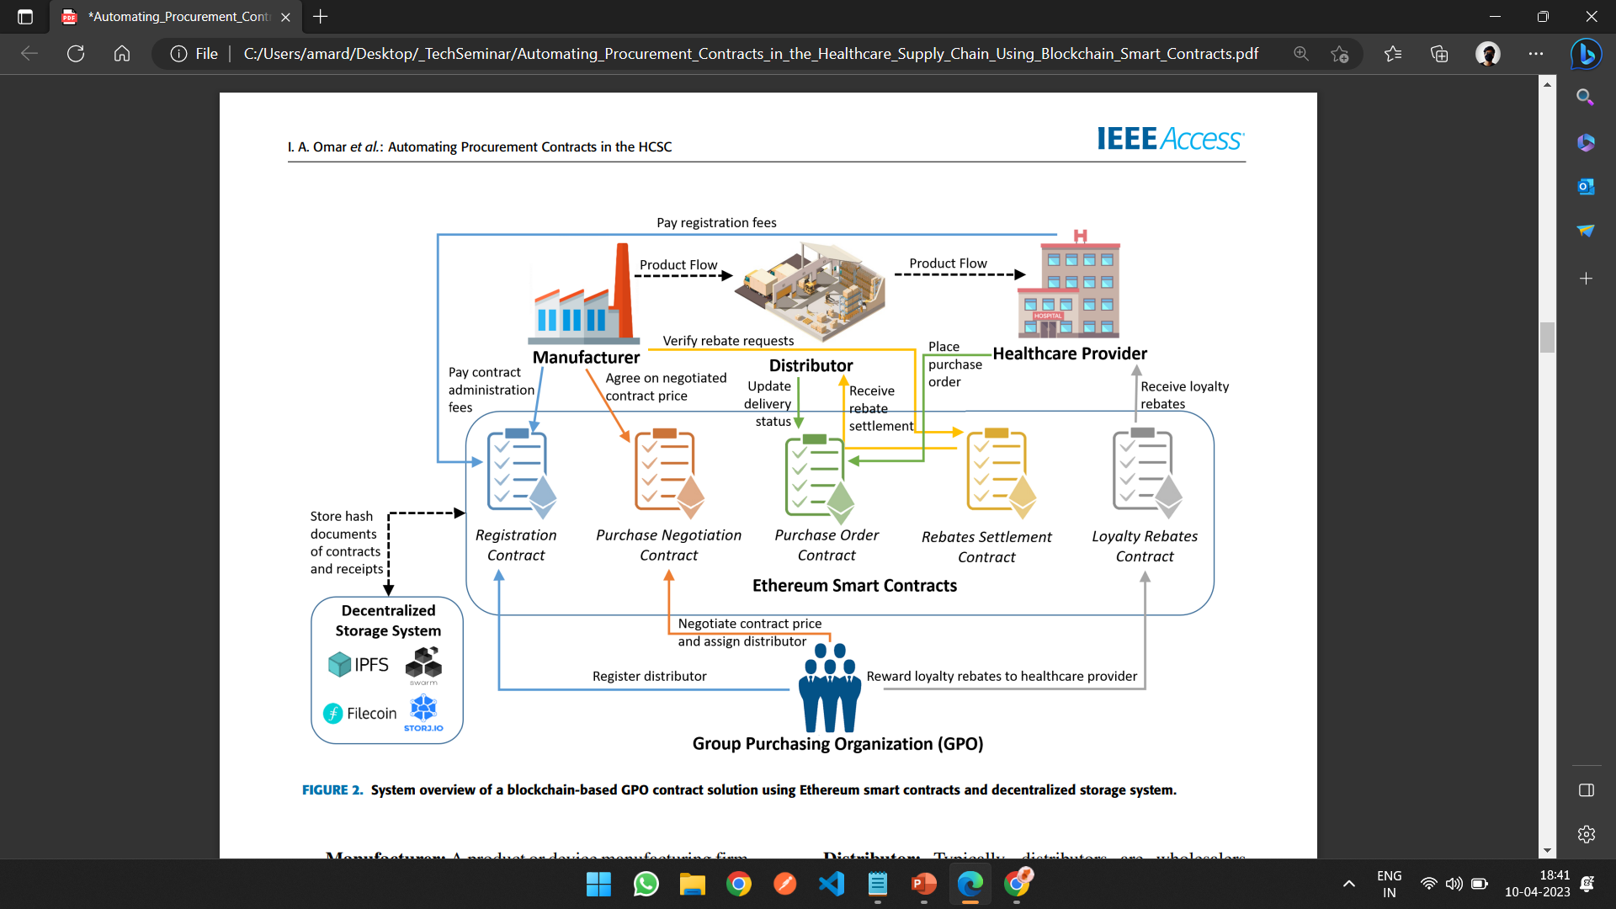
PROPOSED SYSTEM
FIGURE: System overview of a blockchain-based GPO contract solution using Ethereum smart contracts and decentralized storage system.

Slide 10
PROPOSED SYSTEM
STAKEHOLDERS AND COMPONENTS
Manufacturer: A product or device manufacturing firm that develops and sells medical equipment or drugs to be used by healthcare providers. Manufacturers collaborate with GPOs by paying contract administration fees(CAF).
Group Purchasing Organization (GPO): An organization specialized in helping healthcare providers such as hospitals, home health agencies, nursing homes, and ambulatory care facilities. They aggregate purchasing volumes and use that leverage to negotiate selling prices with manufacturers to obtain discounts achieved by economies of scale. Thus, providers prefer working with GPOs as they gain purchasing power and benefit from cost savings.
Distributor: Typically, distributors are wholesalers placed between manufacturers and healthcare providers. They buy products from manufacturers at a distributor price, which is much higher than the contract price agreed between the GPO and manufacturer. Thus, the difference between the distributor price and the contract price is reclaimed by the distributor as rebates from the manufacturer when the distributor delivers products to providers registered in the GPO contract.

Slide 11
PROPOSED SYSTEM
STAKEHOLDERS AND COMPONENTS
Healthcare Provider: Healthcare providers such as nursing homes and hospitals usually buy products from distributors using a GPO contract. The GPO appoints a distributor that would link the providers to the manufacturer. Hence, allowing providers to send purchase orders directly to the distributor using the negotiated price stated in the contract.
Decentralized Storage Technology: A distributed peer to-peer file system that helps in connecting the same file system to all nodes in the network. There are various file systems, such as Interplanetary File System (IPFS) or Filecoin. Large amounts of data can be stored in IPFS by authorized users in the network. Then immutable IPFS links can be created and stored in blockchain transactions as timestamped valid transactions secured using cryptographic technology.
Ethereum Smart Contracts: Second-generation blockchain platforms such as Ethereum allow codes to be written in the form of smart contracts. These contracts can be programmed to execute functions automatically without interference from third parties. They act as software agents that ensure that all stakeholders in the network abide by the terms and conditions stated in the contract.

Slide 12
PROPOSED SYSTEM
CONTRACTS TYPES:
Registration contract: This contract deals with the initial step, which is the registration process. Healthcare providers, manufacturers, and distributors are registered in this contract. To register in the smart contract, providers pay an annual membership.
Purchase Negotiation contract: This contract deals with the pricing negotiation process in which the registered manufacturer and GPO are the active members in the contract. The GPO recommends a contract price on behalf of the provider based on the commitment that the provider would purchase the minimum volume over the specified contract duration. Once the manufacturer agrees on the contract price, the GPO appoints a distributor, and this price is then published for providers to use.
Purchase Order contract: Once the negotiated price is confirmed, the registered providers can purchase products via this smart contract. The providers send purchase orders to the assigned distributor for product delivery at the agreed price. Then, the distributor sends the products from the distribution center to the provider, where an event would be triggered when the provider receives the order.

Slide 13
PROPOSED SYSTEM
CONTRACTS TYPES:
Rebates Settlement contract: This smart contract addresses settling rebates between distributors and manufacturers after the distributor delivers the order successfully. The distributor is eligible to claim rebates from the manufacturer due to the difference between the product purchased at the distributor price and the negotiated contract price.
Loyalty Rebates contract: Upon the successful completion of the contract, the GPO usually rewards its registered providers with a percentage of the contract administration fees (CAF) as loyalty rebates to be used for future purchases.

Slide 14
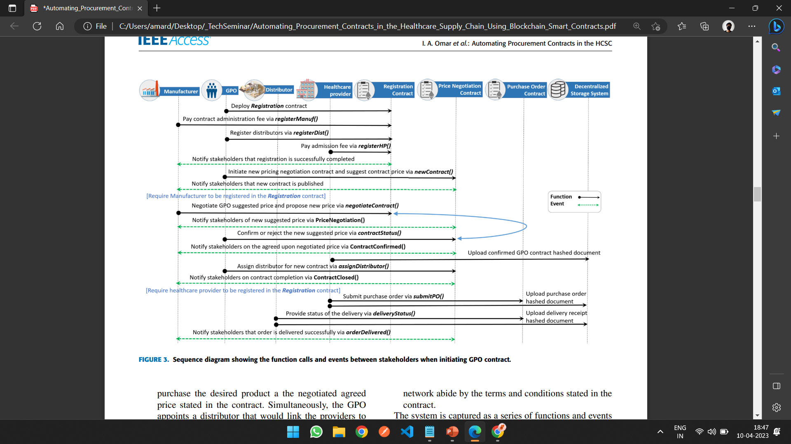
SYSTEM DESIGN
FIGURE: Sequence diagram showing the function calls and events between stakeholders when initiating GPO contract

Slide 15
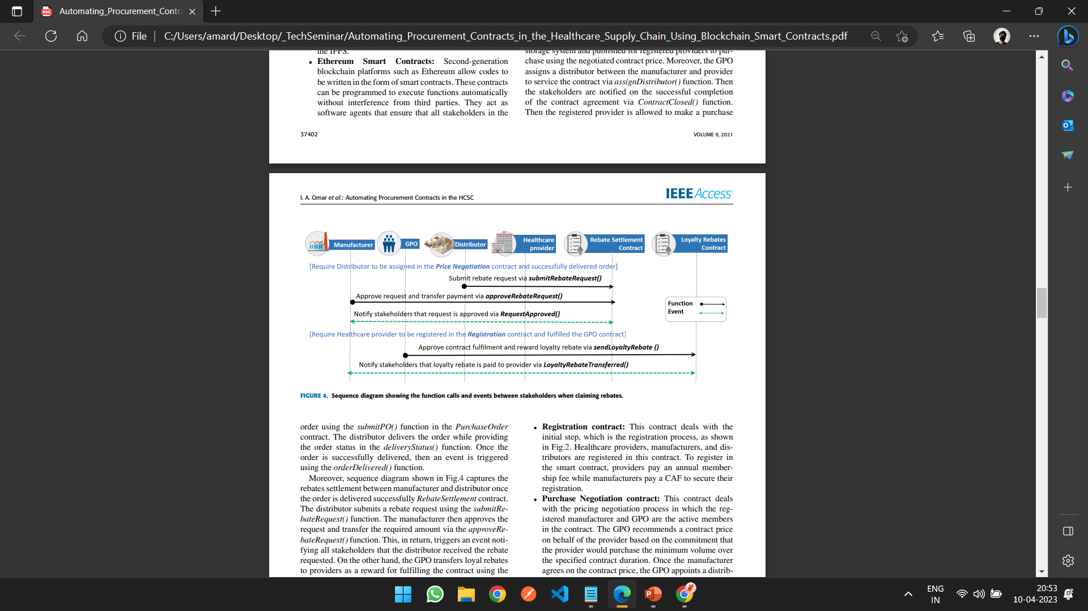
SYSTEM DESIGN
FIGURE: Sequence diagram showing the function calls and events between stakeholders when claiming rebates

Slide 16
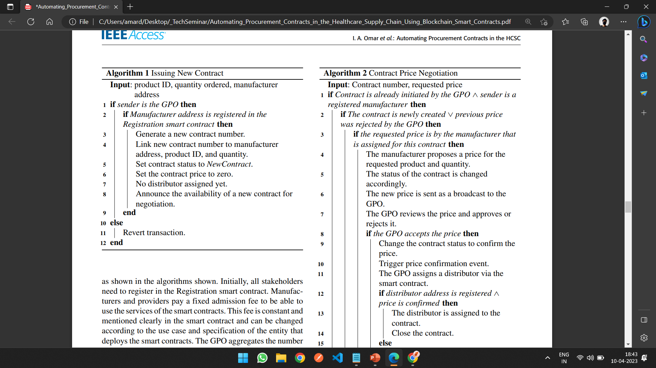
SYSTEM DESIGN

Slide 17
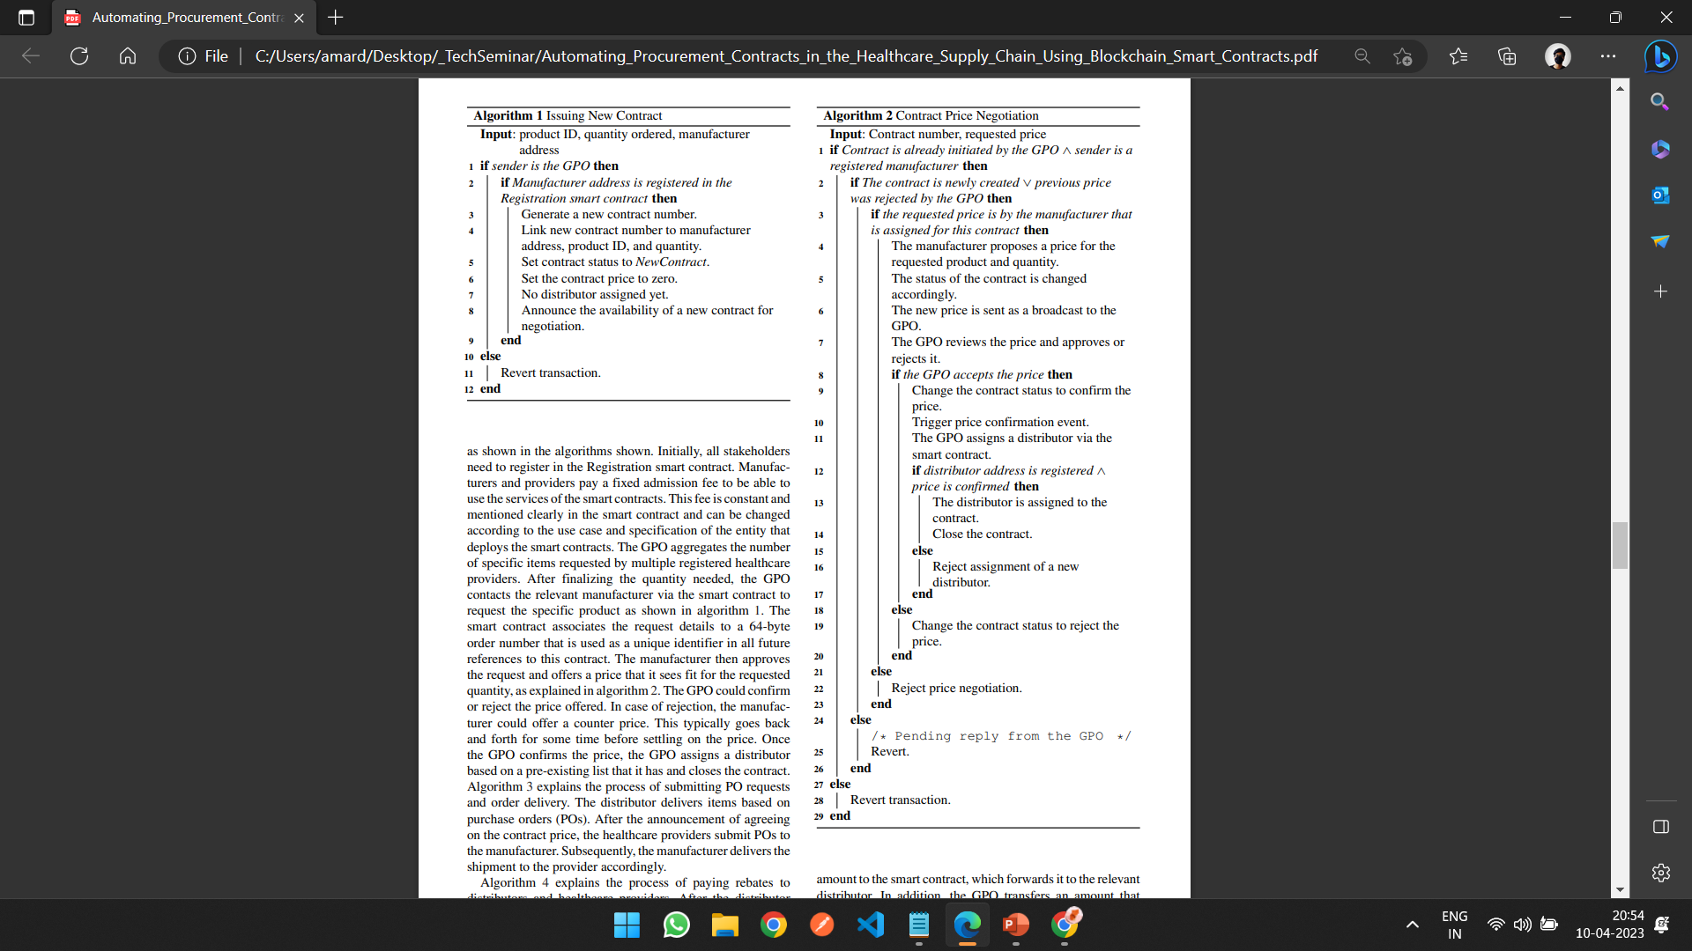
SYSTEM DESIGN

Slide 18
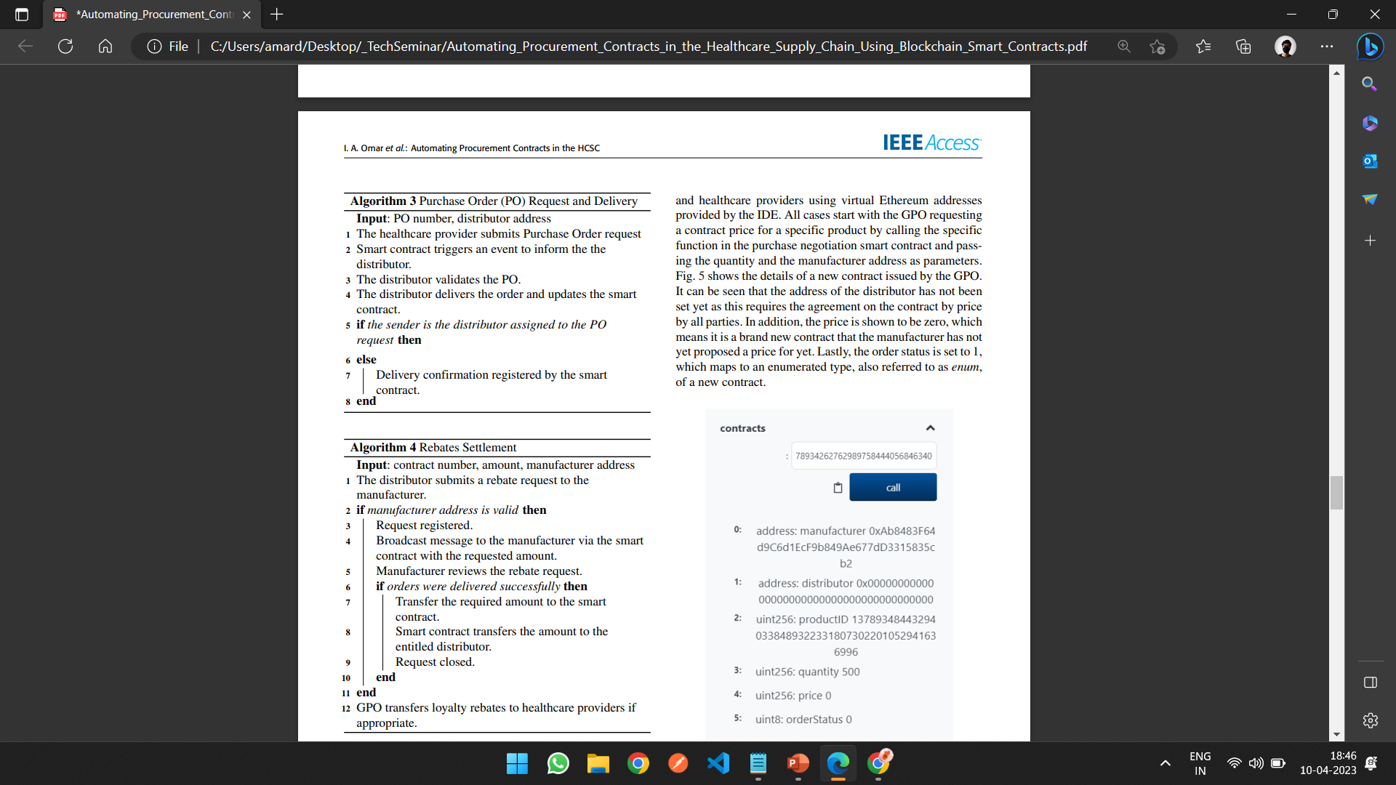
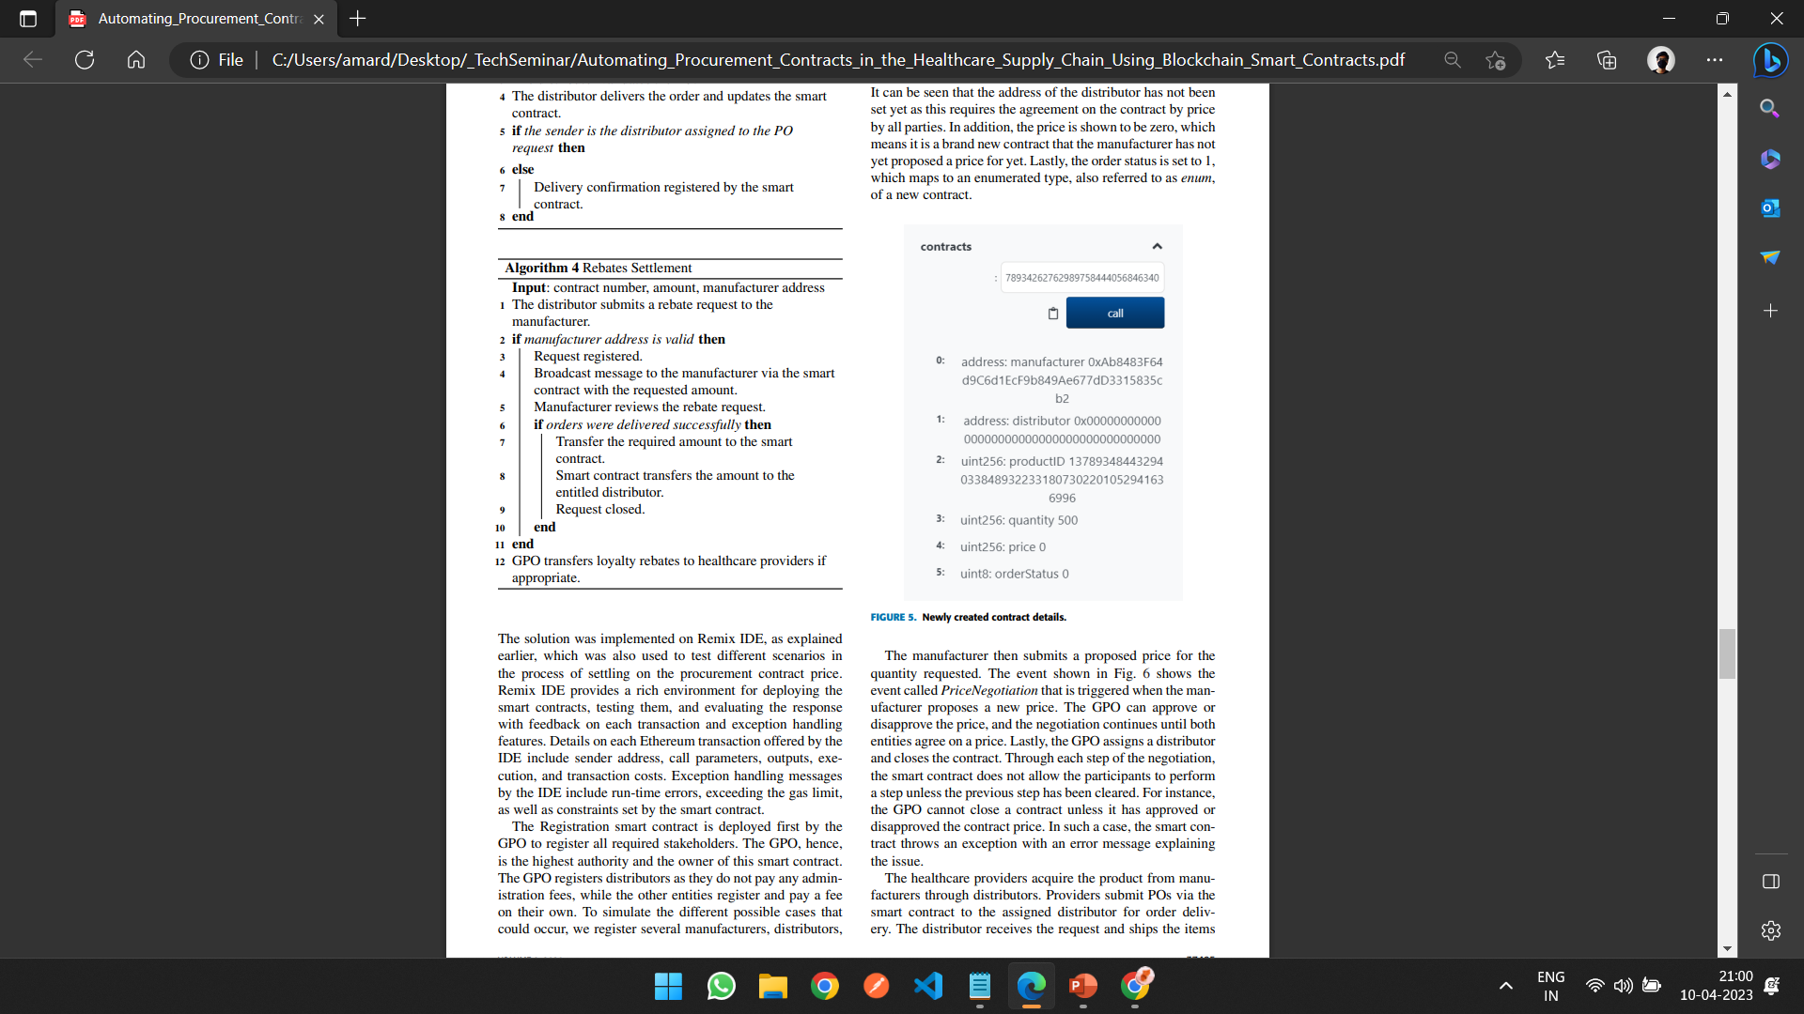
SYSTEM DESIGN

Slide 19
RESULTS AND DISCUSSION
COST ANALYSIS: Triggering function calls in Ethereum smart contracts cost a certain amount of money measured in the unit of gas. The cost of each function is less than $0.73 for cheap or slow execution, less than $0.53 for average execution, and less than $1.2 for fast execution.
GENERALIZATION: Our proposed solution is meant to be generic enough that it can be easily extended to accommodate multiple stakeholders.
SECURITY ANALYSIS:
The technology also ensures that the transactions and identities of participants are protected.
Blockchain technology maintains data integrity and immutability as modification, addition, and deletion of data is not permissible in the distributed ledger. Any data modification required is re-entered in the ledger as a new transaction.
Only registered HCSC members would be able to view the GPO contract.
Stakeholders in the blockchain network cannot deny an action or transaction that was carried out them.
Transactions in the Ethereum network are digitally encrypted and protected by hashing using cryptographic technology. Hence, any attempt made to tamper with any transactions would only be possible if the private key is known.

Slide 20
LIMITATIONS
Adoption: The adoption of blockchain technology in supply chain management is still in its early stages, and it may take some time for businesses to fully embrace it.
Technical expertise: The implementation of smart contracts and blockchain technology requires technical expertise, which may not be available to all supply chain stakeholders.
Interoperability: Different supply chain networks may use different blockchain protocols, which could create interoperability issues when attempting to share inventory data.
Security: While blockchain technology is designed to be secure, the security of a blockchain network is only as strong as its weakest link. If a vulnerability is found, it could potentially compromise the entire network.
Scalability: As more businesses join a supply chain network, the demand on the blockchain network will increase, potentially leading to scalability issues that could affect the performance of the network.
Regulatory Challenges: The healthcare industry is highly regulated, which may pose challenges for the implementation of blockchain-based solutions. Healthcare providers and suppliers must ensure that their procurement contracts comply with relevant regulations, which may vary by jurisdiction.

Slide 21
CONCLUSIONS
Automating procurement contracts in the healthcare supply chain using blockchain smart contracts has the potential to improve efficiency, transparency, and security of the procurement process.
Blockchain technology provides a decentralized and secure system for managing procurement contracts, reducing the need for intermediaries and improving trust among participants.
Smart contracts provide an automated and self-executing mechanism for managing procurement contracts, reducing administrative burden and increasing efficiency.
The use of blockchain smart contracts in the healthcare supply chain could improve the availability of medical supplies and equipment, reducing the risk of shortages and improving patient outcomes.
Though there are certain limitations, they can be overcome by some future enhancement. Overall, automating procurement contracts in the healthcare supply chain using blockchain smart contracts is a promising approach to improving supply chain management and ultimately improving the quality of care delivered to patients.

Slide 22
FUTURE ENHANCEMENTS
Integration with IoT Devices: The integration of smart contracts with IoT devices could enable the automatic ordering of medical supplies and equipment when stock levels fall below a certain threshold, improving supply chain efficiency.
Integration with Predictive Analytics: The integration of smart contracts with predictive analytics solutions could enable the system to anticipate supply chain disruptions and automatically adjust procurement contracts to ensure the continuous supply of medical supplies and equipment.
Development of Blockchain Interoperability Standards: The development of interoperability standards for blockchain-based systems could enable greater interoperability between different systems in the healthcare supply chain, facilitating the exchange of data and transactions.
Real-world implementation and adoption: The paper could analyze real-world implementation and adoption challenges, such as legal and regulatory issues, stakeholder resistance, and the cost and complexity of deploying the solution in a large supply chain network.
Integration with Payment Systems: The integration of smart contracts with payment systems could enable automatic payment processing for procurement contracts, reducing the administrative burden on healthcare providers and suppliers.

Slide 23
REFERENCES
[1] Huang, H., Malik, S., Xie, X., Wang, X., & Sun, X. (2019). A Survey on Blockchain for Supply Chain Management. IEEE Access, 7, 82716-82736.
[2] Dorri, A., Kanhere, S. S., & Jurdak, R. (2019). A survey on smart contract: architectures, applications, and future trends. IEEE Communications Surveys & Tutorials, 21(4), 3,719-3,760. https://doi.org/10.1109/COMST.2019.2921125
[3] Ahmed, I., Ahmed, M., & Hossain, S. (2020). Blockchain technology in healthcare: A systematic review. In Proceedings of the 10th International Conference on Ambient Systems, Networks and Technologies (pp. 440-449). ACM.
[4] Alzahrani, A. I., Alharthi, M. A., Aljaedi, A. A., Almalki, H. S., Alzahrani, A. S., & Alomar, R. S. (2021). Blockchain technology in healthcare: A systematic review. Journal of Healthcare Engineering, 2021, 1-21.
[5] Chen, Y., Zhang, W., & Wang, B. (2020). Blockchain-based smart contracts for healthcare supply chain management: A systematic review. In Proceedings of the 6th International Conference on Industrial Engineering and Applications (pp. 27-33). ACM.
[6] Kumar, R., Tripathi, S., & Sethi, A. (2020). A blockchain-based smart contract solution for healthcare procurement contracts. In Proceedings of the 2020 11th International Conference on Computing, Communication and Networking Technologies (ICCCNT) (pp. 1-6). IEEE.
[7] LHAAM A. OMAR, RAJA JAYARAMAN , MAZIN S. DEBE,KHALED SALAH, (Senior Member, IEEE),IBRAR YAQOOB, (Senior Member, IEEE),AND MOHAMMED OMAR(2021) Automating Procurement Contracts in the Healthcare Supply Chain Using Blockchain Smart Contracts .

Slide 24
QUESTION AND ANSWER

Slide 25
THANK YOU

