Slide 1

Welcome to Introduction to Python
What do you need?
Python: https://www.python.org/downloads/
PyCharm: http://www.jetbrains.com/pycharm/download/
This software has been downloaded for you on the computers in the lab.
Wi-Fi: OSCON
Password: need update

Slide 2
Who is helping you today?
Aimee Maree : Instructor
Cayci: Assistant
Wendell: Assistant
Roger: Assistant

Slide 3
What are we going to do today ?
Python and PyCharm
Basics of Python Programming
Input and output statements
Different data ‘types’
If and basic logic statements
Practice Examples!
Q&A / Showcase

Slide 4
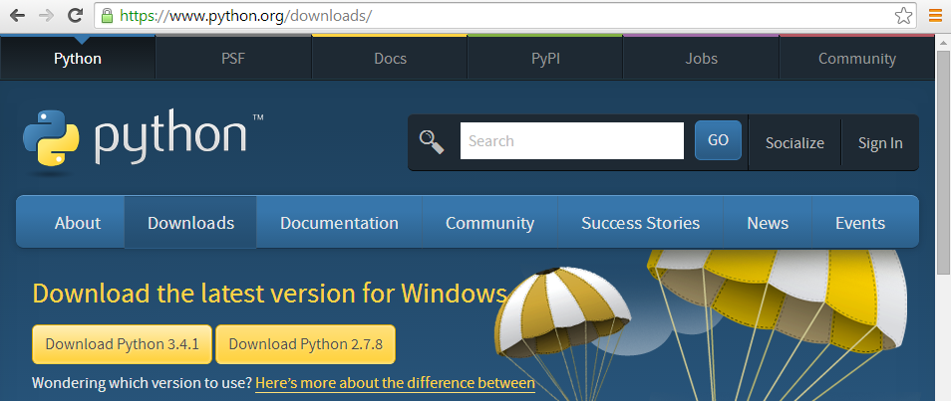
Python:
Python is a scripting language that can be run on Linux, OSX and Windows.
You can download the latest Python from the website.
Python3 is the latest version and it is always best to start new projects in the latest version.
For today the Computers have Python installed on them for you
If you want to install Python at home it is as easy as visiting
https://www.python.org/downloads/

Slide 5
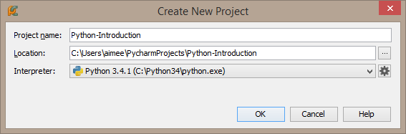
PyCharm:
PyCharm is an IDE (Integrated Development Environment)
We use an IDE because it helps us highlight our code and debug any problems
Because Python needs to be interpreted when we run PyCharm (or an IDE) it will integrate
with the Interpreter when we “Debug” or “Run” the code
In an IDE we can create a “Project” this will be a collection of Scripts that we will create
For the purpose of the Tutorial lets create a new Project
The interpreter should be chosen by default
If you need to change it you can modify it here

Slide 6
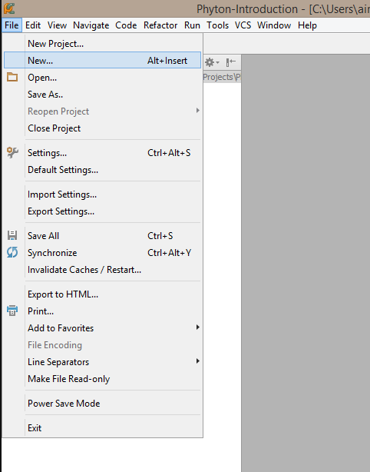
Creating your first Python Script:
To create a new Python Script
Select “File” from the top menu
and select “New”

Slide 7
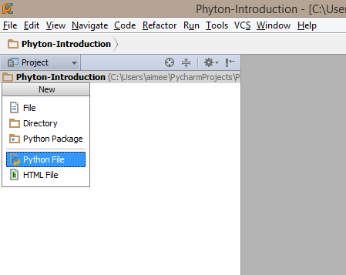
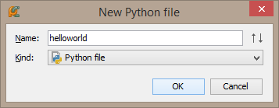
Creating your first Python Script:
A New box will drop down
Select the “Python File” option
A “New Python File” box
Will pop-up type in the name
It is always good to name files
Something that will remind you
What they contain.

Slide 8
Hello World!
#This is our first script
#print tells the interpreter to print the text to the screen
print('Hello, World!')
Notes:
HelloWorld.py

Slide 9
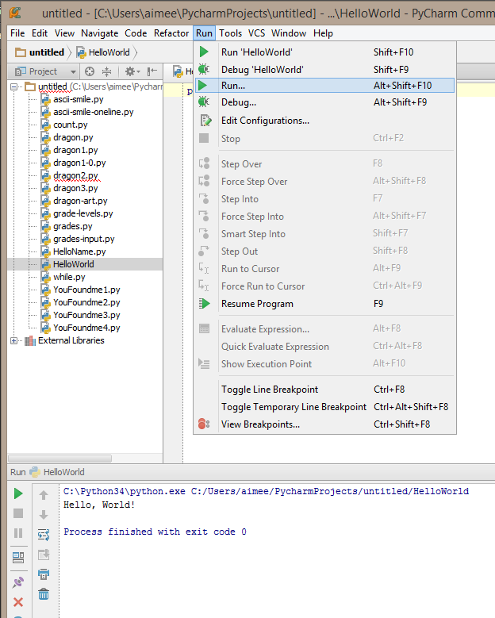
Run Hello World!
Now that we have created our
First Python script we can go
To the menu and select “Run”
And then click on “Run” from
The drop down menu
This will execute the code
In our IDE interpreter console

Slide 10
What we just learned
We ran our first Script.
We printed out some text..
But the main use of programs is to take “inputs” and
then turn them into “outputs”
We are going to look at the ways that Python takes
in Words and Numbers
And how we can interact with programs
Lets create a script with a variable that holds your name
Then we will get the program to ask you for your name

Slide 11
Hello World!
#This is our second script
#First we declare a Variable name
name = ('Aimee')
#here we print the word 'hello' plus the variable name
print('Hello, ' + name)
Notes:
HelloName.py

Slide 12
Hello World!
#This is our third script
#Lets are the user to input their name
#input tells to computer to take something in
#We also need to tell the user what we need them to enter
name = input('What is your name?')
#here we print the word 'hello' plus the variable name
print('Hello, ' + name)
Notes:
HelloName-Input.py

Slide 13
We can create some art with Print
Print is a basic function but we can have some fun with it
Lets see if we can create some ASCII art
ASCII art can be created by printing out the whole
Picture
Or we can be tricky and reduce the lines of Print we use

Slide 14
Print a Smiley face
#The \n symbol means print a new line
print ('\n')
#Here we print each line including the spaces of a smiley face
print('** **')
print('** **')
print('** **')
print ('\n')
print('* *')
print(' * * ')
print(' *** ')
Notes:
HelloName.py

Slide 15
Print a Smiley face on one line
#If we combine the symbols above and print the \n character #where we need to have a new line we can print the picture #using one print command
print('** **\n** **\n** **\n\n* *\n * * \n *** \n')
Notes:
HelloName.py

Slide 16
What we learned
The easiest way to replicate a picture is to print the ASCII art line-by-line
However, this is not the most efficient way
Because the interpreter needs to interpret each line separately,
by placing all the code on one line, we reduce the size of our file,
and also the time it takes to execute the code
You will not see much difference with a small program like printing a smiley face.
However, for a professional programmer, saving time on a large application
is very important
In industry, there are people whose specific role is to analyze the performance
of code and help developers make their code run/load faster

Slide 17
Strings and Numbers
In programming languages we declare strings and numbers differently
The reason we do this is because we want to do different things with them
An example of this is comparing strings (letters/words) with upper case and lower case
For numbers we need to calculations on them
Because we want to do calculations we declare whole numbers such as 10 or 100
Different to how we call numbers with decimals places 20.5 and 4.88
input() (Python 3) and raw_input() (Python 2) always return strings.
Convert the result to integer explicitly with int().

Slide 18
Numbers and Operands
When we want to do calculations in Python we need to use operands that the
Language understands some basic operands are
+ Addition - Adds values on either side of the operator
2 + 2 will give us 4
- Subtraction - Subtracts right hand operand from left hand operand
5 - 2 will give 3
* Multiplication - Multiplies values on either side of the operator
2 * 2 will give 4
/ Division - Divides left hand operand by right hand operand
4 / 2 will give 2

Slide 19
Numbers and Operands
#Lets do some calculations on numbers
a = 4 / 2
b = 10 + 5
c = 2 * 2
d = 50 - 10
e = (2 + 2) – 1
# We can print out the variables on one line
print(a, b, c, d, e)
#Or we can do further math with them
print(a + b)
print(c - e)
print(d * b)
Notes:
HelloName.py

Slide 20
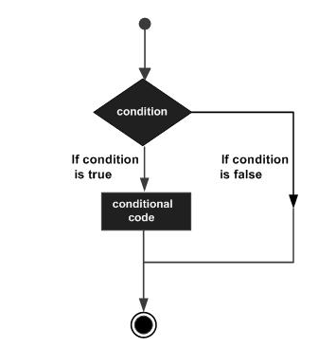
Conditional Statements
A conditional statement is a set of rules performed when certain condition/s are meet.
Here we are looking at an if else statement
If a certain condition is true
Perform an action
If the condition is false
Perform a different action
Then Stop

Slide 21
Comparison Operations
== Checks if the values are equal or not, if yes then condition becomes true. (a == b) is not true.
!= Checks if the value of two operands are equal or not, if values are not equal then condition becomes true. (a != b) is true.
> Checks if the value of left operand is greater than the value of right operand, if yes then condition becomes true. (a > b) is not true.
< Checks if the value of left operand is less than the value of right operand, if yes then condition becomes true. (a < b) is true.
>= Checks if the value of left operand is greater than or equal to the value of right operand, if yes then condition becomes true. (a >= b) is not true.
<= Checks if the value of left operand is less than or equal to the value of right operand, if yes then condition becomes true. (a <= b) is true.

Slide 22
Conditional Statements
#declare the variable name
name = 'Aimee'
#if the variable name == to 'Aimee'
#note we must include : at the end of the if statement
if (name == 'Aimee'):
#then print this text to the screen
print ('You Found me!')
#if the variable name equals anything else print this text
#This is also an example of error catching
else:
print('Try again')
Notes:
Grades.py

Slide 23
Conditional Statements
#declare the variable name
name = 'Aimee'
#if the variable name == to 'Aimee'
#note we must include : at the end of the if statement
if (name == 'Ben'):
#then print this text to the screen
print ('You Found me!')
#if the variable name equals anything else print this text
#This is also an example of error catching
else:
print('Try again')
Notes:
Grades.py

Slide 24
Conditional Statements
#Here we define a grade from 1 to 100
grade = 10
#Now we start our Conditional Statement
#if the Grade is greater then 90 print the below statement
if (grade > 90):
print ('Congratulations, You achieved A Grade')
#for all other grades less then 90 print the below statement
else:
print ('Better try again')
Notes:
Grades.py

Slide 25
Conditional Statements
#Here we define a grade from 1 to 100
grade = 70
#Lets add in some more choices
if (grade >= 90):
print ('Congratulations, You achieved A Grade')
#elif means if the grade is not >=90 but is >=70 do this
elif (grade >= 70):
print ('You achieved a B Grade')
elif (grade >= 50):
print ('You achieved a Pass')
#Last we put in a final else to catch all other grades <50
else:
print ('Better Luck next time')
Notes:
Grades-levels.py

Slide 26
Conditional Statements with input
#Here we ask the user for our name which is a string
name = input('What is your name?')
#Here we ask the user for an integer and use int(input()))
grade = int(input('Enter your grade: '))
print('Hello, ' + name)
#The grade entered runs through our conditional statement
if (grade >= 90):
print ('Congratulations, You achieved A Grade')
elif (grade >= 70):
print ('You achieved a B Grade')
elif (grade >= 50):
print ('You achieved a Pass')
else:
print ('Better Luck next time')
Notes:
Grades-input.py

Slide 27
What we just learned
So we ran some conditional statements
That took some numbers and gave us an output
Based on the grade number we had assigned to the grade variable
Now lets combine our input with some conditional Statements
First we took input as Words in programming we calls these Strings
Now lets look at taking input as Numbers and specifically Integers
Integers are whole digit numbers example 1,2,3,4,5,6,7,8,9,10....

Slide 28
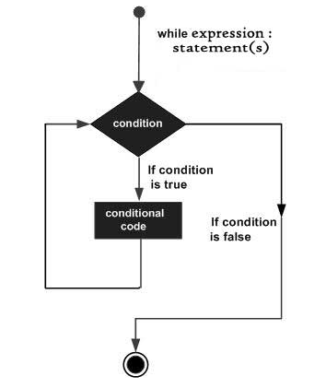
Conditional Statements
A conditional statement is a set of rules performed when certain condition/s are meet.
Here we are looking at a while loop
While a certain condition is true
Perform an action
When this condition is false
Perform another action or Stop

Slide 29
Conditional Statements and Input
#Here we declare a while loop and assign a condition
#While the count is less then 5
while(count < 5):
#Print what the count is and add one to the count
print('The count is: ', count)
count = count + 1
print ('This program is done!')
Notes:
HelloName-Input.py

Slide 30
Conditional Statements and Input
#While the below condition is (True)
while(True):
#Capture the input from the user
count = int(input('Please enter a number:'))
#If the number entered is greater then or equal to 5
if (count >= 5):
print(count, 'is more than or equal to 5')
#capture other numbers by checking the variable is less then 5
else:
#Print the below statement
print(count, 'is less than 5')
#Then exit the program
exit()
Notes:
HelloName-Input.py

Slide 31
What we just learned
A way to make programs make decisions is to use
Conditional statements
The conditional statement tells the program that
It has some options it can take
Conditional statements that we leart where
If, else
And
While

Slide 32
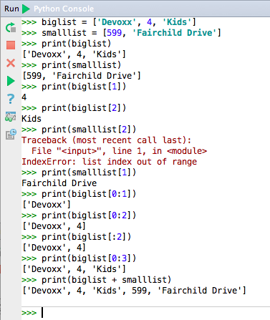
List
“A list contains items separated by
commas and enclosed within
square brackets ([])”
We using a list we can have a
Groups of items that
We can call
We call each item by referring to
Its position in the list

Slide 33
Lists
# First we create a list of options for fighting the Dragon
choicelist = ['1:wait', '2:fight', '3:run away']
#We can print the whole list by calling it
print(choicelist)
Notes:
HelloName-Input.py

Slide 34
Lists
# First we create a list of options for fighting the Dragon
choicelist = ['1:wait', '2:fight', '3:run away']
#We can print each option by calling it by its key remember we #always start with 0
print (choicelist[0])
#Print the second option in the list by calling 1
print (choicelist[1])
#Print the third option in the list by calling 2
print (choicelist[2])
Notes:
HelloName-Input.py

Slide 35
Lets put it all together in a Game
Now that we have learnt some of the basics of Python
We can put all this together in a command line adventure game
Before computer graphics had advanced games used to be
Text based
This would mean that there would be some text on the screen
That would inform the user of the task at hand and then
It would ask the user to pick a choice or type in what to do next
Lets create a text adventure game by using some of
The techniques we have learnt
We can also include some ASCII art in our game

Slide 36
Dragon Game
# First we create a list of options for fighting the Dragon
choicelist = ['1:wait', '2:fight', '3:run away']
print('Dragon Slayer \n Let the Games Begin ')
name = input('Name your character: ')
print ('You are ' + name + ', the young warrior. You have been sent to save the Towns people from an angry dragon.')
print (choicelist[0])
print (choicelist[1])
print (choicelist[2])
myanswer = input("press the corresponding number and ENTER:")
print("You choose the answer number {0}".format(myanswer))
Notes:
HelloName-Input.py

Slide 37
Dragon Game ...continued...
while myanswer == “1”:
print ("nothing happens, the dragon also waits")
myanswer = input("chose your next turn ENTER:")
if myanswer == "2":
Print ('you fight with the dragon.')
Print ('the dragon has been slayed and the towns people rejoice. Game Over.')
elif myanswer == "3":
Print ('You run away, but the dragon is faster than you. The dragon chased you and ate you for lunch. Game Over')
else:
Print ('wrong key pressed')
Notes:
HelloName-Input.py

Slide 38
Further Work
Now that we have a basic game we can make it longer and
Include more options or even some ASCII art.
We can also import a Python module to include a dice
This way instead of having the user enter there choice
They can roll a dice to make a random selection.

Slide 39
Extra Work in ASCII Art
#Below we are creating a Dragon, can you include some art in your game?
print(' <>=======()')
print(' (/\___ /|\\ ()==========<>_ ')
print(' \_/ | \\ //|\ ______/ \)')
print(' \_| \\ // | \_/')
print(' \|\/|\_ // /\/')
print(' (oo)\ \_// / ')
print(' //_/\_\/ / | ')
print(' @@/ |=\ \ |')
print(' \_=\_ \ | ')
print(' \==\ \|\ ')
print(' __(\===\( )\ ')
print(' (((~) __(_/ | ')
print(' (((~) \ / ')
print(' ______/ / ')
print(' \______/ ')
Notes:
HelloName-Input.py

Slide 40
Rolling a dice
#here we import a Python module called random this creates a random
#number like when a person rolls a dice
import random
#here we declare the variable called dice
#random.randrange is a way we set the possible number set for the dice
dice = random.randrange(6)
print ('Press enter to Roll the Dice: ', dice)
#to learn more about options we can use for random check the #documentation https://docs.python.org/3.0/library/random.html
Notes:
HelloName-Input.py

Slide 41
Rolling a dice with options
#here we import a Python module called random this creates a random #number
import random
#here we declare out list options
choicelist = ['1:wait', '2:fight', '3:run away']
#random.randrange set the dice range between 1 and 3
dice = random.randrange(1,4)
print ('Press enter to Roll the Dice: ', dice)
print('You are faced with three options...')
print(choicelist[0])
print(choicelist[1])
print(choicelist[2])
Notes:
HelloName-Input.py

Slide 42
Rolling a dice with options continued
#here we assign the myanswer variable the dice outcome
myanswer = dice
#Then we print the option out the the user
print("You choose to do number {0}".format(myanswer))
Notes:
HelloName-Input.py

Slide 43
Further Work
Can you add the Dragon art into the dragon Game?
Can you create 6 options in the list for the Rolling dice code?
Can you include the Rolling dice code into the dragon Game?

Slide 44
Further Learning
Games are a great way to learn the fundamentals of Programming
https://github.com/amaree/Python-KidsDay
Today we learnt some of the very basics of Python But there is a lot more to learn
Learning programming works best when we are doing something
We enjoy this makes us want to learn more
Most people from my generation learnt how to program
By writing simple games
A great place to start learning games and python is
http://thepythongamebook.com/
Code examples for the book
https://github.com/horstjens/ThePythonGameBook/

