Slide 1



FLIPKART MOBILE PRODUCT PRICE ANALYSIS
BASED ON FEATURES AND BRANDS.
Name: Amit Pandit Name: Jagyansu Padhy Name: Amarendra Nayak
E.ID:-81010501524 E.ID:-81010712624 E.ID:-81010700924
Batch:-315 Batch:-327_329 Batch:-327_329

Slide 2
About us :
We, Amarendra Nayak, Amit Pandit, and Jagyansu Padhy, graduated in Computer Science and Engineering, with a B.Tech degree at National Institute of Science and Technology (autonomous, nba and naac accredited),Berhampur, Odisha,761008.
Currently, We are enhancing our skills in data analysis at Innomatics Research Lab, Hyderabad, Telangana.
LinkedIn Profile:- i)AMIT_PANDIT_315
,ii)AMARENDRA_NAYAK_327-329
,iii)JAGYANSU_PADHY_327-329
Git-Hub Profile:- i)Github-Amitpandit178_315
,ii)Github-Amarendra_327-329
,iii)Github-Jagyansu_327-329

Slide 3
Business Problem Statement:
To analyze the Mobiles available on Flipkart, focusing on key attributes such as price, specifications and features by leveraging data analysis techniques.
To identify trends in mobile (phone) pricing across different brands and evaluate the impact of features like RAM, storage, and camera quality on pricing.
To provide actionable insights into consumer preferences and feature-based comparisons, helping users make informed purchasing decisions.

Slide 4
Use-case domain understanding:
E-Commerce Platforms: Flipkart, a leading e-commerce platform, hosts a wide variety of mobile products. Analyzing this data can provide insights into the performance of various brands, the popularity of certain mobile specifications, and the overall mobile market trends.
Consumer Electronics Market: This analysis helps businesses and consumers understand the relationship between product features and their prices, enabling better inventory management, demand forecasting, and product feature prioritization.
Price Sensitivity & Market Competition: By evaluating the pricing strategies of different brands in response to similar features, businesses can adjust their product positioning and marketing strategies to stay competitive in a fast-moving market.

Slide 5
Objective of the Project:
Analyze Mobile Pricing Trends: To investigate the pricing patterns of mobile (phones) on Flipkart based on key features like brand, RAM, storage, camera specifications, and other technical attributes.
Feature-Price Correlation: To identify and establish correlations between mobile features (e.g., battery, display size, camera,Is_5G) and their prices, helping businesses and consumers understand the value proposition of different features.
Market Insights & Consumer Behavior: To derive actionable insights into consumer preferences based on popular mobile features and price ranges, aiding in more informed purchasing decisions and better-targeted marketing strategies.
Brand Analysis: To assess how different brands position their mobile phones in terms of pricing based on shared features and market competition, identifying which brands offer the best value for specific consumer needs.
Competitive Advantage: To provide recommendations for manufacturers and e-commerce platforms like Flipkart on how to optimize their pricing strategies and product offerings based on feature-driven demand.

Slide 6
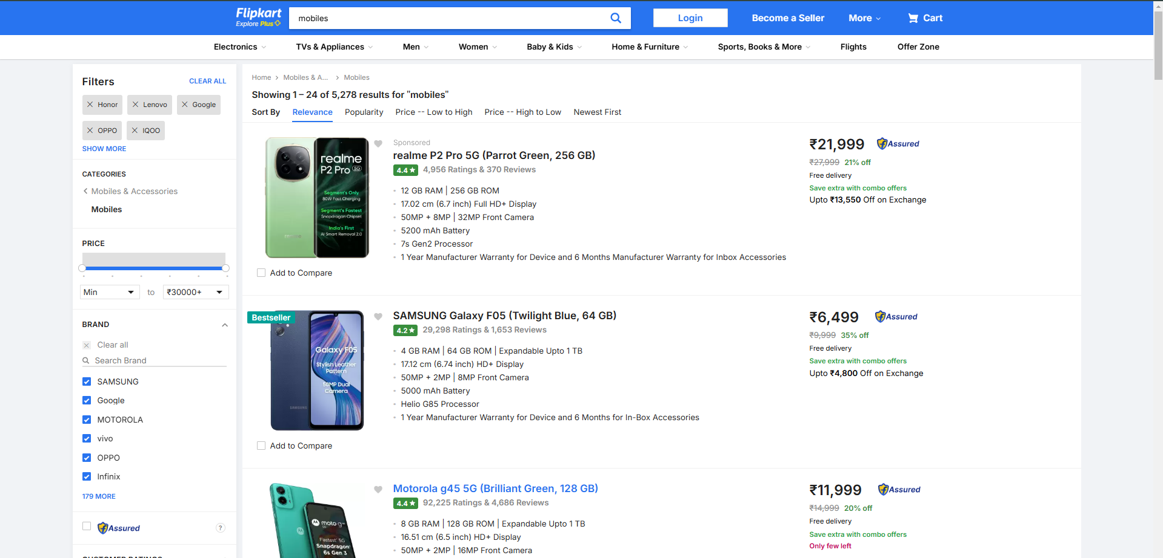
Web Scraping – Details (Websites, Processor you followed) :
Using regular expressions (Regex), I performed data scraping on the Flipkart website to extract valuable information about mobiles.
The key attributes scraped includes the Brand, Device Name, Model, Color, RAM, ROM, IS_5G, Processor Brand, Processor, Display Size, Camera(Front and Back), Battery, Prices, Ratings.
We have conducted web scraping on the Flipkart website to extract detailed data on mobiles.

Slide 7
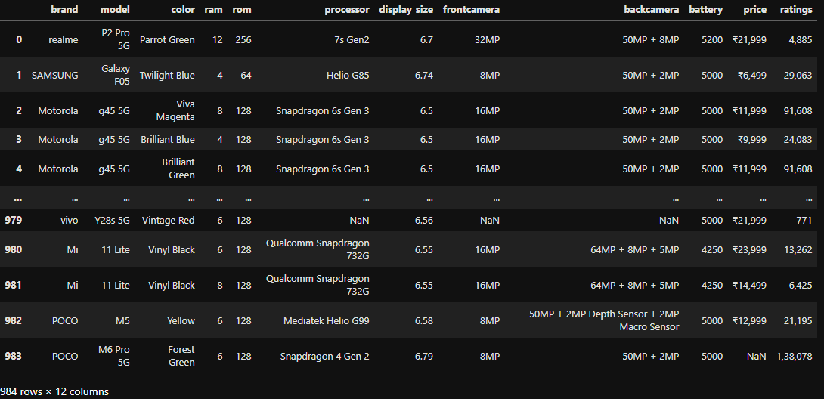
Data Frame:
After scraping the data from the website, I organized the extracted data with 978 rows and 12 columns.

Slide 8
Data Cleaning:
Removing NULL values :
i)dropna():-This function is used to remove all NULL (missing) values from the dataset. The cleaned dataset is stored back into df.
Cleaning the Brand Column:
i).unique():- This function is first used to display the unique brand names before cleaning. The brand names contain inconsistencies such as lowercase, uppercase, and mixed-case spellings.
ii)str.capitalize():-This function is applied to standardize the brand names by capitalizing the first letter of each word.
Replacing specific processor names:
i).replace():-This function standardizes processor names by replacing inconsistent or detailed names with a more uniform format.
Standardizing 'Snapdragon' processors:
i) The .apply( ) function modifies values:- If the processor name contains "8 Elite" or "Gen" but does not include "Snapdragon," it prefixes "Snapdragon" to it.
ii)Similarly, if the processor contains "695" or "778G" but lacks "Snapdragon," it adds "Snapdragon" as a prefix.

Slide 9
Data Cleaning:
Standardizing 'MediaTek' processors:-
i) If the processor name includes "Dimensity" but does not start with "Mediatek," it prefixes "Mediatek" to ensure consistency.
ii)A similar process is applied to "Helio" processors, ensuring they are labeled under "Mediatek.
Standardizing 'Unisoc' processors:
i)If the processor contains "T" but is not labeled "Unisoc," it prefixes "Unisoc" to the name.
Cleaning the Price and Rating Columns :-
i) In the price column:- Remove the ₹ symbol because it's not needed for numerical calculations.
ii)Remove commas (,) to convert large numbers into a plain numeric format.
iii)In the ratings column:- Remove commas (,) so that numbers are in a usable format.

Slide 10
Data Manipulation:
Access the "brand" and "model" columns:
i)It looks at the existing columns "brand" and "model" in the Data Frame.
Concatenate the columns:
i)It joins the values in the "brand" and "model" columns.
Store the result in a new column:
i)The combined text is saved in a new column called device_name.
Example:
i)If the "brand" column contains:-
"Samsung" ,“Realme" ,"OnePlus“.
ii)The "model" column contains:-
"Galaxy S21" ,“11 Pro+ 5G“,"Nord 2" .
iii)The new "device_name" column will have:-
"SamsungGalaxy S21" , “Realme11 Pro+ 5G" , "OnePlusNord 2".

Slide 11
Data Manipulation:
Access the "model" column:
i)This looks at the "model" column in the data table.
Check for "5G":
i)It searches each entry in the "model" column to see if the text "5G" is present, ignoring letter case (so "5g" or "5G" both work).
Handle missing values:
i)If an entry is empty (NaN), it automatically sets the result to False.
Create a new column:
i)The code creates a new column called "is_5g" and stores the result for each row.
Set True or False:
i) True: If "5G" is found in the "model" text.
ii)False: If "5G" is not found or the value is missing.

Slide 12
Data Manipulation:
Access the "processor" (phone model) column:
i) This looks at the "processor" column, which contains phone model details.
Split the text:
i) It splits each phone model's text by spaces.
Extract the first word:
i) It takes the first part of the text (usually the phone brand).
Create a new column:
i) A new column called processor_brand will store the extracted phone brand.
Example:
i)If the "processor" column contains:-
"Snapdragon 8 Gen2“, “Mediatek Dimensity 750“, “Unsioc T612“.
ii)The "processor_brand" column will have:-
"Snapdragon" ,“Mediatek“, “Unisoc“.

Slide 13
Summary of the Data:
General Information:
- The dataset contains 775 rows and 15 columns after cleaning.
- There are no missing values and no duplicate rows.
Column Details:
- The dataset includes information about mobile (phones), such as brand, model, RAM, storage (ROM), processor, display size, camera details, battery capacity, price, and ratings.
- The "is_5G"column indicates whether a phone supports 5G (True/False).
- The "price" and "ratings" columns are numerical, with a wide range of values.
Key Insights:
- The dataset covers 16 different mobile brands, with Realme being the most common.
- The most frequent phone in the dataset is the Realme P2 Pro 5G.
- RAM sizes range from 2 GB to 16 GB, while ROM (storage) varies from 16GB to 512GB.
- The most common processor brand is MediaTek, with the MediaTek Dimensity 6300 being the most frequent model.
- Display sizes range from 5.45 inches to 6.9 inches, with an average of 6.66 inches.
- Battery capacities vary from 3700mAh to 6550mAh, with an average of around 5090mAh.
- Prices range from ₹5,499 to ₹1,61,999, with an average price of ₹25,870.
- The number of ratings per phone varies significantly, from 0 to over 1.16 million.

Slide 14
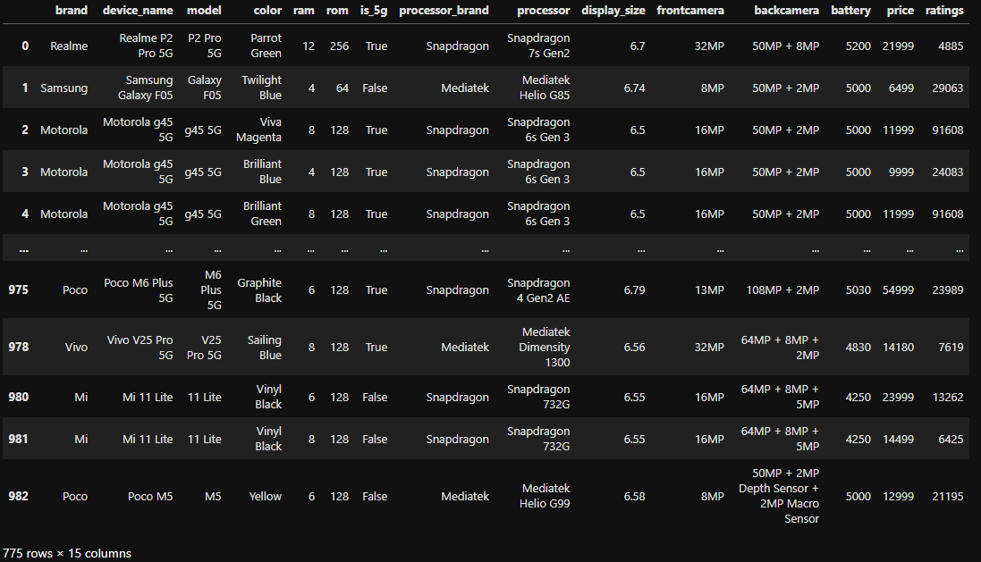
Data Frame:
Representing various mobile specifications and after data cleaning it show 775 rows and 15 columns.

Slide 15
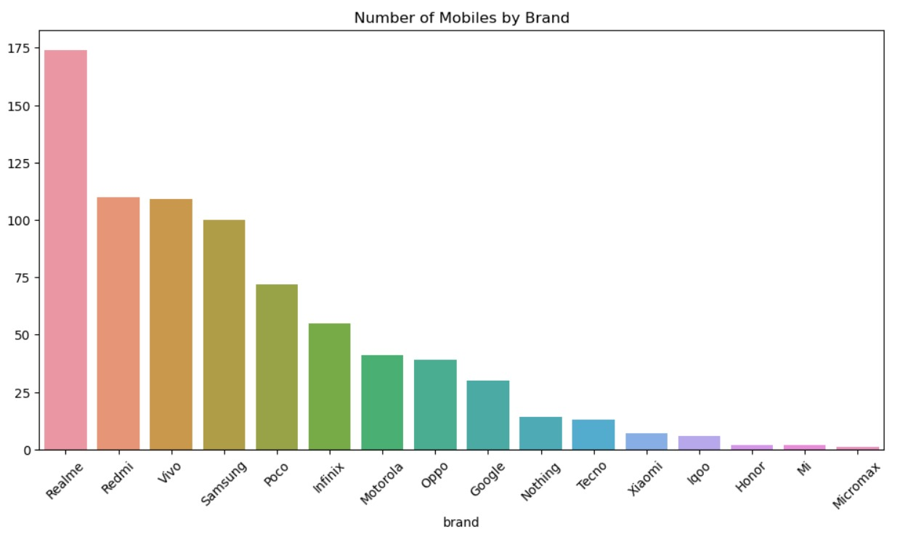
Data Analysis:
The visualization is a bar chart displaying the number of mobile [phones] available for each brand, with Realme having the highest count.

Slide 16
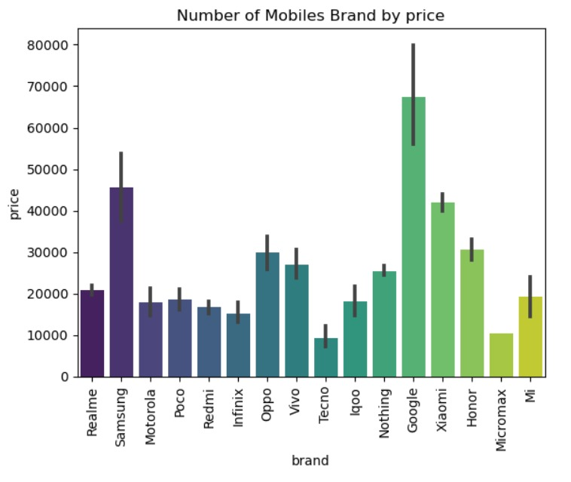
Data Analysis:
The bar chart visualizes the price distribution of mobile (phones) across different brands, showing variations in average prices.

Slide 17
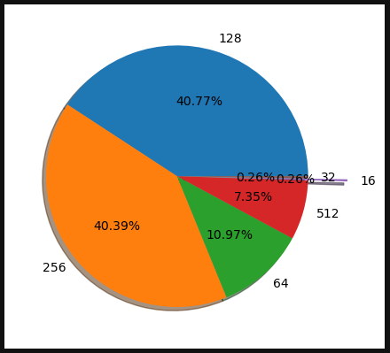
Data Analysis:
The pie chart represents the distribution of different categories, likely memory sizes (e.g., 128, 256, 64, 512, etc.), with corresponding percentages.
The largest portions are 128 (41%) and 256 (40%), followed by 64 (11%), while smaller values like 512 and 16 have minimal representation.
The colors help distinguish different segments, and the percentages provide insight into their relative proportions.

Slide 18
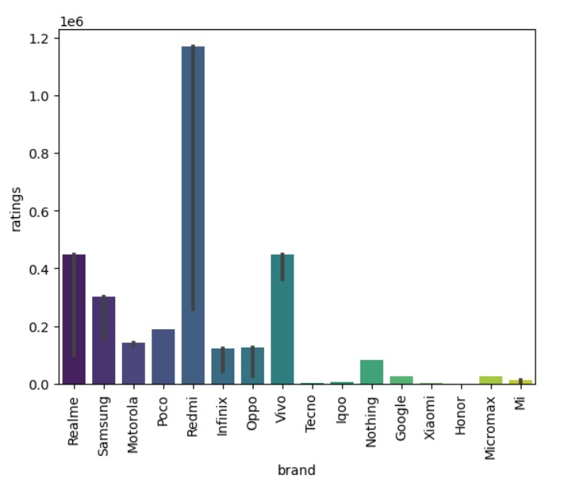
Data Analysis:
The bar chart represents the ratings of different mobile brands.
The x-axis lists various brands like Realme, Samsung, Motorola, Poco, Redmi, etc., while the y-axis represents the number of ratings.
Redmi has the highest ratings, followed by Vivo and Realme. Some brands, like Google, Micromax, and Nothing, have significantly lower ratings. The error bars indicate variability in ratings for each brand.

Slide 19
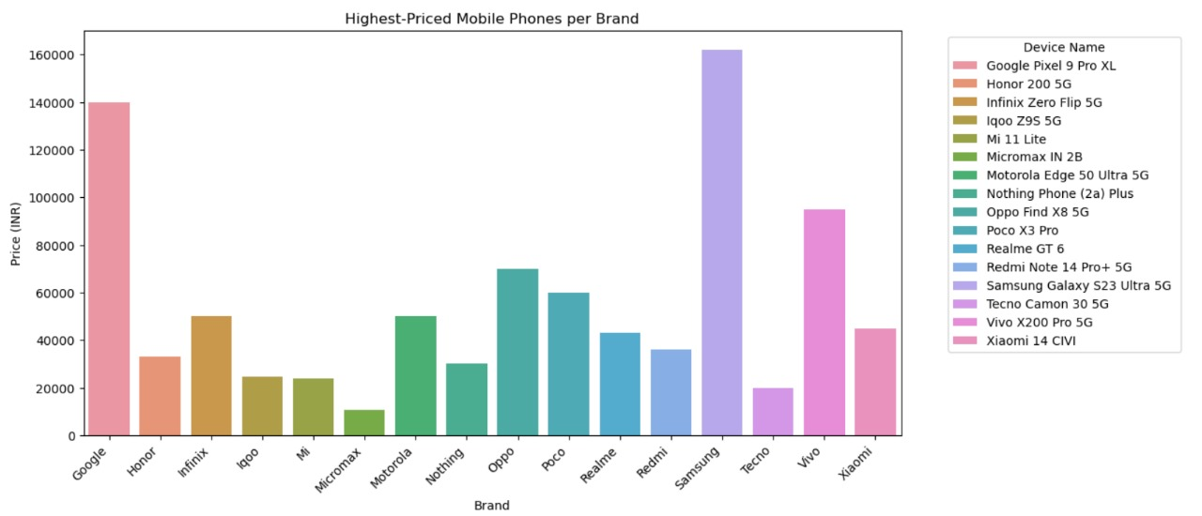
Data Analysis:
The Google Pixel 9 Pro XL, Samsung Galaxy S23 Ultra 5G, and Vivo X200 Pro 5G are among the most expensive models.
Brands like Tecno and Micromax have relatively lower highest-priced models compared to premium brands like Samsung, Google, and Vivo. The color-coded legend shows the specific models for each brand.

Slide 20
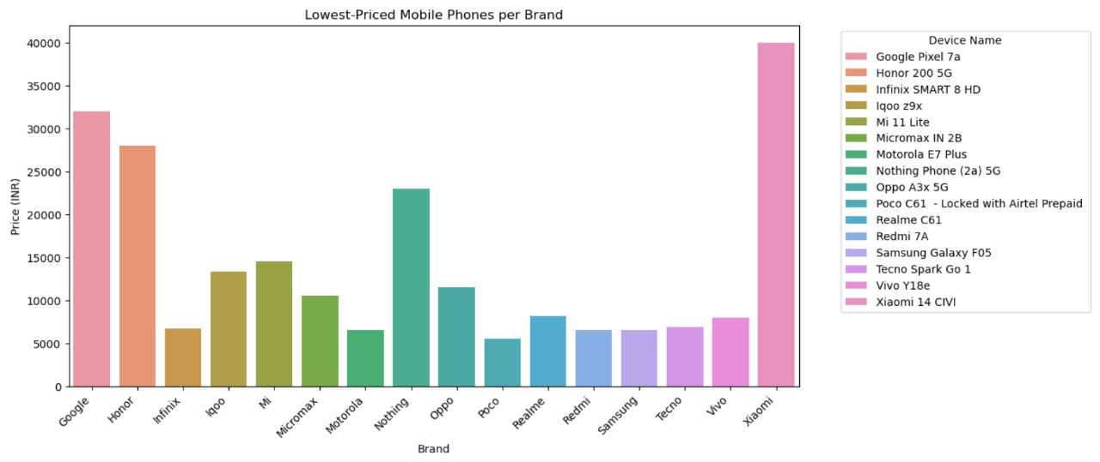
Data Analysis:
Here, Each bar represents the cheapest model for a specific brand.
The colors differentiate different models, with a legend listing device names.
Brands like Google, Honor, and Xiaomi have the highest-priced lowest models, while Poco, Realme, and Redmi have more budget-friendly options.

Slide 21
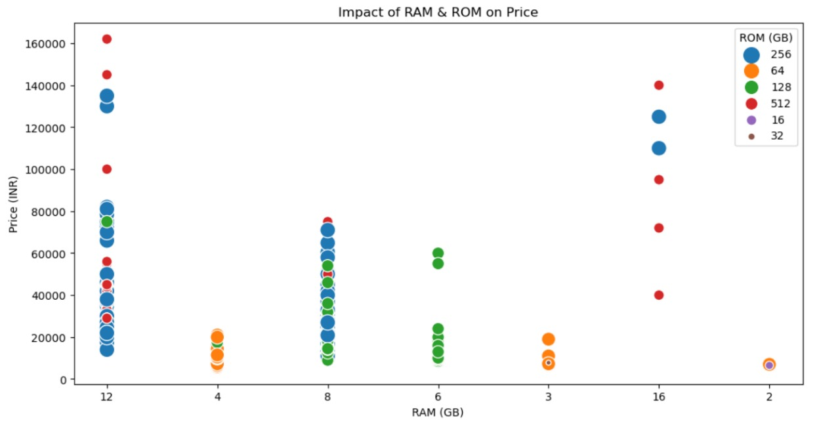
Data Analysis:
Different colors indicate different ROM (storage) sizes, as shown in the legend (16GB, 32GB, 64GB, 128GB, 256GB, 512GB).
Phones with higher RAM (12GB, 16GB) tend to have higher prices, often exceeding ₹100,000.Phones with lower RAM (2GB, 3GB, 4GB) generally have lower prices, usually below ₹20,000.
Phones with larger ROM capacities (512GB, 256GB) tend to be costlier. There is a noticeable price jump between mid-range (6GB-8GB RAM, 128GB-256GB ROM) and high-end phones (12GB+ RAM, 512GB ROM).

Slide 22
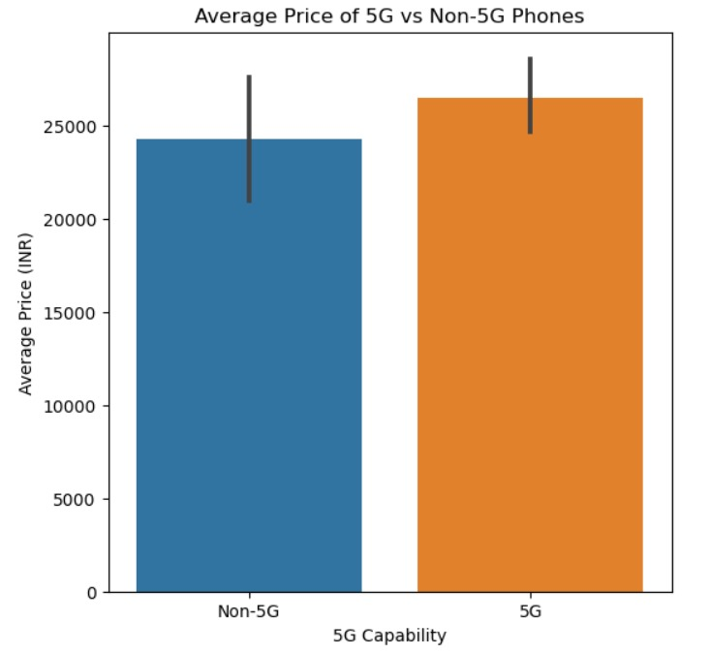
Data Analysis:
The bars show that 5G phones have a higher average price than Non-5G (phones). Error bars indicate the variability in prices.

Slide 23
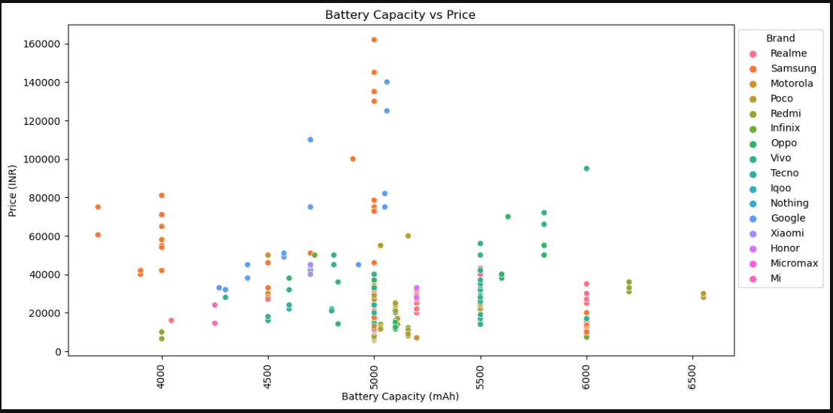
Data Analysis:
Different colors and markers represent various smartphone brands, as indicated by the legend on the right.
The data points are scattered, showing that there is no strict correlation between battery capacity and price, although some brands tend to have more expensive models with higher battery capacities.

Slide 24
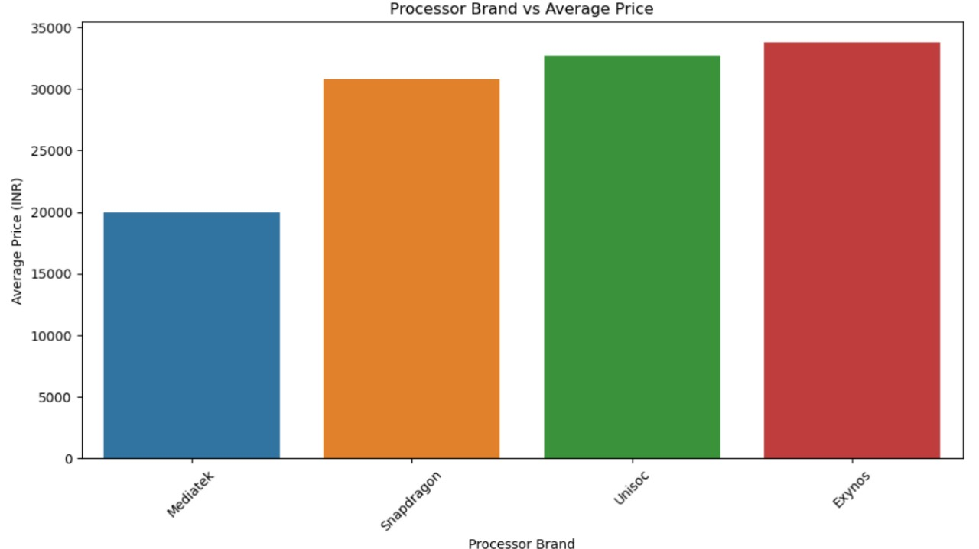
Data Analysis:
The bars indicate that Mediatek-based phones have the lowest average price, while Exynos-based phones have the highest average price.
Snapdragon and Unisoc processors fall in between, with Snapdragon being slightly cheaper than Unisoc and Exynos.

Slide 25
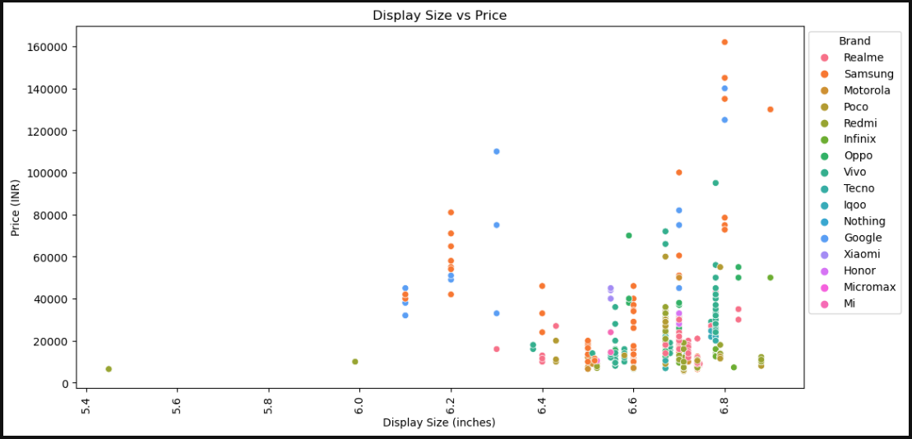
Data Analysis:
Each dot represents a smartphone, with colors distinguishing different brands.
Prices vary significantly for similar display sizes.
Some brands (e.g., Samsung, Google) have higher-priced models.
Display sizes range roughly between 5.45 to 6.88 inches.

Slide 26
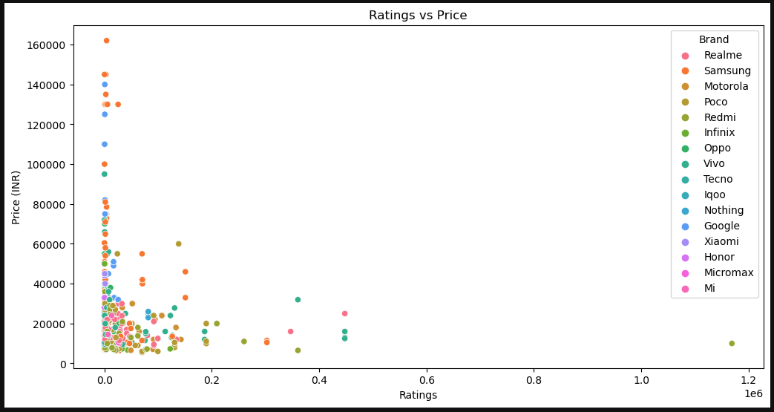
Data Analysis:
The scatter plot shows the relationship between Ratings and Price (INR) for different smartphone brands.
Most expensive smartphones (above ₹50,000) have relatively lower ratings, while mid-range and budget smartphones (under ₹30,000) tend to have higher ratings, indicating better customer satisfaction.
A few outliers exist with exceptionally high ratings, suggesting some models are highly popular regardless of price.

Slide 27
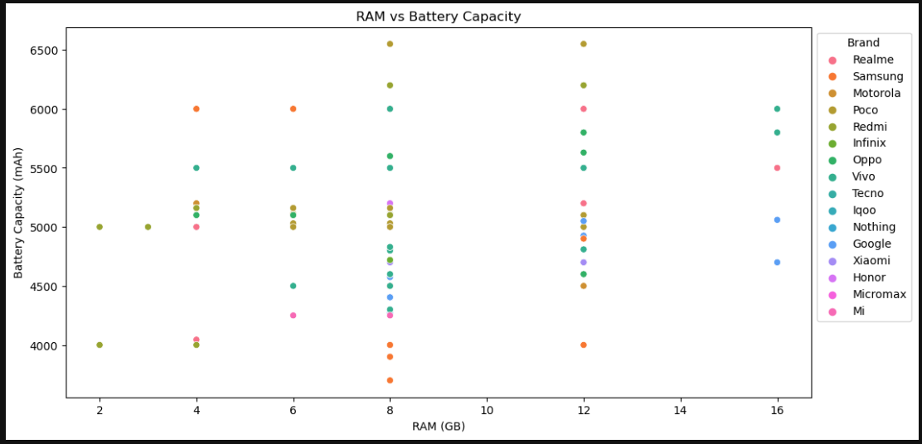
Data Analysis:
The scatter plot shows the relationship between RAM (GB) and Battery Capacity (mAh) across different smartphone brands.
Most devices with higher RAM (8GB-12GB) tend to have battery capacities ranging between 4500-6500 mAh, indicating a trend where performance-oriented phones come with larger batteries.
However, some brands, like Samsung and Motorola, show variations, suggesting that battery size is not solely dependent on RAM.

Slide 28
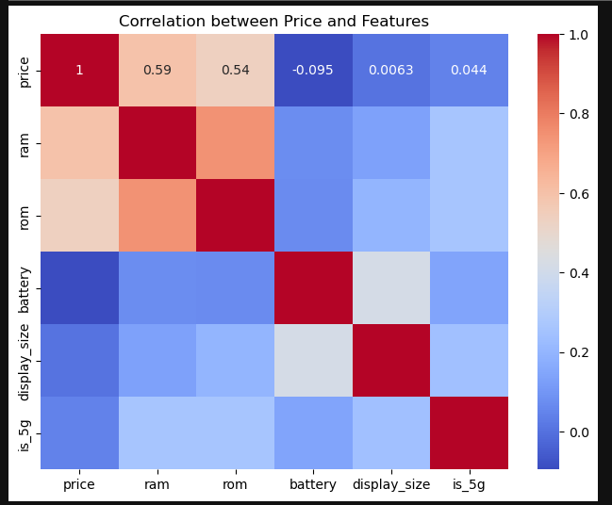
Data Analysis:
Price Correlation:- The strongest positive correlation with price is observed in RAM (0.59) and ROM (0.54), indicating that higher storage and memory contribute significantly to price. Battery capacity, display size, and 5G support show minimal correlation with price.
Feature Interrelationships: RAM and ROM have a strong correlation with each other, suggesting that devices with more RAM also tend to have more ROM.
Battery capacity and display size show some relationship, likely because larger displays demand higher battery capacity.

Slide 29
Key Business Questions:
What are the price trends across different brands and features?
- Understanding how pricing varies across brands, specifications, and market demand.
Which mobile features significantly impact pricing?
- Analyzing factors like RAM, storage, battery life, and camera quality on price variations.
What are the most popular brands and models?
- Identifying top-selling brands and models based on customer preferences and pricing.
How does competition affect mobile pricing on Flipkart?
- Comparing similar models across brands to determine competitive pricing strategies.
What insights can help optimize pricing and sales strategies?
- Recommending data-driven strategies for competitive pricing and promotions.

Slide 30
Conclusion:
Market Analysis: Realme dominated the dataset; premium brands had higher-priced models, while Poco, Realme, and Redmi were budget-friendly.
Pricing Trends: Higher RAM, storage, and 5G support increased prices; MediaTek-based phones were the cheapest.
Consumer Insights: Mid-range phones (128GB-256GB, 6GB-8GB RAM) were popular, guiding better pricing and product strategies.
The project demonstrated the effectiveness of web scraping for data collection offering valuable information for both businesses and consumers in the market.
Project Link
Stream-Lit Link

Slide 31
Future Scope:
Dynamic Pricing Strategy:- Implement AI-driven pricing models that adjust mobile (phone) prices dynamically based on demand, competitor pricing, and customer preferences.
Personalized Recommendation System:- Use customer browsing and purchase behavior to suggest the best mobile (phone) options, increasing conversion rates and customer satisfaction.
Market Trend Prediction:- Analyze past sales data and emerging smartphone features to predict future market trends and consumer preferences, helping businesses stock trending models.
Competitor Price Benchmarking:- Continuously track competitor prices across different e-commerce platforms to optimize pricing strategies and remain competitive in the market.
Feature-Driven Product Differentiation:- Identify key smartphone features (camera, battery, processor) that drive higher sales, helping manufacturers and retailers highlight these features in marketing.
Inventory and Supply Chain Optimization:- Forecast demand for specific brands and models based on price trends, ensuring efficient inventory management and reducing overstock or stockouts.

Slide 32
Working Experience On This Project:
Automated Data Extraction:- Collected mobile (phone) pricing, specifications, and user ratings from Flipkart using Selenium and BeautifulSoup, ensuring efficient and structured data retrieval.
Data Cleaning & Processing:- Performed extensive data preprocessing using Pandas and NumPy, handling missing values, duplicates, and inconsistencies to prepare high-quality data for analysis.
Feature Engineering & Comparative Analysis:- Analyzed key attributes like RAM, storage, camera, battery, and brand to understand their influence on pricing, using statistical correlation and trend analysis.
Visualization & Data Storytelling:- Developed interactive visualizations using Matplotlib and Seaborn, including scatter plots, bar charts, and heatmaps, to uncover pricing patterns and brand performance insights.
Market Trends & Consumer Insights:- Identified the most popular brands, pricing trends, and consumer preferences, helping to understand factors driving high or low mobile sales.
Business Decision Support:- Provided data-driven recommendations on pricing strategies and feature optimizations, enabling businesses to align product offerings with market demand.

Slide 33

THANK YOU

