Slide 1
Meeting Summary Generator
Group 10
Team Members:
Amaresh Goshika
Navya Sri Sunku
Lakshmi Padmavathi Devara
Supervising Professor
Dr. Jane Liu
Faculty Committee Members
Dr. Md Rakib Islam
Dr. Xingya Liu

Slide 2

Introduction
A meeting is a gathering of two or more people for the purpose of making decisions or discussing company objectives and operations.
This project will be able to recognize speech in meeting Video or Audio and convert it to text using Natural Language Processing techniques.
Key points will be identified from summarized text using Abstraction based summarization.

Slide 3
Motivation
Having a meeting summary is for the people to remember the meeting and to keep track of the certain points that have already been discussed.
It exists to record the highlights of the meeting proceedings such as the decisions that have been made like motions, votes, plans for the future, identifying problems or issues and resolving them, reporting accomplishments of the company or organization for the past month or quarter, etc.
Ref : K.P. Vijayakumar, Hemanth Singh, Animesh Mohanty ”Real-Time Speech-To-Text/Text-To-Speech Converter with Automatic Text Summarizer using Natural Language Generation and Abstract Meaning Representation”, Volume-9 Issue-4, April 2020, Page no:2361-236.

Slide 4
Objectives
To recognize speech in meetings and convert it to text using Natural Language Processing Techniques.
To summarize the text by identifying key points in the meeting using Abstraction-based summarization.
To be able to share the produced summary with the team members.

Slide 5

Challenges during Meetings
Inefficient communication
Lack of Clarity
Time-consuming while note-taking

Slide 6

Benefits of Efficient Summaries
Focusing on actual conversation rather than taking notes.
Summarized text will available 24/7, including key points of the meeting.
Less expensive comparatively hiring a secretary/notetaker
Immune the risk of human error(While note taking)
Ref: A. Vinnarasu, Deepa V. Jose, “Speech-to-text conversion and summarization for effective understanding and documentation”, Vol. 9, No. 5, October 2019, pp. 3642~3648.

Slide 7
Methodology
The user has to login or signup using username/email and password.
After the successful login, user has to register the emails of the employees/management, that which generated text to be sent.
To generate the summarized text, user needs to upload the audio file, this can be done by clicking the Upload button in the UI.
Once the audio is uploaded, click the recognize button, then a summarized text will be displayed. User can verify the generated text.
Once user confirms the text, he can click on send to email button to send the generated text to emails that are registered earlier.

Slide 8
Functional Requirements
Receiving and validating user credentials
Users must be able to upload the audio file of their meetings.
Users can convert the audio file into text format.
Users can summarize the text with just one click.
User must be capable of sending the summary to his colleagues through emails.

Slide 9
Non-Functional Requirements
Accuracy and Precision: the system should perform its process in accuracy and precision to avoid problems.
Modifiability: the system should be easy to modify, any wrong should be corrected.
Security: the system should be secure and saving user’s privacy.
Usability: the system should be easy to deal with and simple to understand
Maintainability: the maintenance group should be able to fix any problem that occurs suddenly.
Speed and Responsiveness: Execution of operations should be fast.

Slide 10
Technologies Used
Natural Language Processing
Machine learning
Python
Bootstrap
Django
Audio Summarizer Modals

Slide 11
Natural Language Processing
Natural language processing (NLP) is a subfield of linguistics, computer science, and artificial intelligence concerned with the interactions between computers and human language, and how to program computers to process and analyze large amounts of natural language data. The result is a computer capable of ”understanding” the contents of documents, including the contextual nuances of the language within them. The technology can then accurately extract information and insights contained in the documents as well as categorize and organize the documents themselves.
Ref: Real-Time Speech-To-Text by K. P. Vijayakumar, Hemant Singh, Animesh Mohanty

Slide 12
Machine Learning
The discipline of machine learning employs various approaches to teach computers to accomplish tasks where no fully satisfactory algorithm is available. In cases where vast numbers of potential answers exist, one approach is to label some of the correct answers as valid. This can then be used as training data for the computer to improve the algorithm it uses to determine correct answers. For example, to train a system for the task of digital character recognition, the MNIST dataset of handwritten digits has often been used
Ref: Automatic text summarization using deep learning by Keerthana P

Slide 13
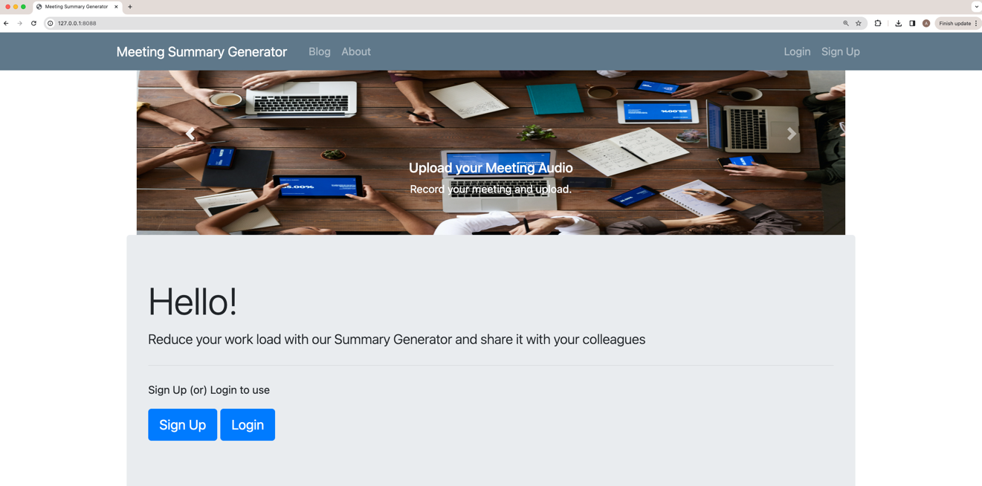
Landing Page

Slide 14
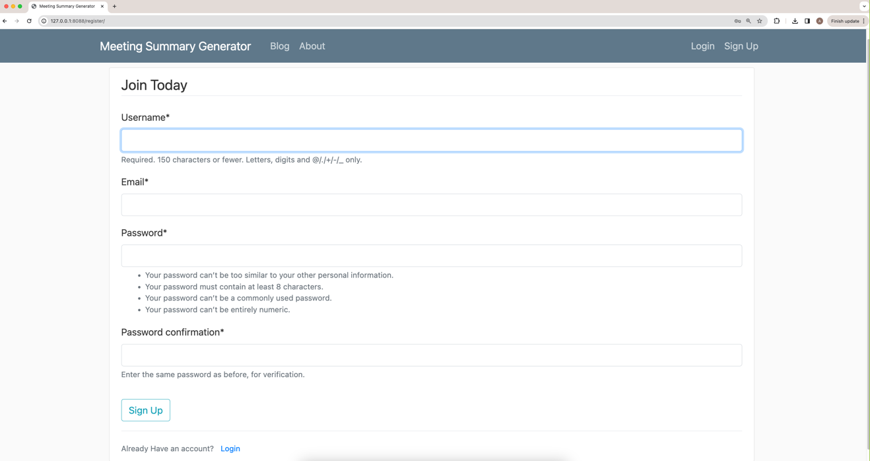
Sign Up Page

Slide 15
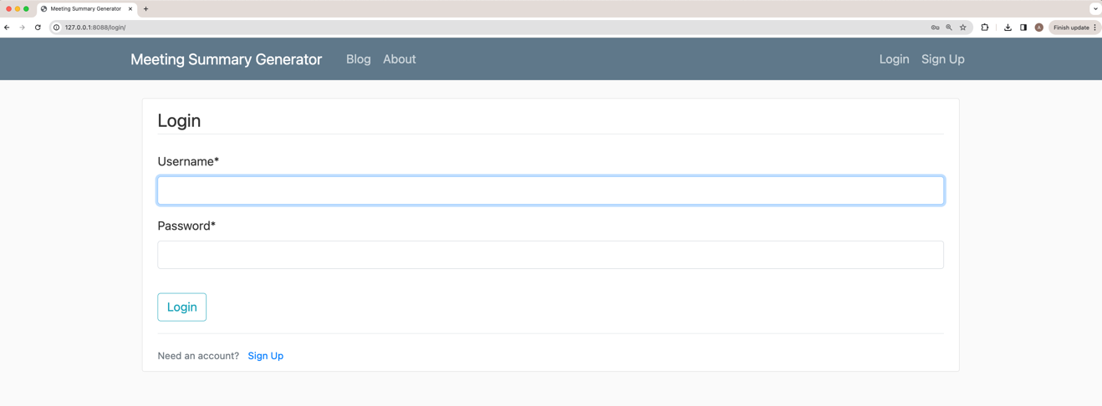
Login Page

Slide 16
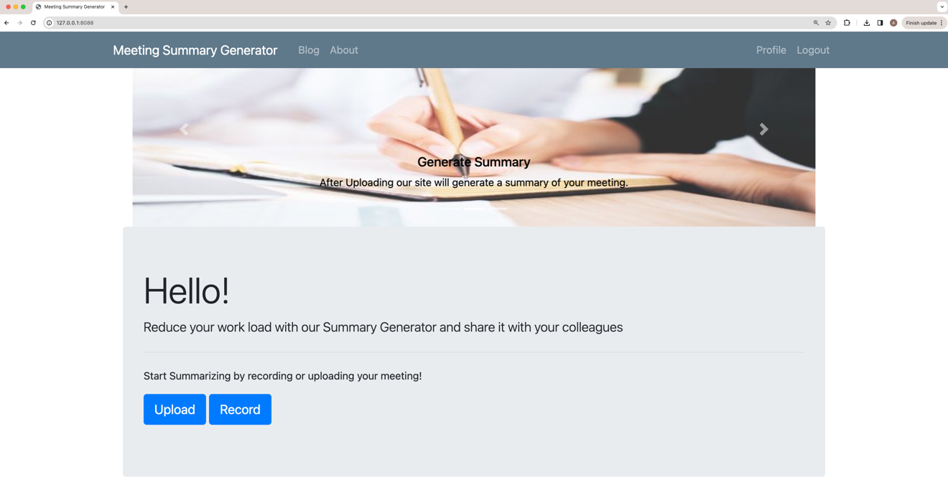
Home Page

Slide 17
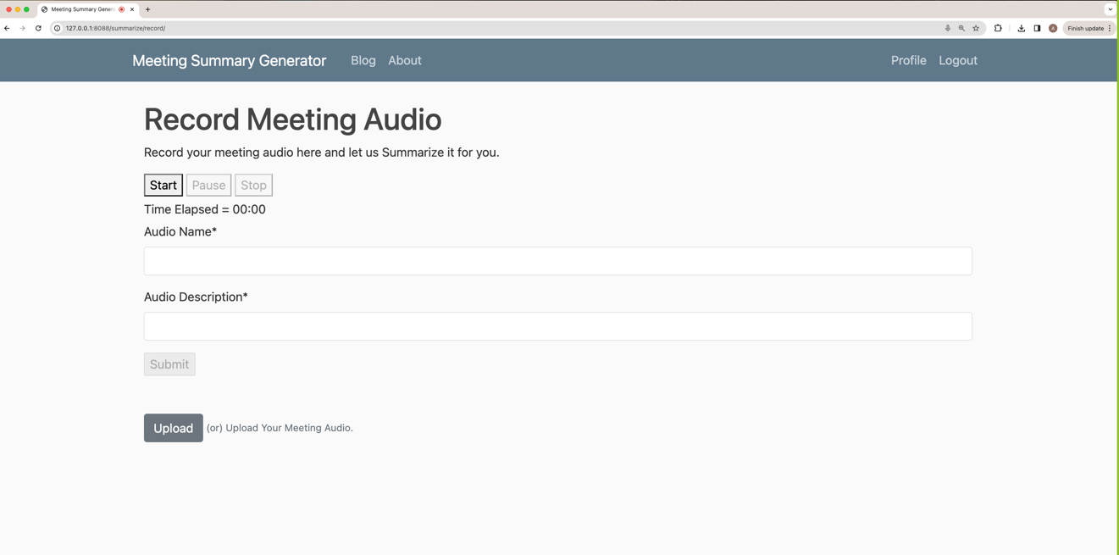
Audio Recording Page

Slide 18
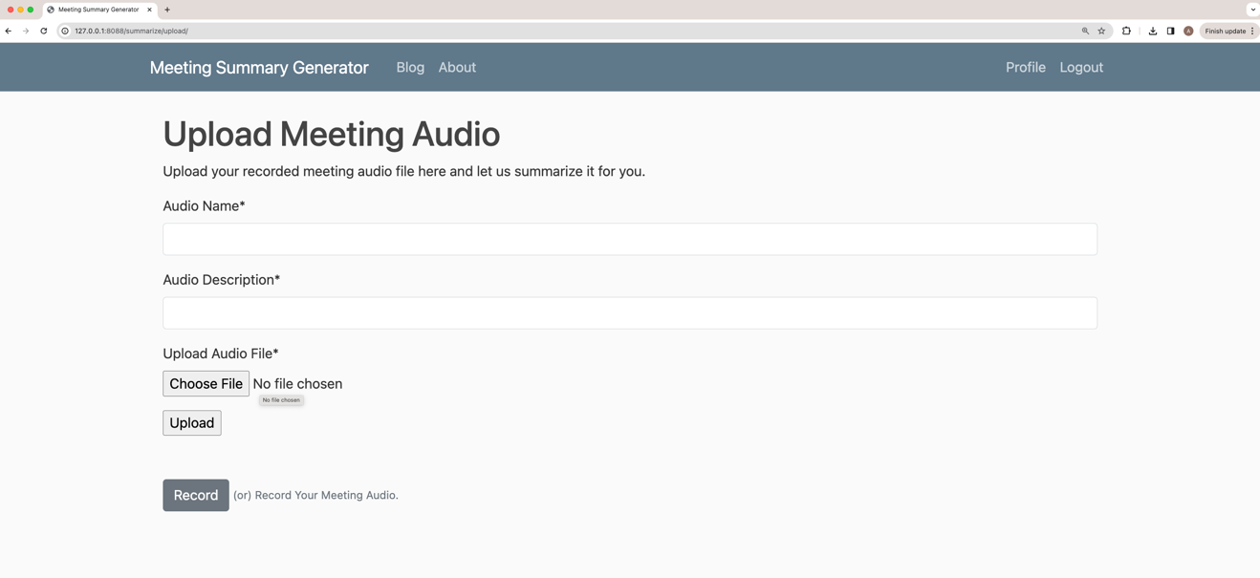
Audio Upload Page

Slide 19
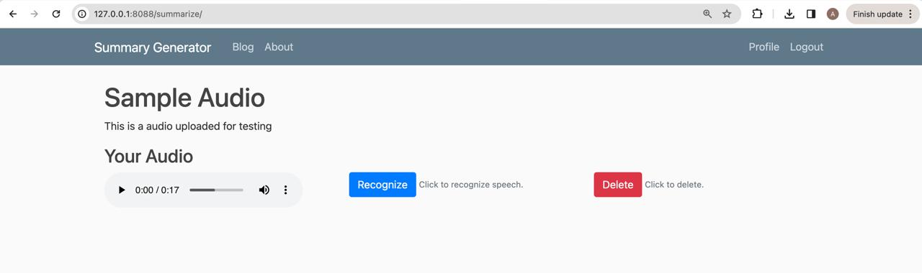
Audio View Page

Slide 20
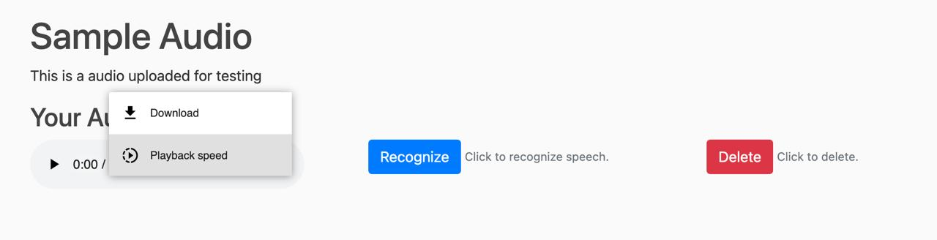
Audio Options Page

Slide 21
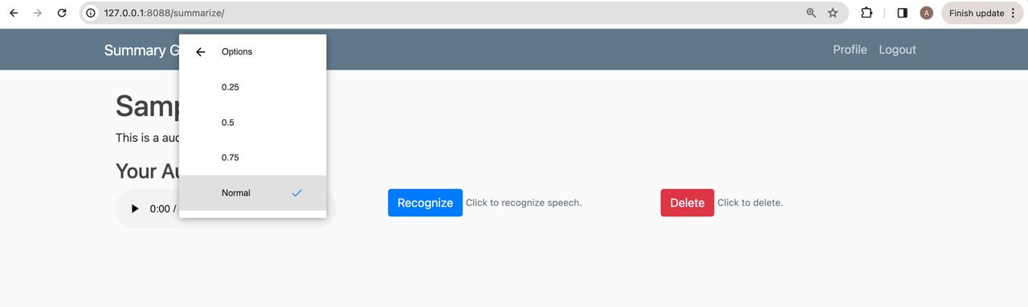
Audio Playback Speed Page

Slide 22
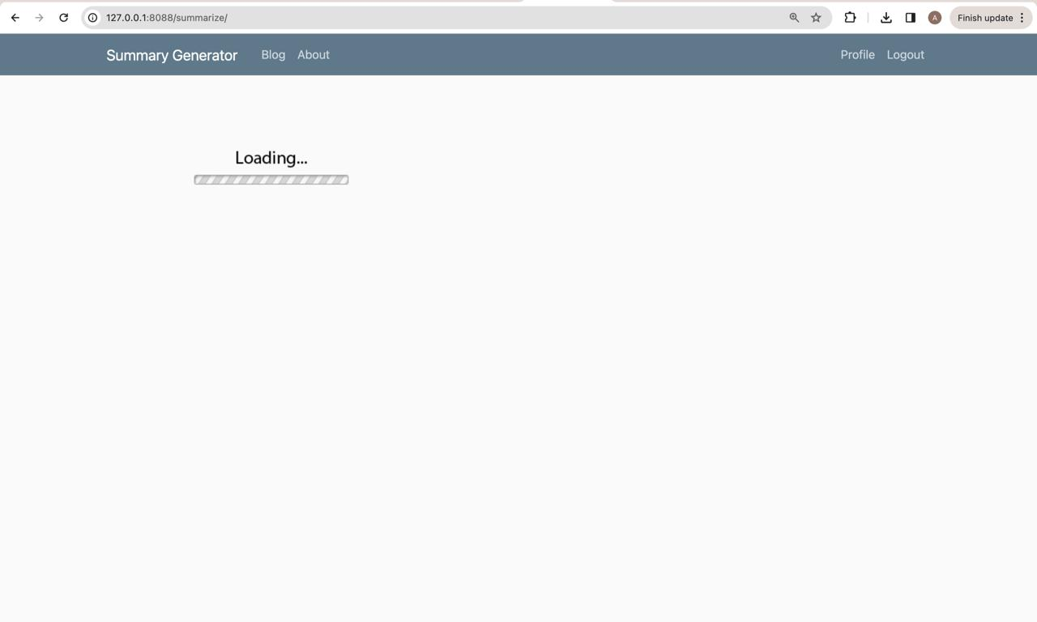
Loading Page

Slide 23
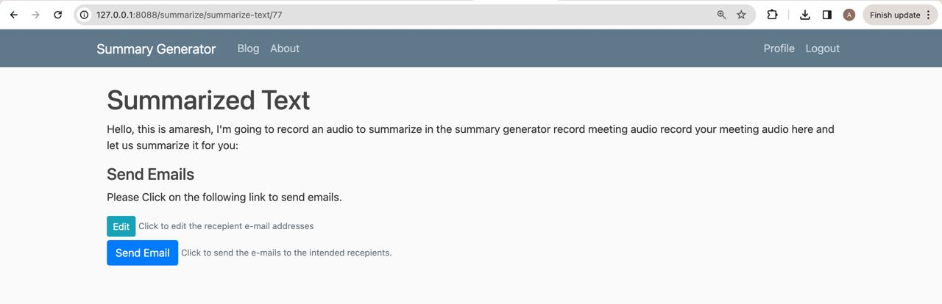
Summarized Text Page

Slide 24
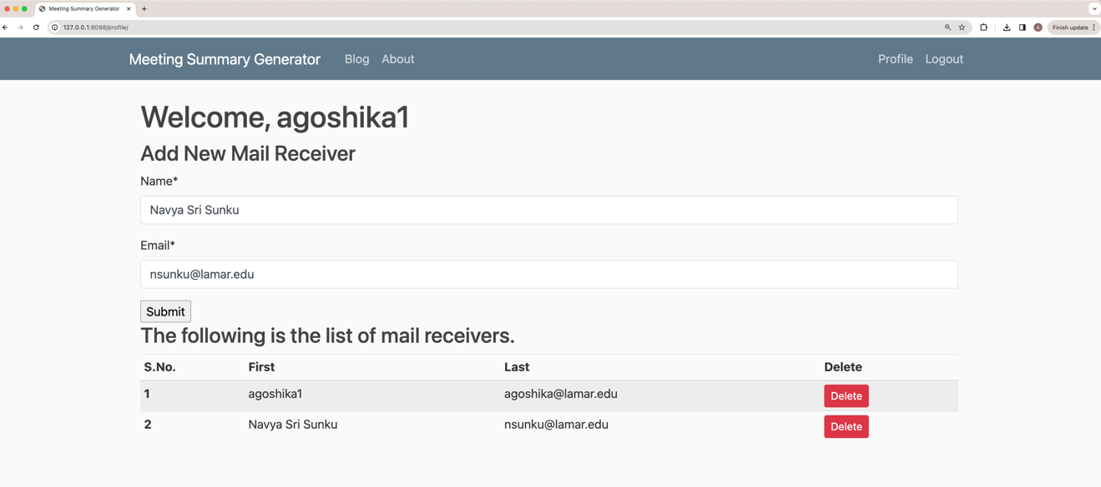
Adding Recipients Page

Slide 25
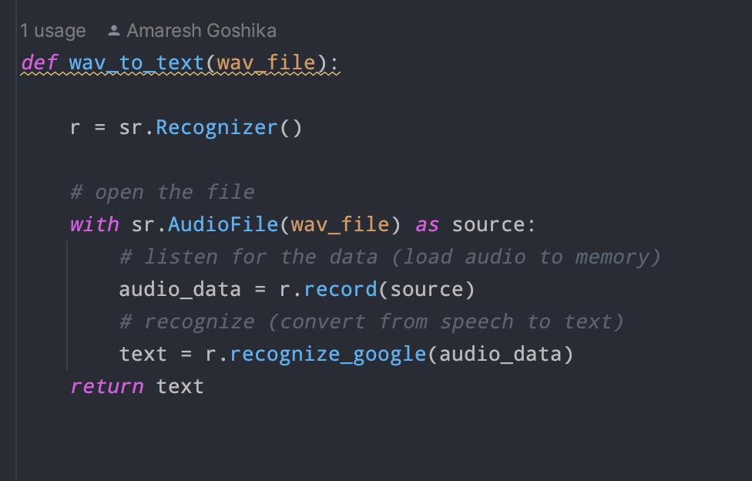
Audio To Text Converter

Slide 26
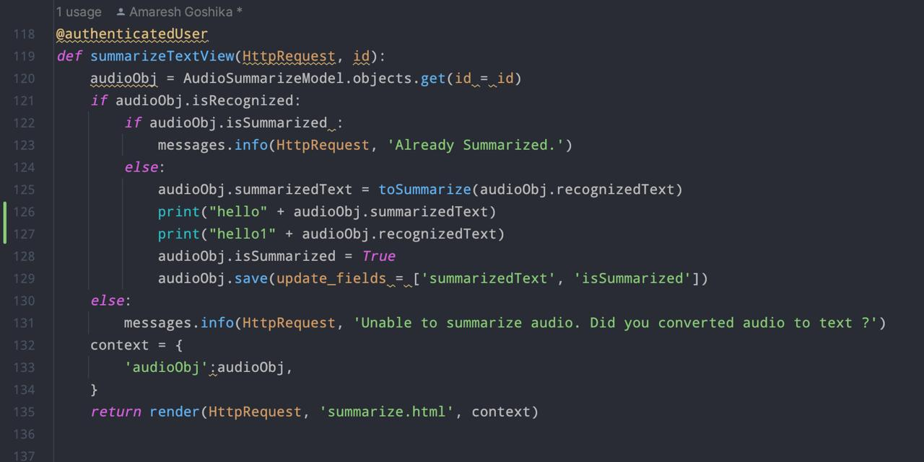
Generated Text Summarizer

Slide 27
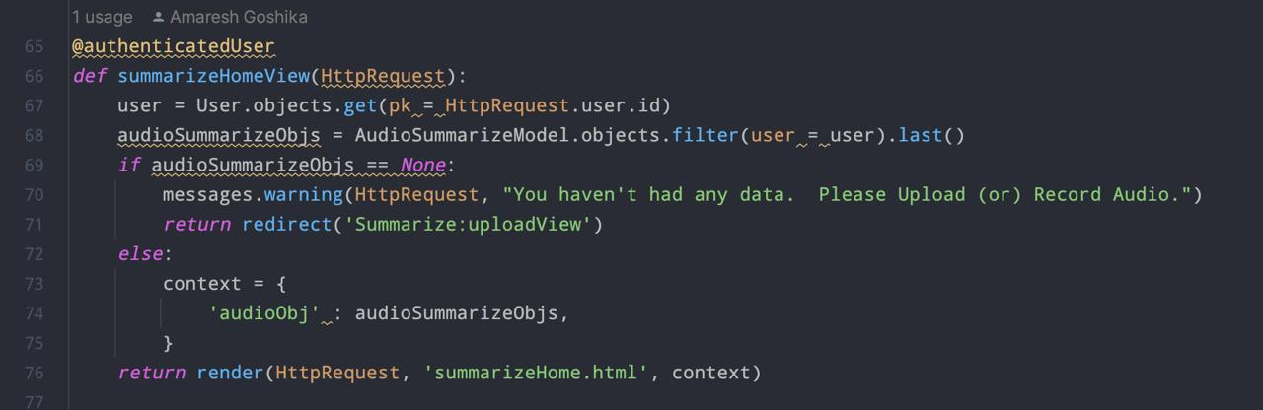
View Summarized text

Slide 28
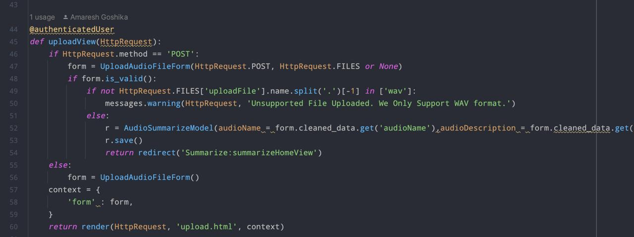
Audio Upload function
V

Slide 29
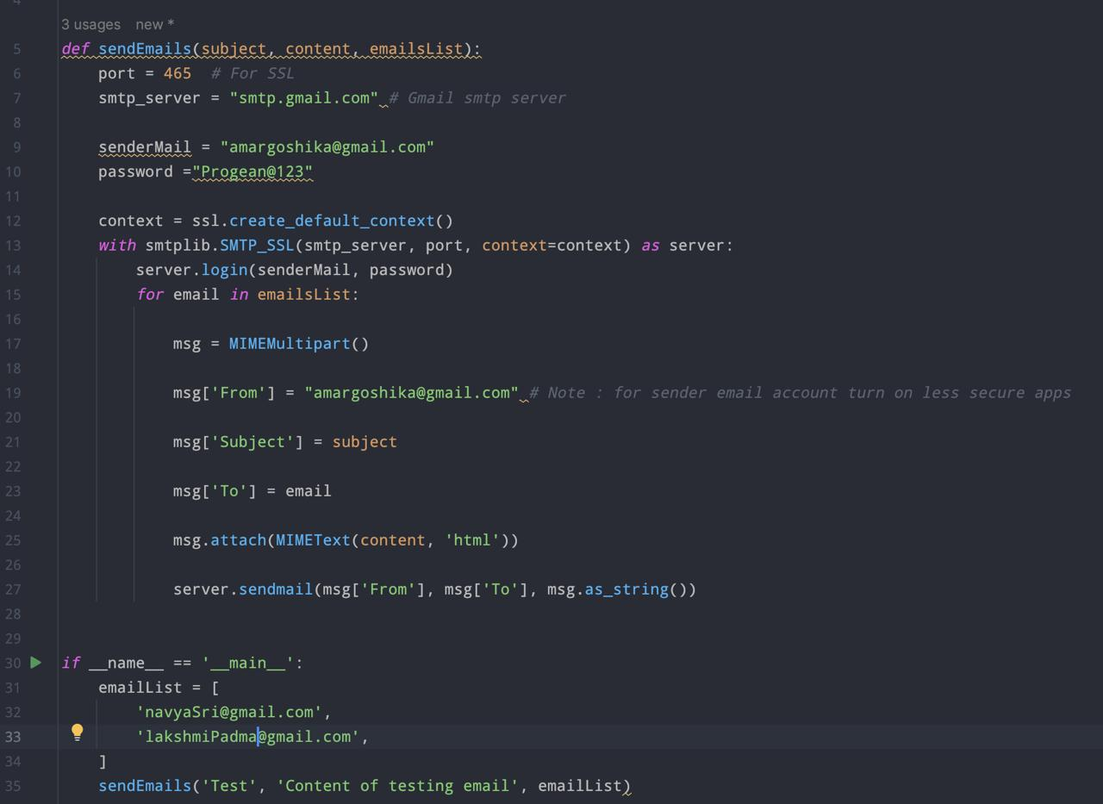
Sending emails function

Slide 30
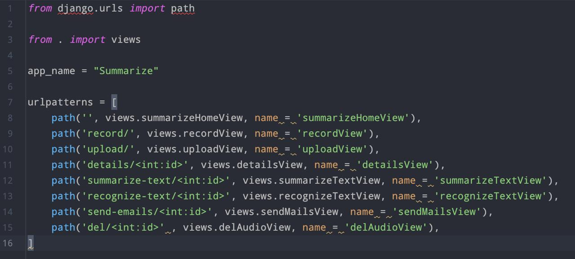
URL paths and patterns

Slide 31

Conclusion
Extensive use of the project provides the problem of notetaking during the meetings and give clear information with the key points with key points. This project also reduces the human errors while taking the notes.

Slide 32
References
Oleh Basystiuk, Nataliia Melnykova, “Multimodal Approaches for Natural Language Processing in Medical Data”, December 2022, Conference: IDDM 2022 Informatics & Data-Driven MedicineAt: Lyon, FranceVolume: Vol-3302.
Keerthana P, “Automatic Text Summarization using Deep Learning”, Volume: 7, Issue: 4, April 2021, Journal DOI: 10.36713/epra2013, SJIF Impact Factor 2021: 8.047, ISI Value: 1.188.
Natural Language Processing Techniques Applied in Information Retrieval-Analysis and Implementation in Python, TulikaNarang, International Journal of Innovations Advancement in Computer Science IJIACS ISSN 2347 – 8616 Volume 5, Issue 4 April 2016.
7 ways Audio books benefit students who struggle with reading. (n.d.).Retrieved March 09, 2021, from: https://learningally.org/Solutions-for School/7-Ways-Audio Books-Benefit-Students Who Struggle with-Reading.

Slide 33
Thank you!

