Slide 1
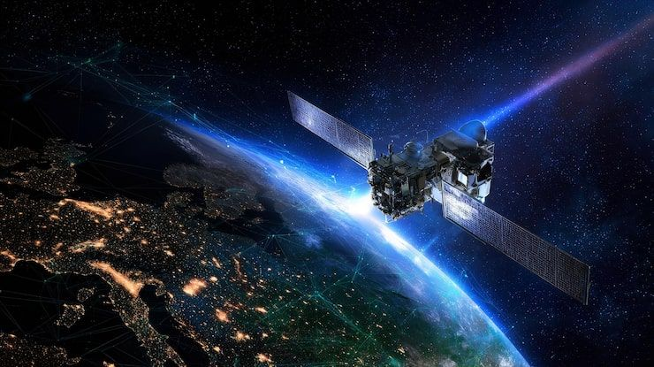

Satellite Land-Use Classification Using CNN Optimization and Transfer Learning on EuroSAT
Presented to:
Dr. Mostafa Risk
Presented by:
Aya MRAD
Kamar MASALKHI FARSHOUKH
Zahraa TARHINI

Slide 2
Outlines
Page 1/17
01 | INTRODUCTION & DATASET
Project Objectives · EuroSAT · Preprocessing
02 | EXPERIMENTAL SETUP
Workflow · Baseline CNN Architecture
03 | CNN OPTIMIZATION
Architecture · Optimizers · Learning Rates · Augmentation
04 | OPTIMIZED CNN RESULTS
Final CNN · Baseline Comparison
05 | TRANSFER LEARNING
ResNet-18 · Frozen, Partial & Full Fine-Tuning
06 | MODEL EVALUATION
Test Accuracy · Per-Class Analysis · Confusion Matrices
07 | CHECKPOINT & LIVE INFERENCE
Model Verification · Sample Predictions
08 | CONCLUSION & FUTURE WORK
Key Findings · Limitations · Future Improvements

Slide 3
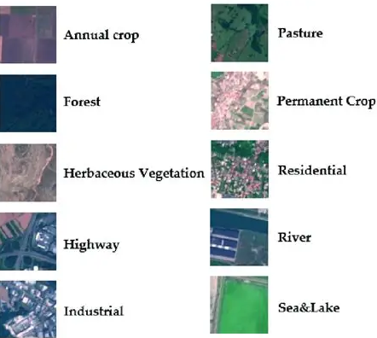
Introduction and Project Objectives
Page 2/17
Problem
Satellite land-use classification supports:
Land-use mapping.
Environmental monitoring.
Geographic analysis.
Challenge: Distinguishing visually similar land-cover categories.
Objectives
Baseline CNN | CNN Optimization | Transfer Learning
Build a CNN from scratch | Study architecture, optimization and augmentation | Compare CNN with pretrained ResNet-18

Slide 4

EuroSAT Dataset and Preprocessing
Page 3/17
27,000 | 10 | 64 × 64
Satellite Images | Land-Use Classes | RGB Image Resolution
Training | Validation | Testing
70% | 15% | 15%
18,900 images | 4,050 images | 4,050 images
Scratch CNN
Resize (64 × 64)
ToTensor
ResNet-18
Resize (64 × 64)
ToTensor
ImageNet Normalization
Preprocessing Methods

Slide 5
Experimental Workflow
Page 4/17
BASELINE DEVELOPMENT
Stage 1: Dataset Pipeline and Baseline CNN
CNN OPTIMIZATION
Stage 2: Architecture Experiments
TRANSFER LEARNING & EVALUATION
Stage 6: ResNet-18 Transfer Learning
Stage 3: Optimizers and Learning Rates
Stage 4: Data Augmentation
Stage 5: Final Optimized CNN
Stage 7: Final Evaluation and Comparison
Stage8: Checkpoint Verification and Live Inference

Slide 6
Baseline CNN Architecture
Page 5/17
Input Image
3 × 64 × 64
Optimizer | Learning Rate | Loss Function | Epochs
Adam | 0.001 | CrossEntropyLoss | 10
Convolution 1
32 Filters | 3×3 ReLU + MaxPool
Convolution 2
64 Filters | 3×3 ReLU + MaxPool
Convolution 3 128 Filters | 3×3 ReLU + MaxPool
Flatten
8,192 Features
Fully Connected
256 Neurons
Results
Peak Validation Accuracy: 84.62%
Test Accuracy: 85.60%
Output Layer
10 Classes

Slide 7
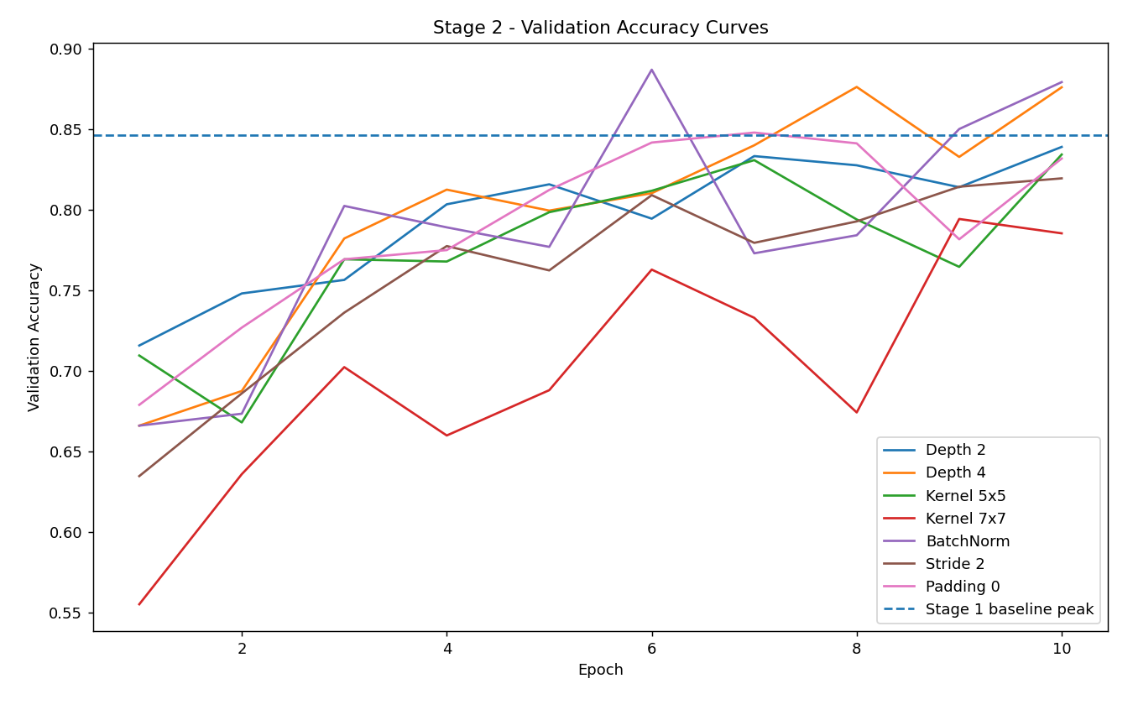
CNN Architecture Experiments
Architecture | Peak Validation Accuracy
Baseline | 84.62%
2 Convolutional Layers | 83.88%
4 Convolutional Layers | 87.60%
5×5 Kernels | 83.41%
7×7 Kernels | 79.41%
Stride 2 | 81.93%
Padding 0 | 84.77%
No Hidden Linear Layer | 85.56%
BatchNorm | 88.67%
Page 6/17
Experimental Changes
1. Network depth
2. Kernel size
3. Stride and padding
4. Linear-layer depth
5. Batch Normalization

Slide 8
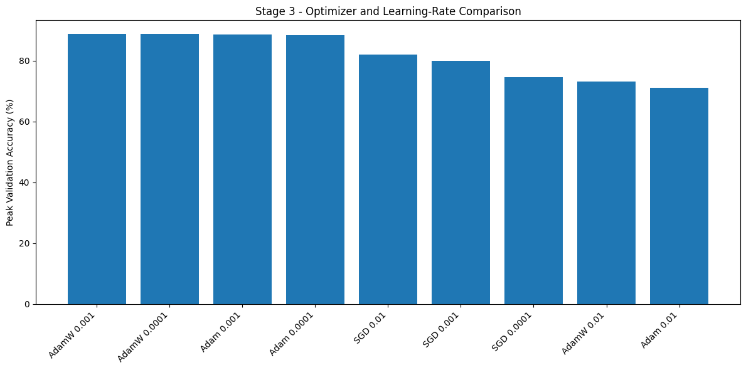
Optimizer and Learning Rate Optimization
Page 7/17
Selected optimizer
AdamW
Learning rate: 0.001
StepLR: every 3 epochs
Decay factor: 0.1
Configuration | Peak Validation Accuracy
AdamW without StepLR | 88.84%
AdamW with StepLR | 90.02%

Slide 9
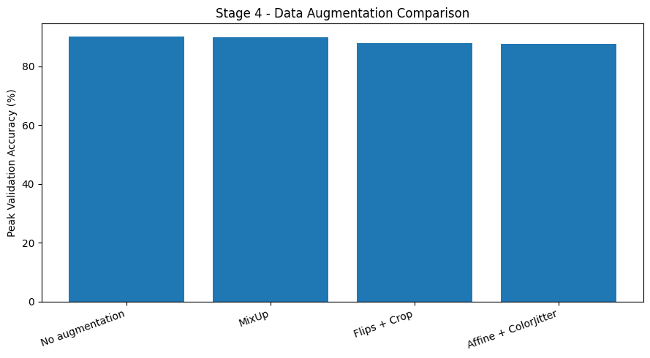
Data Augmentation Experiments
Page 8/17
Augmentation | Peak Validation Accuracy
No Augmentation | 90.02%
MixUp | 89.78%
Flips + Crop | 87.88%
Affine + ColorJitter | 87.56%

Slide 10
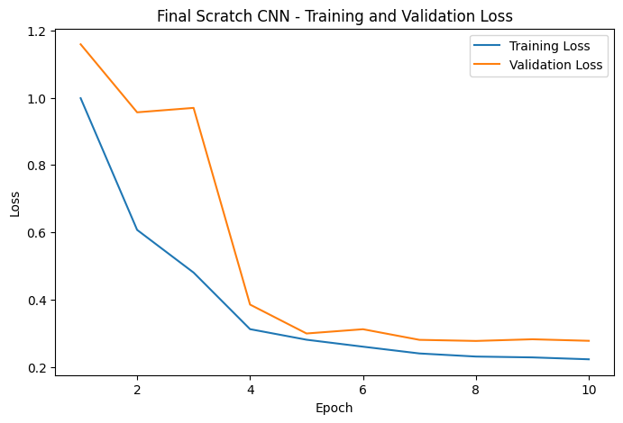
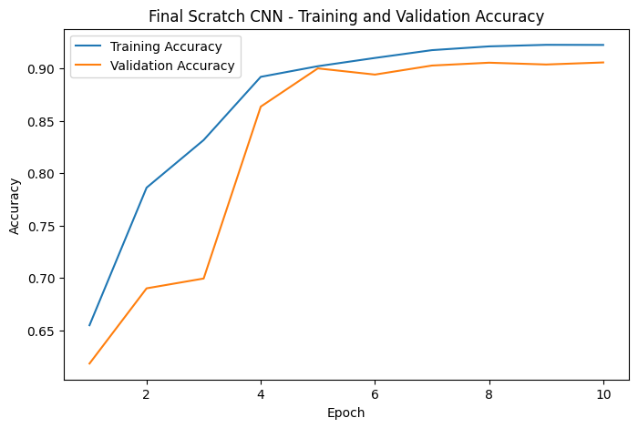
Final Optimized CNN
Page 9/17
Results
Peak Validation Accuracy: 90.59%
Test Accuracy: 91.04%
Architecture | Optimizer | Scheduler | Augmentation | Epochs
CNN + BatchNorm | AdamW (0.001) | StepLR (3,0.1) | No Augmentation | 10

Slide 11
Baseline vs. Optimized CNN
Page 10/17
Metric | Baseline CNN | Optimized CNN
Peak Validation Accuracy | 84.62% | 90.59%
Test Accuracy | 85.60% | 91.04%
Generalization Gap | 3.05 pp | 1.67 pp
Total Parameters | 2,193,226 | 2,193,674
Training Runtime | 16.33 min | 21.61 min
Inference Latency | 1.8606 ms/image | 1.9726 ms/image
Model checkpoints were selected on validation accuracy; the test set was reserved for final evaluation.

Slide 12
Transfer Learning with ResNet-18
ImageNet-Pretrained ResNet-18
Backbone frozen Classifier trainable 5,130 trainable parameters
Earlier layers frozen
Layer4 + classifier trainable
8.399M trainable parameters
Entire network trainable
All layers trainable
11.182M trainable parameters
Page 11/17

Slide 13
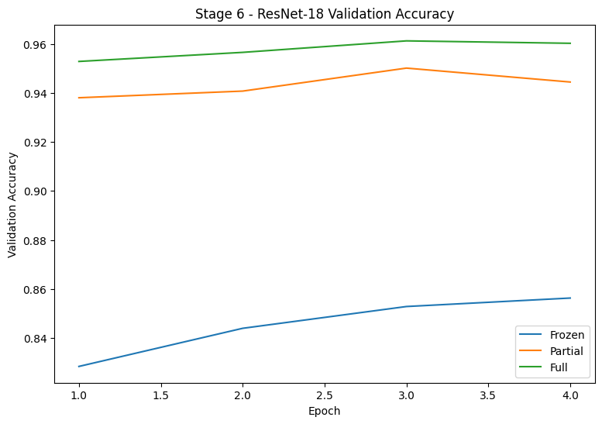
ResNet-18 Transfer Learning Results
Full Fine- tuning wins!
Page 12/17
96.12%
95.01%
Training setup
4 epochs AdamW
Weight decay: 0.01
Frozen LR:
0.001
Fine-tuning LR:
0.0001
85.63%

Slide 14
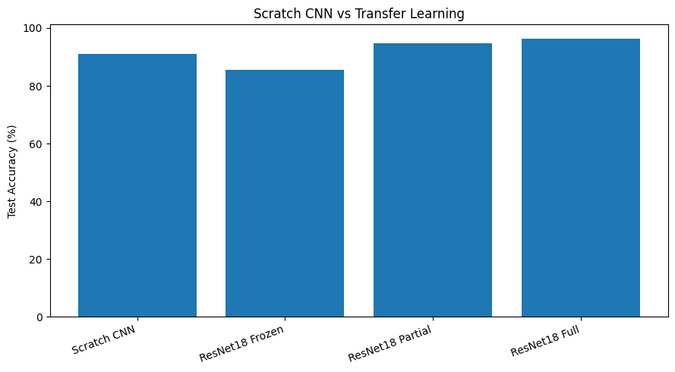
Final Model Evaluation
Page 13/17
Model | Parameters | CPU Latency
Optimized CNN | 2.194M | 1.9726 ms/image
ResNet Frozen | 11.182M | 3.1964 ms/image
ResNet Partial | 11.182M | 3.4163 ms/image
ResNet Full | 11.182M | 3.8358 ms/image
Test accuracy: Scratch 91.04% | Frozen 85.58% | Partial 94.64% | Full 96.40%.
The table shows model size and CPU latency.

Slide 15
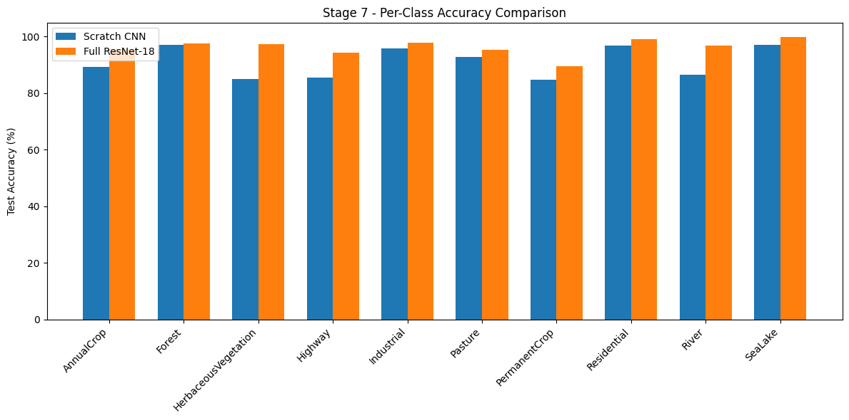
Per-Class Accuracy Analysis
Page 14/17
+12.23 pp
+8.95 pp
+10.40 pp
Most difficult reported ResNet-18 class

Slide 16
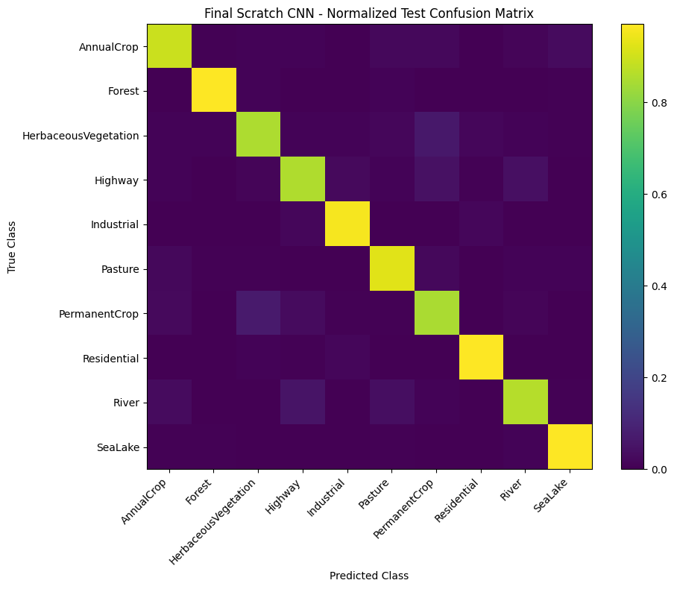
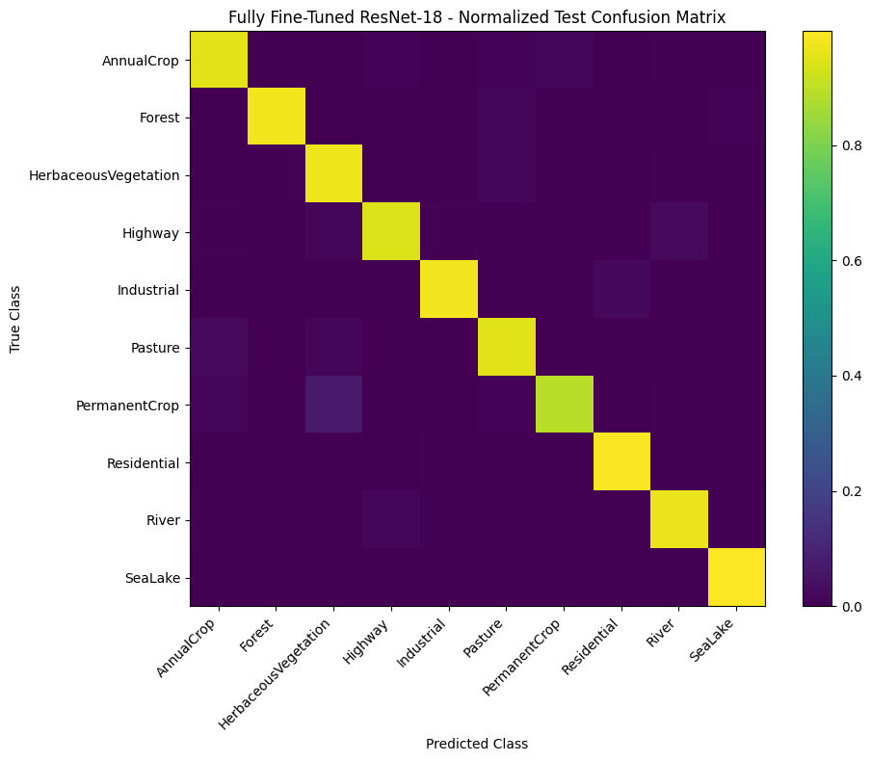
Normalized Confusion Matrix Comparison
Page 15/17
Final Scratch CNN
Fully Fine-Turned ResNet-18

Slide 17
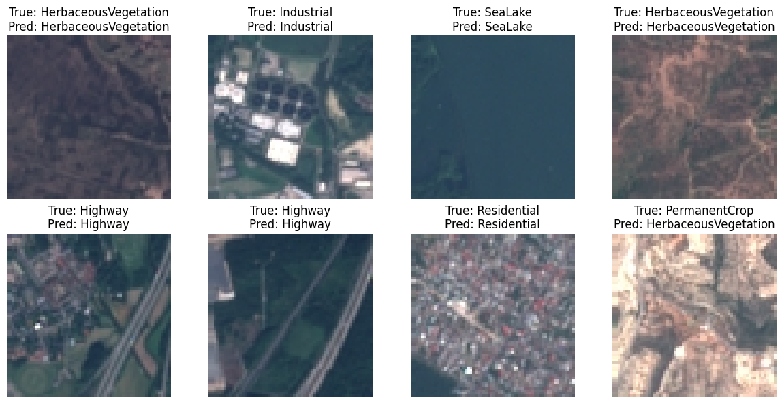
Checkpoint Verification and Live Inference
Page 16/17
Checkpoints | Predictions
Both successfully reloaded | 7/8 correct for each model
The complete test set provides the more reliable overall accuracy comparison.

Slide 18
Conclusion and Future Work
Page 17/17
CONCLUSION
FUTURE WORK
1. CNN Optimization Improved Performance
The optimized CNN increased test accuracy from 85.60% to 91.04% (+5.44 pp) through the selected BatchNorm, AdamW, and StepLR configuration.
2. Transfer Learning Achieved the Best Results
Full fine-tuning of pretrained ResNet-18 achieved 96.40% test accuracy, outperforming the optimized CNN by 5.36 percentage points.
3. Accuracy–Efficiency Trade-Off
ResNet-18 achieved higher classification accuracy, while the optimized scratch CNN required fewer parameters and lower CPU inference latency.
1. Multiple Random Seeds
Repeat experiments across different random seeds.
2. Extended Training
Investigate longer and matched training budgets.
3. Augmentation Search
Explore augmentation strategies more systematically.

Slide 19


