Slide 1

Email Phishing Detection Using
Machine Learning & MLops
Team Members
Amar H M ENG23AM1001 Contact-Details – amarhm26@gmail.com
Sanjay S (ENG23AM1004)
Deepak Mahto (ENG22AM0087)
Shashanka (ENG23AM1006)

Slide 2
MLOps Workflow Stages
Data Ingestion: Automatic retrieval of emails from IMAP server
Preprocessing: Cleaning noise, decoding content, preparing usable text
Feature Engineering: TF-IDF transformation for high-quality vector features
Model Training: Logistic Regression trained on labeled email dataset
Evaluation: Metrics generated and stored for comparison
Model Registry: All trained models archived with version control
Deployment: Real-time API + user-facing Streamlit app
Monitoring: Drift tracking based on predicted phishing percentage
Alerting & Retraining: Threshold-based retraining workflows

Slide 3
Core MLOps Tools Stack
Source & Packaging
Git & GitHub for version control
Docker for consistent runtime environment
Workflow & Automation
Prefect for orchestration
GitHub Actions for CI automation
Modeling Tools
Scikit-learn for TF-IDF & classification
Joblib/Pickle for model persistence
Monitoring & Logging
Custom monitoring script for drift
Training/prediction/drift logs maintained with timestamps
Serving & Interface
FastAPI for backend API
Streamlit for dashboard visualization

Slide 4
1. Data Ingestion & Processing
Ingestion Pipeline
Connects securely to IMAP server
Retrieves real emails from inbox
Extracts metadata: sender, subject, body, date
Supports multiple MIME types (plain, HTML)
Preprocessing Techniques
Lowercasing and trimming
Removing scripts, URLs, HTML tags
Token normalization
Email signature & noise removal
Concatenating subject + body for improved context
Label assignment for phishing/ham classification
Outcome
Produces a clean, high-quality dataset ready for ML tasks.

Slide 5
2. Model Training & Tracking
Training Workflow
Load cleaned dataset
Train-test split (80/20)
Convert text into TF-IDF vectors
Train Logistic Regression with optimized hyperparameters
Model Tracking
Stores model performance metrics in artifacts folder
Saves vectorizer and model with timestamps
Logs every training cycle for debugging & reproducibility
Key Advantages
Lightweight, fast, and interpretable
Works well with email-based text features
Easy to update and retrain

Slide 6
3. Model Registry & Versioning
Model Storage Strategy
Every model saved with version numbers (v1, v2, v3...)
Vectorizers stored alongside models for consistency
Models archived in model_registry/ folder
Version Control Practices
Git tracks changes in code, workflows, configs
Training logs stored per version
Evaluation metrics compared before approving new model version
Benefits
Easily rollback to older models
Ensures reproducibility and stability
Maintains a history of improvements

Slide 7
4. On-Premise Deployment
Deployment Components
FastAPI endpoint for predictions
Streamlit dashboard for analysts and admins
Docker image packaging entire pipeline
Local deployment via batch scripts
Capabilities
Predict phishing risks from incoming emails
Show logs, metrics, and trends
Provide real-time insights into email security
Why On-Prem?
Better security for sensitive email data
Faster updates during development
Controlled environment for debugging

Slide 8
5. Cloud Deployment
Cloud-Ready Architecture
Docker containers can run on AWS EC2, Azure VM, GCP Compute
API and dashboard easily exposed via cloud load balancers
Cloud orchestration possible using GitHub Actions or Prefect Cloud
Future Cloud Plan
Automatic deployment of new model versions
Scheduled retraining on cloud infrastructure
Scalable email ingestion and monitoring

Slide 9
6. CI/CD Pipeline with GitHub Actions
GitHub Actions CI Pipeline Includes
Syntax, style, and lint checks
Environment setup verification
Package installation tests
Code integrity tests before merging
Basic automated pipeline testing (trainer, ingest, predict)
Impact
Ensures stable codebase
Reduces errors during deployment
Maintains project quality across versions
Deployment Automation Steps
Build Docker image
Run containerized FastAPI service
Serve Streamlit dashboard in parallel
Pull and load latest model version
Update environment variables and config
Outcome
A fully automated local deployment experience requiring minimal user intervention.

Slide 10
7. Model Serving & Inference
FastAPI Endpoints
/predict: Accepts email text and returns phishing probability
/healthcheck: Confirms service is active
Streamlit Dashboard Features
Real-time email classification
Visual summaries of phishing trends
Version comparison view
Interactive filtering & browsing of logs
Strength
Fast, lightweight, and user-friendly serving layer.

Slide 11
8. Monitoring & Observability
Drift Detection
Compares current phishing percentage with training baseline
Calculates drift magnitude
Triggers retraining if threshold exceeded
Logs drift events with time & values
Prediction Monitoring
Logs sender, subject, prediction label, confidence
Tracks email volume trends
Useful for auditing & analysis
Why This Matters
Maintains long-term reliability and prevents accuracy degradation.

Slide 12
End-to-End MLOps Workflow
Connect to IMAP server → fetch emails
Clean subject & body → preprocess
Convert to TF-IDF feature vectors
Predict using Logistic Regression
Log every prediction
Compare phishing rates → detect drift
If drift found → retrain model automatically
Save new model to registry
Deploy updated API + dashboard
Streamlit visualizes results & logs

Slide 13
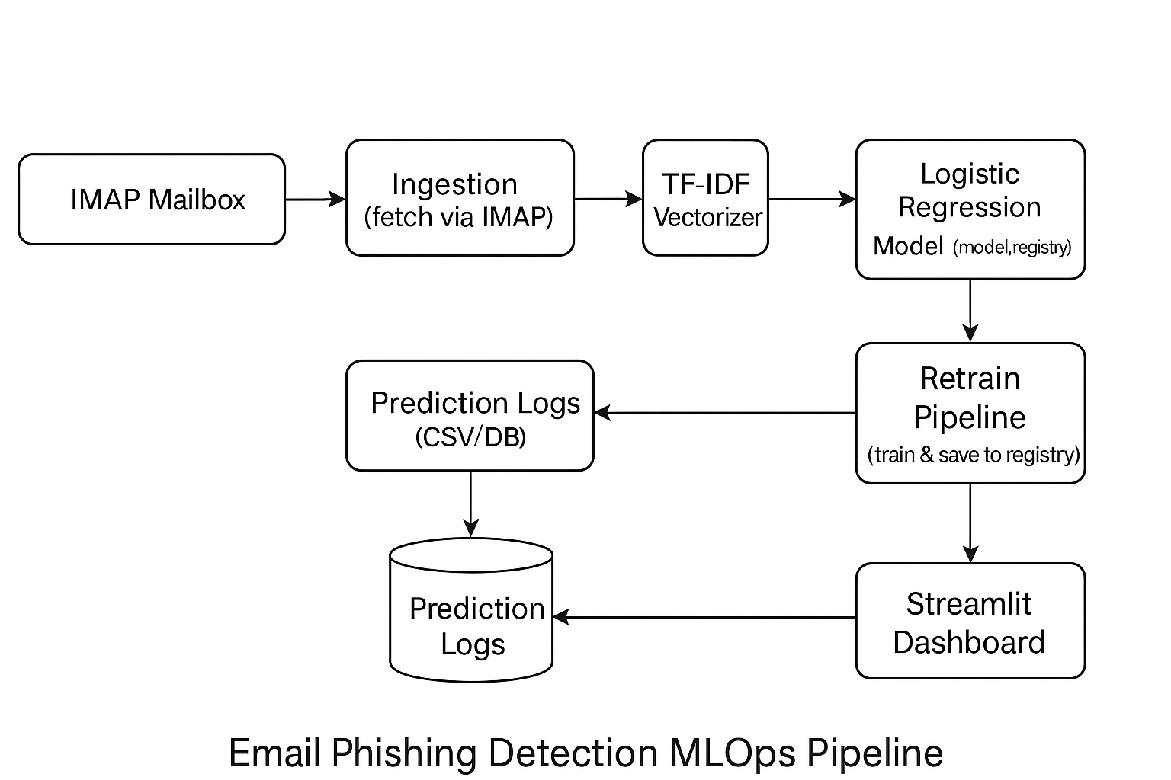
End-to-End MLOps Workflow

Slide 14
Project Implementation Guide
Identified problem: phishing email detection
Collected email dataset
Implemented ingestion script
Developed preprocessing & TF-IDF pipeline
Trained baseline model and evaluated
Added versioning & registry structure
Implemented drift monitoring
Automated retraining mechanism
Created API layer & dashboard
Containerized entire system
Added CI pipeline
\Validated end-to-end MLOps workflow

Slide 15
Results & Evaluation
Model Performance
Solid accuracy across multiple test sets
High precision — low false positives
High recall — catches majority of phishing mails
TF-IDF features capture language patterns effectively
Pipeline Performance
Fully automated from ingestion → prediction → monitoring
Minimal human intervention
Continuous improvement ensured through drift monitoring
Visual Results
Dashboard shows clear trends of phishing detection
Logs highlight real-world email classification patterns

Slide 16
Conclusion
This project represents more than just a phishing detection model — it shows how a traditional machine-learning solution can be transformed into a living, evolving system through MLOps.
By combining automated data ingestion, intelligent preprocessing, robust model training, reliable deployment, and continuous monitoring, we built an end-to-end pipeline that mirrors real industry practices. Every component — from drift detection to retraining and version control — works together to ensure that the system stays accurate, adaptable, and trustworthy over time.
Through this journey, the project highlights a timeless lesson: technology becomes truly powerful only when it is maintained, improved, and cared for continuously. Just like emails evolve, threats evolve — and our model evolves along with them.
Ultimately, this MLOps pipeline is not just a technical achievement but a step toward building secure, dependable systems that protect users in the digital age. It stands as a reminder that with thoughtful design, discipline, and dedication, even a student project can reach professional standards and create meaningful impact.

Slide 17
References
Bird, S., Klein, E., & Loper, E. (2009). Natural Language Processing with Python. O’Reilly Media.
Salton, G., & McGill, M. J. (1983). Introduction to Modern Information Retrieval. McGraw-Hill. (TF–IDF)
Hosmer, D. W., Lemeshow, S., & Sturdivant, R. X. (2013). Applied Logistic Regression (3rd ed.). Wiley.
Jain, A., Gupta, B., & Kumar, A. (2021). “Machine Learning Approaches for Phishing Email Detection.” International Journal of Computer Applications, 174(19), 1–9.
Symantec Corporation. (2020). Email Threat Report. Broadcom.
Rasool, T., & Shakir, M. (2020). “Detection of Phishing Emails Using Machine Learning.” Journal of Information Security, 11(2), 61–69.
Maimon, D., & Fisher, A. (2021). “Cybercrime Trends and Prevention Techniques.” Cybersecurity Journal, 6(3).
Python Software Foundation. (2023). email — An email and MIME handling package. https://docs.python.org
IMAP Protocol RFC 3501. (2003). Internet Message Access Protocol. IETF.
Pedregosa, F., et al. (2011). “Scikit-learn: Machine Learning in Python.” Journal of Machine Learning Research, 12, 2825–2830.

Slide 18
Thank You!
Questions & Discussion

