Slide 1
⚡
voltix
SOUND REIMAGINED • SHOP REIMAGINED
Voltix: A Responsive Electronics
E-Commerce Website
Built entirely with hand-written HTML5 & CSS3 — a fully responsive, mobile-first
online electronics store, designed and coded as an academic web project.
TEAM
Arnav Sharma
Amarinder Singh
Yashkaran Singh
Roll No. 2510992821
Roll No. 2510993775
Roll No. 2510993712
01

Slide 2
⚡
WHAT WE'LL COVER
Presentation Agenda
01
Project overview & objective
02
Tech stack & site structure
Why we built Voltix and what it demonstrates
Pure HTML/CSS, the page map, and design system
03
Walkthrough of every page
04
How the code works
Home, Shop, Product, Cart, Login & Signup
Divs, tables, forms, Flexbox/Grid, CSS-only interactivity
05
Responsive & mobile-first design
06
Challenges & future roadmap
Fixed navbar, hamburger menu, mobile filters
What's hardcoded today, and what comes next
02

Slide 3
⚡
PROJECT OVERVIEW
What is Voltix?
Voltix is a fictional online electronics store — phones, audio, laptops, wearables, gaming gear and accessories — built as a front-end web development project.
The goal was to design a complete, realistic e-commerce experience (browse → view product → add to cart → checkout → account) using only HTML and CSS, no back-end and no JavaScript.
Every interaction you can click through — the mobile menu, the image gallery, the filters panel, the signup/login switch — is real and working, built purely with semantic HTML and CSS tricks.
The layout is fully responsive: the same markup adapts from a small phone screen up to a full desktop using CSS Flexbox, CSS Grid and media queries.
8
100%
HTML pages
HTML + CSS
no JS
3
6
breakpoints
(desktop/tablet/mobile)
hardcoded
products
03

Slide 4
⚡
HOW IT'S BUILT
Tech Stack & Approach
</>
HTML5
style.css
Semantic tags throughout — <header>, <nav>, <main>, <section>, <article>, <aside>, <footer> — instead of generic <div> soup.
:root {
--ink: #101426;
--blue: #445cff;
--mint: #23d8b3;
--muted: #64708a;
--line: #e7eaf1;
--radius: 22px;
}
/* used everywhere: */
.button {
background: var(--blue);
border-radius: var(--radius);
}
{ }
CSS3
One shared stylesheet (style.css). CSS Variables for the whole colour palette, Flexbox for rows/nav, Grid for card layouts, and media queries for responsiveness.
✕JS
Zero JavaScript
Every 'interactive' feature — menus, toggles, image switchers — is done with pure CSS using the checkbox/radio 'hack', on purpose, per the syllabus scope.
One set of CSS variables drives every colour and radius on the site — change it once, it updates everywhere.
04

Slide 5
⚡
SITE STRUCTURE
6 Pages, One Shared Stylesheet
1
2
3
index.html
shop.html
product-*.html × 6
Homepage — hero, categories, deals, trending products
Full catalogue with filters & sorting
One dedicated page per product
4
5
6
cart.html
login.html
signup.html
Shopping cart with order summary
Sign-in form (+ toggle to Sign up)
Registration form (+ toggle to Log in)
Every page links back to style.css, so the whole site shares one consistent design system.
05

Slide 6
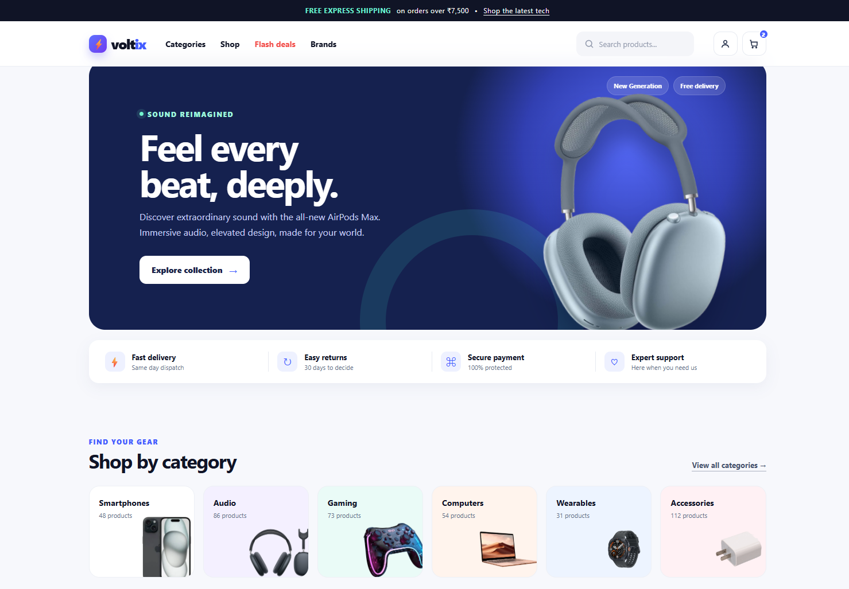
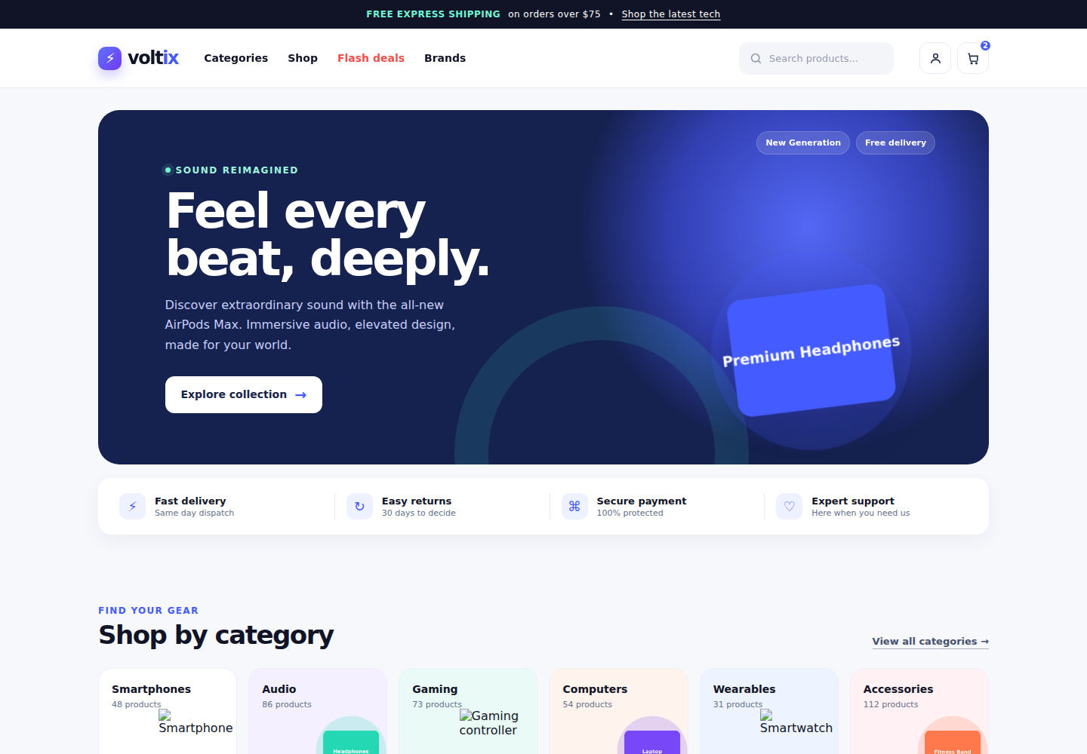
⚡
PAGE WALKTHROUGH
The Homepage (index.html)
Hero banner: a flex row (.hero-card) with the headline on the left and the product image floated on the right using position: absolute.
Category grid: a CSS Grid (.categories) with 6 equal columns on desktop, collapsing to 3 then 2 columns on smaller screens.
Trending products: reuses the same .product “card” component that appears on the Shop page — built once, used everywhere.
Flash-deal banner and newsletter strip: full-width sections, each its own <section>, stacked in normal document flow.
Hero, trust row, category grid — all real content
06

Slide 7
⚡
LAYOUT TECHNIQUE
How the Layout Divs Work
Almost every section is a plain <div class="container"> that centres content and caps its width at 1180px — this one class controls the whole site's margins.
Rows of items (nav links, hero content, trust badges) use display: flex so items sit side-by-side and share space evenly.
Grids of same-sized cards (categories, products) use display: grid with repeat(n, 1fr) — CSS works out equal column widths automatically.
Nesting divs by role, not by appearance, keeps the HTML readable: .product-media wraps the image, .product-info wraps the text.
index.html + style.css
<!-- product "card" component -->
<article class="product">
<div class="product-media">
<span class="badge">NEW</span>
<img src="..." alt="...">
</div>
<div class="product-info">
<h3>Galaxy S24 Ultra</h3>
<div class="price-row">
<div class="price">$1,099</div>
</div>
</div>
</article>
.products {
display: grid;
grid-template-columns: repeat(4,1fr);
}
07

Slide 8
⚡
NAVIGATION
A Fixed Nav Bar on Every Page
The promo strip and the <nav> are both position: fixed to the top of the viewport, so they stay visible while the page scrolls — on desktop AND mobile.
Because fixed elements leave the normal page flow, the <body> gets matching padding-top so content never hides underneath the bar.
The whole navigation — logo, links, search box, account & cart icons, and the mobile menu button — lives inside one semantic <nav> element, as required.
style.css
header {
position: fixed;
top: 38px; left: 0; right: 0;
}
body { padding-top: 116px; }
Announcement strip + <nav> pinned to the top
08

Slide 9
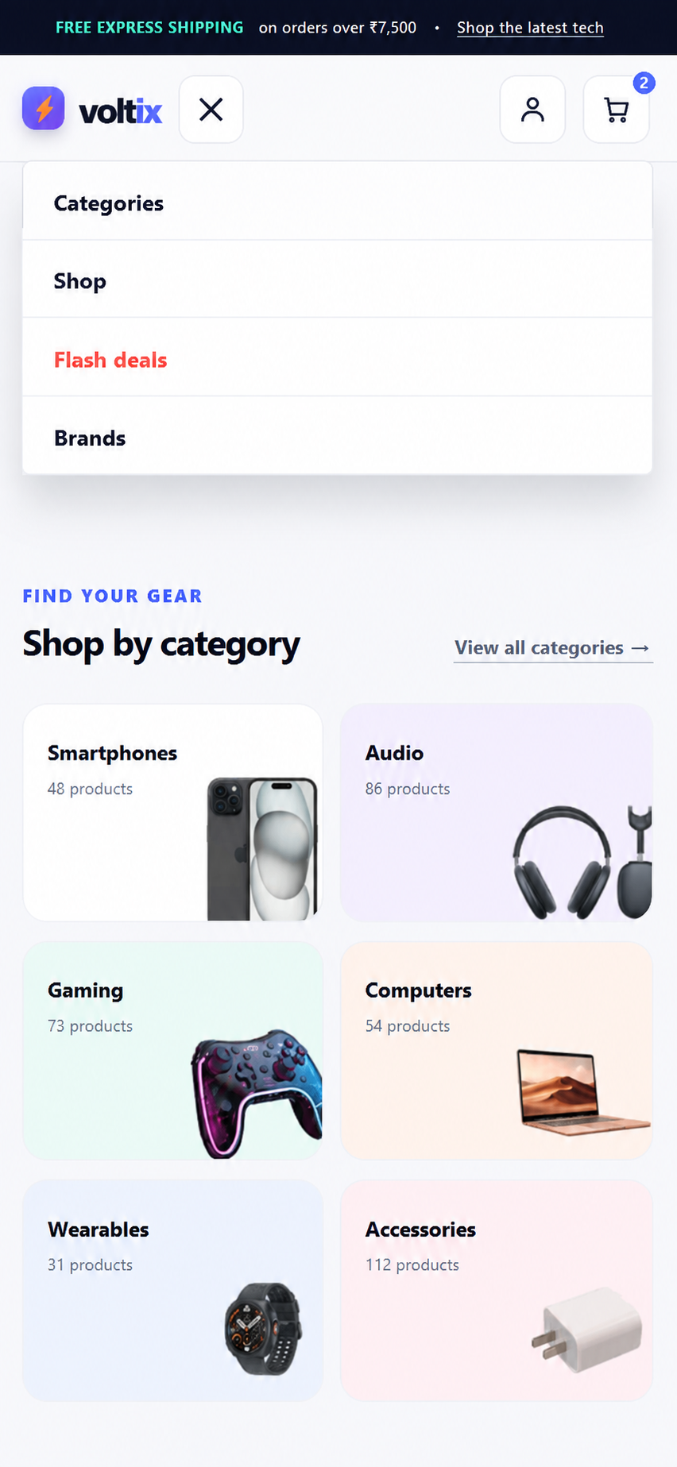
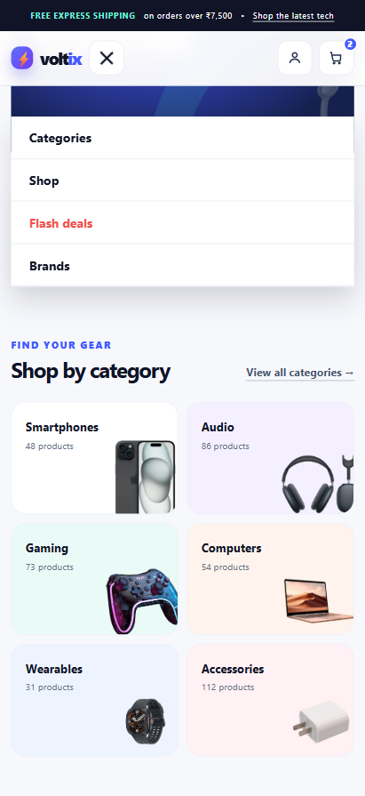
⚡
MOBILE-FIRST RESPONSIVE DESIGN
Hamburger Menu — Zero JavaScript
A hidden <input type="checkbox"> plus a <label> styled as the ☰ button is the entire trick — clicking the label toggles the checkbox, no JavaScript involved.
CSS then reads that checkbox state with the :checked selector to expand the link list — the classic 'checkbox hack'.
The dropdown is positioned with top: 100% relative to the <nav>, so it always sits flush under the header with no gap, on any screen size.
The account icon now stays visible on every mobile width, so login is always one tap away.
index.html + style.css
<input type="checkbox" id="nav-toggle">
<label for="nav-toggle">☰</label>
#nav-toggle:checked ~ .nav-links {
max-height: 320px;
}
Menu open, flush under the nav
09

Slide 10
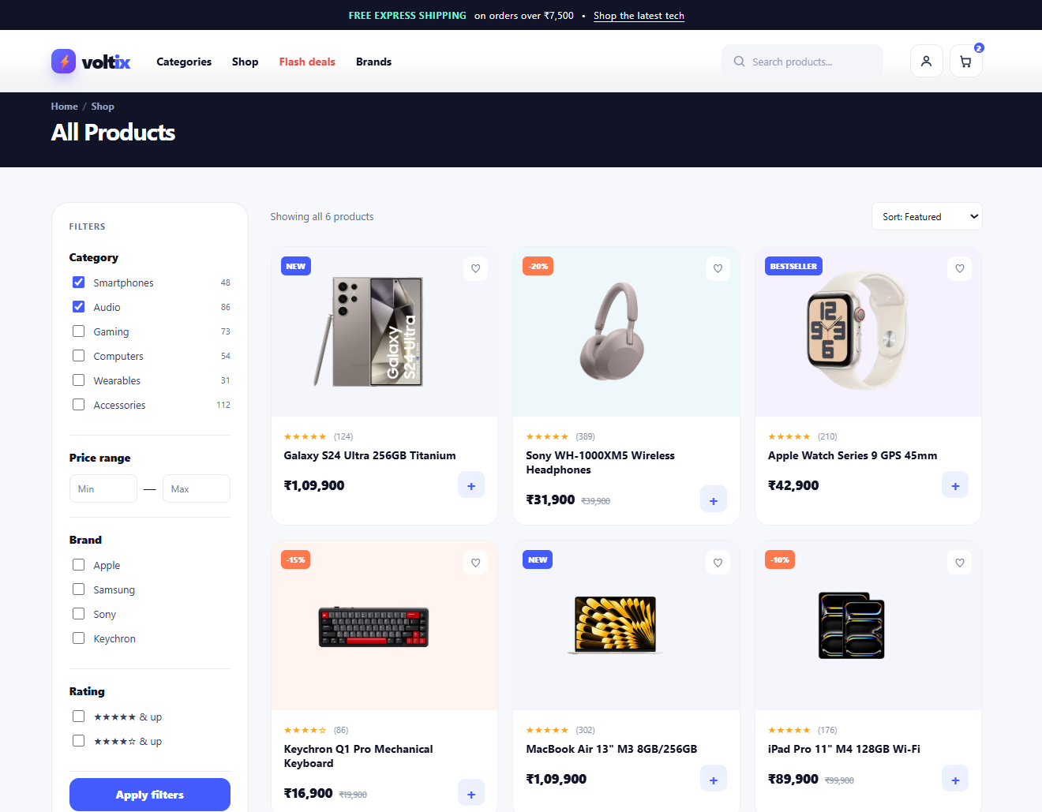
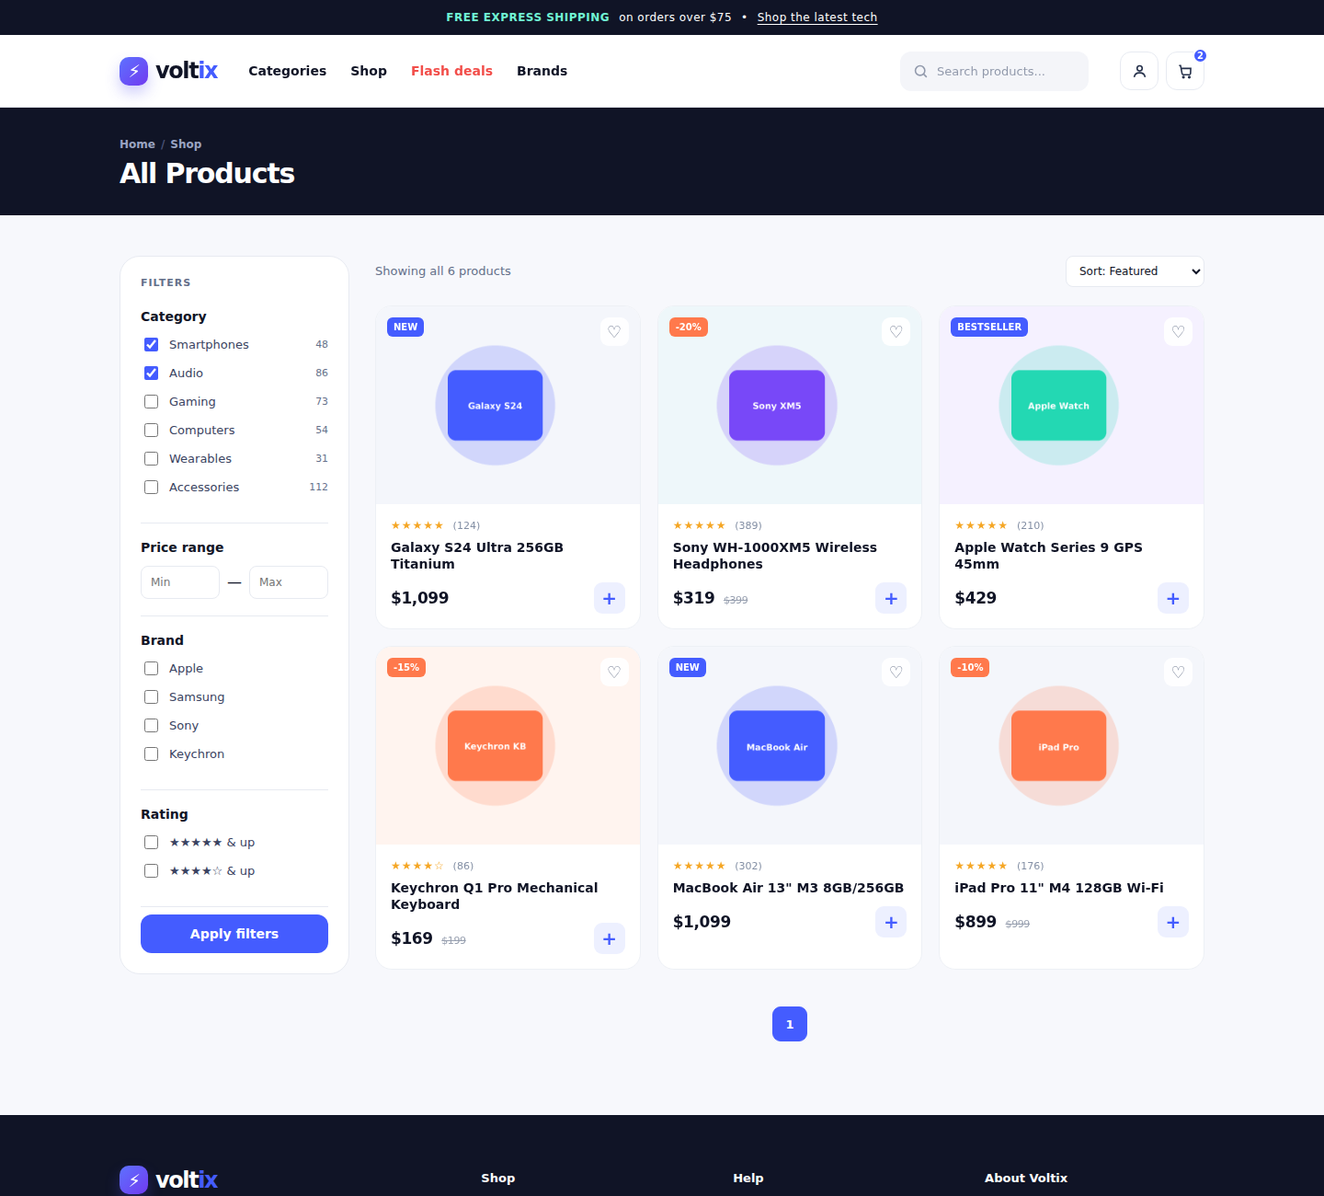
⚡
PAGE WALKTHROUGH
The Shop Page (shop.html)
We kept the catalogue short on purpose: 6 real products, each hardcoded, each linking to its own dedicated detail page instead of one shared placeholder.
The filter sidebar (<aside class="filters">) is a stack of <div class="filter-group"> blocks, each holding real checkboxes and <label>s.
The layout uses CSS Grid: grid-template-columns: 250px 1fr — a fixed sidebar next to a flexible product area.
On mobile, the sidebar collapses into a “Filters” button (next slide) instead of pushing the product grid down the page.
Sidebar filters + a short, deliberate 6-product grid
10

Slide 11
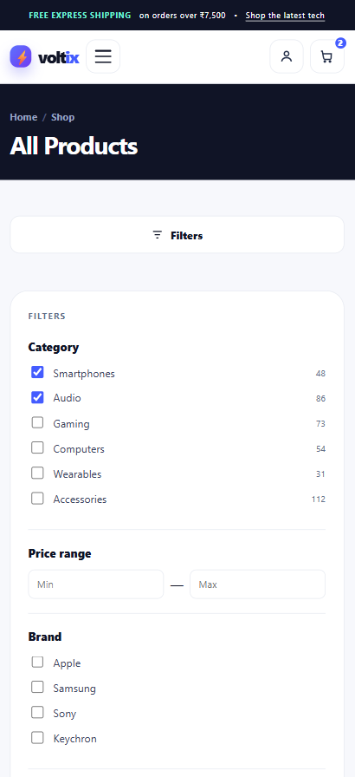
⚡
MOBILE-FIRST RESPONSIVE DESIGN
Filters Become a Button on Mobile
Same checkbox-hack pattern as the nav menu: a hidden checkbox + a “Filters” <label> sit above the filter panel.
By default the panel is display: none on mobile, so the product grid is what visitors see immediately — no scrolling past filters first.
Tapping the button checks the box, and #filters-toggle:checked ~ .filters reveals the full filter panel underneath it.
Desktop is completely unaffected — the filters sidebar still shows permanently, because this rule only applies inside a mobile media query.
shop.html
<input id="filters-toggle" type="checkbox">
<label for="filters-toggle">Filters</label>
<aside class="filters">...</aside>
Collapsed by default, one tap to open
11

Slide 12
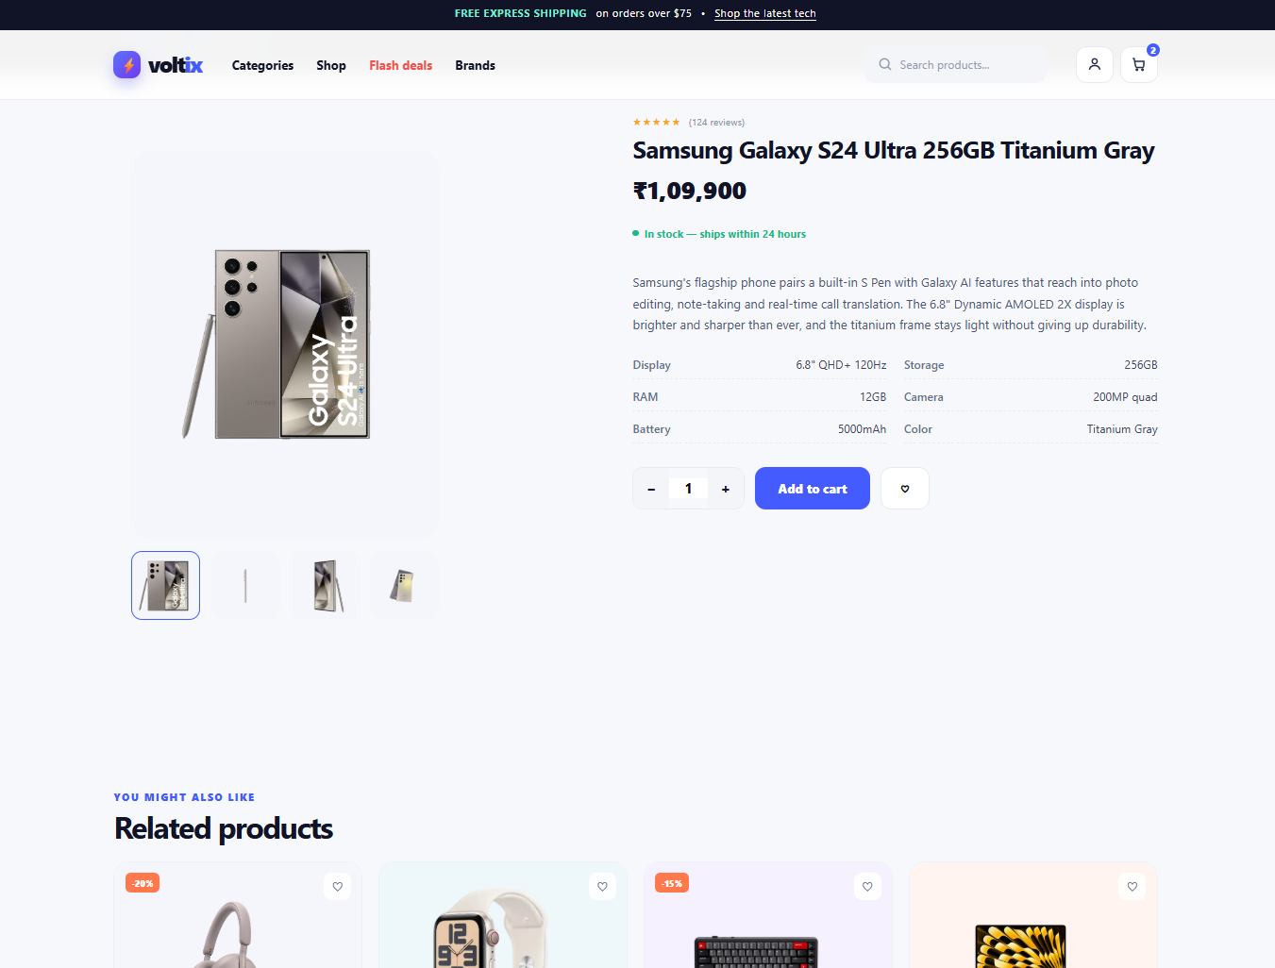
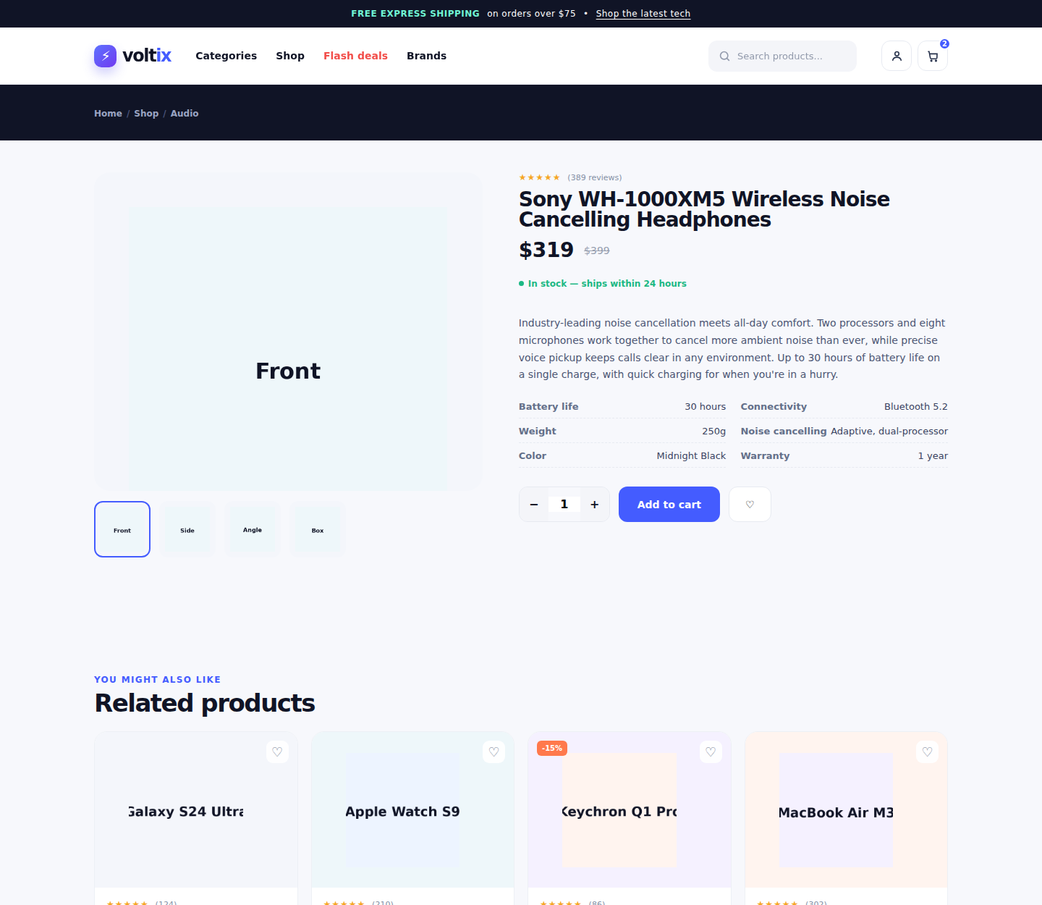
⚡
PAGE WALKTHROUGH
Individual Product Pages
Instead of one generic product.html, every product has its own file (e.g. product-galaxy-s24-ultra.html) with real title, price, description and specs.
Specs are a plain <ul class="pd-specs"> list, each <li> holding a bold label and a value — styled into a two-column grid with CSS.
The “Related products” row at the bottom reuses the same .product card component and cross-links to the other 5 real product pages.
Because each page is a separate file today, this is where an API would plug in later (see Future Plans).
product-sony-wh1000xm5.html — one of six
12

Slide 13
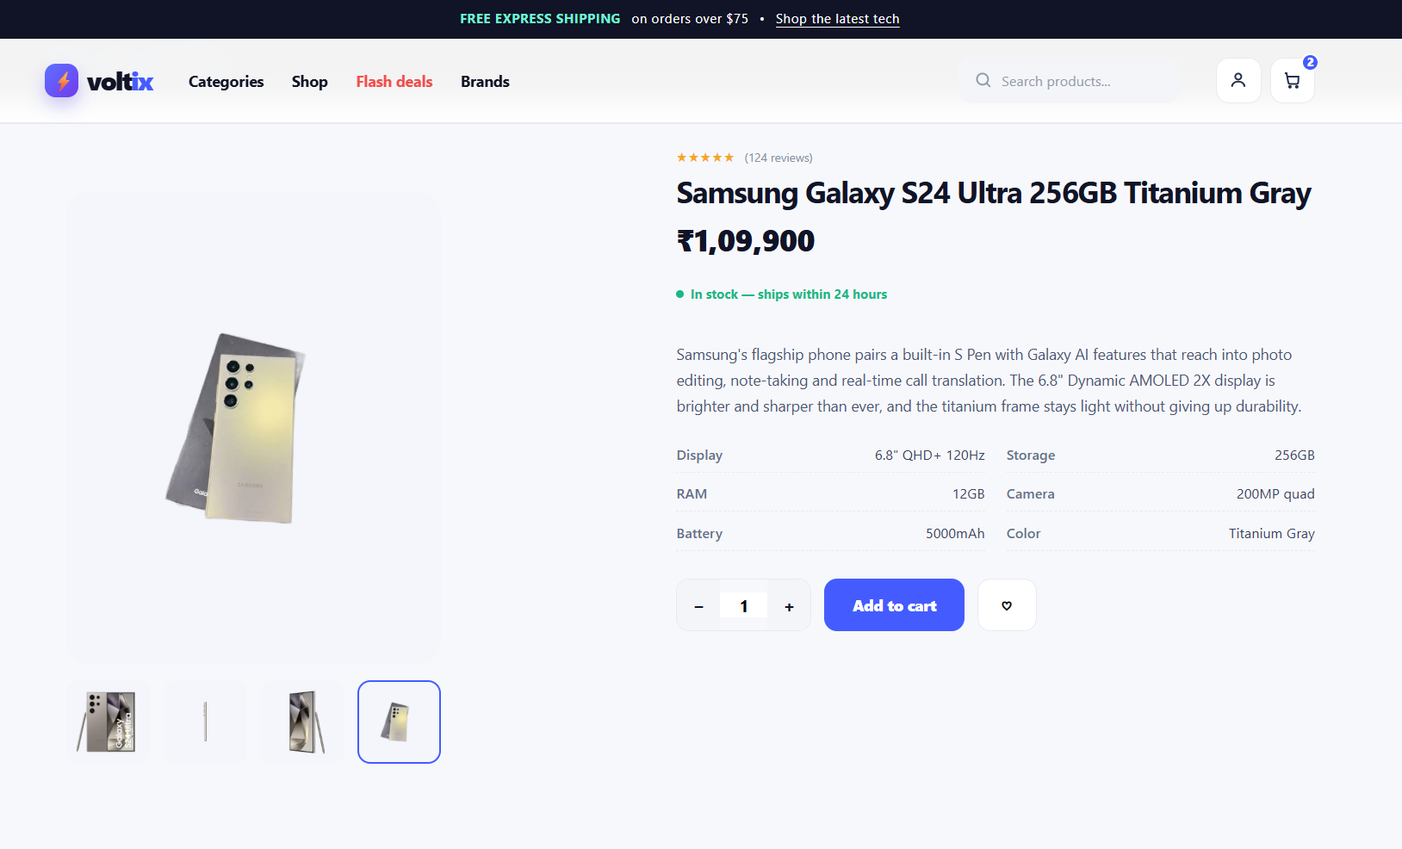
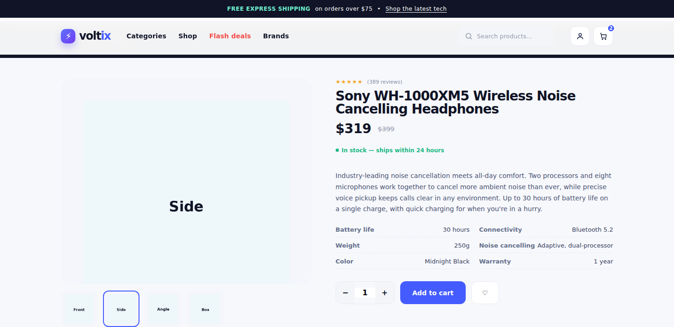
⚡
INTERACTIVITY WITHOUT JAVASCRIPT
Clickable Image Gallery
Four hidden radio inputs (one per photo angle) sit before the gallery in the HTML.
Each thumbnail is a <label for="view-...">, so clicking the photo checks its radio — that's the whole interaction.
CSS then shows only the matching main image with :checked ~ .gallery-main .gv-side { display:block; } and outlines the active thumbnail with a blue border.
style.css
#view-side:checked ~
.gallery-main .gv-side,
#view-side:checked ~
.thumbs label[for=view-side] {
display: block;
border-color: var(--blue);
}
“Side” thumbnail selected — note the blue active border
13

Slide 14
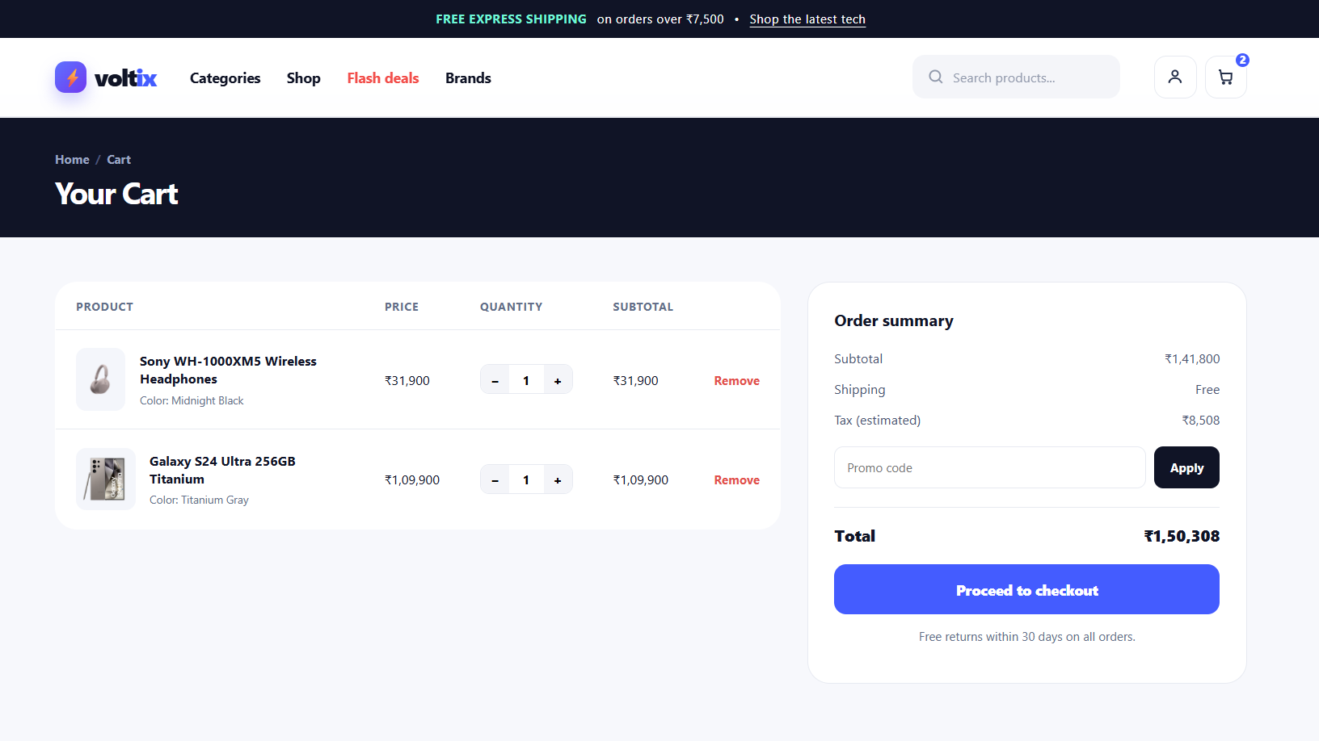
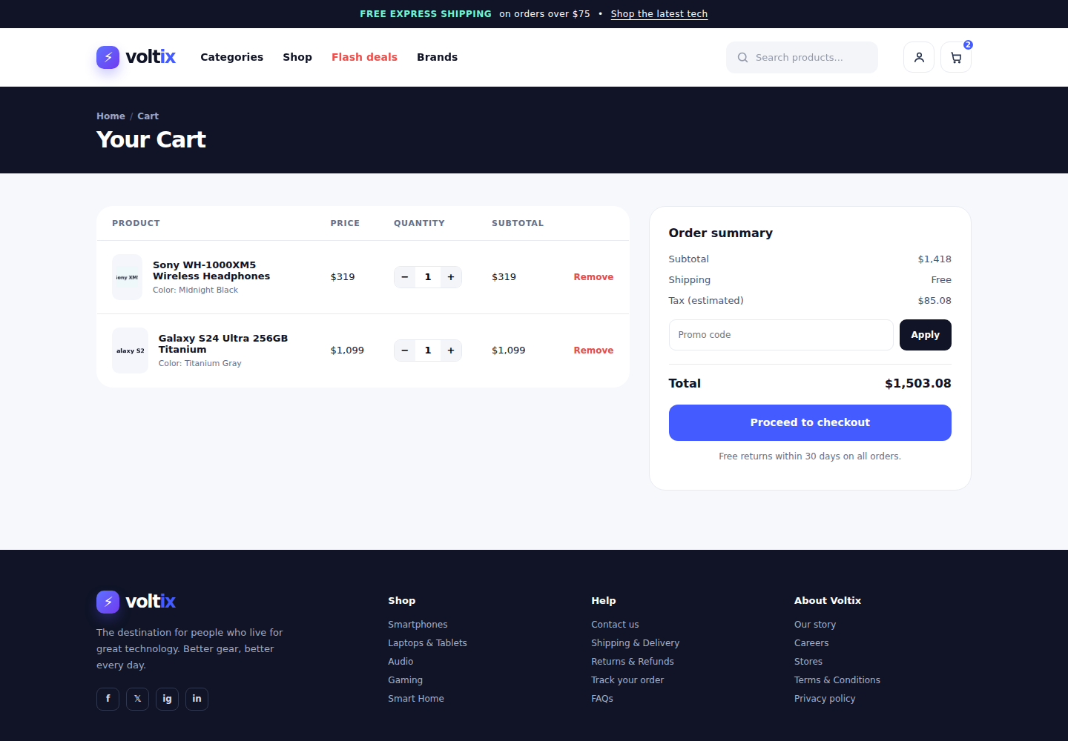
⚡
PAGE WALKTHROUGH
The Shopping Cart & <table>
The cart items are a genuine HTML <table>: <thead> holds the column headers (Product, Price, Quantity, Subtotal), <tbody> holds one <tr> per item.
This is deliberate — tabular, row-and-column data like a cart belongs in a <table>, not in styled <div>s, for both semantics and accessibility.
The order summary beside it is a separate card (<aside class="cart-summary">) with flex rows for Subtotal / Shipping / Tax / Total.
Quantity steppers use plain <button> + <input> pairs, ready to be wired to real logic once JavaScript is introduced.
cart.html — a real HTML table, styled with CSS
14

Slide 15
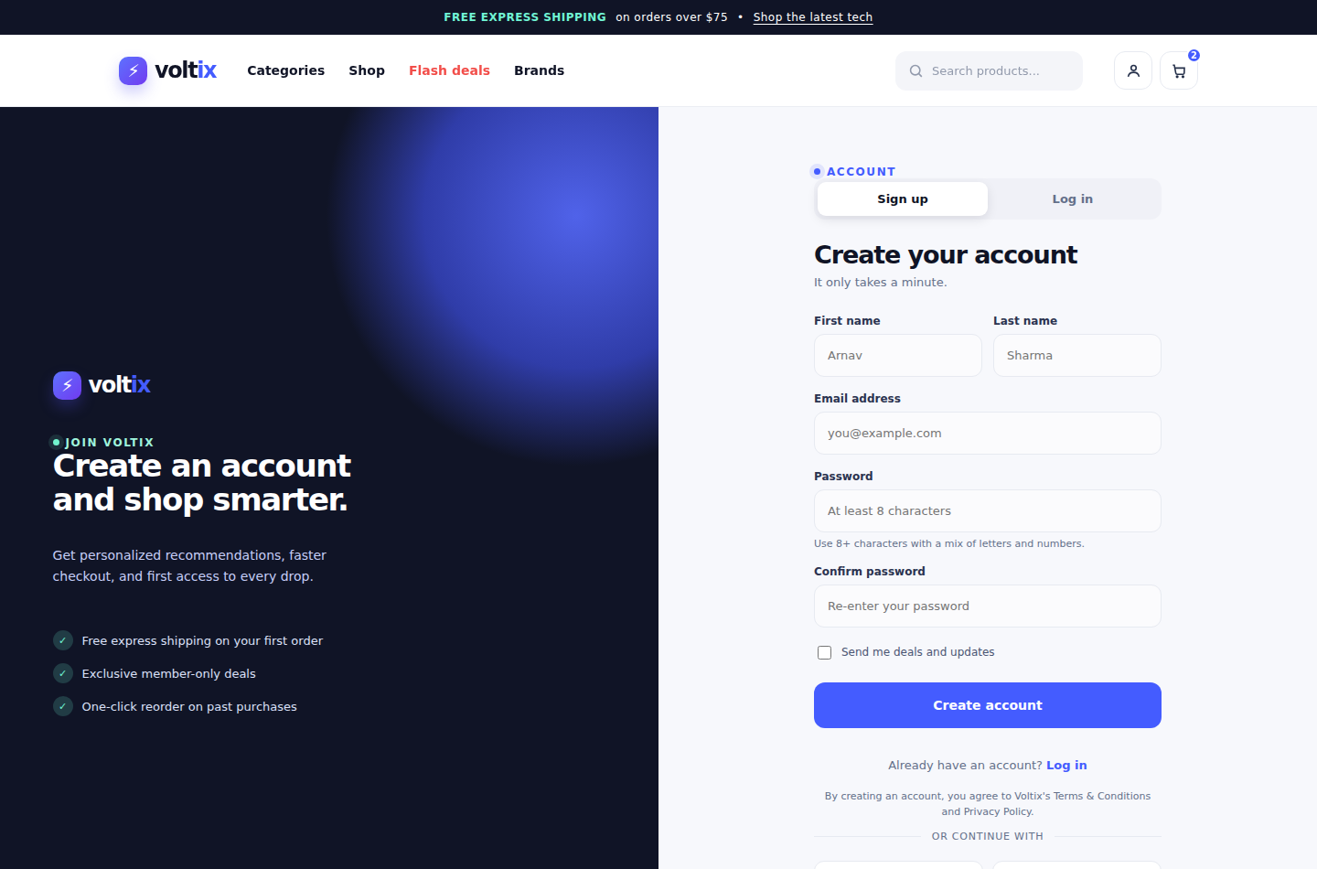
⚡
PAGE WALKTHROUGH
Sign Up ⇄ Log In Toggle
Real HTML forms with proper input types (email, password), required and minlength validation — the browser itself blocks bad input.
The Sign up / Log in switch uses two more hidden radio buttons; whichever is :checked shows its .auth-panel and highlights its tab.
“Already have an account?” is a <label for="auth-tab-login"> styled like a link — clicking it flips the same toggle from inside the other panel.
Forms post to process-signup.php / process-login.php — stubbed action attributes, ready for a real backend (see Future Plans).
One toggle, two real <form>s, zero JavaScript
15

Slide 16
⚡
CONSISTENCY ACROSS PAGES
One Design System, Site-Wide
Ink / Navy
Primary Blue
Mint Accent
Sale / Hot
#101426
#445cff
#23d8b3
#ff794c
Typography: Inter (a modern sans-serif) throughout, bold weights for headings, all driven from one font-family rule on <body>.
Reusable components: .button, .badge, .card / .product, .icon-btn — the same class names and look everywhere they appear.
Rounded corners (22px radius) and soft drop shadows on every card, consistently, via the --radius and --shadow variables.
Icons sit inside small colored circles or rounded squares (trust badges, category icons, the nav's account/cart buttons) — a motif repeated across every page.
16

Slide 17
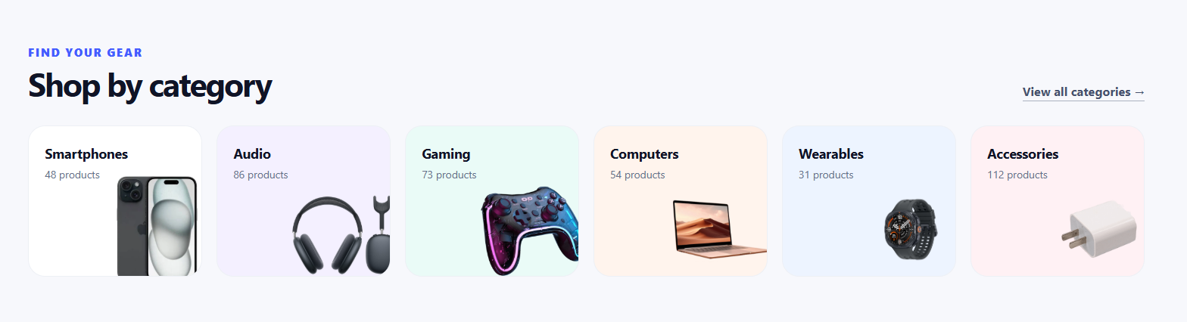
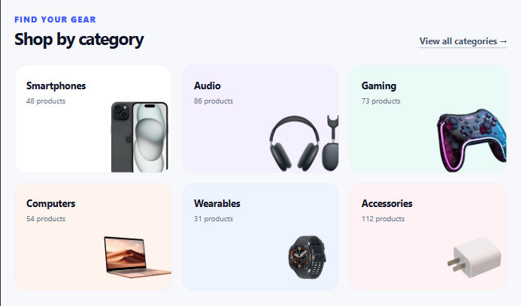
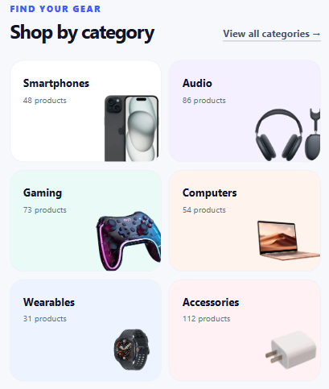
⚡
MOBILE-FIRST RESPONSIVE DESIGN
Three Breakpoints, One Codebase
> 980px
651px – 980px
≤ 650px
Desktop
Tablet
Mobile
4–6 column grids, sidebar filters visible, full nav links shown inline
Grids drop to 2–3 columns, hamburger menu appears, sidebar still visible
1-2 column, filters & menu collapse behind buttons, search bar hidden
@media (max-width: 980px) { ... } @media (max-width: 650px) { ... }
17

Slide 18
⚡
WHAT WE LEARNED
Challenges We Solved with CSS Alone
No JavaScript allowed
Fixed nav + no layout jump
Every toggle (menu, filters, gallery, auth tabs) had to be rebuilt with the checkbox/radio 'hack' instead of onclick handlers.
Taking the header out of normal flow with position: fixed meant carefully matching body padding-top so content never hid underneath.
Flush mobile dropdowns
Keeping 6 pages consistent
Anchoring the mobile menu to top: 100% of the nav (instead of a guessed pixel value) keeps it pixel-perfect at any header height.
One shared style.css and repeated component classes (.product, .btn-primary, .field) kept every page visually identical without a template engine.
18

Slide 19
⚡
WHAT COMES NEXT
Future Plans for Voltix
→
Working filters
→
Live countdown timer
Connect the category, price and brand checkboxes to real JavaScript (or a backend query) that actually narrows the product grid.
Replace the static 08:34:51 flash-deal clock with a real JS countdown that ticks down to a live deadline.
→
Products via an API
→
Real login & signup
Swap hardcoded product HTML for data fetched from a REST API / database — add, edit or remove products without touching markup.
Wire the existing forms to a PHP/MySQL (or Node) backend for real authentication, sessions and password hashing.
→
Persistent, working cart
→
Search & checkout flow
A real cart stored in a database or localStorage — quantities, totals and “Remove” actually updating the page.
A functional search bar and a full checkout process with payment gateway integration.
19

Slide 20
⚡
voltix
Thank You!
Arnav Sharma (2510992821) • Amarinder Singh (2510993775) • Yashkaran Sekhon (2510993712)
20

