Slide 1
CodeGladiators - Ecommerce
TechGig 2018
Team : Data_Insights

Slide 2
What’s new in this version?
Added code to parse the given xml file and convert it into a csv file
Video enclosed
Incorporating Machine Learning Techniques - Kmeans clustering, Latent Dirichlet allocation (Topic Modeling)
Included list of packages used in the project
Included how to run file and slide

Slide 3
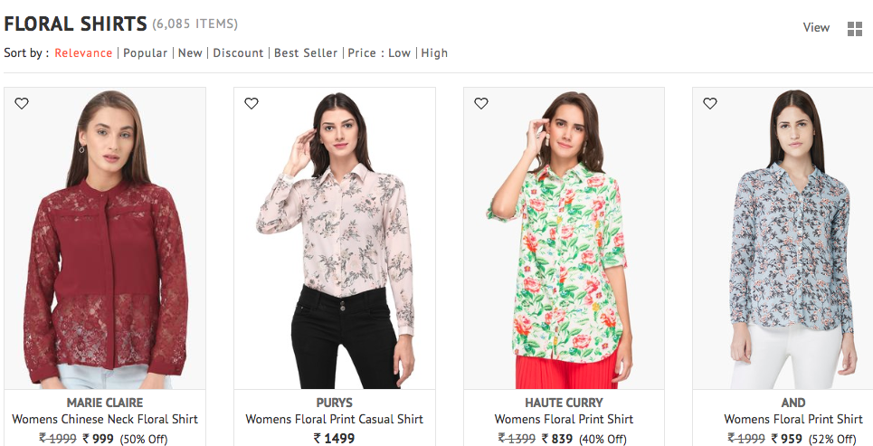
Use Case
Retrieval of effective and intelligent search results corresponding to a query text.
Ex: Query is “Floral shirts”

Slide 4
Problem Statement
From a list of given items, a context driven semantic search algorithm has to be designed for retrieving effective products.
Deliverables:
i) User Interface : text box with a Go button
ii) Functionality : NLP/ML driven semantic search algorithm

Slide 5
Tools & Technologies
UI: HTML
Backend: Python 3.6
API: Flask
Packages: bs4, pandas, re, gc, difflib, warnings, gensim, numpy

Slide 6
How to run the code?
Install packages bs4, pandas, re, gc, difflib, warnings, gensim, numpy
Use code converting_xml_to_csv.py to convert given xml to csv file
Use using_ml_for_text_clustering_topic_modeling.py to generate features using machine learning
Change paths according to the generated data file in tg_cg18_ecomm_final.py
To run the python file from terminal write:
python tg_cg18_ecomm_final.py
In browser type http://0.0.0.0:5000/
Enter search query in the text field and press GO

Slide 7
Exploring the dataset
Each item has the following fields:
Item_id
Group_id
Title
Link
Description
google_product_category
L2_category
Product_type
Image_link
condition
Size
Color
Availability
Price
Brand
Shipping
Sale_price
Total_discount
Material
Adult
Custom_label_ 3 , 2 ,4
And may be some others like gtin

Slide 8
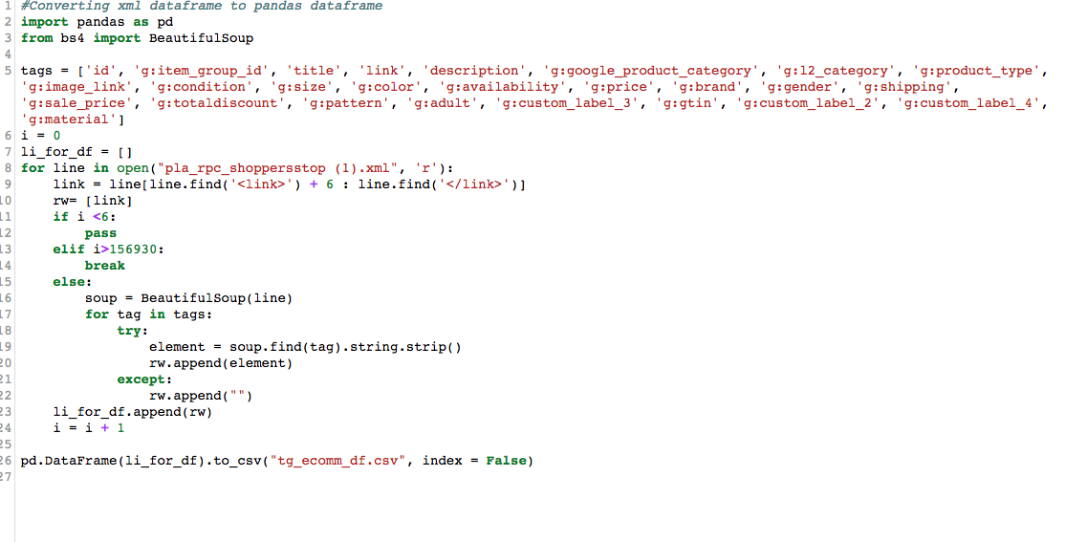
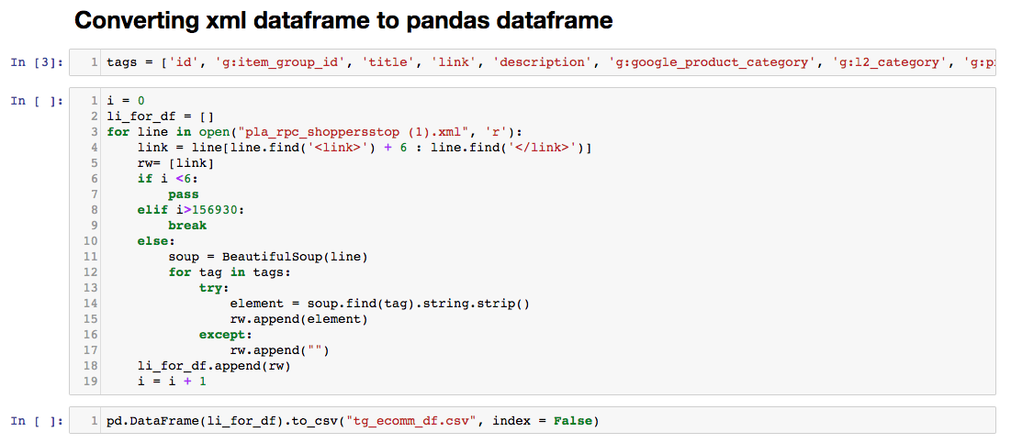
Converting xml data to csv format

Slide 9
Methodology - Description
Intelligent parsing of input text
Defining matrices for relevancy
Ranking results corresponding to the relevancy criteria
Designing an error function & minimizing it [The ranks of the products retrieved also needs to be considered]. Presently, this is not being done due to the absence of such dataset.

Slide 10
Methodology - Pictorial View
Reducing error
Ranking results corresponding to the relevancy criteria
Input Text
Error evaluate
Intelligent parsing using NLP/ML

Slide 11
Methodology - Detailed
Parsing techniques : Occurrence, Longest common subsequence matching with a previous dictionary, using word tokenizer
Ranking criteria : Computation of similarity score of products followed by Hard matching & Soft/Fuzzy matching [like document clustering, topic modeling LDA etc.]
Evaluation / Error Matrix: F1 score [Presently no test dataset is given to do this]

Slide 12
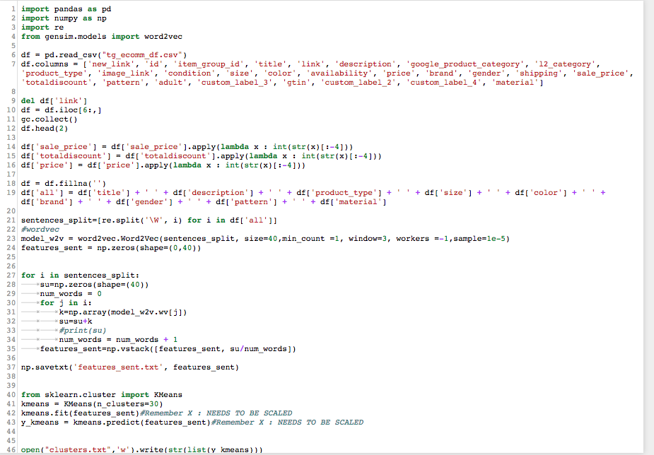
Generating feature : cluster number using K-means clustering on vectors of text

Slide 13
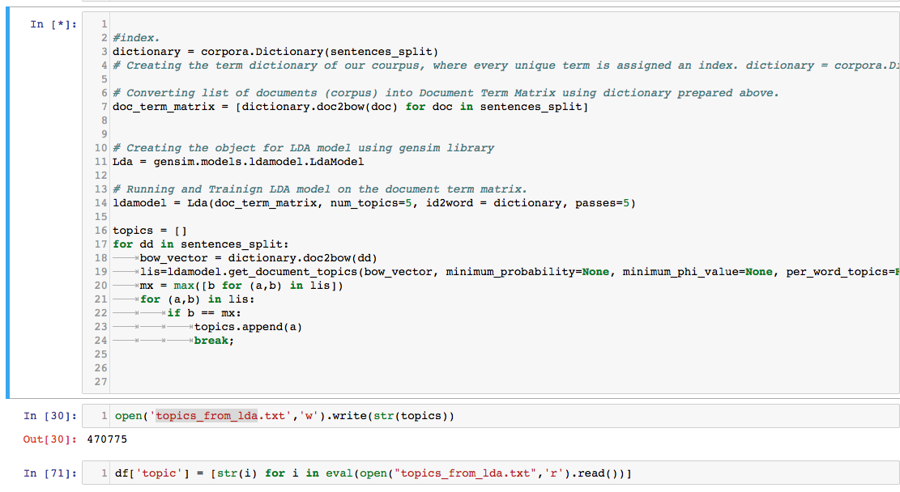
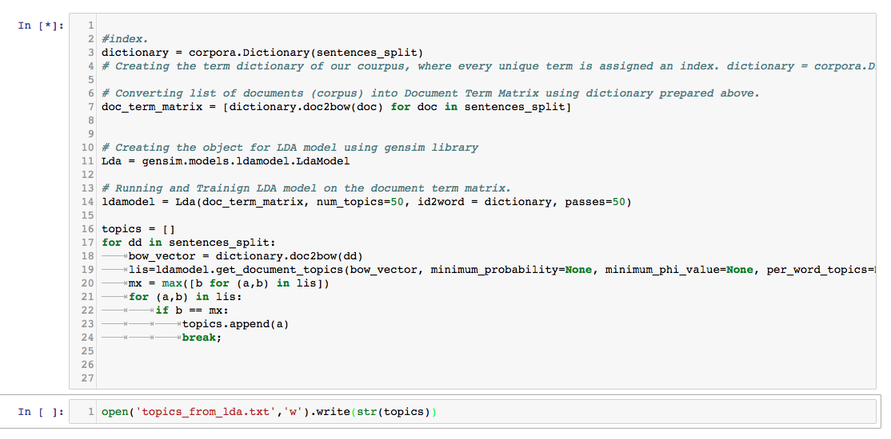
Generating feature : topics using LDA

Slide 14
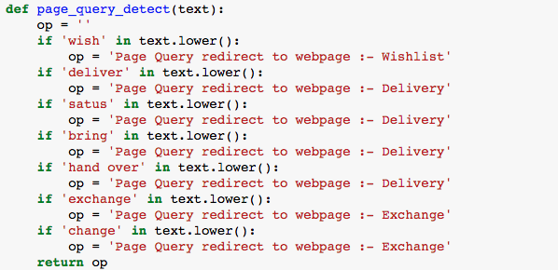
Parsing function to detect if query has to be redirected to another page

Slide 15
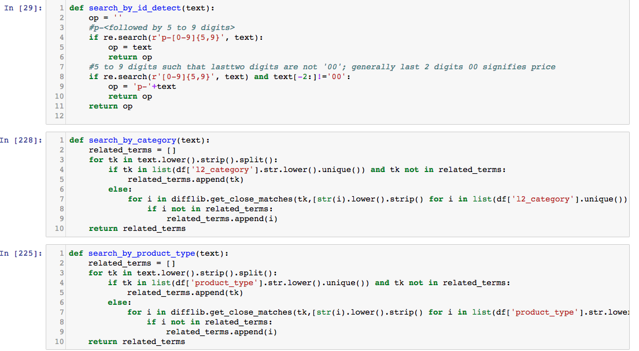
Parsing function to detect if query is done by is, category or product type

Slide 16
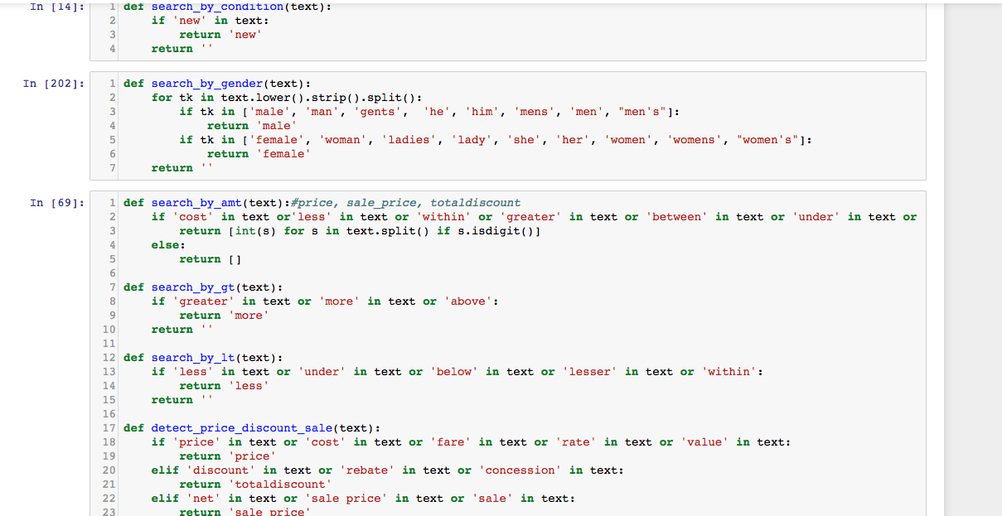
Parsing function to detect if query is done by condition, gender or amount

Slide 17
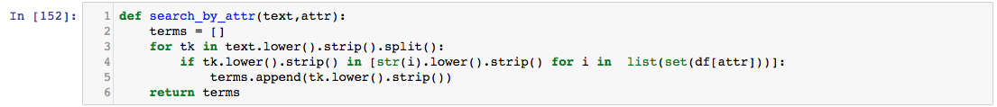
Parsing function to detect if query is done by attributes like ‘size’, ‘color’, ‘brand’ etc.

Slide 18
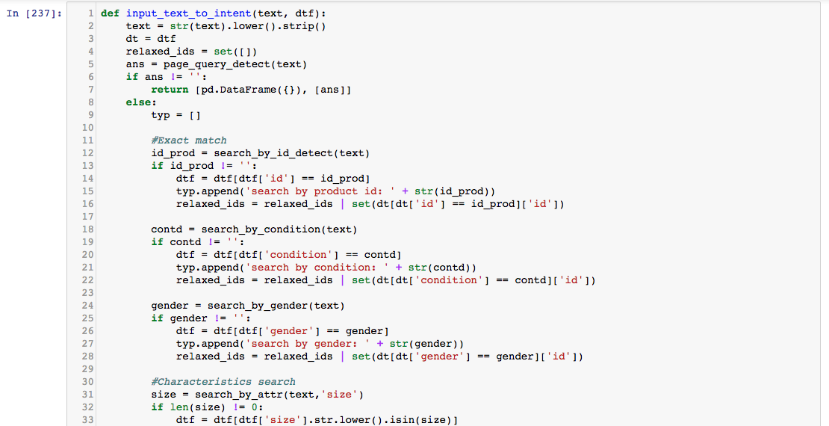
Input text to Intent Detection & Matching Function - 1

Slide 19
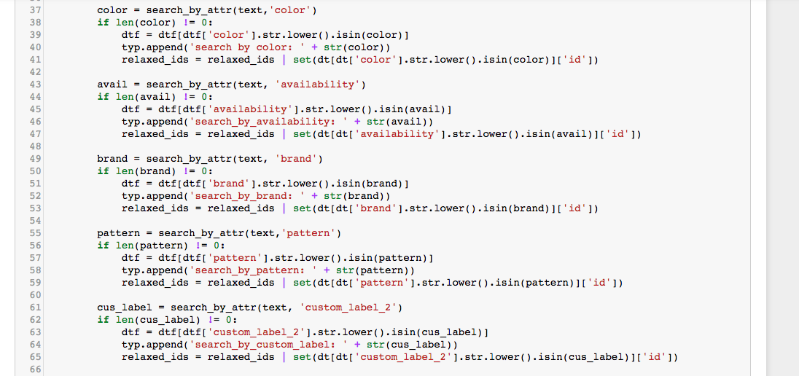
Input text to Intent Detection & Matching Function - 2

Slide 20
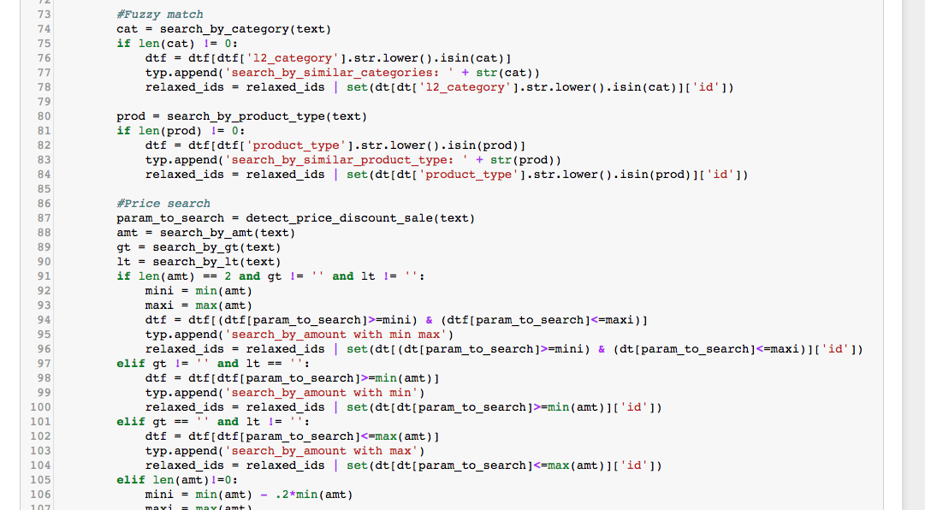
Input text to Intent Detection & Matching Function - 3

Slide 21
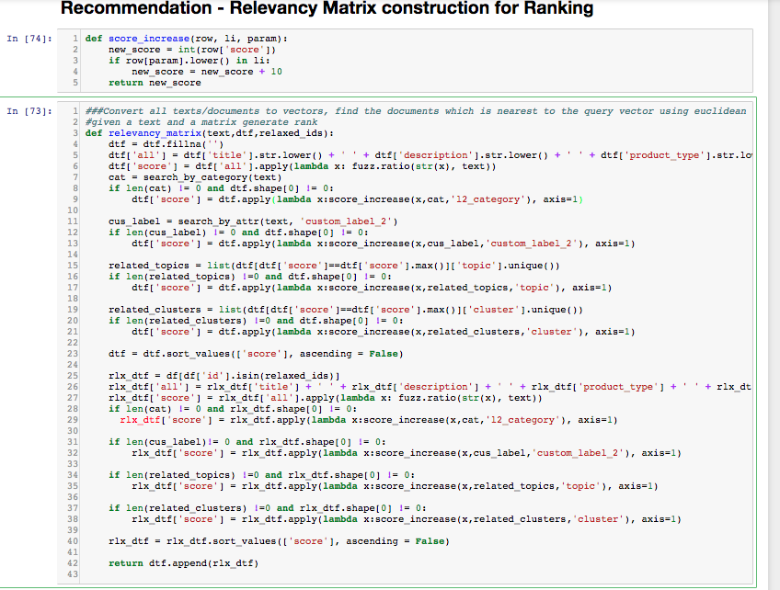
Relevancy Matrix

Slide 22
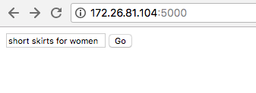
Sample UI : Input

Slide 23
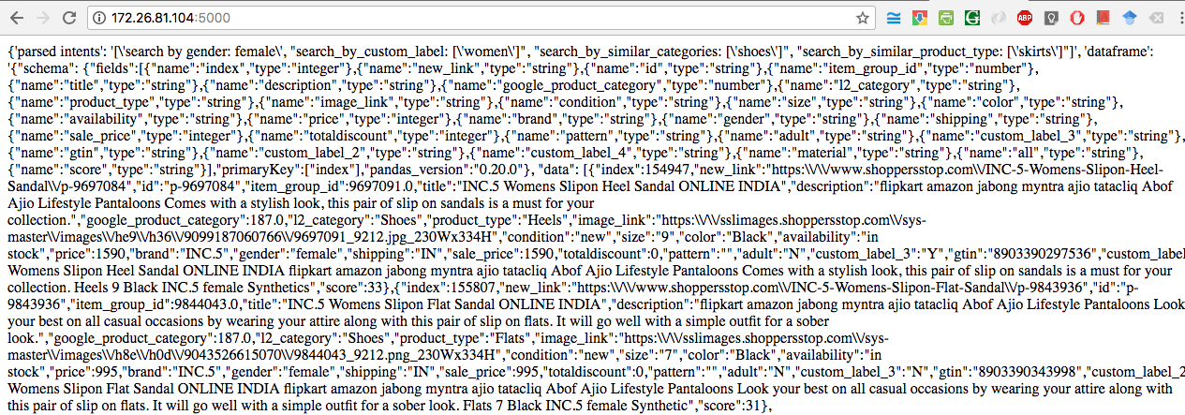
Sample UI : Output

Slide 24
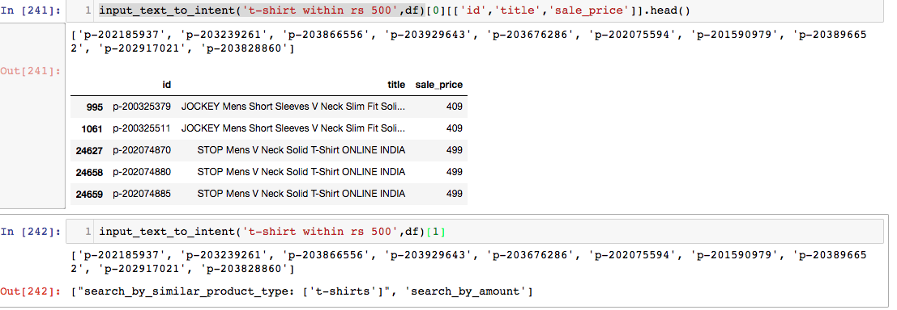
Sample output for query : ‘t-shirt within rs 500’

Slide 25
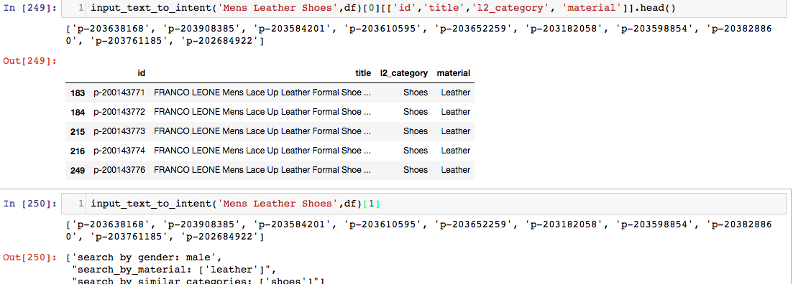
Sample output for query : ‘Mens Leather shoes’

Slide 26
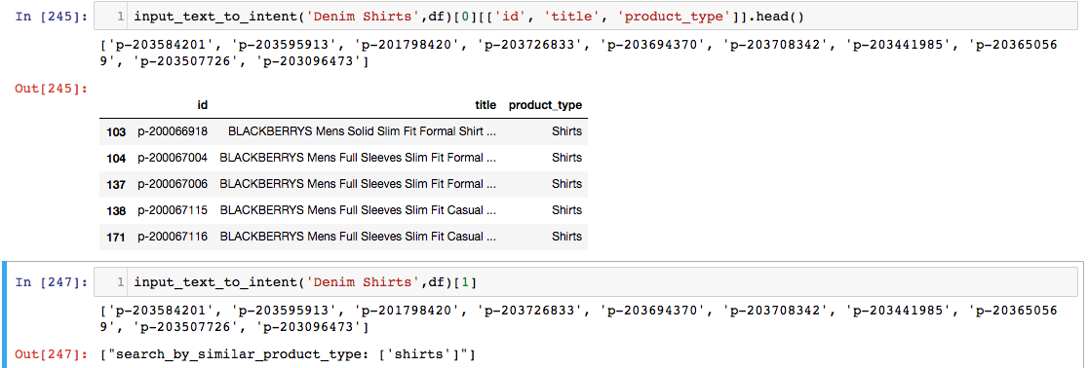
Sample output for query ‘Denim Shirts’

Slide 27
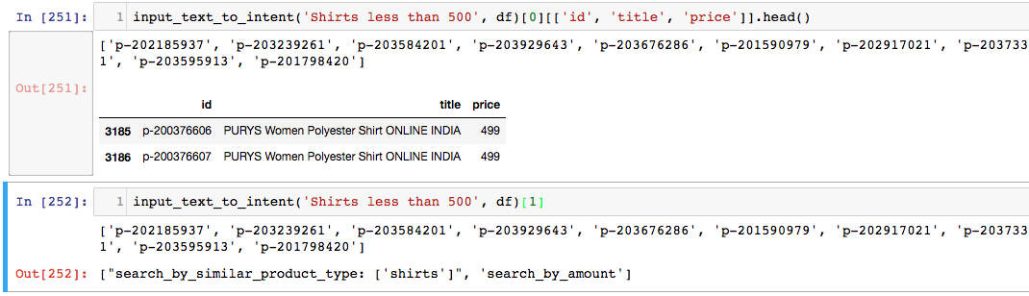
Sample query: Shirts less than 500

Slide 28

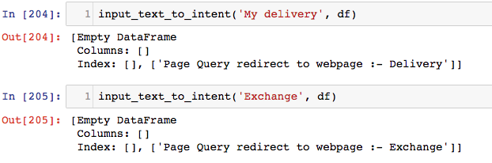
Sample output for queries: ‘my wishlist’, ‘my delivery’, ‘exchange’

Slide 29
Challenges Faced
Absence of training & test data has made it inconvenient to calculate the relevancy of the search results
Preparing sample queries
Images are missing from the dataset thus features from images could not be extracted

Slide 30
Uniqueness of the solution - Why should this solution be chosen for the final round
Used the whole XML file (size 200 MB) instead of sample xlsx size (size 5MB)
Codes are production ready
Intelligent parsing which captures human intent
Smart relevance criteria based on machine learning algorithms used for ranking results
Used Machine Learning based features generated using k-means clustering and Latent Dirichlet Allocation (Topic Modeling)

Slide 31
Future Works & Possible Improvements
Improvements in Tokenization: k-gram indexes, other intelligent tokenizers for detecting bi-grams, tri-grams etc.
Introducing spelling corrections, synonyms, stemming and lemmatization
Preparing separate training and test set. Measuring error corresponding to the sample queries.
Including features of images prepared by Convoluted Neural Networks while calculating relevance
Improving relevance criteria for minimizing the error
Missing values imputations
Manually grouping similar patterns, materials and categories together
Dealing with cold start problem for unknown products
Google product category will also be taken into account while calculating the final score
Using elastic search / solr search to improve the throughput

Slide 32
Thank You

