Slide 1
CodeGladiators - BigData
TechGig 2018
Team : Data_Insights

Slide 2
What’s new in this version?
Added code to parse json file and convert it into a csv file
Added code to write the data frame into a hive table
Connected hive with Tableau to visualize how average sentiments & subjectivity are varying with days

Slide 3

From comments made by users in Reddit (a social bookmarking website) during February 2018, we have done the following :-
Exploratory Data Analysis
Variation of average score with time
Sentiment Analysis and its’ variation with time
Subjectivity Analysis and its’ variation with time
Sample Comments Data:
{"author":"YouthfulPhotographer","author_flair_css_class":null,"author_flair_text":null,"body":"Welcome to generation void ","can_gi
ld":true,"controversiality":0,"created_utc":1517443200,"distinguished":null,"edited":false,"gilded":0,"id":"dtjoj2e","is_submitter":
false,"link_id":"t3_7uaobc","parent_id":"t1_dtj8323","permalink":"/r/tumblr/comments/7uaobc/nihilism_across_generations/dtjoj2e/","r
etrieved_on":1518478113,"score":7,"stickied":false,"subreddit":"tumblr","subreddit_id":"t5_2r7hk","subreddit_type":"public"}
{"author":"fiorescuro","author_flair_css_class":null,"author_flair_text":null,"body":"I'm sorry that happened to you, I had a simila
r thing happen to me and it worked out okay. I went to a first aid class with the rest of my uni cohort and fainted after doing CPR
(I was doing a fitness challenge at the time and probably hadn't eaten/drunken enough that day, so my own fault really). I was out f
or maybe 10 seconds at most, and when I came to my classmates were all super concerned. One guy gave me his sandwich, another went t
o buy me some Powerade and bananas. I went home, then the next time I went to class a couple of friends asked me if I was okay and t
hat was it. Never brought up again, I wasn't the focus of attention at all. It was just a couple of friends checking up on me, as if
I'd just had the flu or something. \n\nAnd I also kinda dealt with it through humour, which is kinda my go-to. For example, I had t
o do a speech later that year to the same class and I made a joke about how I never could've been a doctor because I couldn't even g
et through a first aid class without fainting. I still use that all the time when people ask me why I chose my career (biomed engine
ering). Being able to laugh with people about something frightening or bad can really help you to realise it's no big deal, but I al
so get it if that wouldn't work for you - it's just an idea!","can_gild":true,"controversiality":0,"created_utc":1517443200,"disting
uished":null,"edited":false,"gilded":0,"id":"dtjoj2t","is_submitter":false,"link_id":"t3_7ubw4j","parent_id":"t3_7ubw4j","permalink"
:"/r/Anxiety/comments/7ubw4j/just_fainted_while_presenting_in_class/dtjoj2t/","retrieved_on":1518478113,"score":2,"stickied":false,"
subreddit":"Anxiety","subreddit_id":"t5_2qmij","subreddit_type":"public"}
Problem being solved
Data Source: http://files.pushshift.io/reddit/comments/

Slide 4
Data Sources
Reddit comments data : http://files.pushshift.io/reddit/comments/RC_2018-02.xz
For sentiment analysis : https://cs.stanford.edu/people/alecmgo/trainingandtestdata.zip

Slide 5
While converting of unstructured json file to structured data-frame we keep the following columns:
Author
Body
Created_utc
Controversiality
Edited
Author_flair_css_class
Author_flair_text
Link_id
Parent_id
Score
Unstructured to structured data conversion

Slide 6
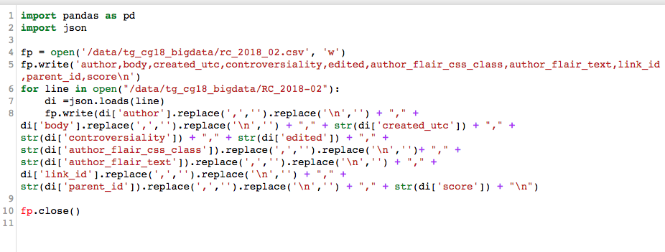
Code to convert json to csv

Slide 7




Solution approach and architecture
Sentiment Analysis
Comments data
Exploratory Data
Analysis
Transforming unstructured to structured data
And many others

Slide 8
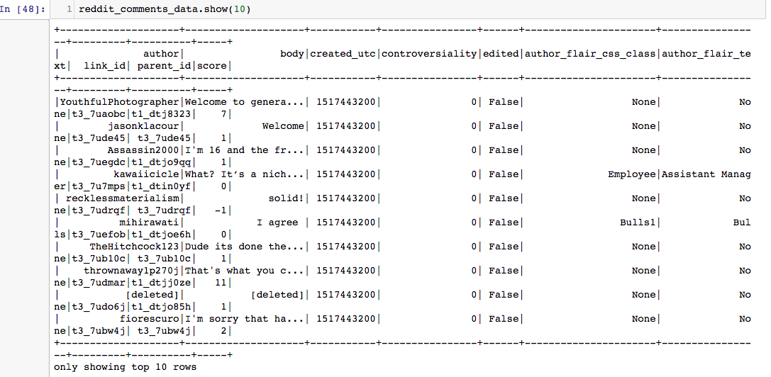
Sample Data loaded in Hadoop

Slide 9
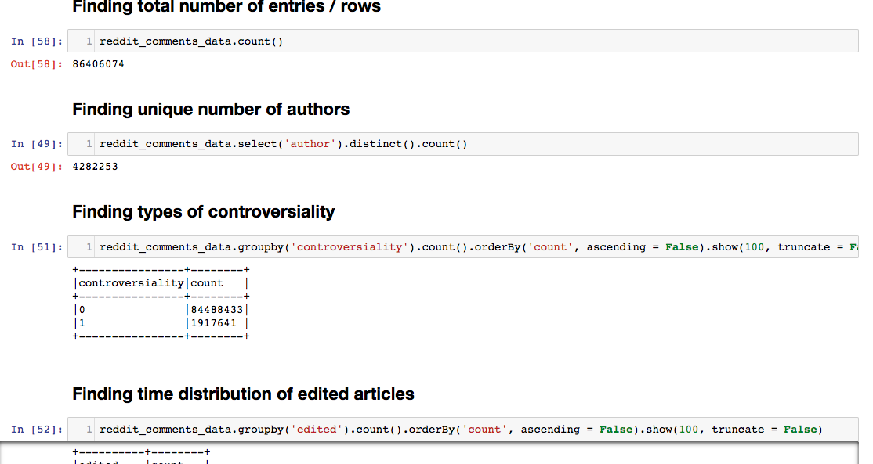
EDA - 1

Slide 10
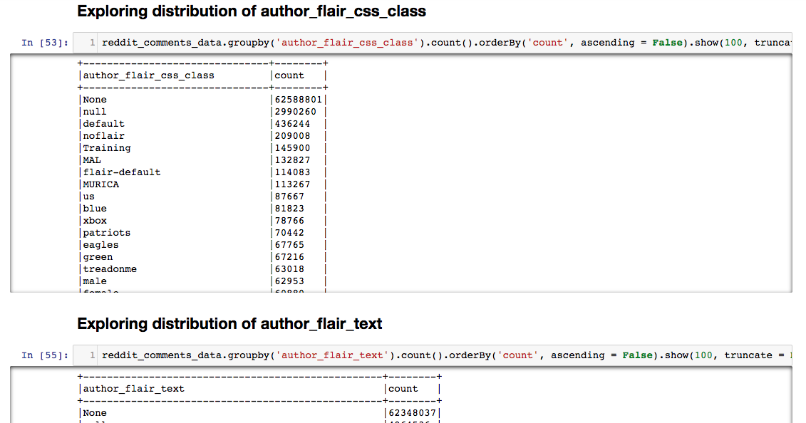
EDA - 2

Slide 11
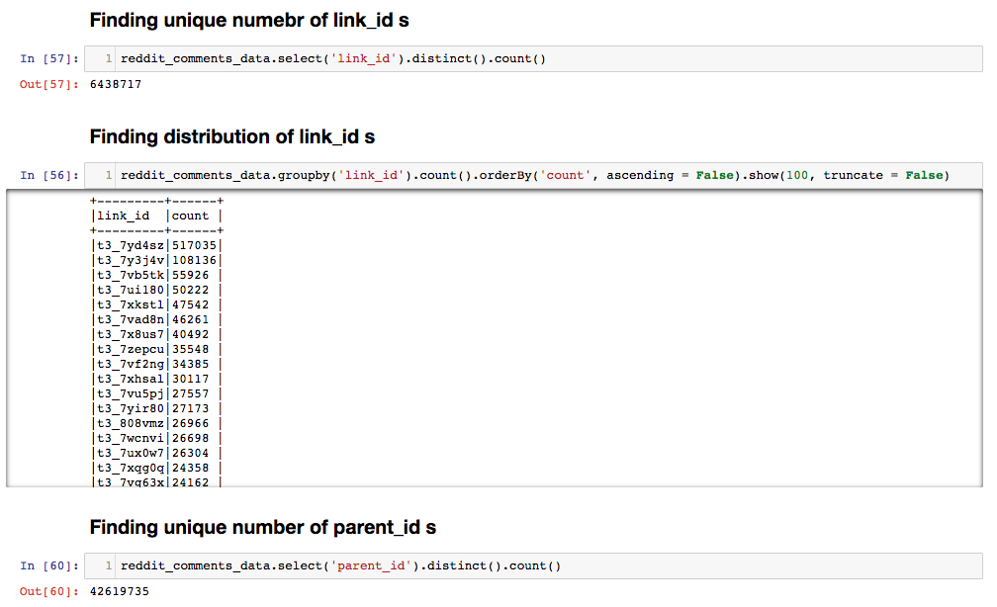
EDA - 3

Slide 12
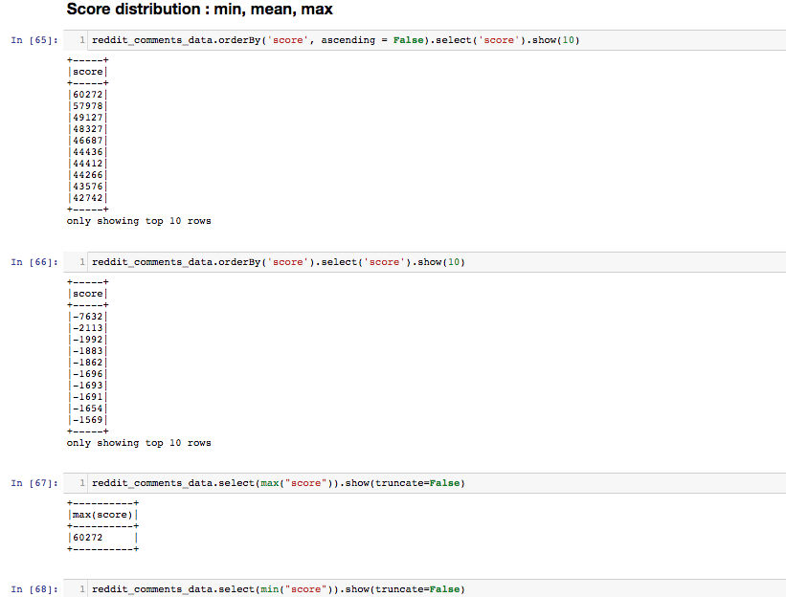
EDA - 4

Slide 13
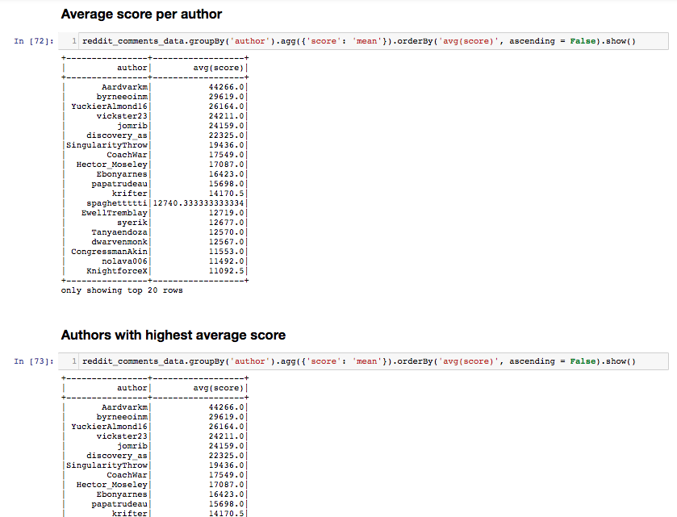
EDA - 5

Slide 14
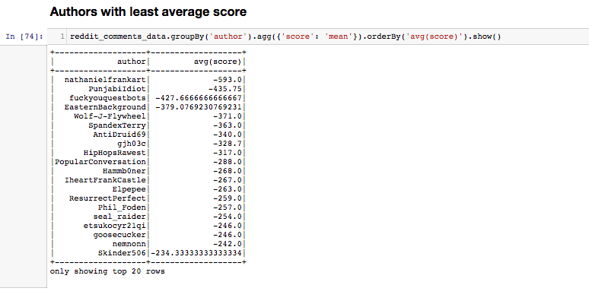
EDA - 6

Slide 15
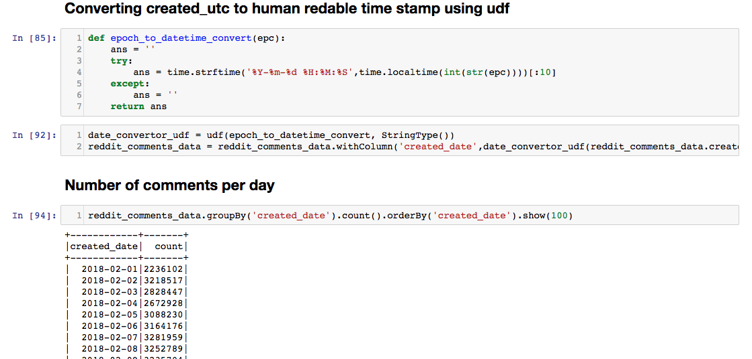
Converting date to human readable format

Slide 16
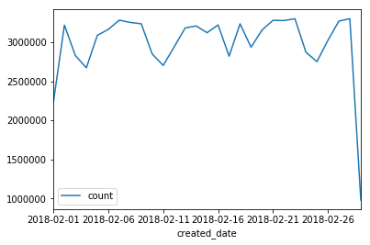
Variation of average score with date

Slide 17
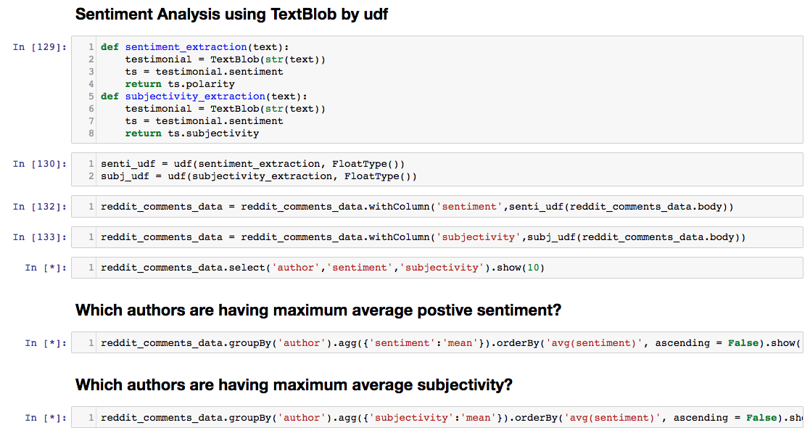
Sentiment & Subjectivity Analysis

Slide 18
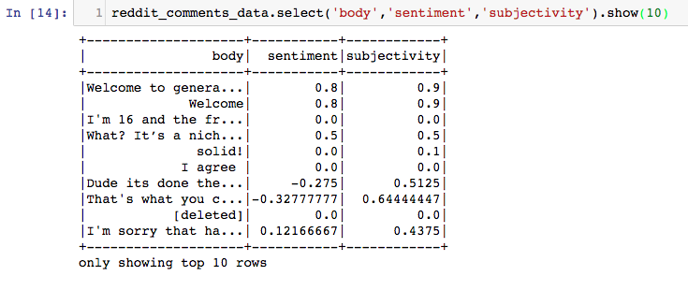
Sentiment & Subjectivity Analysis

Slide 19
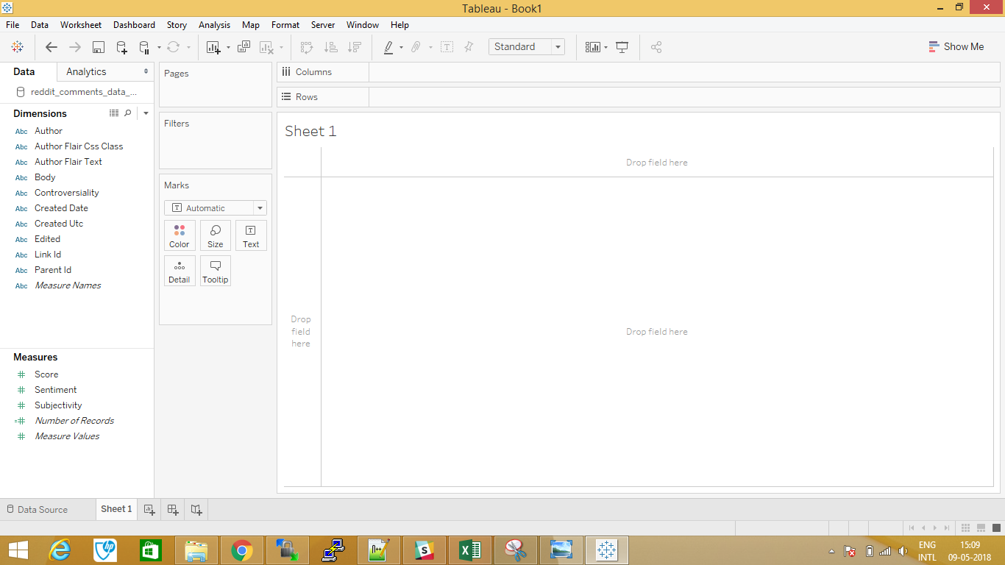
Connecting Hive to Tableau

Slide 20
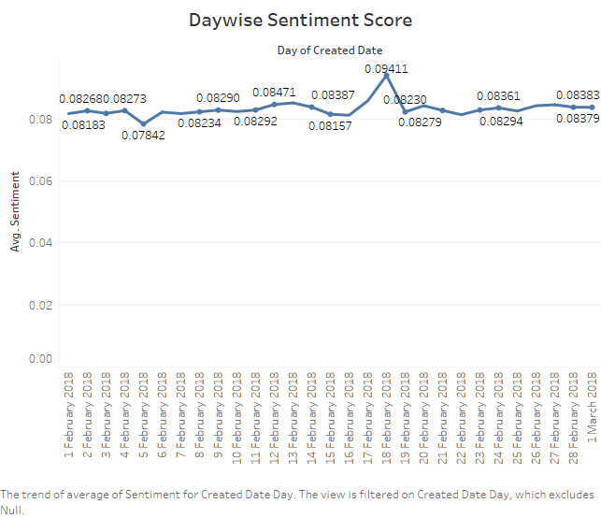
Variation of sentiment with date (Data stored in Hive is being displayed using Tableau)

Slide 21
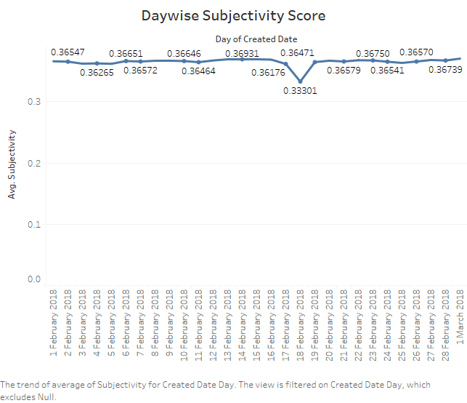
Variation of subjectivity with date (Data stored in Hive is being displayed using Tableau)

Slide 22
Hadoop (version 2.8.3) : for storing and processing comments and submissions data
Spark (version 2.3.0) : for analyzing data stored in Hadoop
Python (version 3.6) : Combined with spark
Technology/Tool/Cloud Stack

Slide 23
Hadoop Cluster with Spark : 1 Master Node, 1 Salve node
Number of cores : 16
Total memory : 128 GB
Hardware specifications

Slide 24
Sentiment analysis by training custom classifier
Popular author detection
Popular link detection
Exploring the author - author graph in detail
Future works

Slide 25


