Slide 1

Notes:
Welcome to ALongTable. I will lead with the numbers. In Seattle alone, empty off peak tables cost restaurants $667,680 a month. That is the problem in one figure, and the next slides put the math behind it, then show how much of that loss can be saved. After the numbers, I will show the pain on each side, the owner, the organizer, and the guest, because those stories explain why the numbers happen. Then I will show the one platform that solves it.

Slide 2
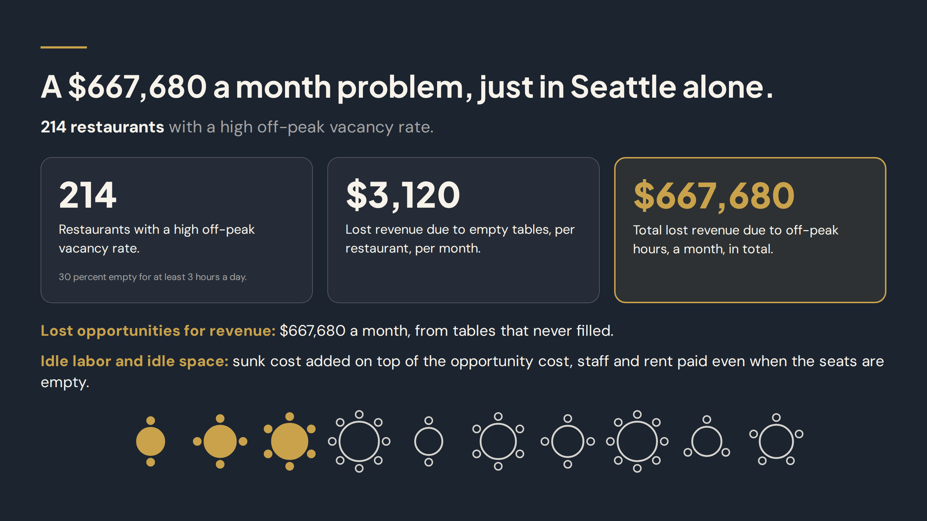
Notes:
$667,680 a month. This is a problem, just in Seattle alone. We count 214 restaurants with a high off peak vacancy rate, each losing $3,120 a month, which gives the $667,680 total. These places are 30 percent empty for at least 3 hours a day. The round table icons on this slide, 3 gold taken and 7 outline empty, show what that loss looks like. And that total is only lost cover revenue. Idle labor and idle space sit on top of it as sunk cost.

Slide 3
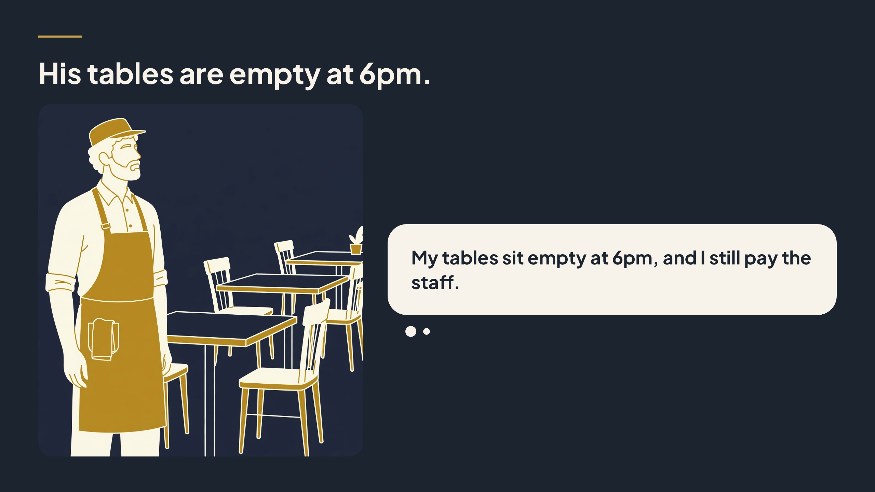
Notes:
Those numbers happen for a simple reason, and it starts with the owner. Start with the restaurant owner. His tables are empty at 6pm, early in the evening, when the room should be earning. The cost does not pause. He still pays staff to stand by, and he still pays for the space, whether anyone sits down or not. An empty seat at 6pm cannot be saved and sold later. That lost hour is gone, and on thin margins, those quiet hours add up fast every single week.

Slide 4
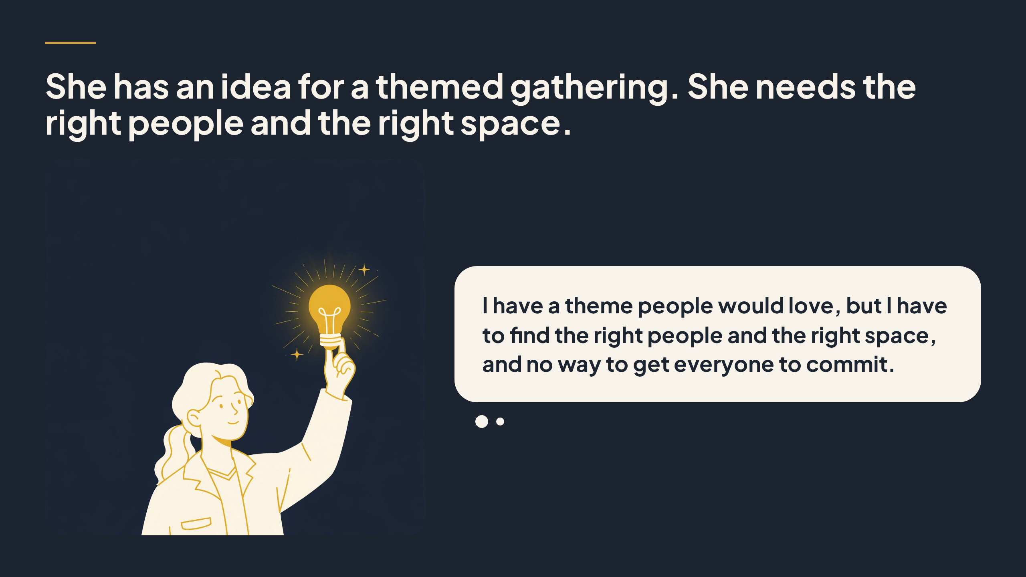
Notes:
Now meet the organizer. She has an idea for a themed gathering, something people would enjoy and want to join. What she does not have is an easy way forward. She needs the right people, people who share that interest, and she needs the right space, a place that feels good and fits the group. Finding both at the same time, and getting people to commit, is the hard part that stops good ideas from ever happening.

Slide 5
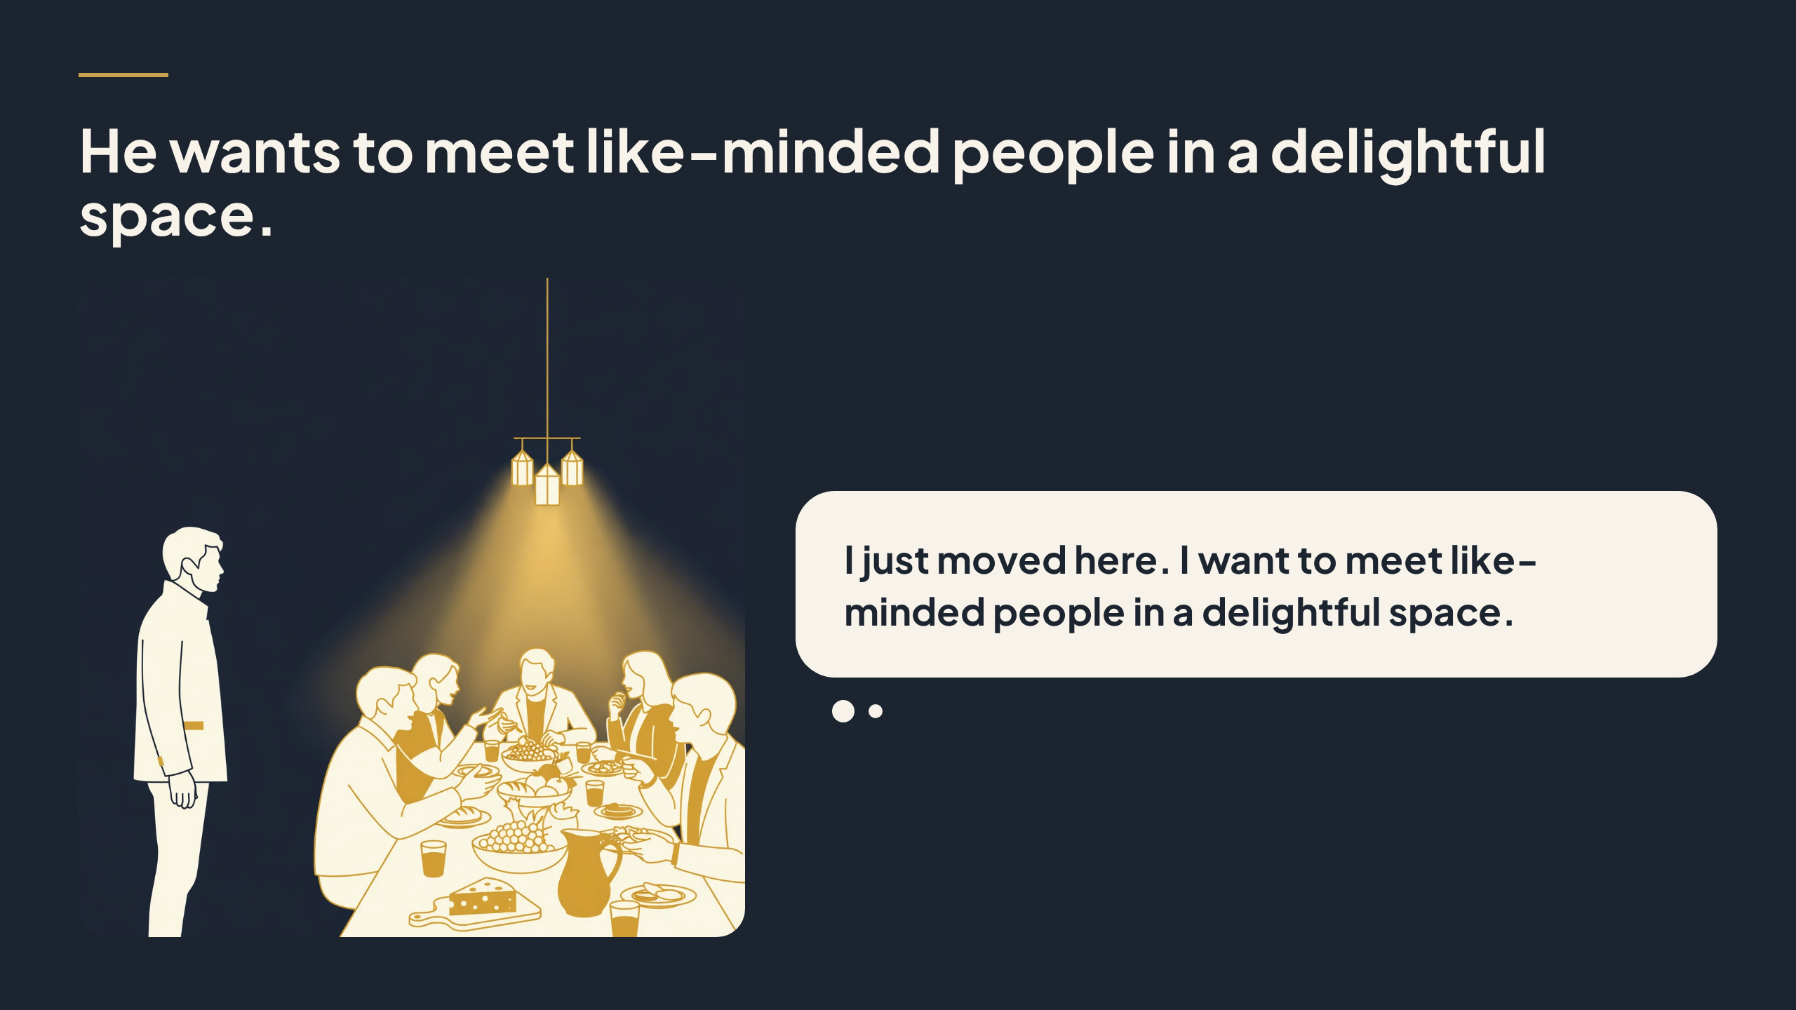
Notes:
Then there is the guest. He wants to meet like-minded people, people who share his interests, and he wants to do it in a delightful space, not through another cold approach or another night alone. A clear theme helps. It gives him a reason to show up, something to talk about, and a table where everyone chose to be there for the same reason. That makes meeting people feel natural, not forced.

Slide 6
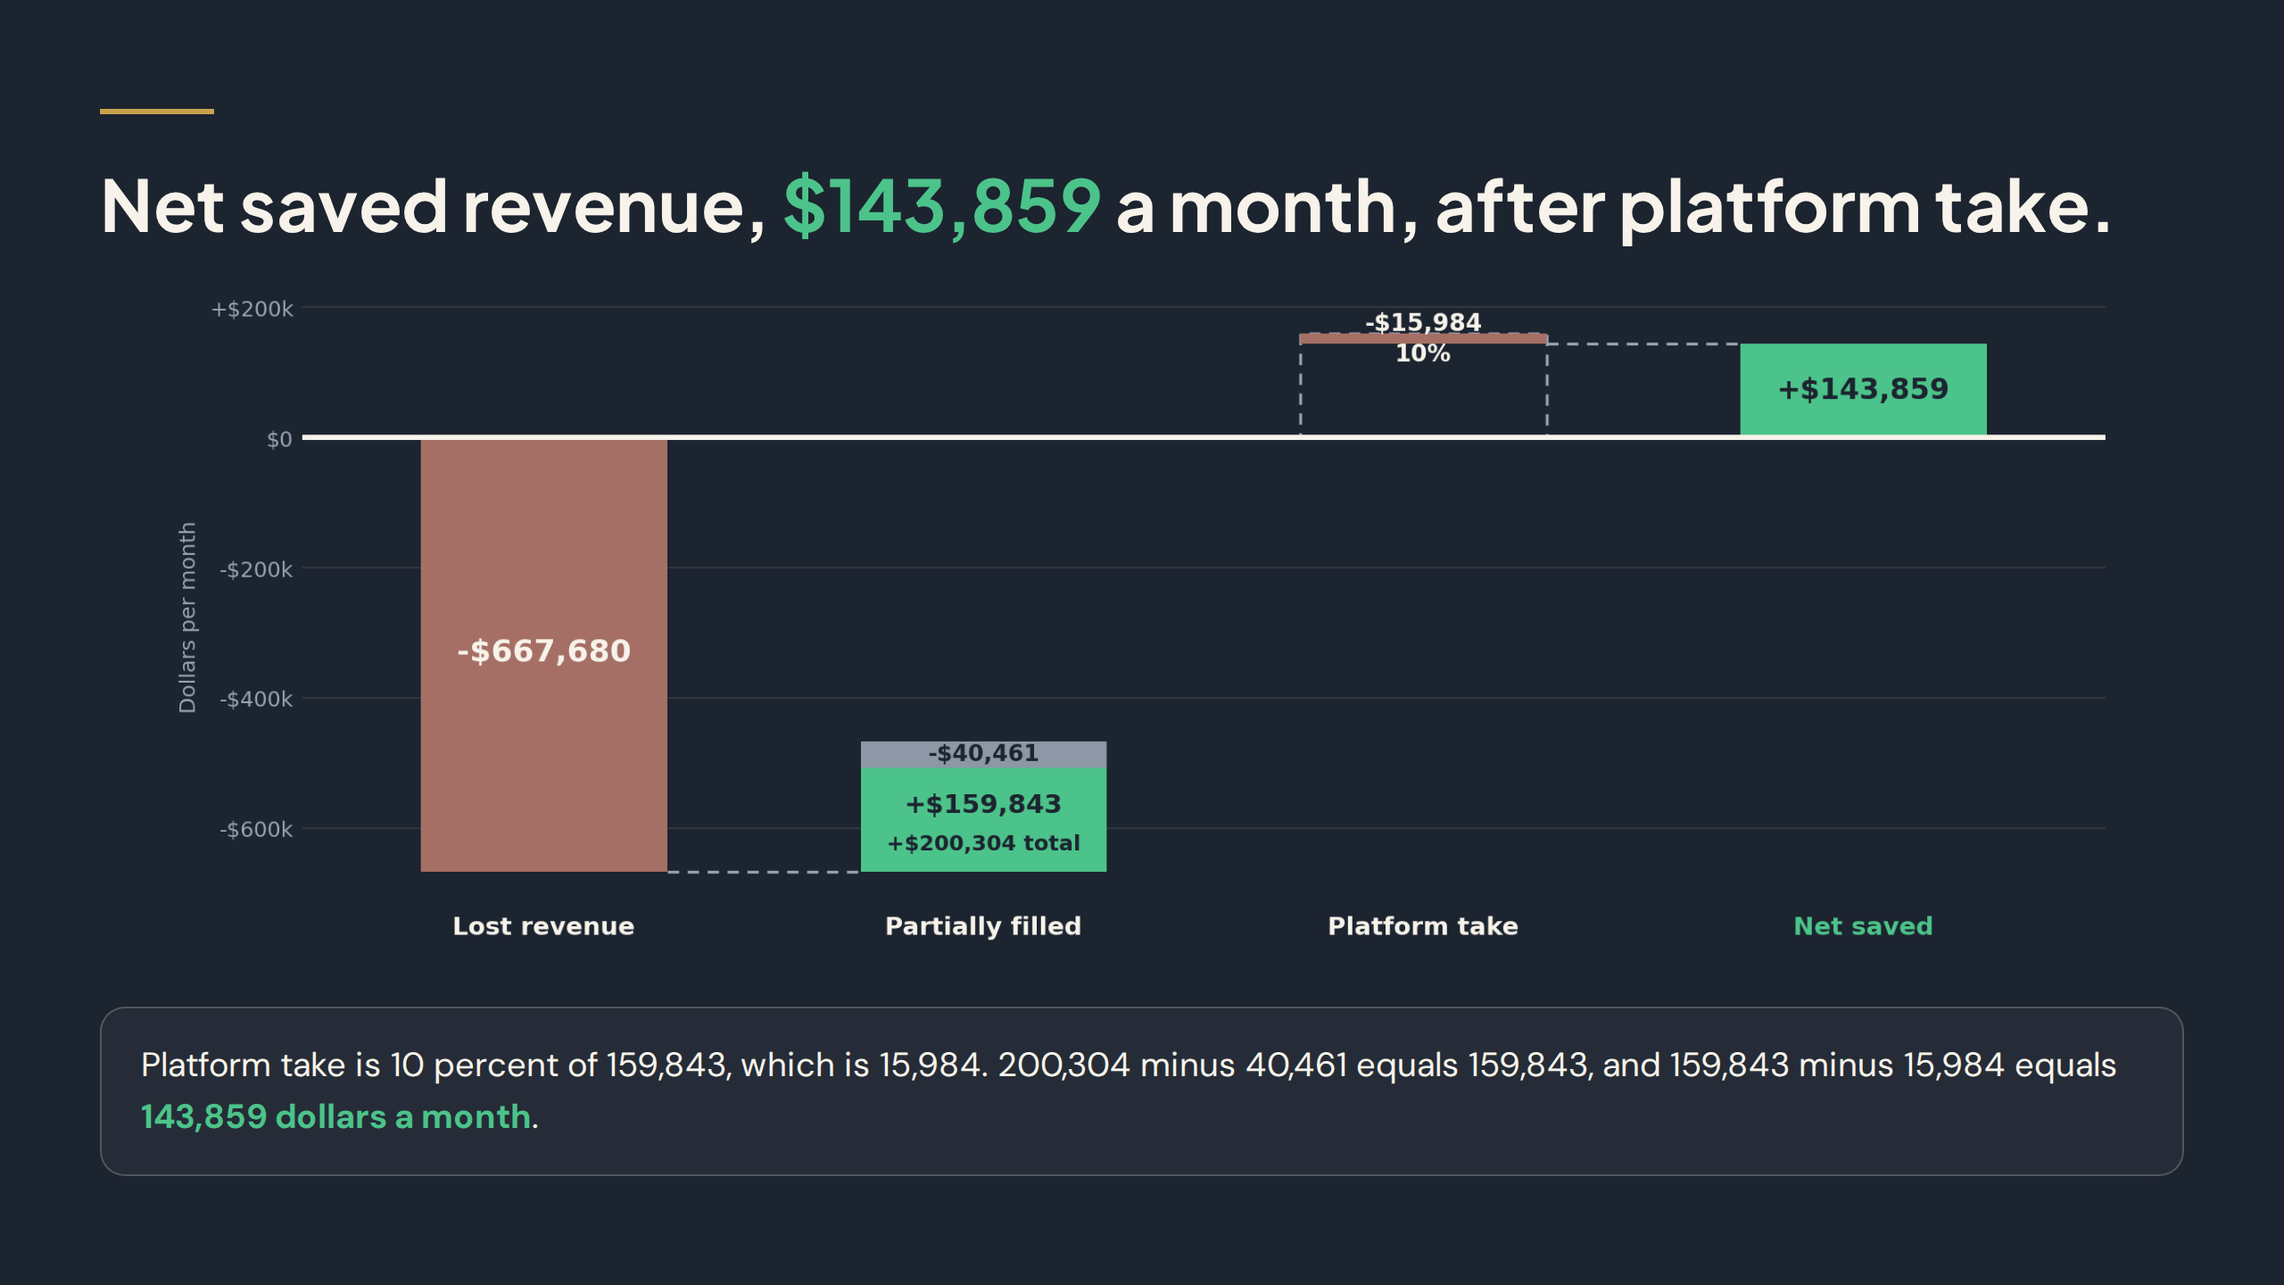
Notes:
So the numbers lead, and this slide shows the recovery. Now the waterfall, read from left to right. Lost revenue is minus $667,680, below the zero line. The platform partially fills that loss with plus $200,304, which is 30 percent more filled. Inside that filled bar, the grey part is the average discount, minus $40,461. So saved revenue is filled minus discount: $200,304 minus $40,461 equals $159,843, in green above the line. The platform then takes 10 percent of saved, minus $15,984. Net saved is saved minus platform take, $143,859 a month. The fill and discount here are an illustrative scenario, not a measured rate.

Slide 7
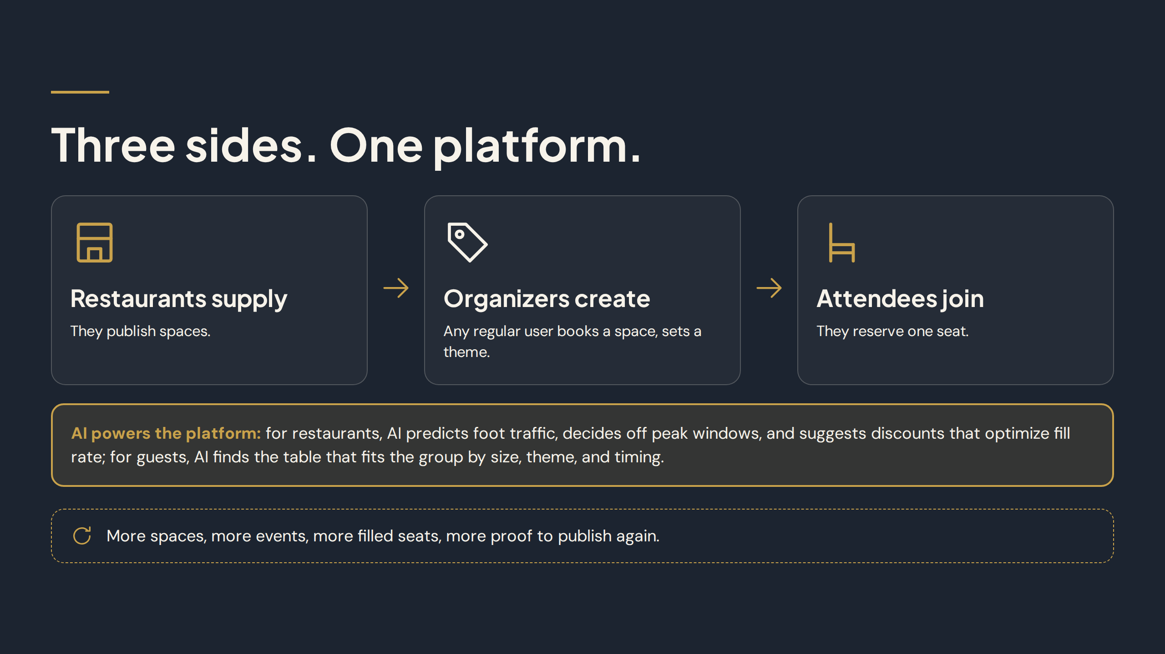
Notes:
That is the pain on all three sides. Here is the solution. Three sides, one platform. Restaurants supply the spaces, the tables that sit empty at off-peak times. Organizers create the events, choosing a theme and shaping the gathering. Attendees join by reserving one seat, not a whole table. Each side needs the other two. Restaurants need people, organizers need space and guests, and guests need a reason and a place to go. ALongTable brings all three together in one booking, so no side has to build this alone.

Slide 8
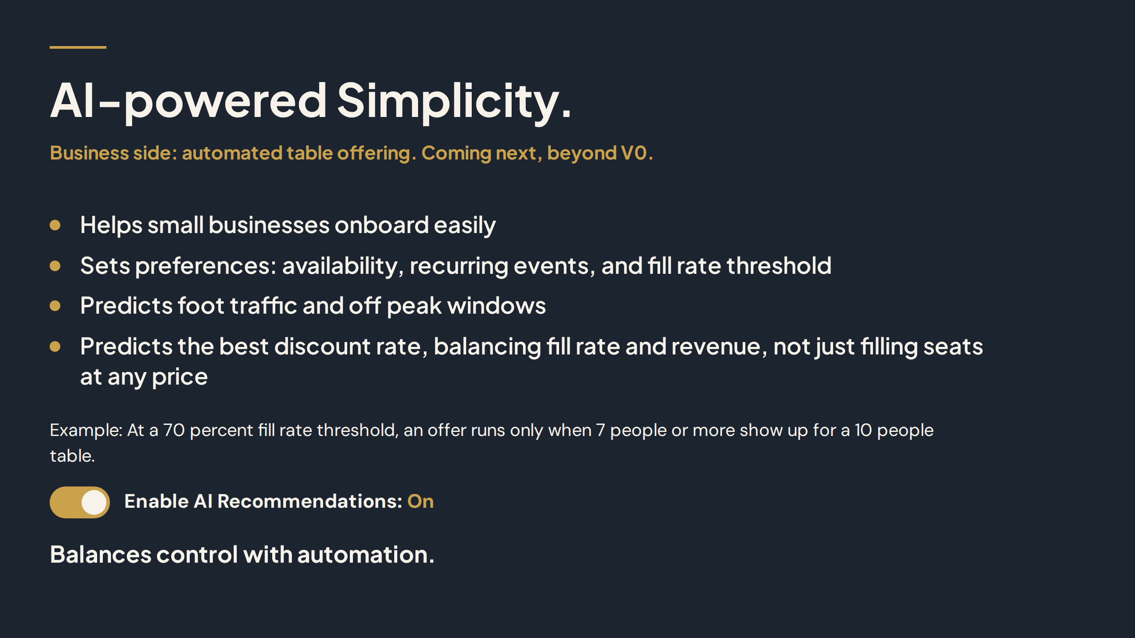
Notes:
AI helps a small business onboard in minutes. The owner sets preferences once: availability, recurring events, and a fill rate threshold. Then AI predicts foot traffic and off peak windows, and predicts the best discount rate, balancing how full the table gets against how much revenue the restaurant keeps. It is not about filling seats at any price. The restaurant keeps control, with the Enable AI Recommendations toggle On or Off.

Slide 9
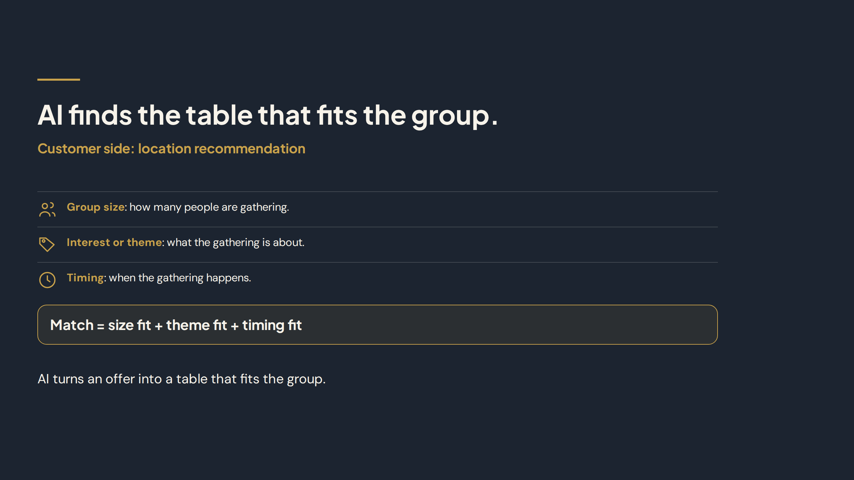
Notes:
On the customer side, AI finds the table that fits the group. It matches on three things. First, group size, how many people are gathering. Second, interest or theme, what the gathering is about. Third, timing, when the gathering happens. Put together, the match is size fit plus theme fit plus timing fit. Instead of searching through every event, the guest is shown a table that fits, which makes choosing and joining much simpler.

Slide 10
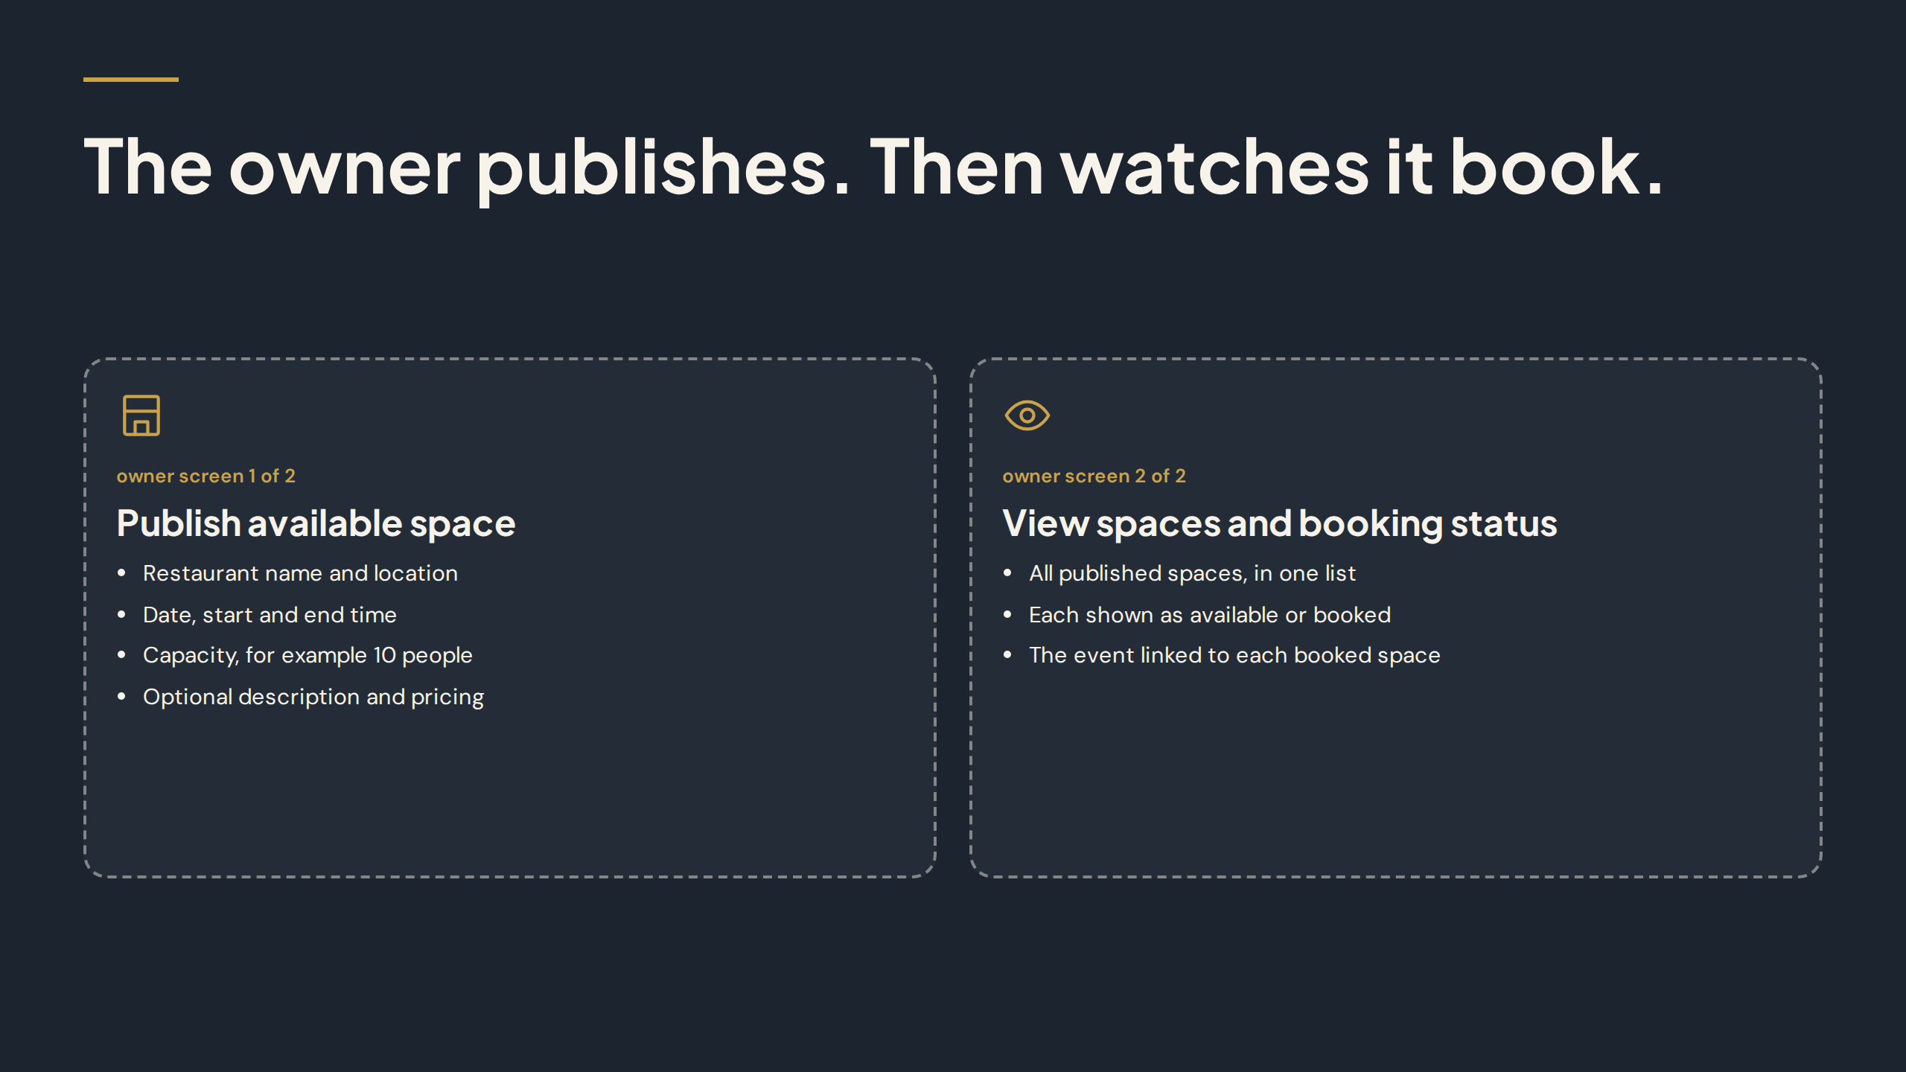
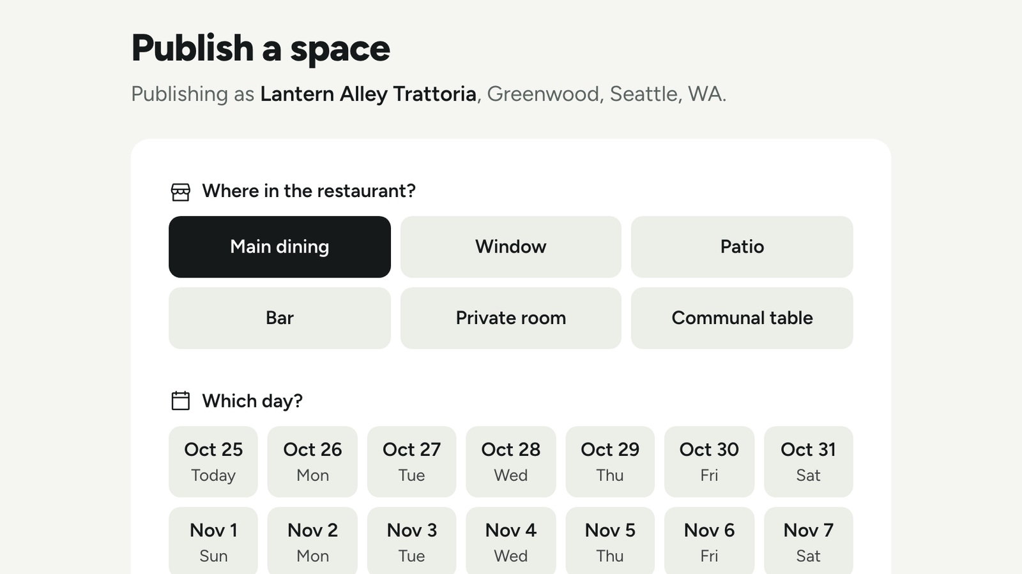
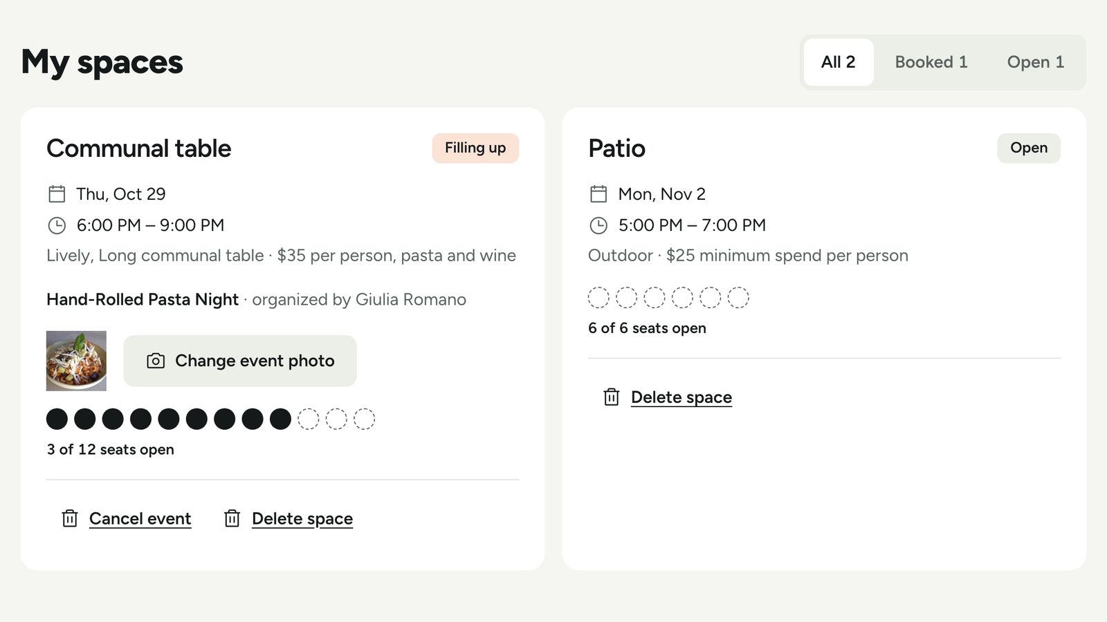
OWNER SCREEN 1 OF 2
OWNER SCREEN 2 OF 2
Publish available space
View spaces and booking status
Date, time, capacity, and optional description and pricing
Every space shown as open or booked, with its event
Notes:
Here is the restaurant side in the product. The owner publishes available spaces, choosing which tables and times to offer, including the quiet hours he wants to fill. Then he watches it book. He can see the space move from available to reserved, without chasing calls, messages, or group chats. For the owner, the value is control and visibility. He decides what to offer, and the platform shows him, clearly, when that empty space starts to fill.

Slide 11
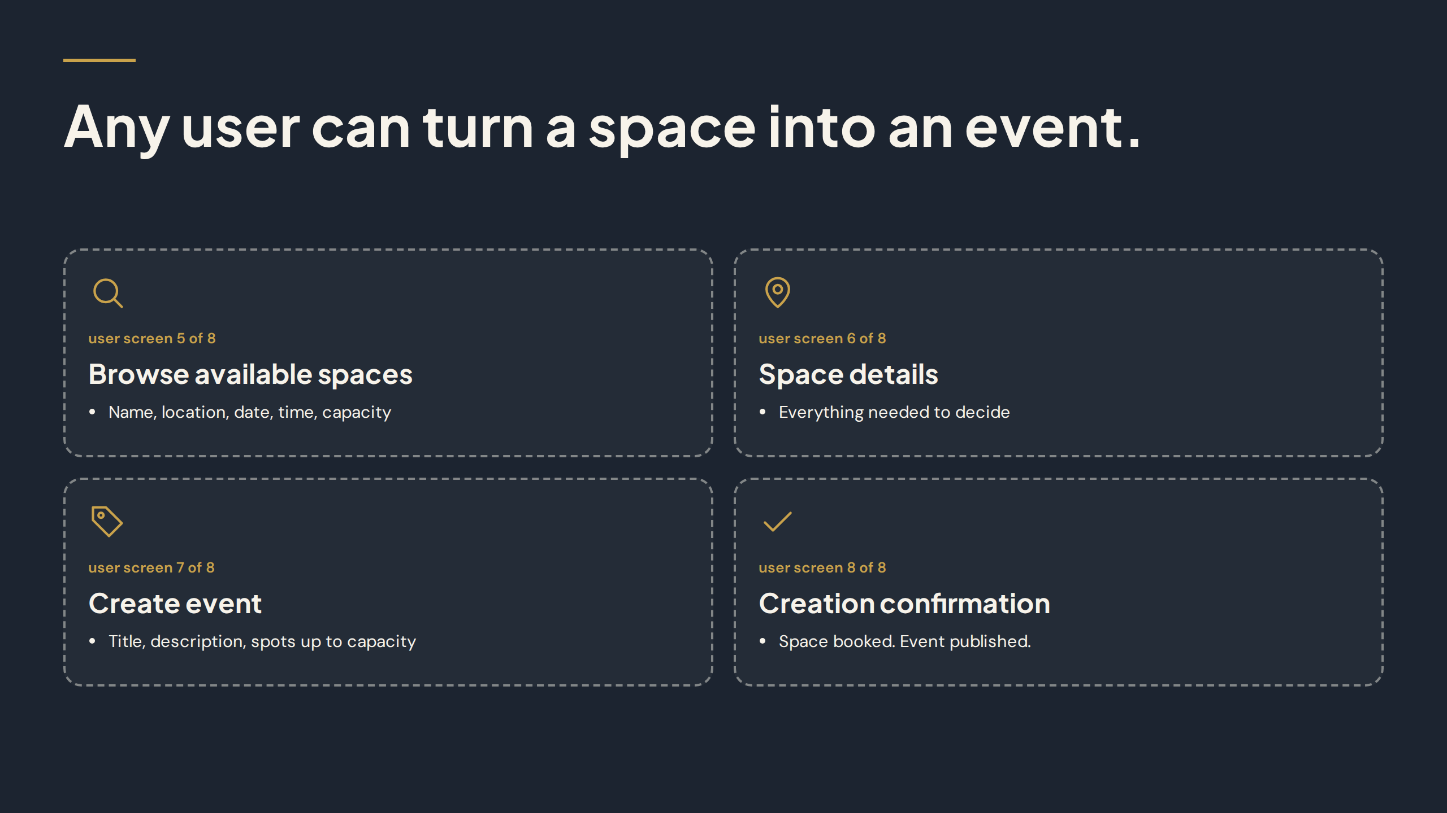
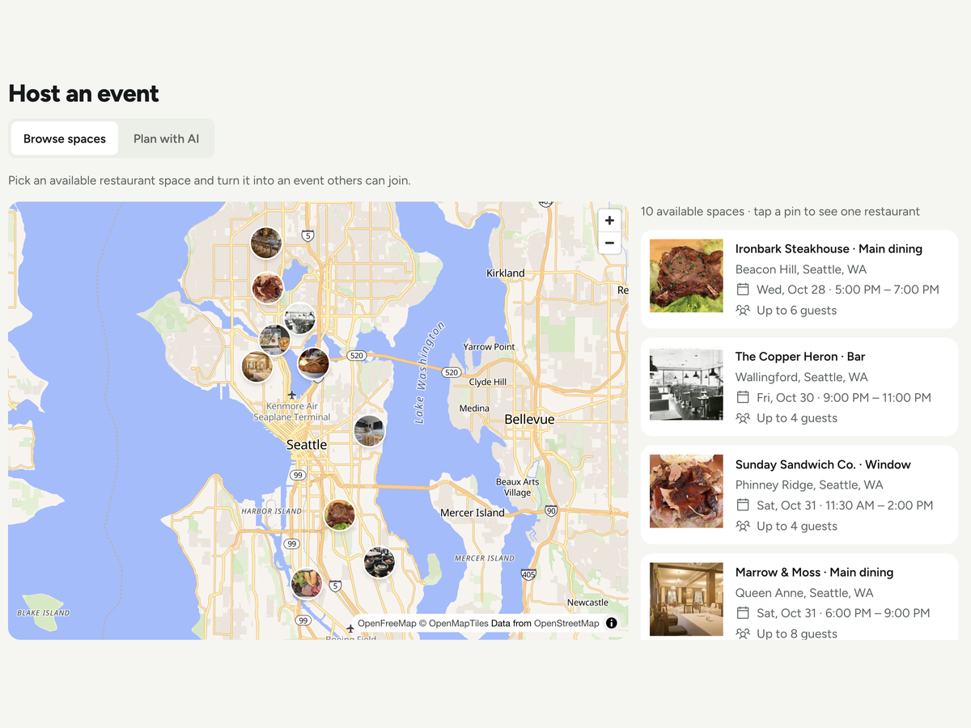
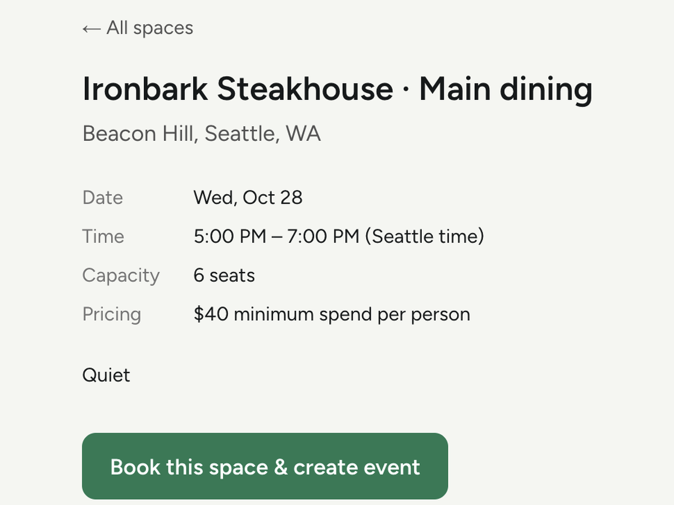
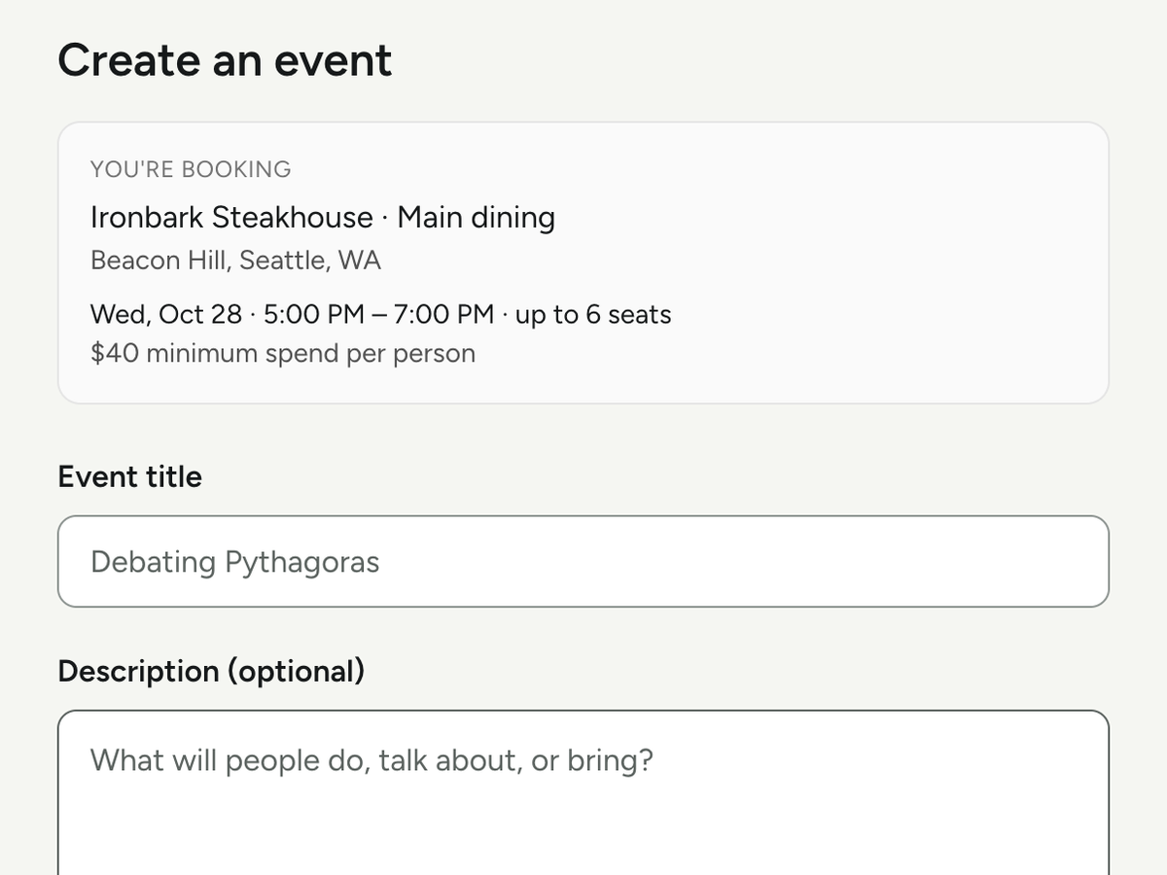
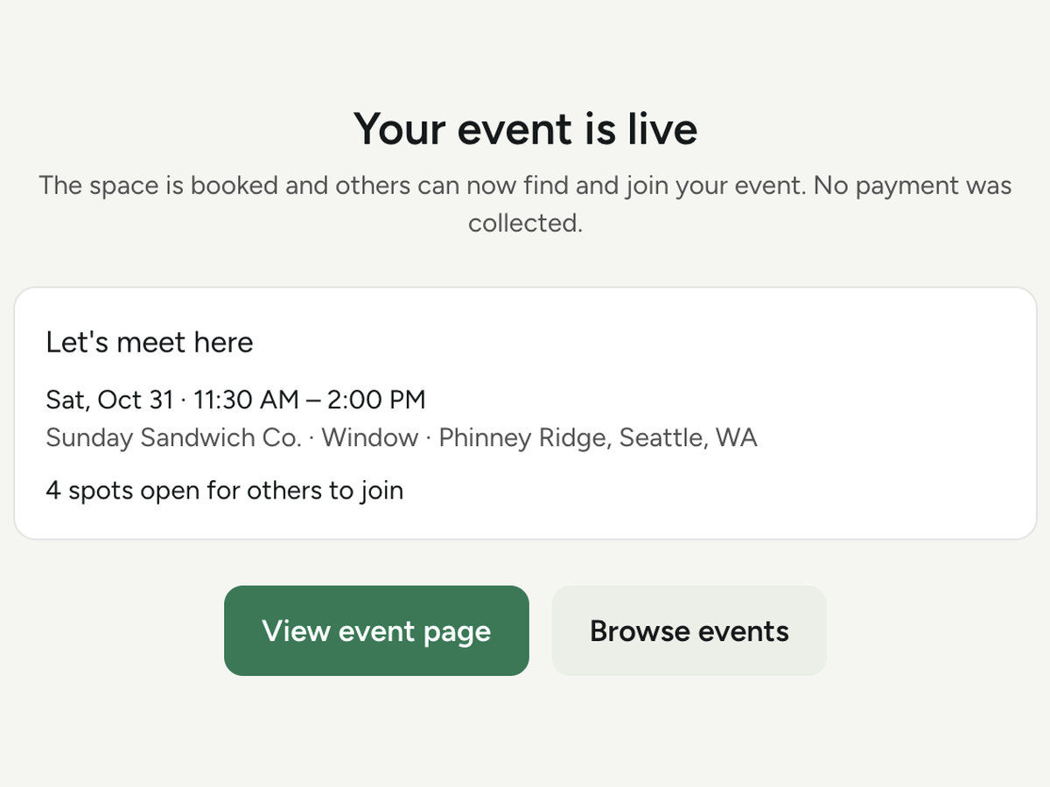
USER SCREEN 5 OF 8
USER SCREEN 6 OF 8
USER SCREEN 7 OF 8
USER SCREEN 8 OF 8
Browse available spaces
Space details
Create event
Creation confirmation
Name, location, date, time, capacity
Everything needed to decide
Title, description, spots up to capacity
Space booked. Event published.
Notes:
Any user can turn a space into an event. A regular user, not just a restaurant, books a published space, sets a theme, and publishes an event that other people can discover and join. That matters for growth. The platform does not depend on a small set of professional hosts. Anyone with a good idea for a gathering can start one, in a real restaurant space, with the seats and the time already set.

Slide 12
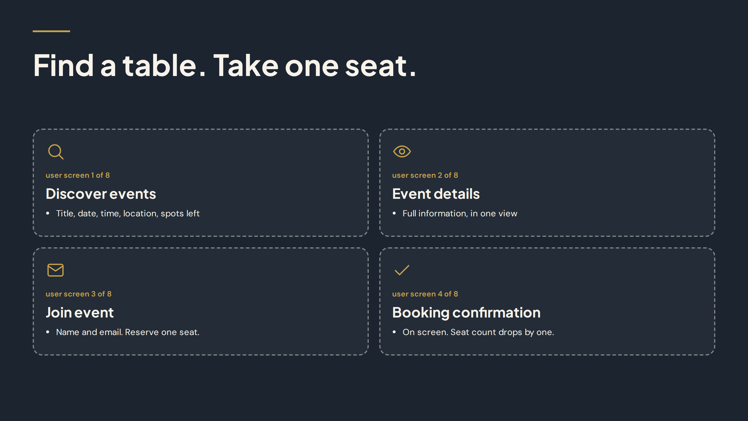
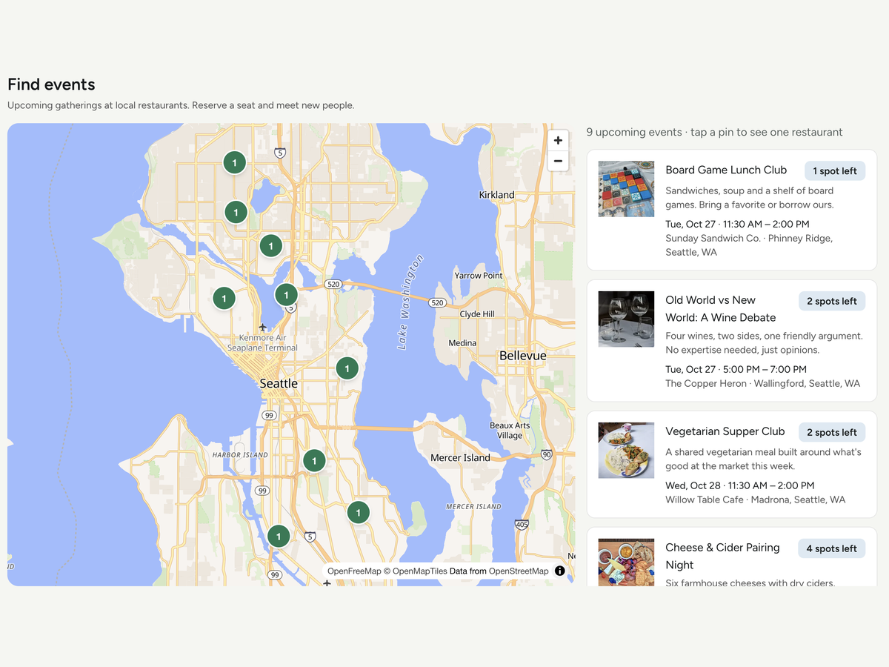
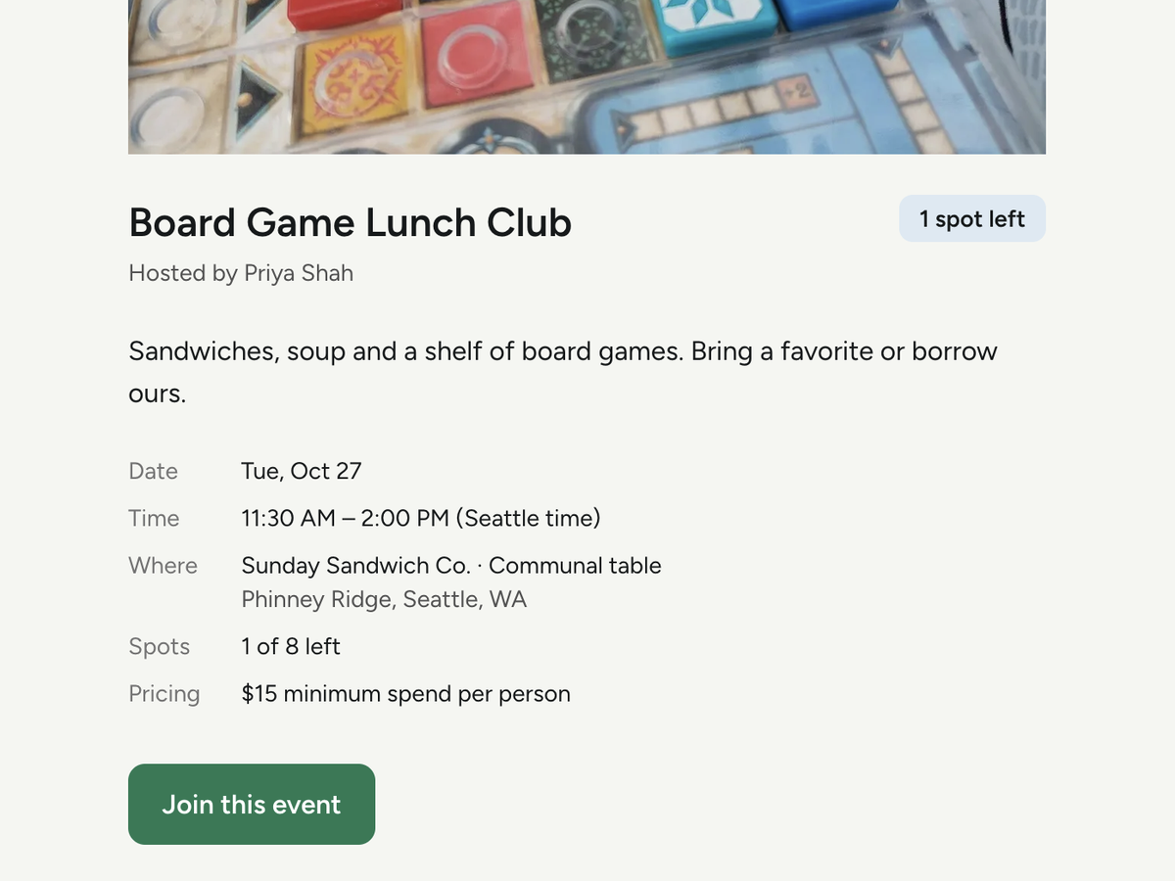
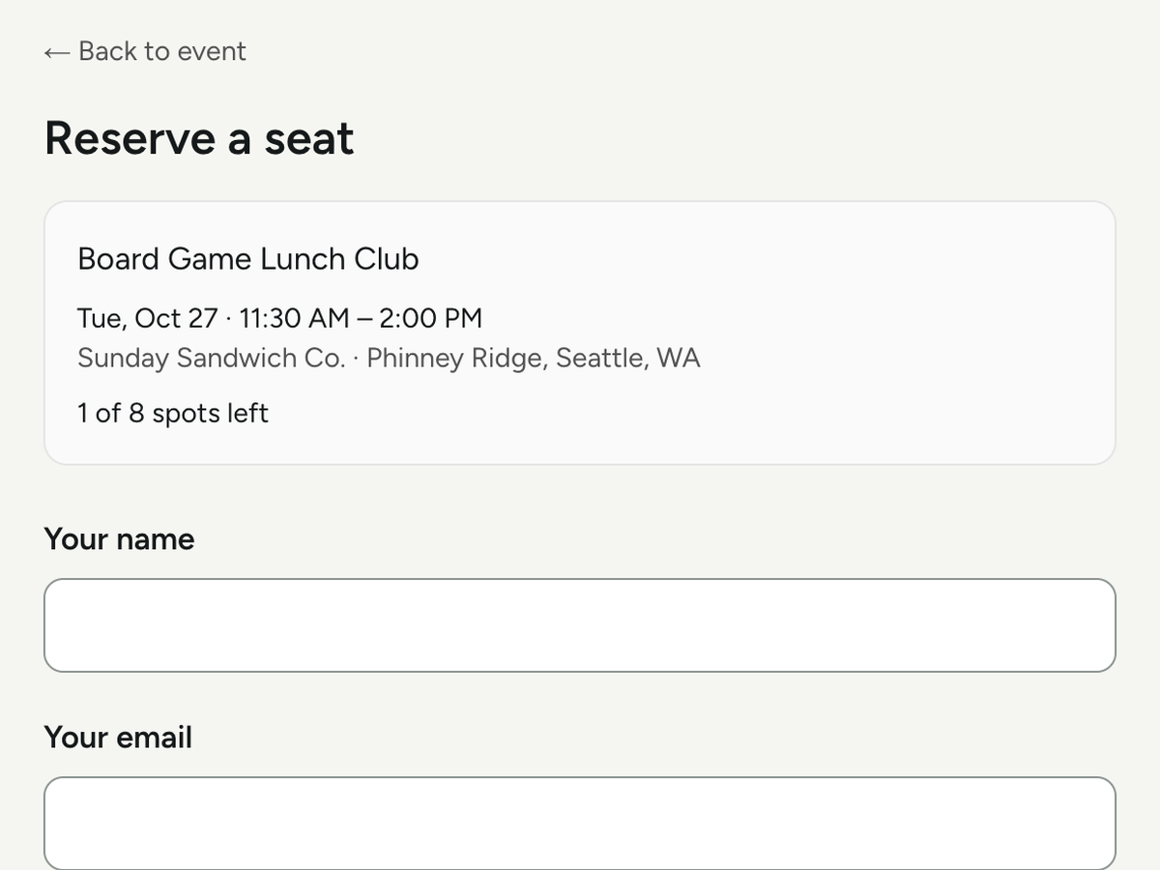
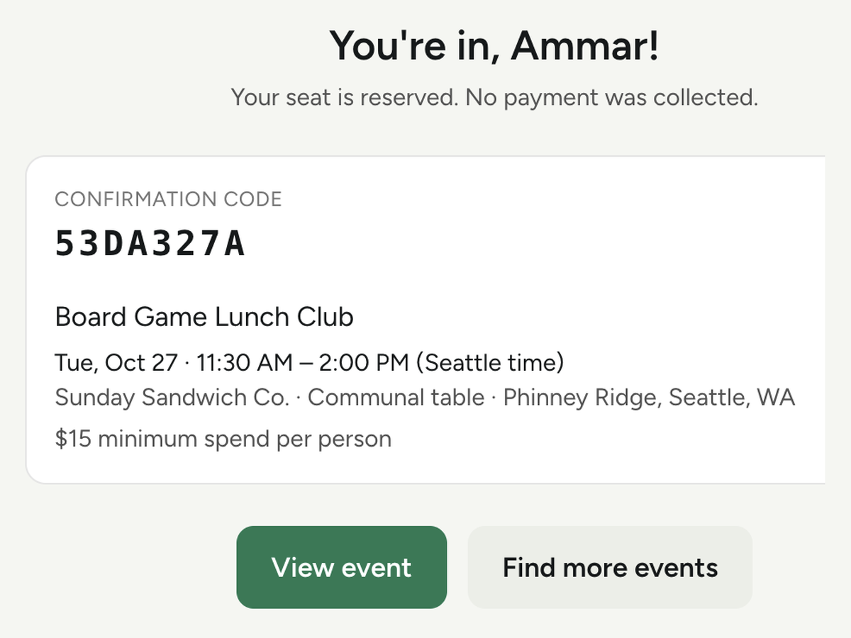
USER SCREEN 1 OF 8
USER SCREEN 2 OF 8
USER SCREEN 3 OF 8
USER SCREEN 4 OF 8
Discover events
Event details
Join event
Booking confirmation
Title, date, time, location, spots left
Full information, in one view
Name and email. Reserve one seat.
On screen. Seat count drops by one.
Notes:
For attendees, the flow is simple. Find a table, take one seat. Attendees discover events by theme, place, and time, then reserve a single seat at a table they like. There is no need to gather a full group first, and no need to book the whole table. The confirmation appears on screen, so the guest knows the seat is theirs. One seat lowers the barrier, and that is what makes joining easy.

Slide 13
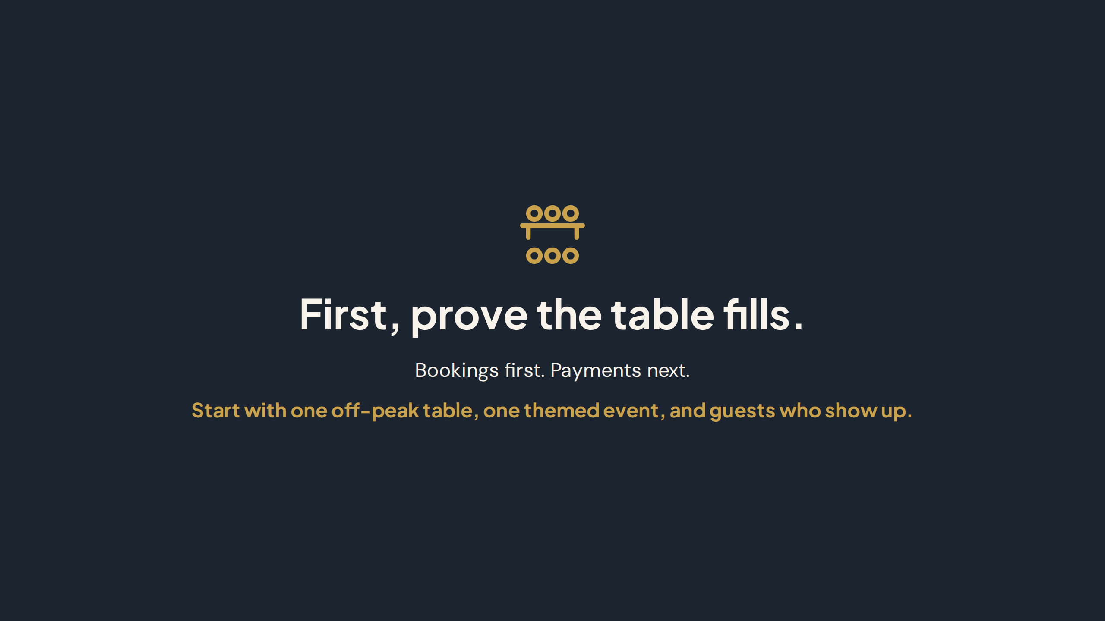
Notes:
So we close with proof, not with a feature list. First, prove the table fills. Bookings first. Payments next. Start with one off peak table, one themed event, and guests who show up. If that table fills, the owner sees real value, the organizer sees a gathering that works, and the guest gets the night they wanted. That proof comes first.

Slide 14
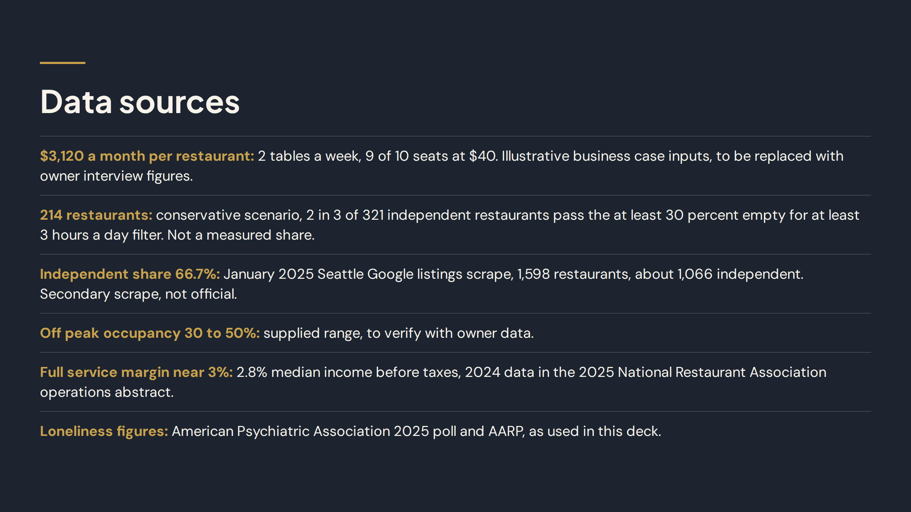
Notes:
These are the sources behind the numbers in this deck, listed on this slide. The $3,120 a month per restaurant uses illustrative business case inputs. The 214 restaurants use a conservative scenario based on a January 2025 Seattle Google listings scrape. Off-peak occupancy of 30 to 50 percent is a supplied range. The margin figure uses 2024 data in the 2025 National Restaurant Association operations abstract. Loneliness figures come from the American Psychiatric Association 2025 poll and AARP.

