Slide 1
NOSQL “Towards the end of RDBMS”
Amarjeet Singh (Technical Architect)
(Asreet Consulting Services)

Slide 2
History of the World
Relational Databases – mainstay of business
Web-based applications caused spikes
Especially true for public-facing e-Commerce sites
Developers begin to front RDBMS with memcache or integrate other caching mechanisms within the application (ie. Ehcache)

Slide 8
Some Advantages of NoSQL Databases
Dynamic Schemas
The (classic) Relational Databases follow a vertical architecture where in a single server holds the data, as all the data is related.
Relational Databases does not provide Sharding feature by default, to achieve this a lot of efforts has to be put in, because transactional integrity(Inserting/Updating data in transactions), Multiple table JOINS etc cannot be easily achieved in distributed architecture in case of Relational Databases.
NoSQL Databases have the Sharding feature as default. No additional efforts required. They automatically spread the data across servers, fetch the data in the fastest time from the server which is free, while maintaining the integrity of data.

Slide 9
Replication
Auto data replication is also supported in NoSQL databases by default. Hence, if one DB server goes down, data is restored using its copy created on another server in network.

Slide 10
Integrated Caching
Many NoSQL databases have support for Integrated Caching, where in the frequently demanded data is stored in cache to make the queries faster.

Slide 11
How did we get here?
Explosion of social media sites (Facebook, Twitter) with large data needs
Rise of cloud-based solutions such as Amazon S3 (simple storage solution)
Just as moving to dynamically-typed languages (Ruby/Groovy), a shift to dynamically-typed data with frequent schema changes
Open-source community

Slide 12
Dynamo and BigTable
Three major papers were the seeds of the NoSQL movement
BigTable (Google)
Dynamo (Amazon)
Gossip protocol (discovery and error detection)
Distributed key-value data store
Eventual consistency
CAP Theorem

Slide 13
The Perfect Storm
Large datasets, acceptance of alternatives, and dynamically-typed data has come together in a perfect storm
Not a backlash/rebellion against RDBMS
SQL is a rich query language that cannot be rivaled by the current list of NoSQL offerings

Slide 14
CAP Theorem (Proposed by Eric Brewer (talk on Principles of Distributed Computing July 2000)
Three properties of a system:
Consistency
write a value and then you read the value you get the same value back
availability
may not always be able to write or read. The system will say you can't write because it wants to keep the system consistent
partitions
divide nodes into small groups that can see other groups, but they can't see everyone

Slide 15
Choose a specific approach based on the needs of the service.
To scale you have to partition, so you are left with choosing either high consistency or high availability for a particular system. You must find the right overlap of availability and consistency.
For the checkout process: you always want to honor requests to add items to a shopping cart because it's revenue producing.
In this case you choose high availability: Errors are hidden from the customer and sorted out later.
When a customer submits an order you favor consistency: Because several services--credit card processing, shipping and handling, reporting are simultaneously accessing the data.
Everyone who builds big applications builds them on CAP : Google, Yahoo, Facebook, Amazon, eBay, etc.

Slide 18
Key/Value
Pros:
very fast
very scalable
simple model
able to distribute horizontally
Cons:
- many data structures (objects) can't be easily modeled as key value pairs

Slide 22
Common Advantages
Cheap, easy to implement (open source)
Data are replicated to multiple nodes (therefore identical and fault-tolerant) and can be partitioned
Down nodes easily replaced
No single point of failure
Easy to distribute
Don't require a schema
Can scale up and down
Relax the data consistency requirement (CAP)

Slide 26
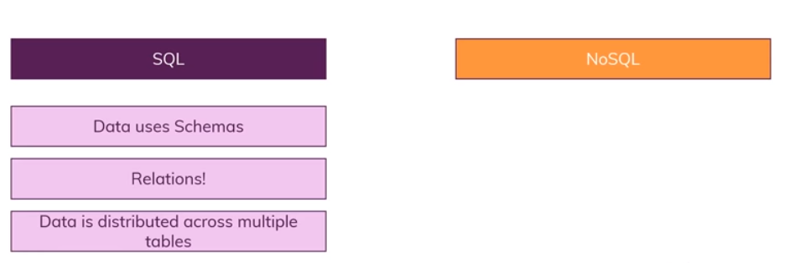

Slide 27
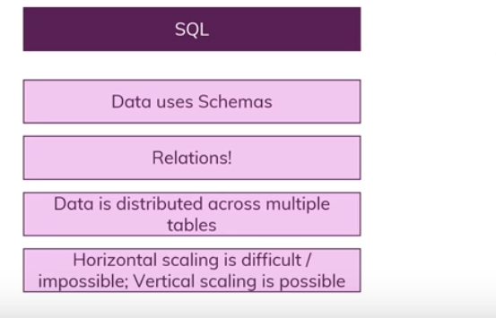

Slide 28
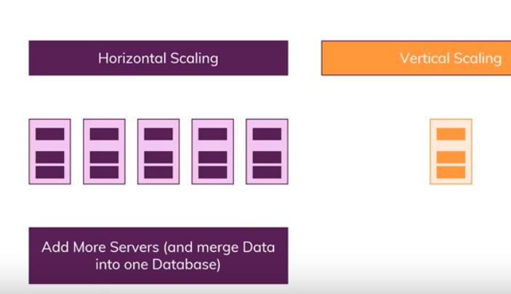

Slide 29
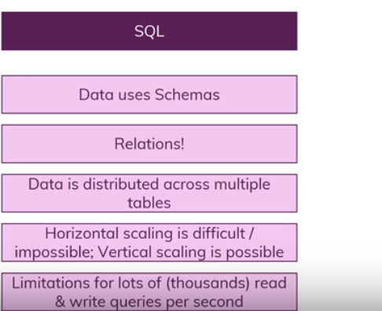

Slide 32
Thank you

